Slide 1






Slide 2
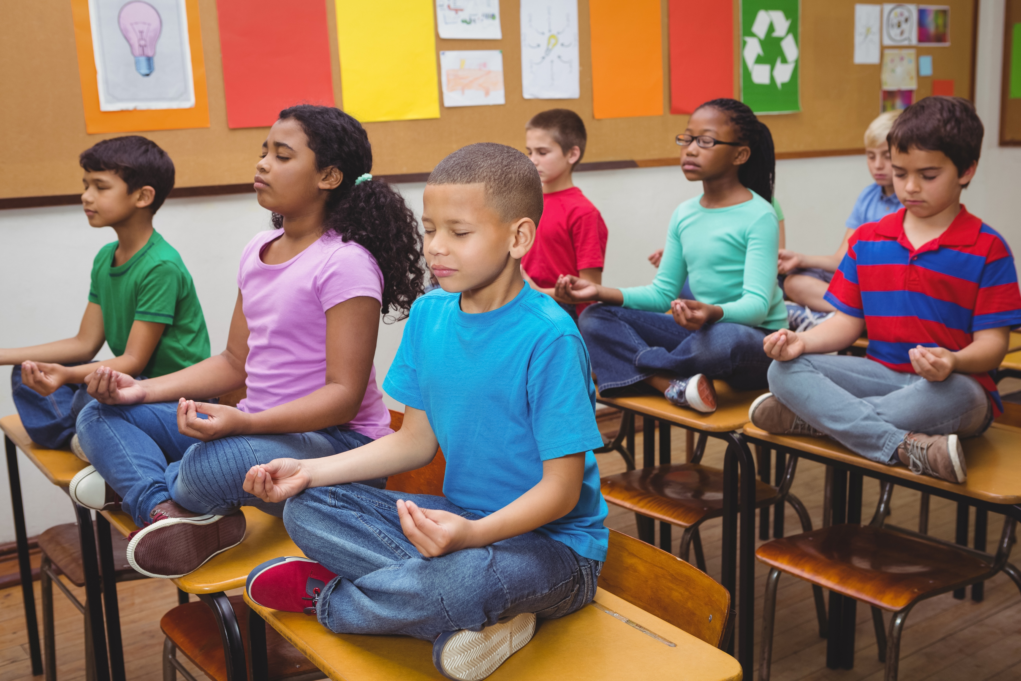
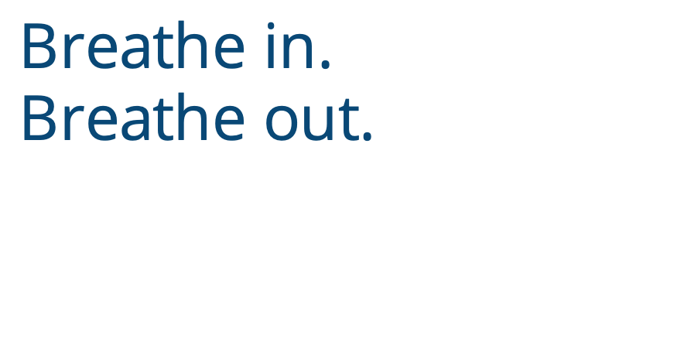
Notes:
Instructor Notes:
Begin by encouraging students to find a comfortable area in the classroom where they can sit quietly.
Once they are seated, ask them to close their eyes.
Lead the class in taking three deep breaths: in and out, in and out, in and out.
Then instruct the students to keep their eyes closed and guide them through the following prompts:
As you breathe in and out, think about what you can hear. Focus on the louder sounds first. What noises can you hear easily? Then focus on the quieter sounds. What noises are softer and a little harder to hear? Are there any sounds that you can just barely make out? Keep your eyes closed and try to focus only on the sounds that you are hearing.
Allow about 30 quiet seconds to pass before moving on to the next prompt.
Now think about what you can feel. As you sit on the floor, what is touching your skin? Can you feel the ground? What does it feel like? Can you feel your clothing? What does it feel like on your skin? Keep your eyes closed and try to focus only on everything you can feel on your skin.
Allow about 30 quiet seconds to pass before moving on to the next prompt.
Carefully open your eyes and look up toward the ceiling. Move your eyes very slowly and take in everything you can see, little by little. Look carefully at one area before slowly moving on to the next. Try to focus only on everything you can see.
Allow about 30 quiet seconds to pass before moving on.

Slide 3

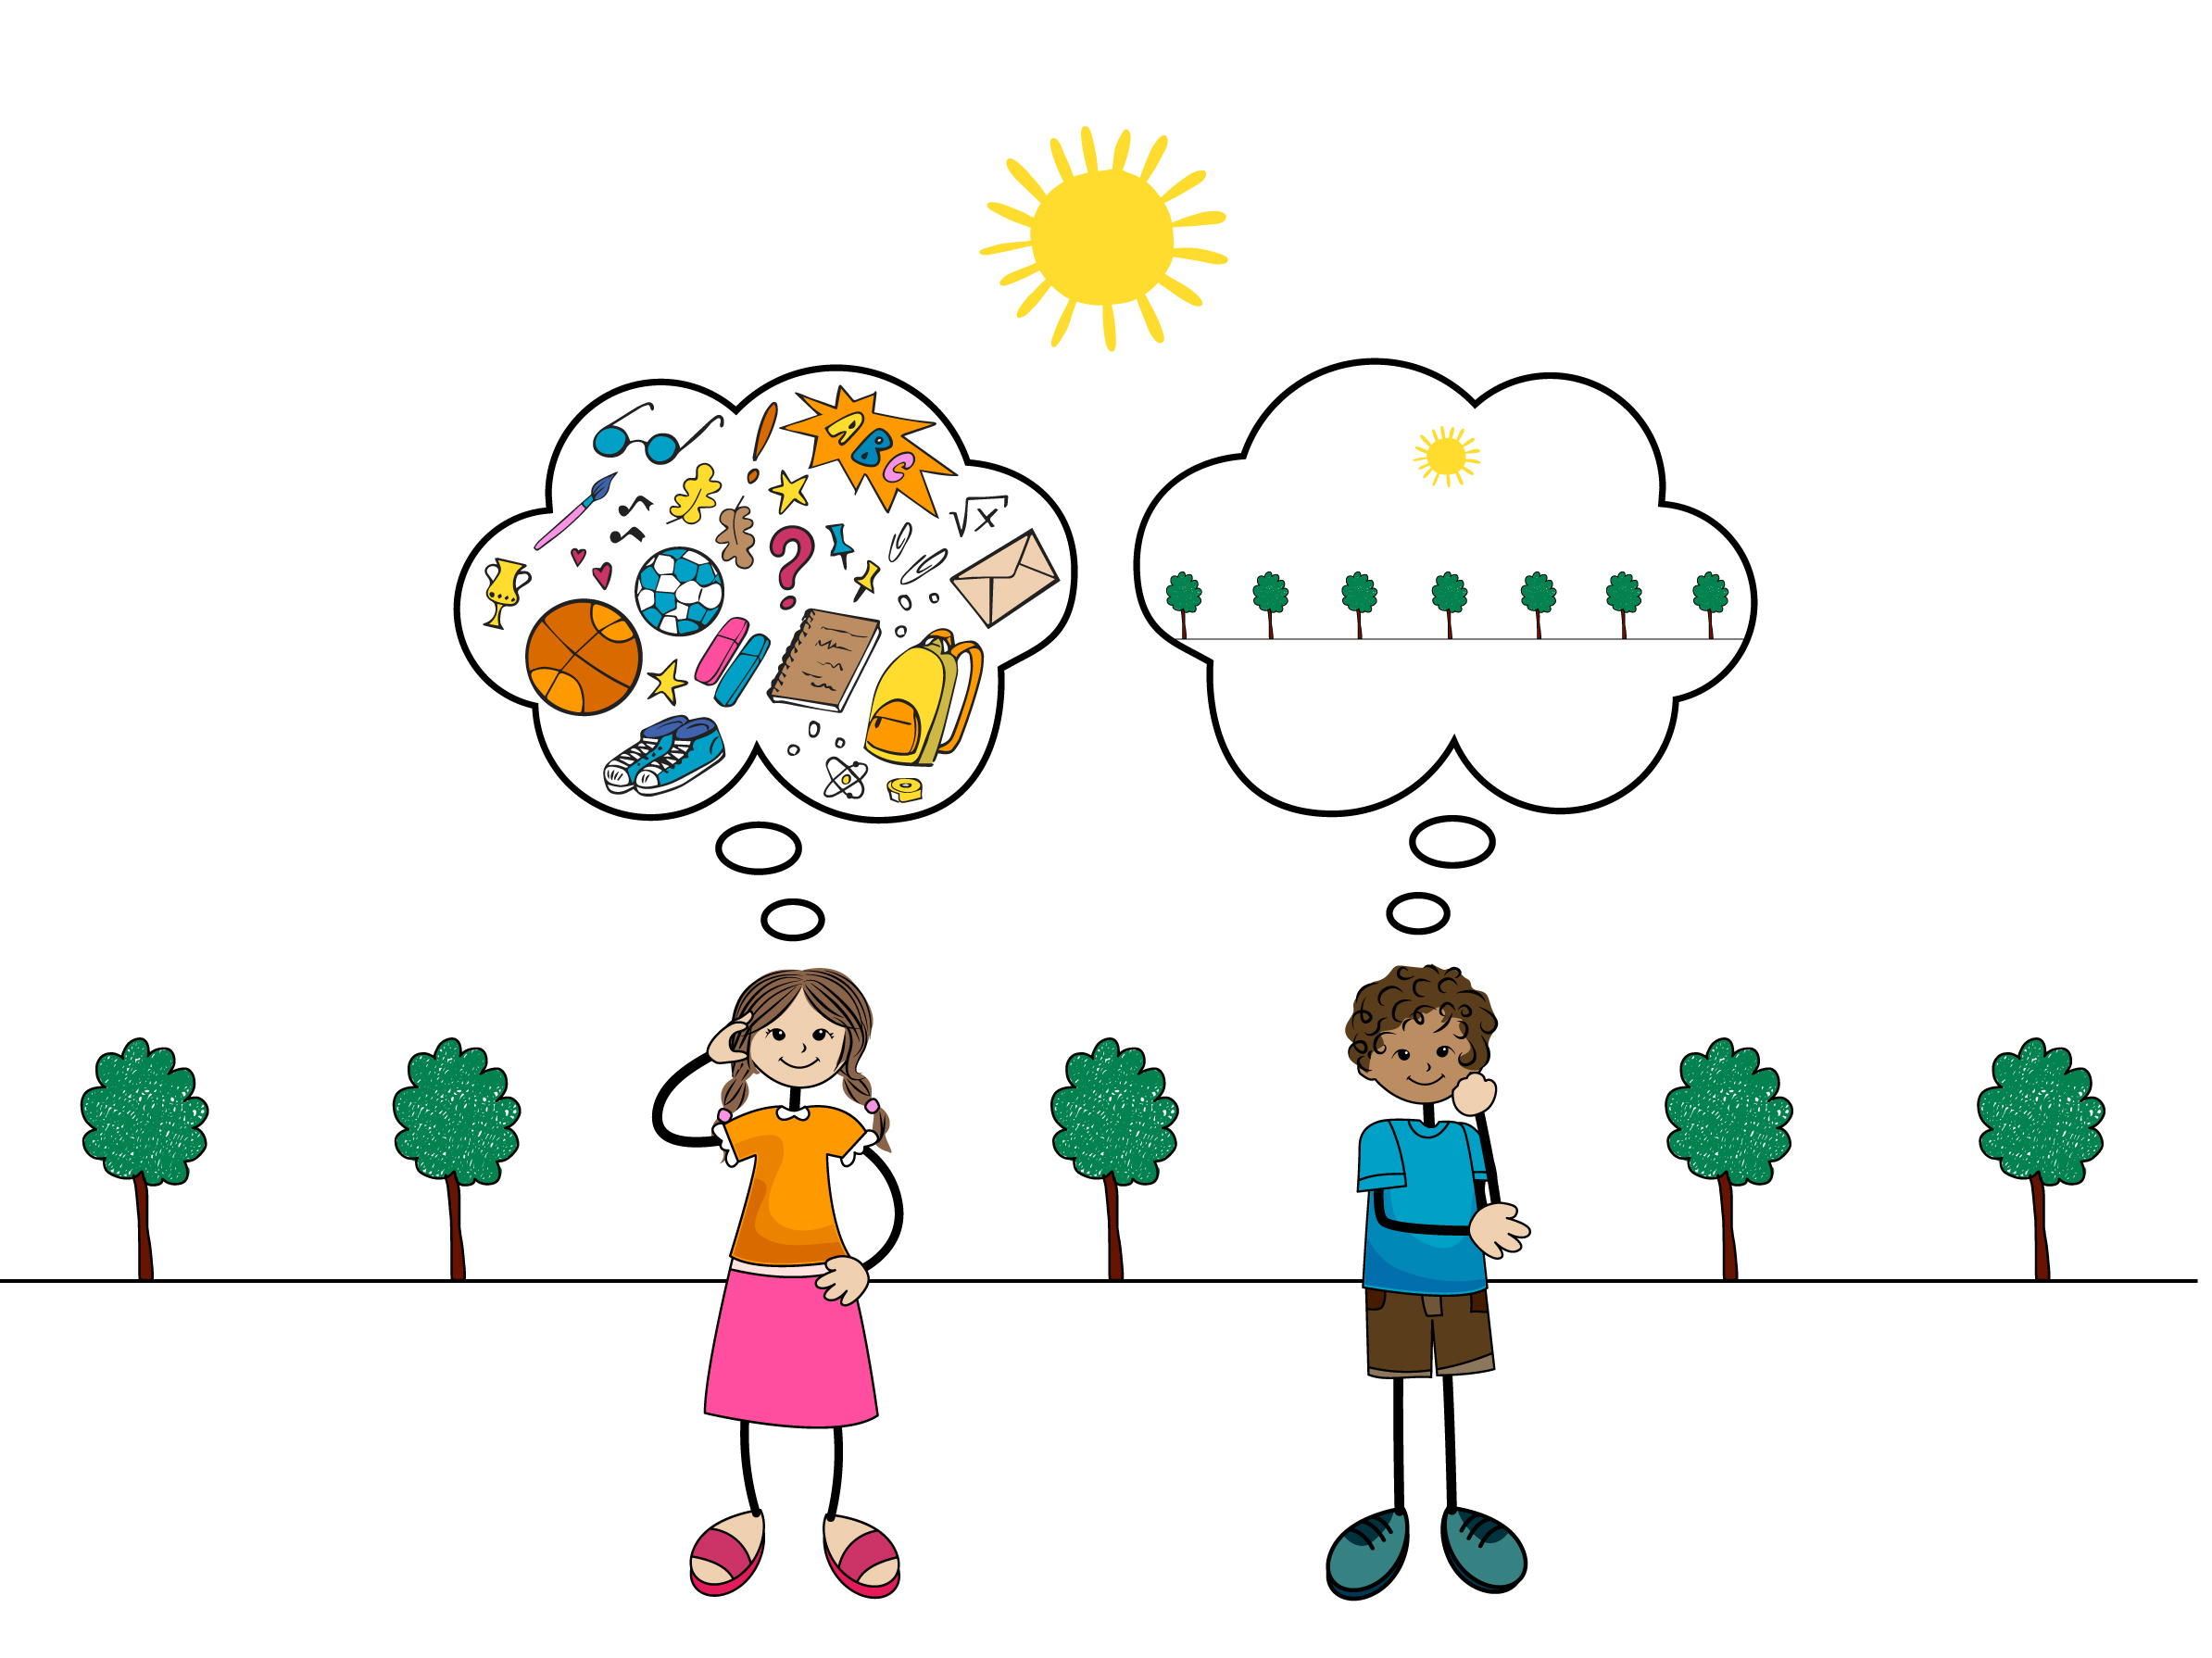
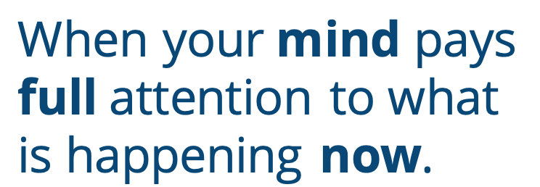
When your mind pays full attention to what is happening now.
Notes:
Instructor Notes:
Ask the students to come back together and sit on the floor in a circle or semicircle. Join the students by sitting at their level.
Click once to reveal the word “Mindful.”
Then click again and tell students that when you are mindful, your mind pays full attention to the present moment—not what happened before and not what is about to happen. You slow down, take your time, and focus on now.
Ask students:
Were you mindful as you focused on your hearing, feelings, and vision? In other words: Were you able to only think about what you heard, felt, or saw?
Why or why not?
Was it hard not to think about other things?
Explain that if the students were able to turn off their thoughts and focus only on what they were hearing, feeling, or seeing, they were being mindful—even if it wasn’t for the entire time. Being mindful takes practice, and every little bit counts.

Slide 4
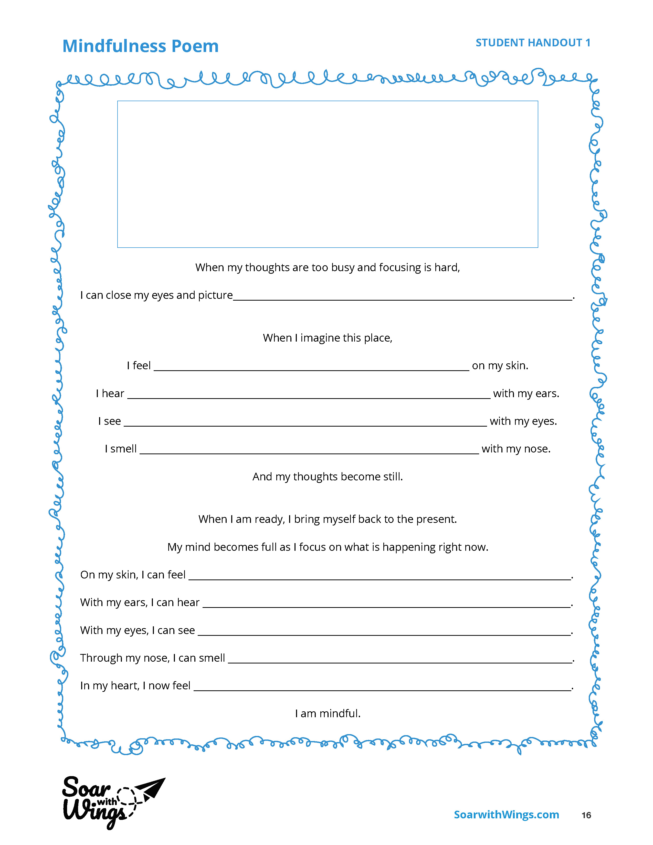

Notes:
Instructor Notes:
Ask students to raise their hands if they ever have so much going on in their minds that it’s hard to concentrate.
Explain that one strategy that can help us be mindful and focus on now is to picture a peaceful place in our minds—real or imaginary. This can help us quiet our thoughts. If we can do this, it becomes a lot easier to focus on what is happening now and what we are feeling now.
Pass out Handout 1: Mindfulness Poem to each student.
Then click once and review the first half of the poem together.
Next, encourage students to close their eyes, take a moment to picture a peaceful imaginary place, and slowly take in all the details.
When they are ready, instruct the students to open their eyes, draw a picture of this peaceful place on their handouts, and then describe it by filling in the poem’s blanks.
Once most of the class has finished the first half of the poem, encourage the students to close their eyes and again picture the place they just described.
Then click twice and ask the students to open their eyes, bring their minds back to what is happening now, and fill in the second half of the poem.
When they are done, ask students: Did picturing your peaceful place help you quiet your mind and work on the rest of your poem? Why or why not?
Students should then place their poems in a folder, binder, or other location where they can access them easily. If there is room, you could also hang the completed poems in the classroom.
Moving forward, remind students to picture their peaceful places or read their poems whenever they need to quiet their thoughts and focus on the present.

Slide 5



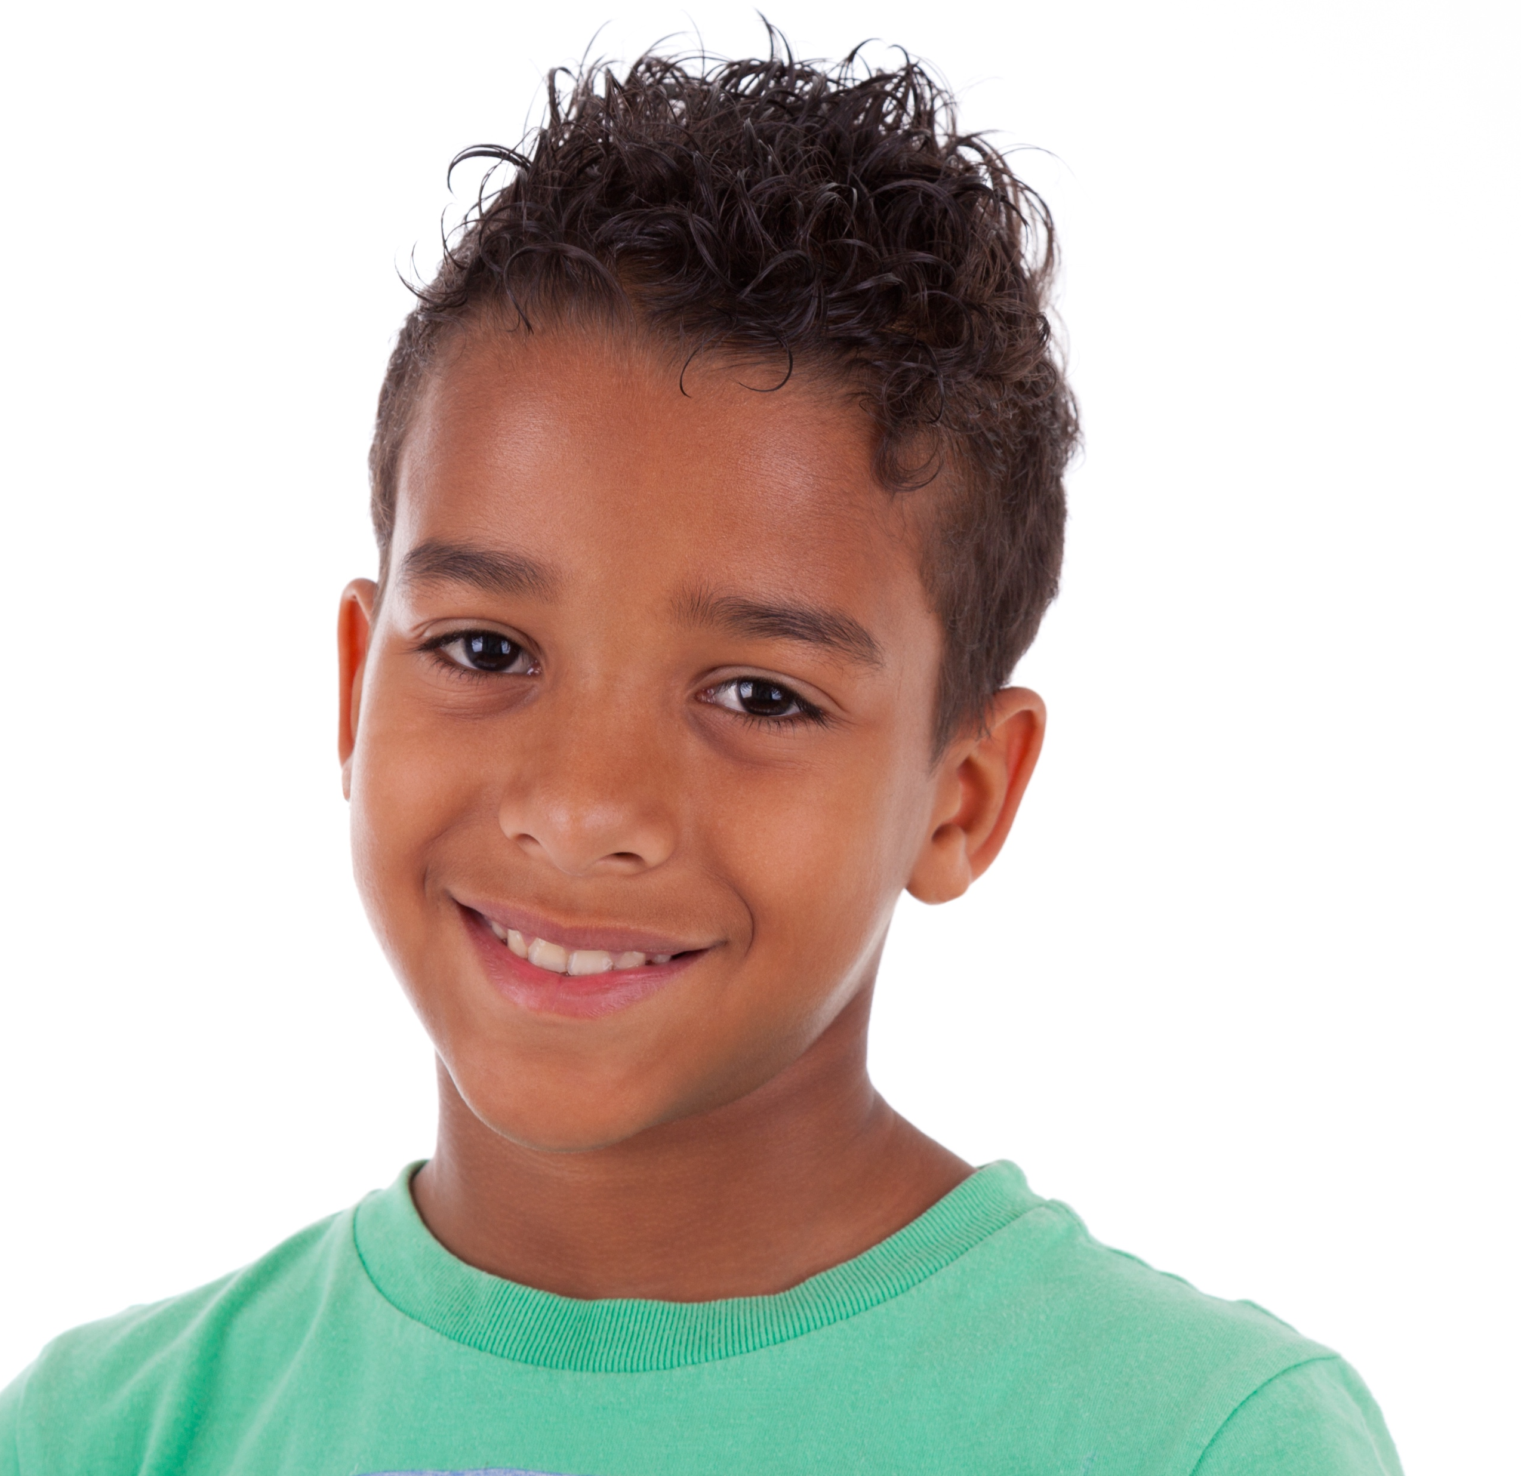
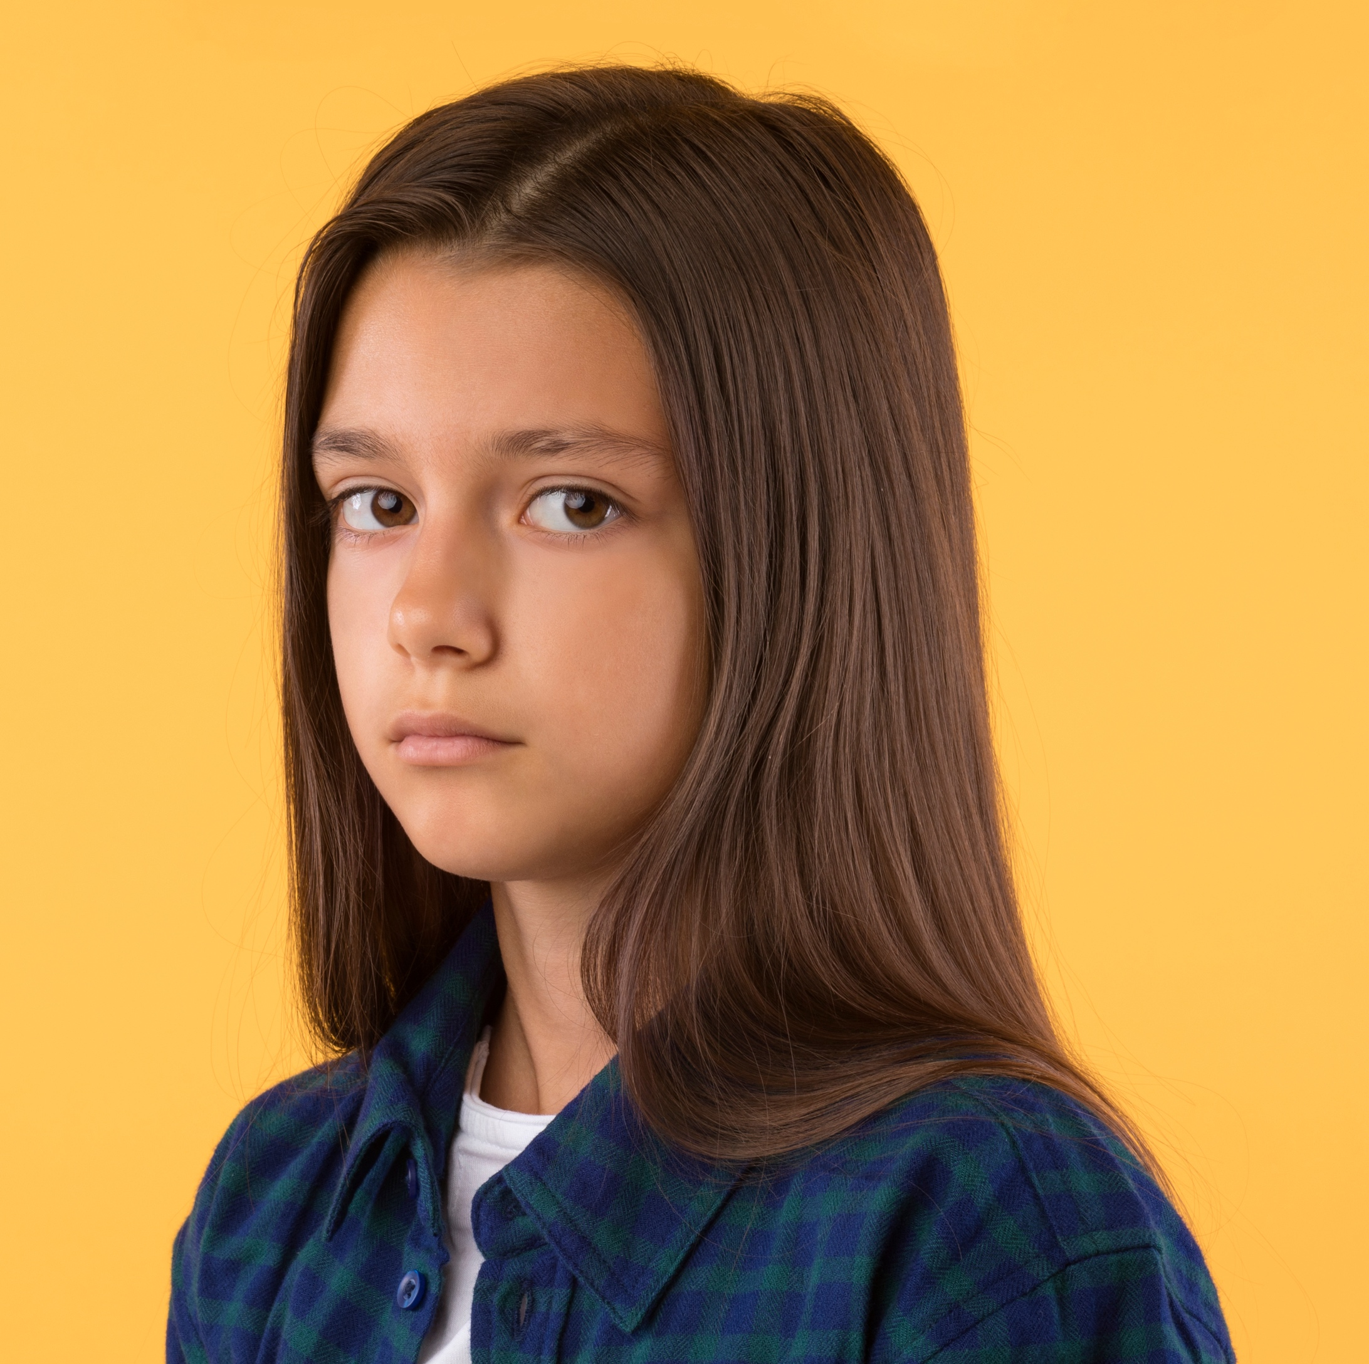
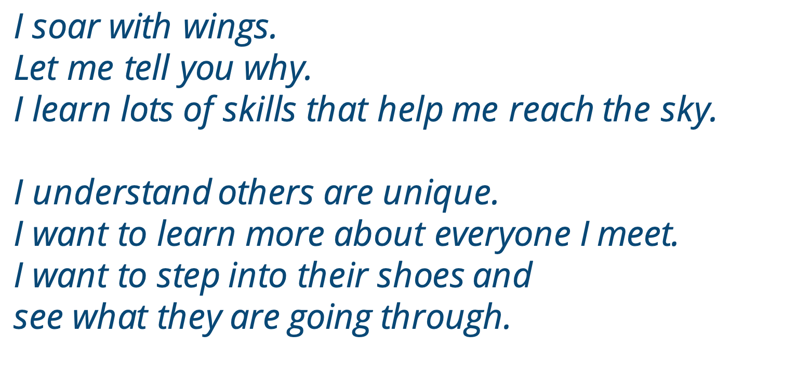


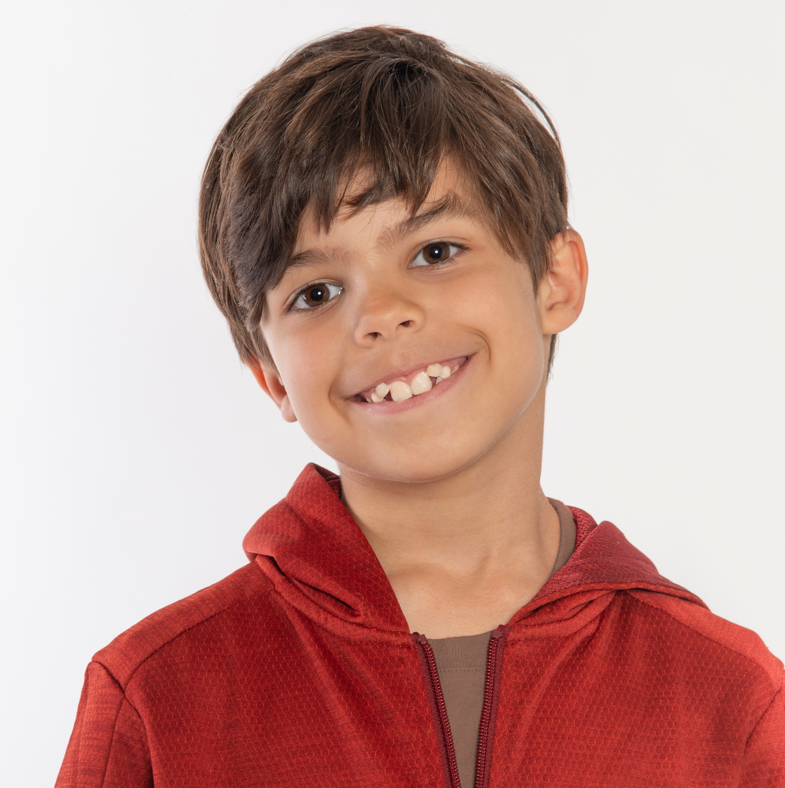

Notes:
Instructor Notes:
Bring the students back to a circle or semicircle and click to display and read the Words to Live By excerpt aloud.
Explain that students are about to see how being mindful can help them better understand others, learn more about everyone they meet, step into their shoes, and see what they are going through.

Slide 6

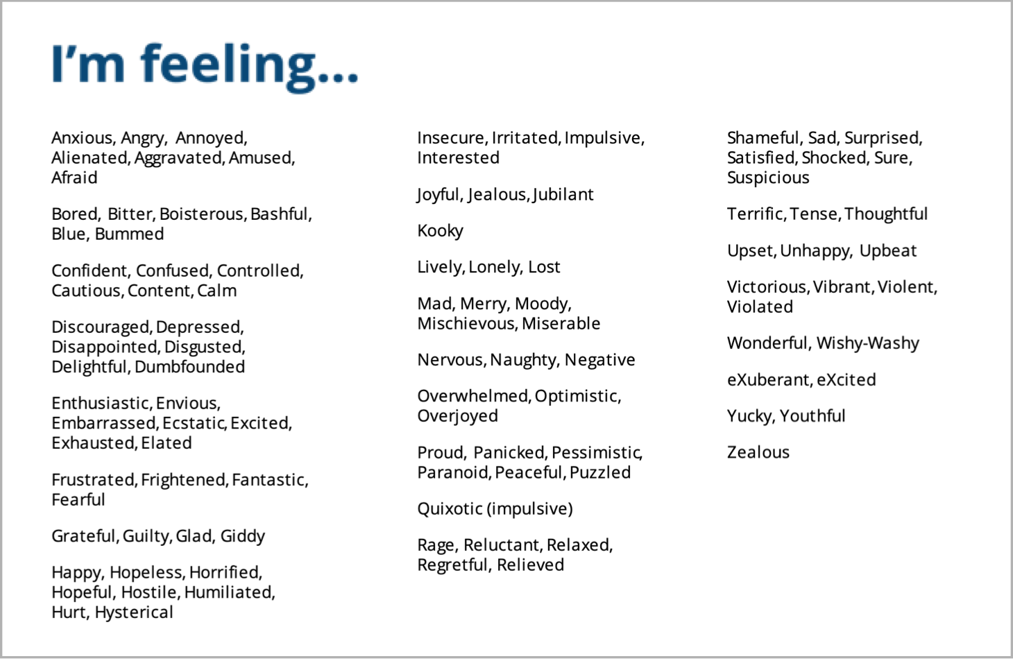
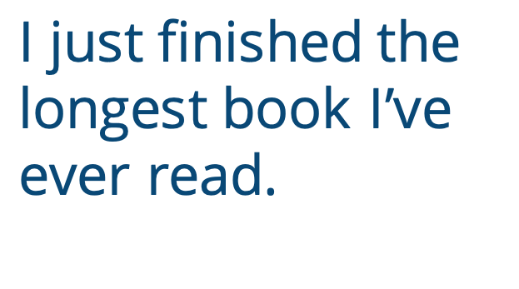
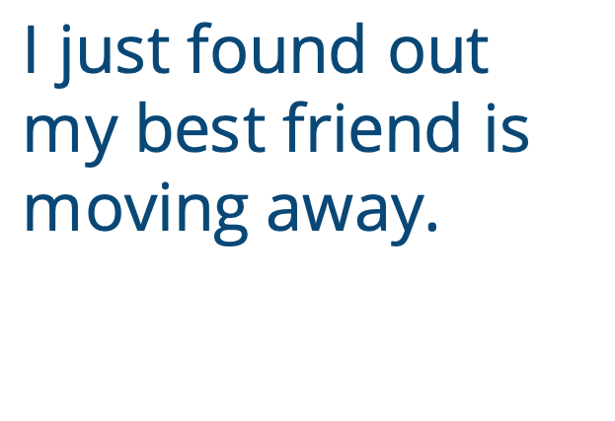
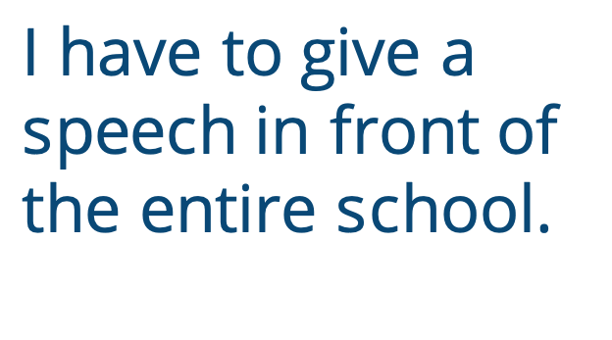
I just found out my best friend is moving away.
I just finished the longest book I’ve ever read.
I have to give a speech in front of the entire school.
Notes:
Instructor Notes:
Distribute one Handout 2: I Feel/They Feel to each student.
Tell the class that you are about to describe a few different situations. As you do, students should close their eyes and focus on how they might feel if they were in each one.
To prepare, ask students to close their eyes and picture their peaceful places.
After a few seconds, click once to project and read the first scenario: “I just found out my best friend is moving far away.”
Ask students to focus their thoughts on how they might feel if this were happening to them. They should then open their eyes and record at least one emotion on the “I may feel” line of Situation 1. Instruct them to express the emotion in a word and create an emoji to further illustrate this emotion.
Note: If students need help thinking of specific emotions, guide them in selecting one from the Emotion Alphabet on the slide.
Once students have recorded an emotion, encourage them to stand up and find a partner. Each partner should explain how the situation would make him or her feel and why. Each student should then write his or her partner’s emotion on one of the handout’s “They may feel…” lines.
Encourage students to do this with two or three of their peers and then sit back down.
Once the class is sitting, instruct the students to again close their eyes, picture their quiet places, and focus their thoughts.
Click twice to repeat the activity with the following two scenarios:
I just finished the longest book I’ve ever read.
I have to give a speech in front of the entire school.

Slide 7
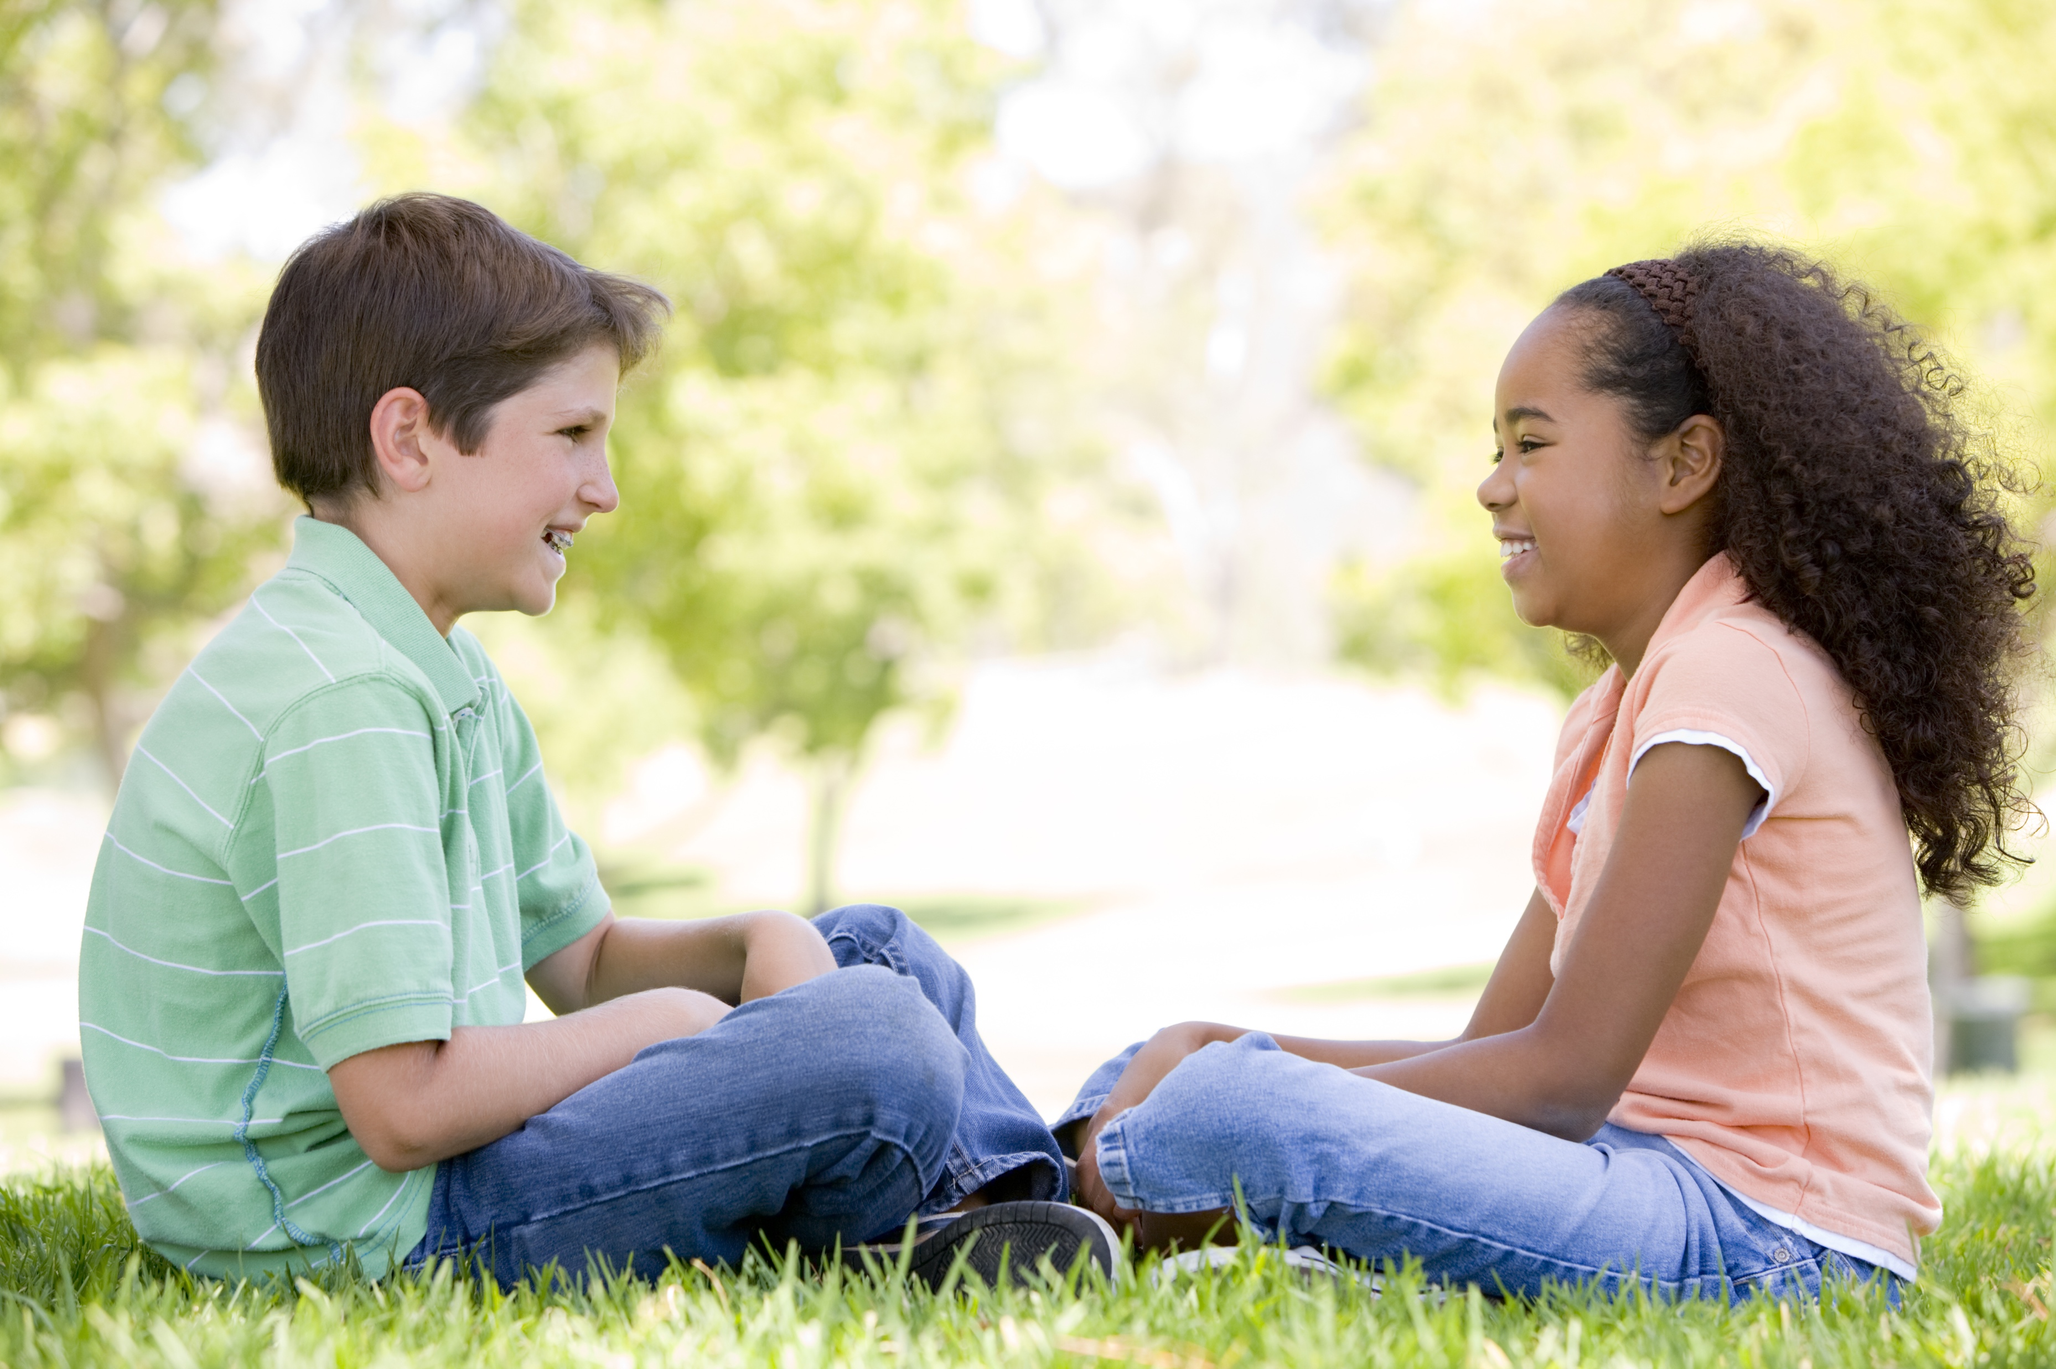
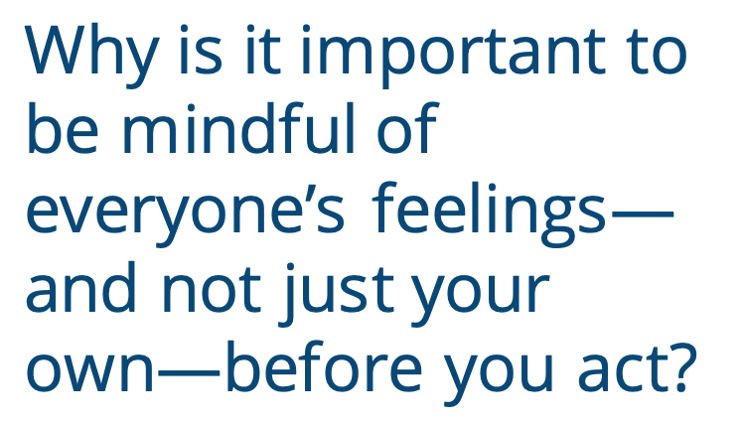
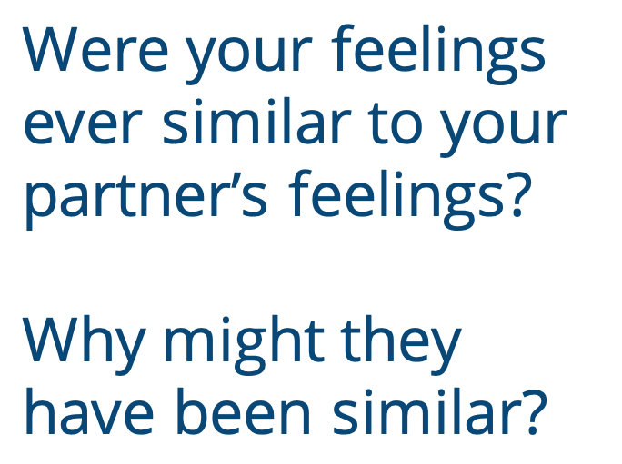
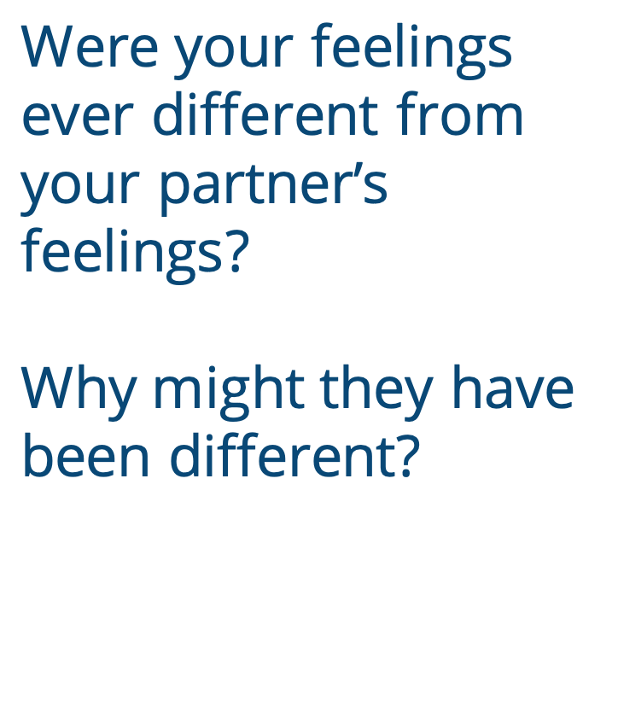
Why is it important to be mindful of everyone’s feelings—and not just your own—before you act?
Were your feelings ever similar to your partner’s feelings?
Why might they have been similar?
Were your feelings ever different from your partner’s feelings?
Why might they have been different?
Notes:
Instructor Notes:
Bring the students back together to discuss the activity. Ask:
Who had similar feelings to those of your peers? Why do you think you might have felt similarly?
Click twice.
Who had different feelings from those of your peers? Why do you think you might have felt differently?
Click twice.
Why is it important to be mindful of everyone’s feelings—and not just your own—before you act?
Wrap up by summarizing:
It’s important to remember that not everyone thinks and feels the same way we do. While we all have similarities, everyone is also different and unique.
Being mindful of our own feelings can help us begin to think about why others feel the way they do—even if they feel differently. It’s important to think about everyone’s feelings before we act or react.

Slide 8
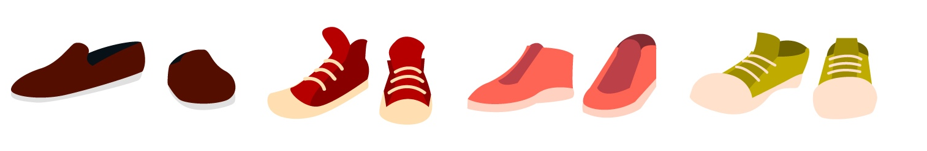

Notes:
Instructor Notes:
Begin the second session by asking the class to sit on the floor in a circle or semicircle and join the students by sitting at their level.
Then read the Words to Live By excerpt aloud again.
Click once and ask students: What does it mean to step into someone’s shoes?
Review and/or explain that that when you think about what someone else is seeing, thinking, and feeling, you are putting yourself into someone else’s shoes. When we try to understand how someone else is feeling, we are able to be as supportive and kind as possible.

Slide 9

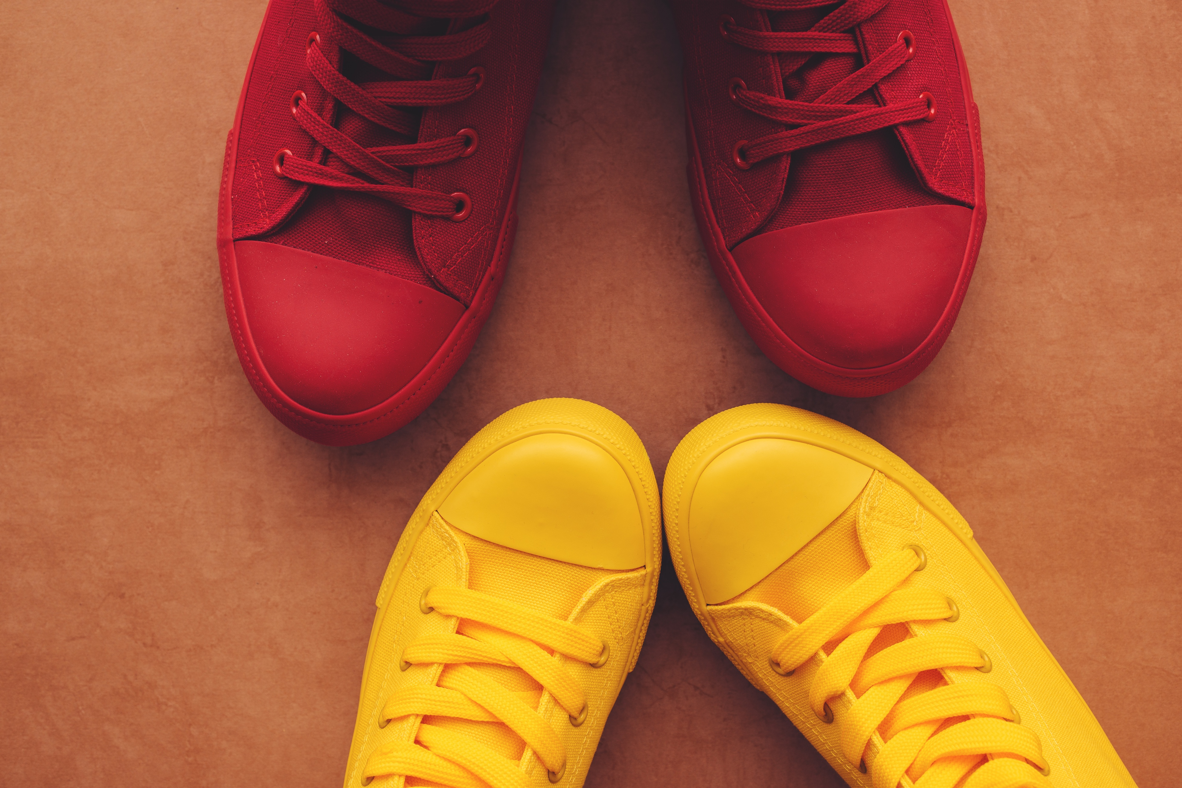
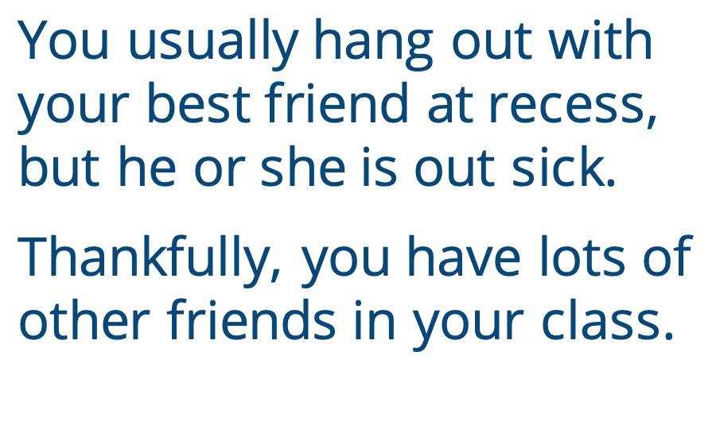
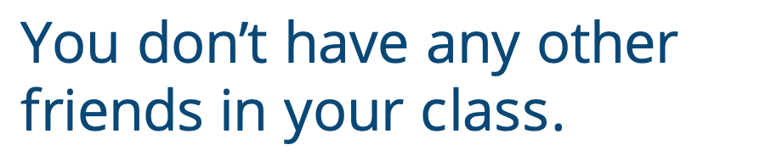
You usually hang out with your best friend at recess, but he or she is out sick.
Thankfully, you have lots of other friends in your class.
You don’t have any other friends in your class.
Notes:
Instructor Notes:
Distribute one piece of blank paper to each student. Explain that they will draw an outline of their shoe(s) on this paper. To do so, instruct them to stand on the paper and use a pencil to trace at least one of their shoes as best as they can. It doesn’t have to be perfect!
Next, ask students to find a partner and stand facing this person. They should then place their shoe outline on the floor in front of them, and stand on top of the outline.
Click to project a scenario on the board and ask students to consider what they would think and how they would feel if they were in this situation:
You usually hang out with your best friend at recess, but he or she is out sick. Thankfully, you have lots of other friends in your class.
Once students have a moment to think independently, encourage them to share with their partners what they might think and feel.
Then instruct students to swap sides with their partners so they are now standing on top of their partner’s shoe outline.
Click twice to project a slightly different scenario and explain that students should now pretend they are in someone else’s shoes. Then read:
You usually hang out with your best friend at recess, but he or she is out sick. You don’t have any other friends in your class.
Again, encourage students to share how they might think and feel if they were in this person’s shoes.
Then ask students to rejoin the circle or semicircle.
Say: You just pretended to stand in two different people’s shoes. When your friend was out sick, did you feel the same in both pairs of shoes? Why or why not?
Be sure students understand that standing in someone else’s shoes can feel very differently on the inside, even if it does not look that different from the outside. There are all kinds of things that make us and our situations unique—and we may not realize this until we try to stand in someone else’s shoes.
For this reason, it’s important to always do our best to be mindful of our own feelings and the feelings of others.

Slide 10
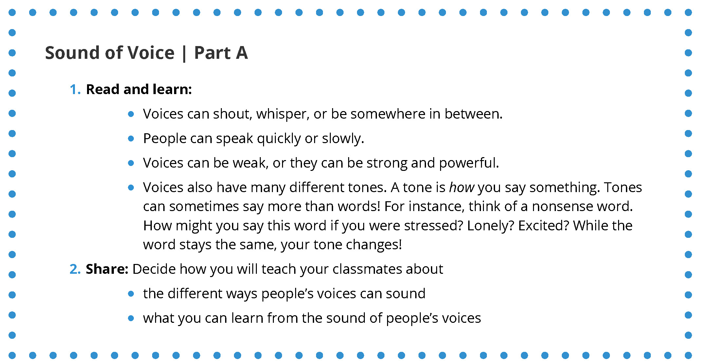
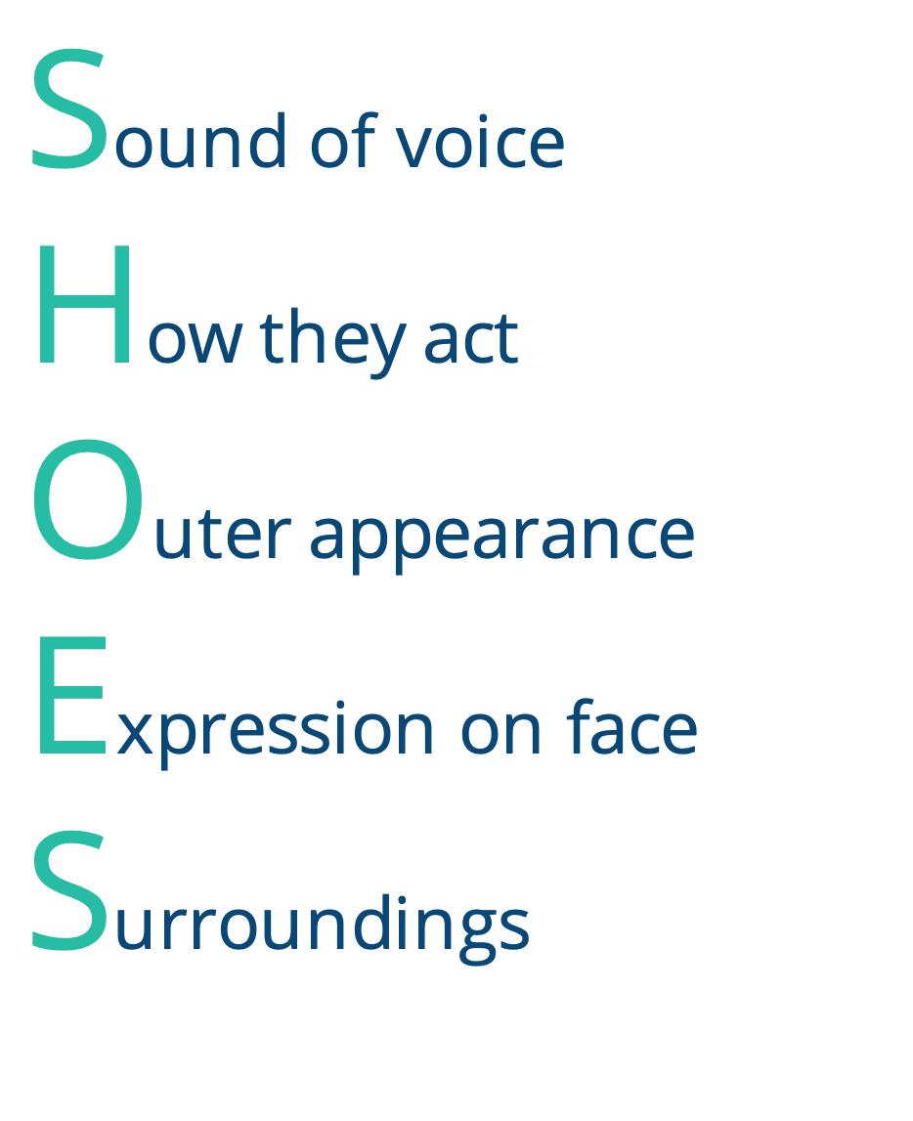
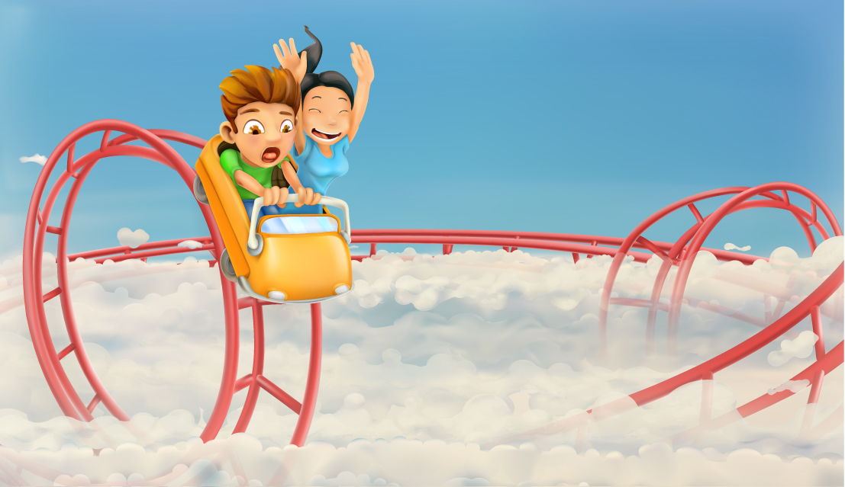
In your …
Sound of voice
How they act
Outer appearance
Expression on face
Surroundings
Notes:
Instructor Notes:
Bring students’ attention to the SHOES acronym on the slide.
Review and/or explain that each letter in SHOES can help us understand what someone is seeing, thinking, and feeling. We can also use it to think about ourselves.
Note: If students already completed the 3-5 Time to Create digital learning bundle, they should remember the SHOES acronym. Regardless, the following activity will help them take a deeper dive into this subject.
Click to fill in the last “S” in SHOES with “Surroundings.”
Explain that for this activity, the class will pretend they are at an amusement park with their friend’s family, and they are in line to go on the biggest roller coaster they have ever seen. It even goes upside down. This is their surroundings.
Next, divide the class into eight groups of mixed ability levels.
Click once and explain that each group will be preparing a presentation about one letter of SHOES. The goal of the presentation will be to teach the rest of the class how the letter can be used to understand our own feelings and the feelings of others. Two groups will focus on each letter.
With the roller coaster surroundings in mind, distribute one SHOES card* from Handout 3 to each group.
*Note: There is a Part A card and a Part B card for each letter—so one group should receive the How People Act Part A Card, one group should receive How People Act Part B Card, etc.
Click twice to display a sample card on the screen.
Review the card and explain that every card has two sections:
a Read and Learn section that helps students understand the concept
a Share section that explains what the group should be ready to share with the class
Be sure to also explain that everyone’s card is different, so each group must follow the directions on its own card. Let the students know they may ask you if they have any questions.
Then click two more times. Encourage groups to read their card and begin working on their presentations.

Slide 11
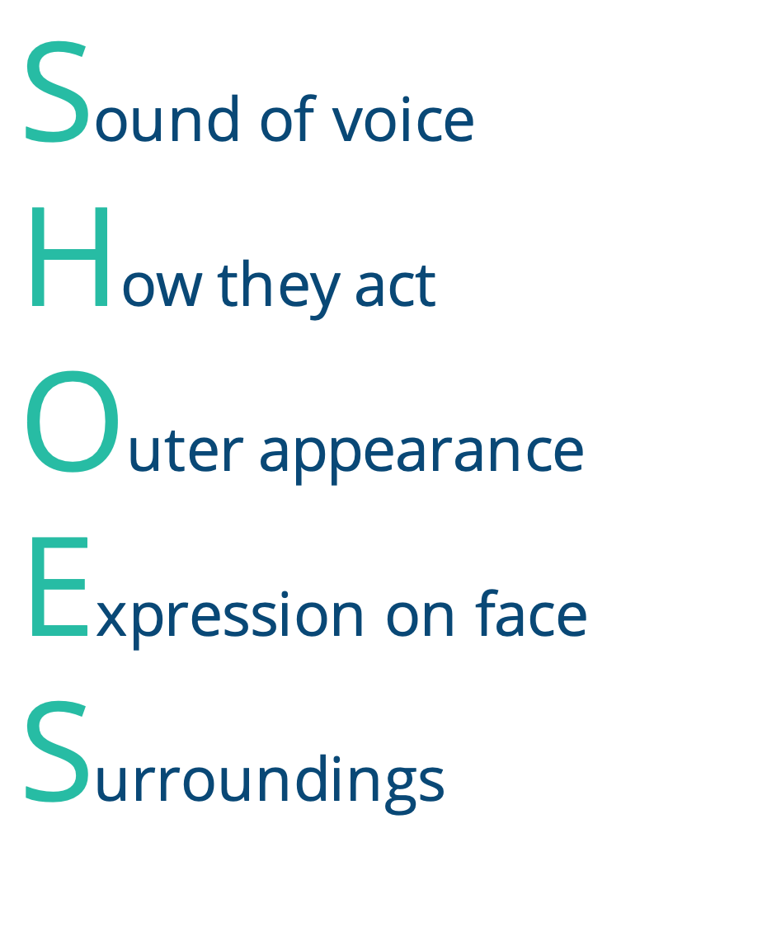
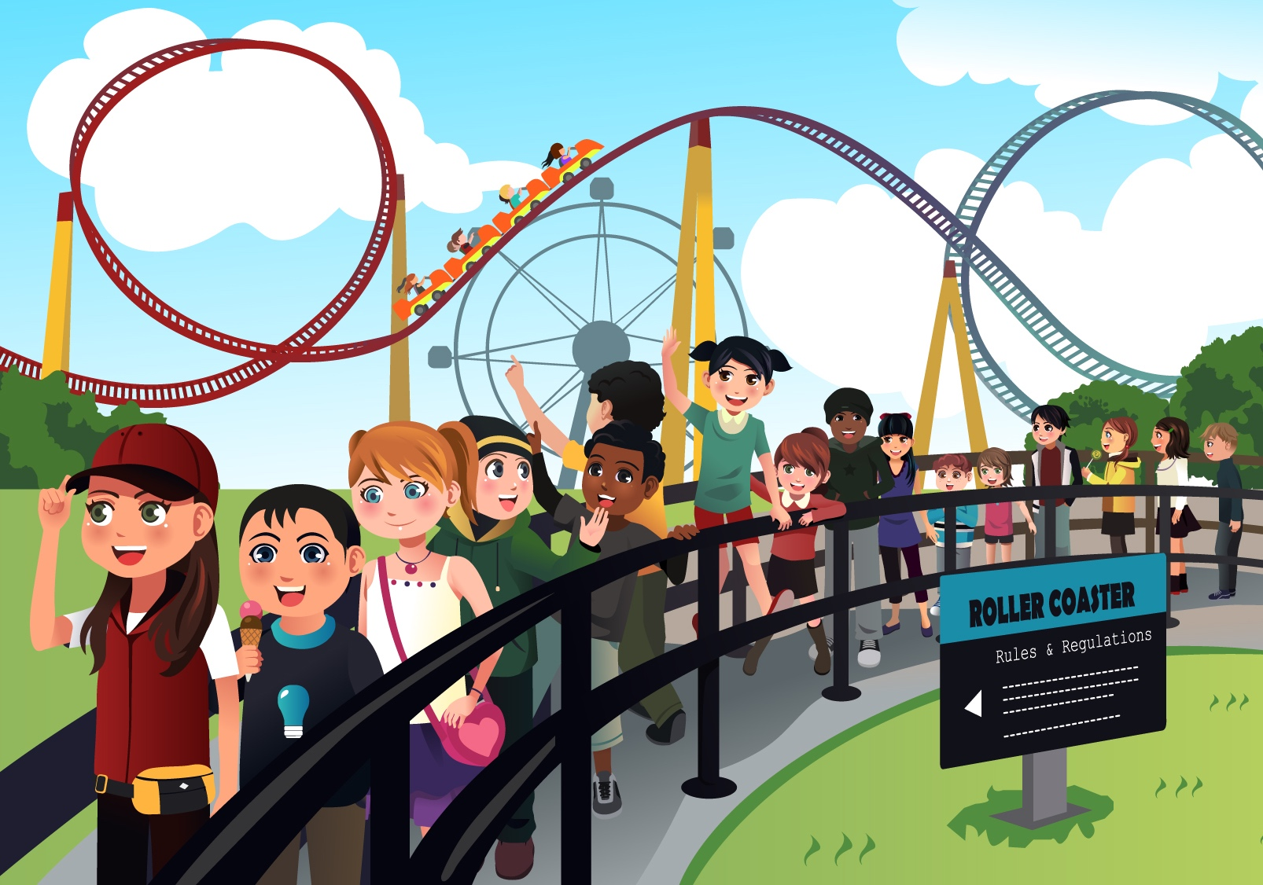
Notes:
Instructor Notes:
When groups are ready to present, bring the students back together.
Pass out one Handout 4: Shoes Notes to each student.
As groups share, encourage students in the audience to take notes on at least one important tip they learn from each presentation that may help them put themselves in someone else’s shoes in the future.
Then call up groups one at a time, beginning with Sound of Voice Part A, then Sound of Voice Part B, moving on to How They Act Part A, and so on. Click once to bring up each new SHOES letter as groups present.
Note: Each A presentation should provide an overview of the concept whereas each B presentation should act out specific examples.
Once all presentations are complete, wrap up by explaining that SHOES can help us figure out our own emotions too. It’s not always easy to know exactly how we feel, but thinking about these letters can help.
When we try to figure out how we feel or how someone else feels, it’s almost like we’re detectives solving a mystery:
Some clues may be easy to spot, and some may be harder.
No matter what, each part of SHOES gives us a little clue into someone’s feelings. The more clues we can collect, the better we can understand where someone else is coming from.
Once we understand where someone is coming from, we can respond kindly and thoughtfully.

Slide 12

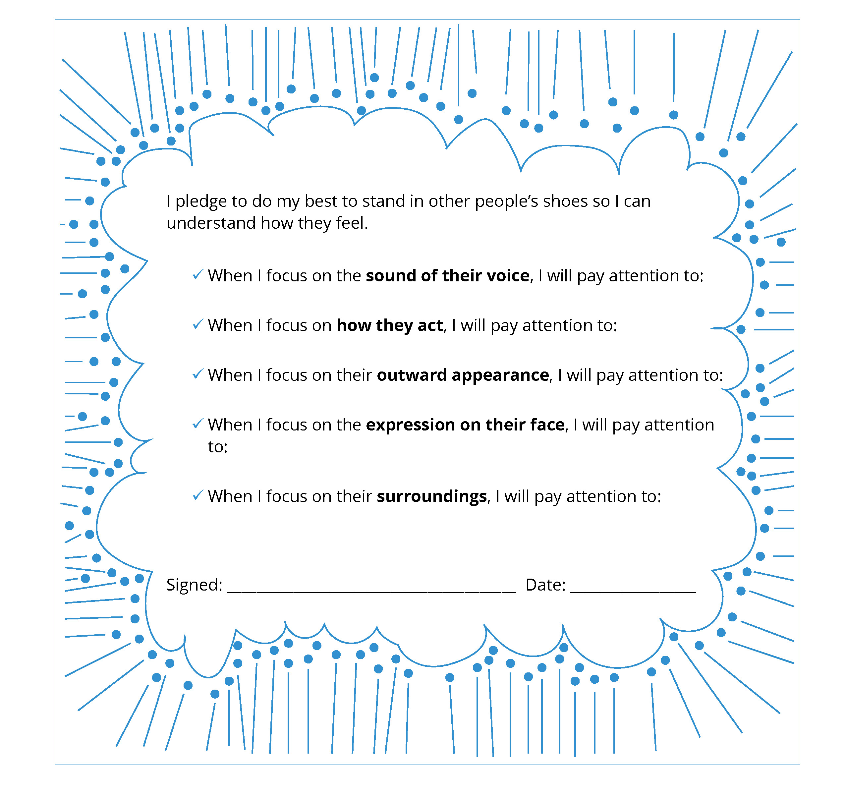
Notes:
Instructor Notes:
Explain that students will now apply what they learned from the group presentations to make a pledge to continue putting themselves in others’ shoes.
Tell students that if they are mindful of putting themselves into someone else’s shoes and continue to practice it, it will get easier. Eventually they will be able to focus on more than one part of SHOES at the same time—which will help them better understand how someone else feels!
Distribute one Handout 5: My Pledge to each student.
Review the text on the pledge sheet and explain that students should fill in the blanks with at least one tip for each part of SHOES. For instance, a student could complete the “I can try to better understand how people feel from the sound of their voice by paying attention to…” phrase with “whether they are speaking quietly or loudly,” “whether their voice sounds weak or strong,” etc.
Encourage students to use their presentation notes to pick a tip or strategy that will be helpful to them!
Give students a few minutes to fill in their pledge sheets. It may be beneficial to discuss their ideas with a peer.
Then regroup and challenge the students to begin following their pledge today, both at school and at home. To accomplish this, they will need to be mindful and practice putting themselves into other people’s shoes whenever possible.
Note: Students will be asked to think about their pledge at the beginning of next session, so either encourage students to put their pledge sheets in a safe place or collect them for safe keeping.

Slide 13

√
√
√
√
√
Notes:
Instructor Notes:
Begin the third session by asking students to take out their Handout 5: My Pledge (or redistribute it to the students).
Then encourage the class to sit on the floor in a circle or semicircle and join the students by sitting at their level.
Briefly review the SHOES acronym letter by letter.
As you read each part, encourage students to share what they have done since last class session to be more mindful of this part of SHOES.
Click to reveal a checkmark as students share about each letter before you move on to the next one.

Slide 14

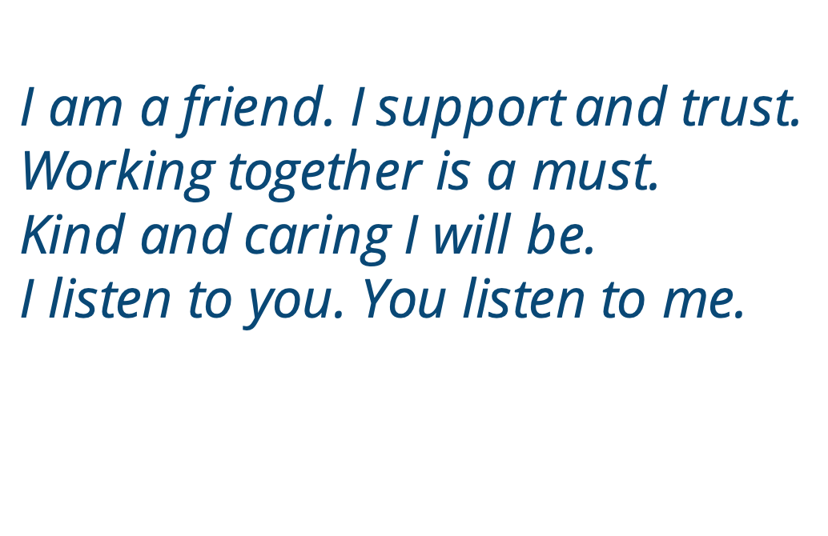
Notes:
Instructor Notes:
Then explain that while being able to put ourselves into other people’s shoes is one important way to understand others, there are also other ways to treat people well and with respect.
Click to project and read the following Words to Live By excerpt aloud:
I understand others are unique.
I want to learn more about everyone I meet.
I want to step into their shoes and
see what they are going through.
I am a friend. I support and trust.
Working together is a must.
Kind and caring I will be.
I listen to you. You listen to me.
Ask students to help you identify text details: According to these Words to Live By, what are some other ways that we can treat others well and be a good friend?

Slide 15
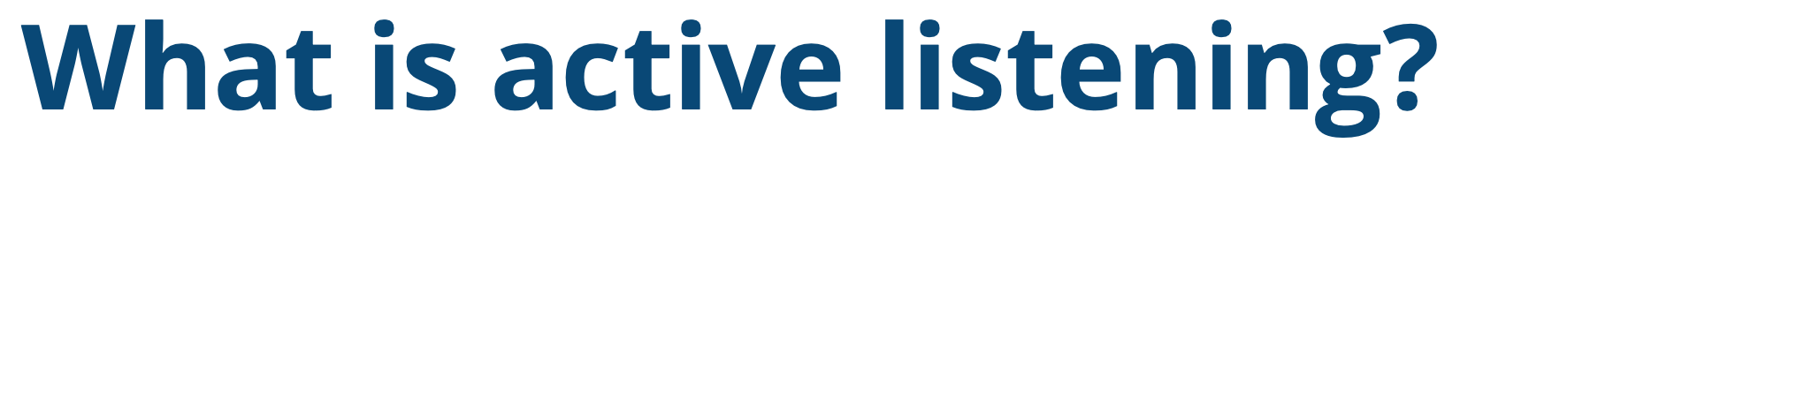

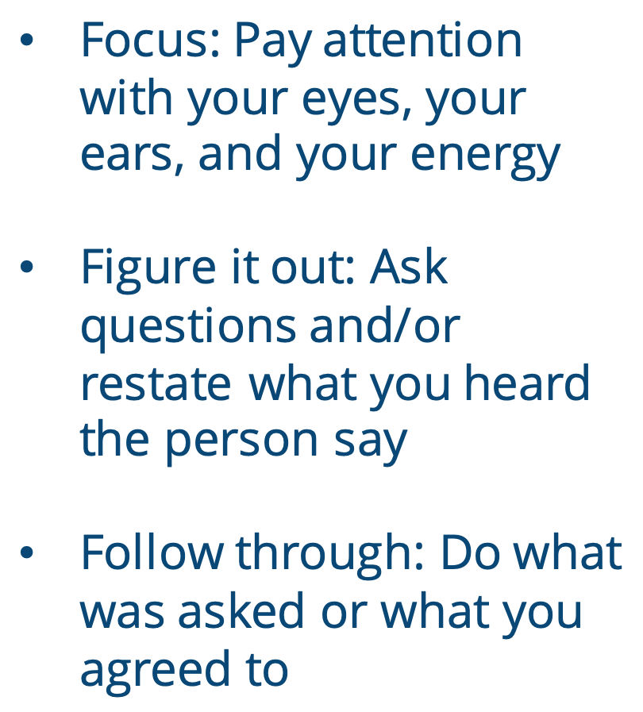
What is active listening?
Focus: Pay attention with your eyes, your ears, and your energy
Figure it out: Ask questions and/or restate what you heard the person say
Follow through: Do what was asked or what you agreed to
Hearing does not ≠ Listening
Notes:
Instructor Notes:
Review and/or explain that one way to be a kind and caring friend is to listen. When you listen, you are taking time to understand the other person.
Tell students that many of them know some of the skills they need to be a good listener.
To prove it, ask students to pretend that they’re not listening. What would they look like?
Explain that this is the key difference between hearing and listening. When people look like the students do now, they can likely hear the sounds that are coming out of your mouth. But because they are not trying to understand what you say, they are not truly listening.
Click twice and explain that when you are truly listening, it is called “active” listening—because someone is actively choosing to listen and pay attention.
Click again and explain that active listening consists of 3Fs:
Focus: Pay attention with your eyes, your ears, and your energy
Figure it out: Ask questions and/or restate what you heard the person say
Follow through: Do what was asked or what you agreed to

Slide 16
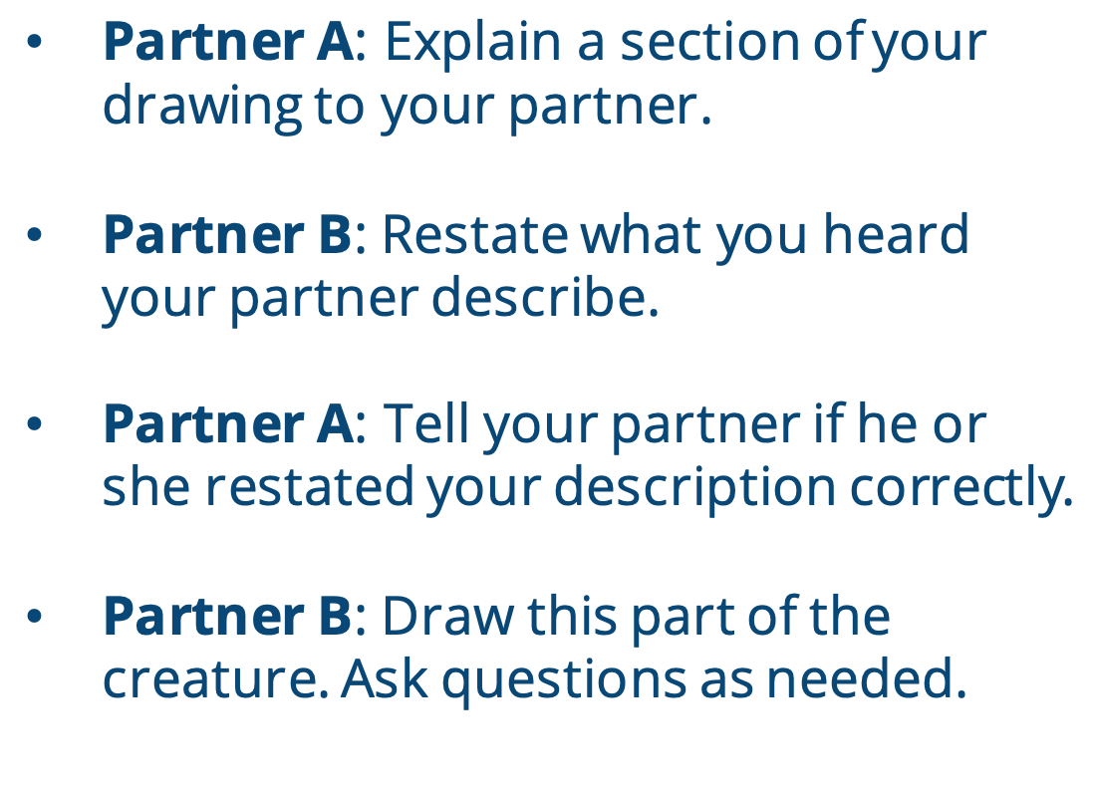

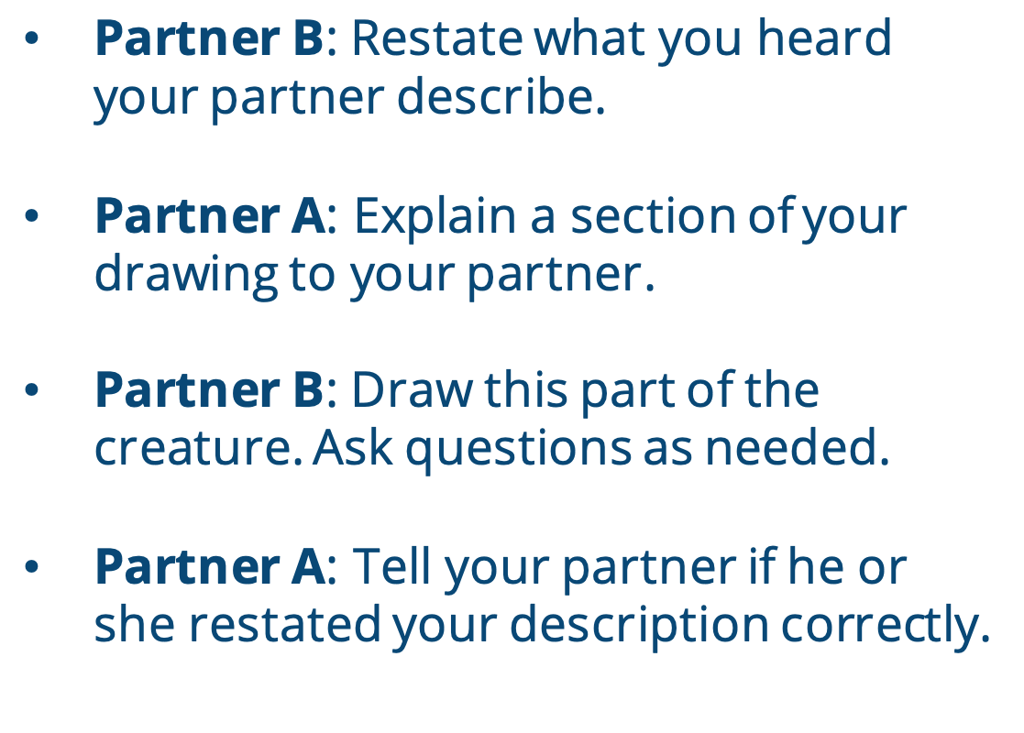


Partner A: Explain a section of your drawing to your partner.
Partner B: Restate what you heard your partner describe.
Partner A: Tell your partner if he or she restated your description correctly.
Partner B: Draw this part of the creature. Ask questions as needed.
Partner B: Restate what you heard your partner describe.
Partner A: Explain a section of your drawing to your partner.
Partner B: Draw this part of the creature. Ask questions as needed.
Partner A: Tell your partner if he or
she restated your description correctly.
Continue until time is called.
Notes:
Instructor Notes:
Explain that students are about to practice active listening.
Pair students with one another and instruct them to sit back to back with a pencil in hand and a notebook or clipboard to bear on.
Pass out Handout 6: Active Listening to each student.
Explain that each partner will have just a few minutes to draw an imaginary creature in the top rectangle. The picture must show the imaginary creature’s face and body. The oval shape in the rectangle must be included somewhere in the drawing. There should be nothing else in the drawing other than the creature.
Once a few minutes have passed, click twice and instruct pairs to turn to face each other, keeping their drawings hidden.
Ask each pair to designate one partner as Partner A and one partner as Partner B.
Then read the directions on the slide and explain that pairs will now take turns completing the following:
Partner A: Explain a section of your drawing to your partner.
Partner B: Restate what you heard your partner describe.
Partner A: Tell your partner if he or she restated your description correctly.
Partner B: Draw this part of the creature. Ask questions as needed.
Continue until time is called.
Give pairs about four or five minutes to follow these directions. Then call time, click twice, and instruct students to swap roles.
When both partners are done, encourage them to show each other what they have drawn and see how close they are to the originals.

Slide 17


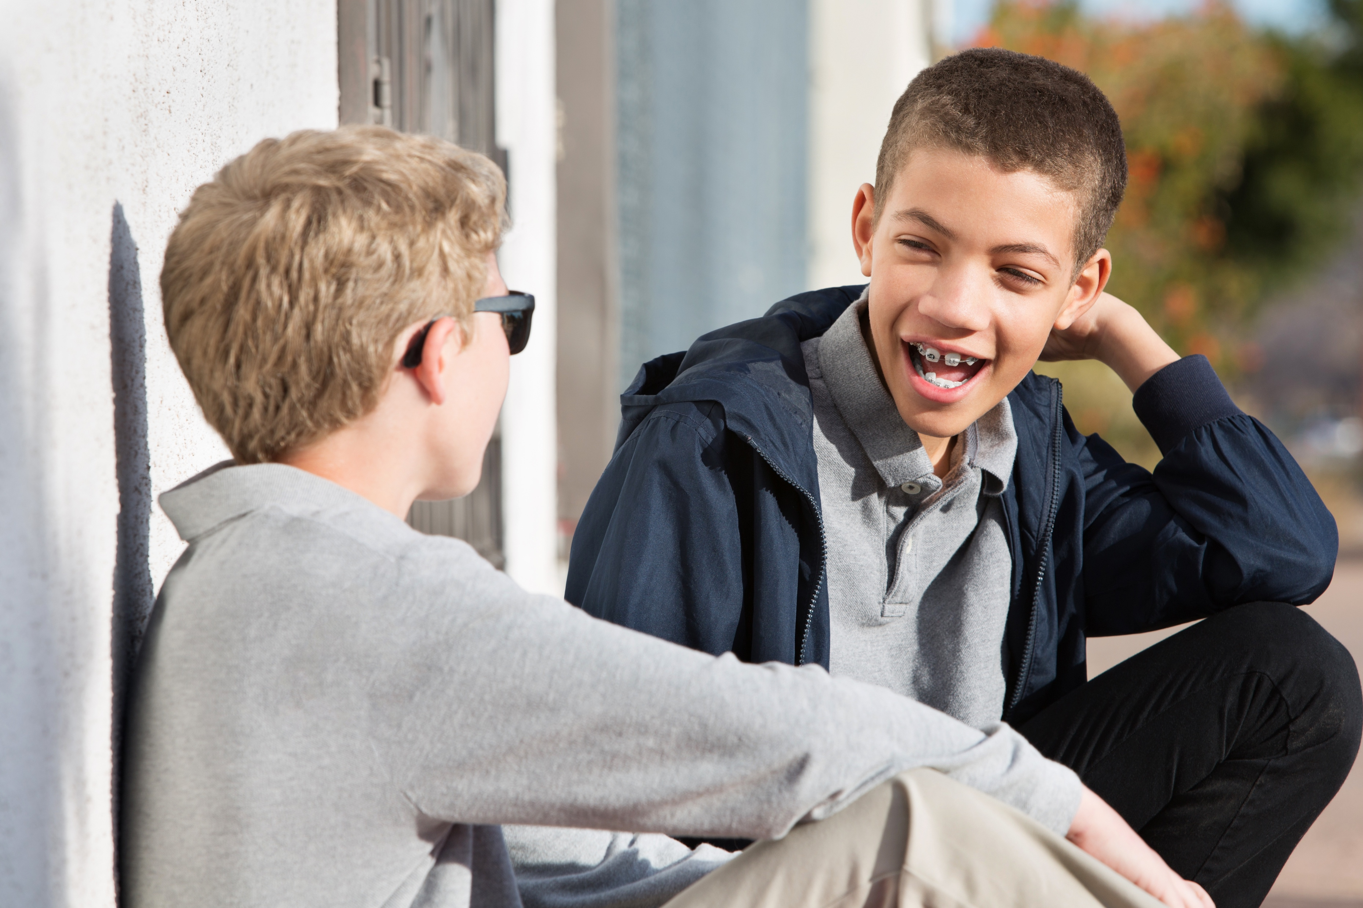
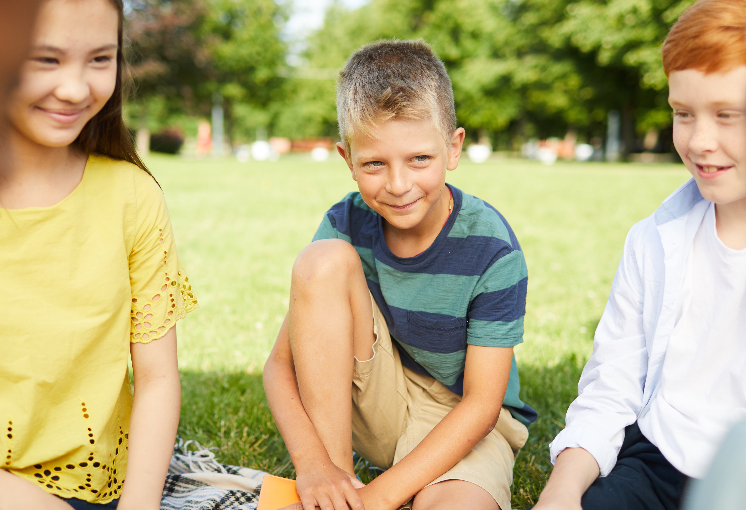

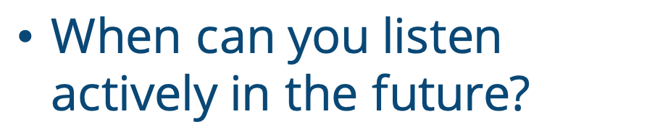
What worked well?
What was difficult?
How could you improve?
When can you listen actively in the future?
Notes:
Instructor Notes:
Bring the students back together in a circle or semicircle.
Then discuss the activity, clicking to display each of the following questions:
What part of the 3Fs worked well when you were actively listening?
What part of the 3Fs was difficult?
What could you do better?
When can you listen actively in the future?
Tip: It may be helpful to click back quickly to Slide 14 to remind students of active listening’s 3Fs!
Then click again to connect active listening to the idea of mindfulness.
Ask: How does active listening connect to being mindful?
Click again and be sure students understand that both active listening and mindfulness relate to focusing your attention on one thing at a time. When you are actively listening to someone, you are being mindful of that person and what he or she is saying.
Ask students to raise their hands if they have ever felt like someone wasn’t listening to them.
Invite students to think-pair-share: How did this make you feel?
Explain that these negative feelings make sense because it can feel like someone doesn’t care about you when they are not listening.
When you are mindful and listen actively, you are doing your best to understand the other person. This shows him or her that you do care.

Slide 18

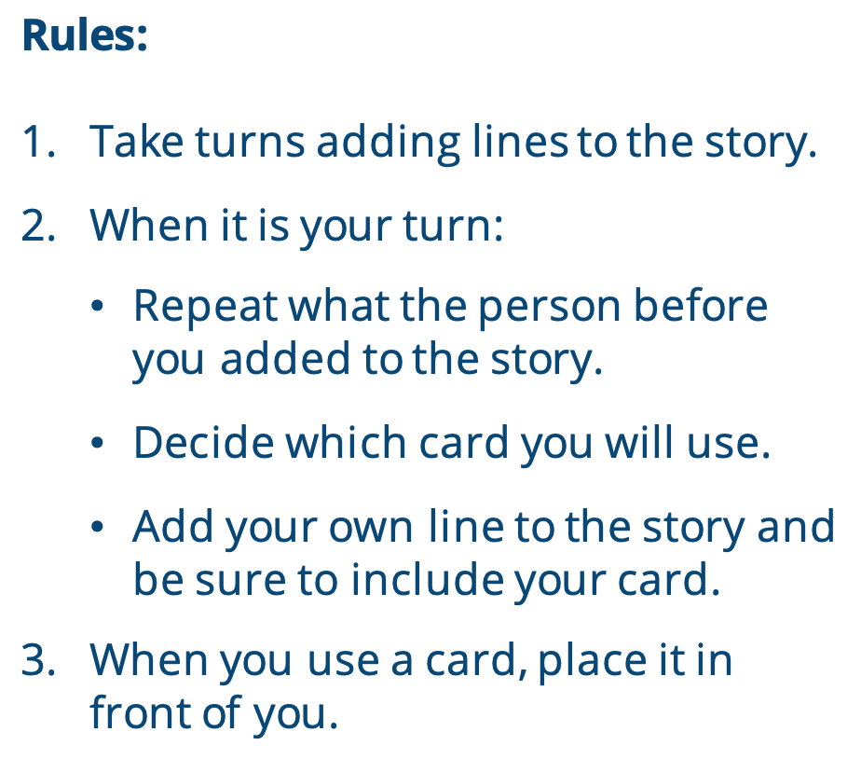

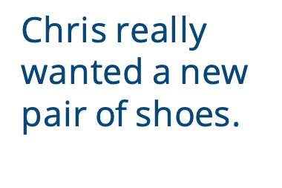
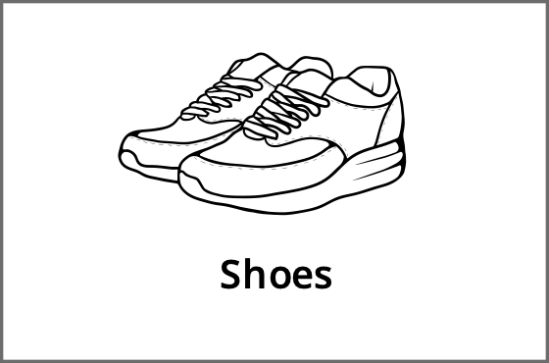
Rules:
Take turns adding lines to the story.
When it is your turn:
  Repeat what the person before you added to the story.
  Decide which card you will use.
  Add your own line to the story and be sure to include your card.
When you use a card, place it in front of you.
There was once a student named Chris…
Chris really wanted a new pair of shoes.
Shoes
Notes:
Instructor Notes:
Ask: If I were to tell you that you were going to tell a story with your classmate, but you would not be allowed to plan for the story or talk about it before you tell it together, how hard do you think it would be to tell a story that makes sense?
Encourage the students to show you their thoughts using their facial expressions and body language.
Then explain that they are about to participate in an activity where they will do exactly this and that it will require them to listen actively and be mindful in order to be successful.
Divide students in groups of three and give each student four cards from Handout 7: Story Cards. They should not show their cards to their group members.
Click once to reveal on the board: “There was once a student named Chris …”
Explain that each group is now going to work together to come up with a story that continues from this one line. Click once and explain that in order to do this students must follow these steps:
Add to the story one student at a time, moving around the circle.
Each time a student speaks, he or she must:
repeat what the person before added
use one of his or her own cards and add to the story
As students use their cards, they should place them on the floor or desk so their group members can see them.
Students may add one sentence to the story or a few sentences as long as they incorporate one of their cards.
Help students understand by providing an example:
Click once and bring students’ attention to the sneakers card on the slide.
Explain that if it was your turn, you would first repeat, “There was once a student named Chris.”
Click again and say that you would then put your sneakers card down and add on to the story with something like this: “Chris really wanted a pair of new shoes.”
Explain that this line makes sense and adds your sneakers card to the story.
Then explain two other important rules:
Everything that you say should be connected to what was said before. In order to do this, you have to be mindful and an active listener.
Try to step into your classmates’ shoes. If it looks like they need help, ask to see their cards and try your best to help them.
Answer any questions and then encourage students to begin. Groups should continue adding to the story on the board until they are out of cards.
Keep an eye on groups as they begin working. Reiterate the importance of active listening and guide students as needed.

Slide 19

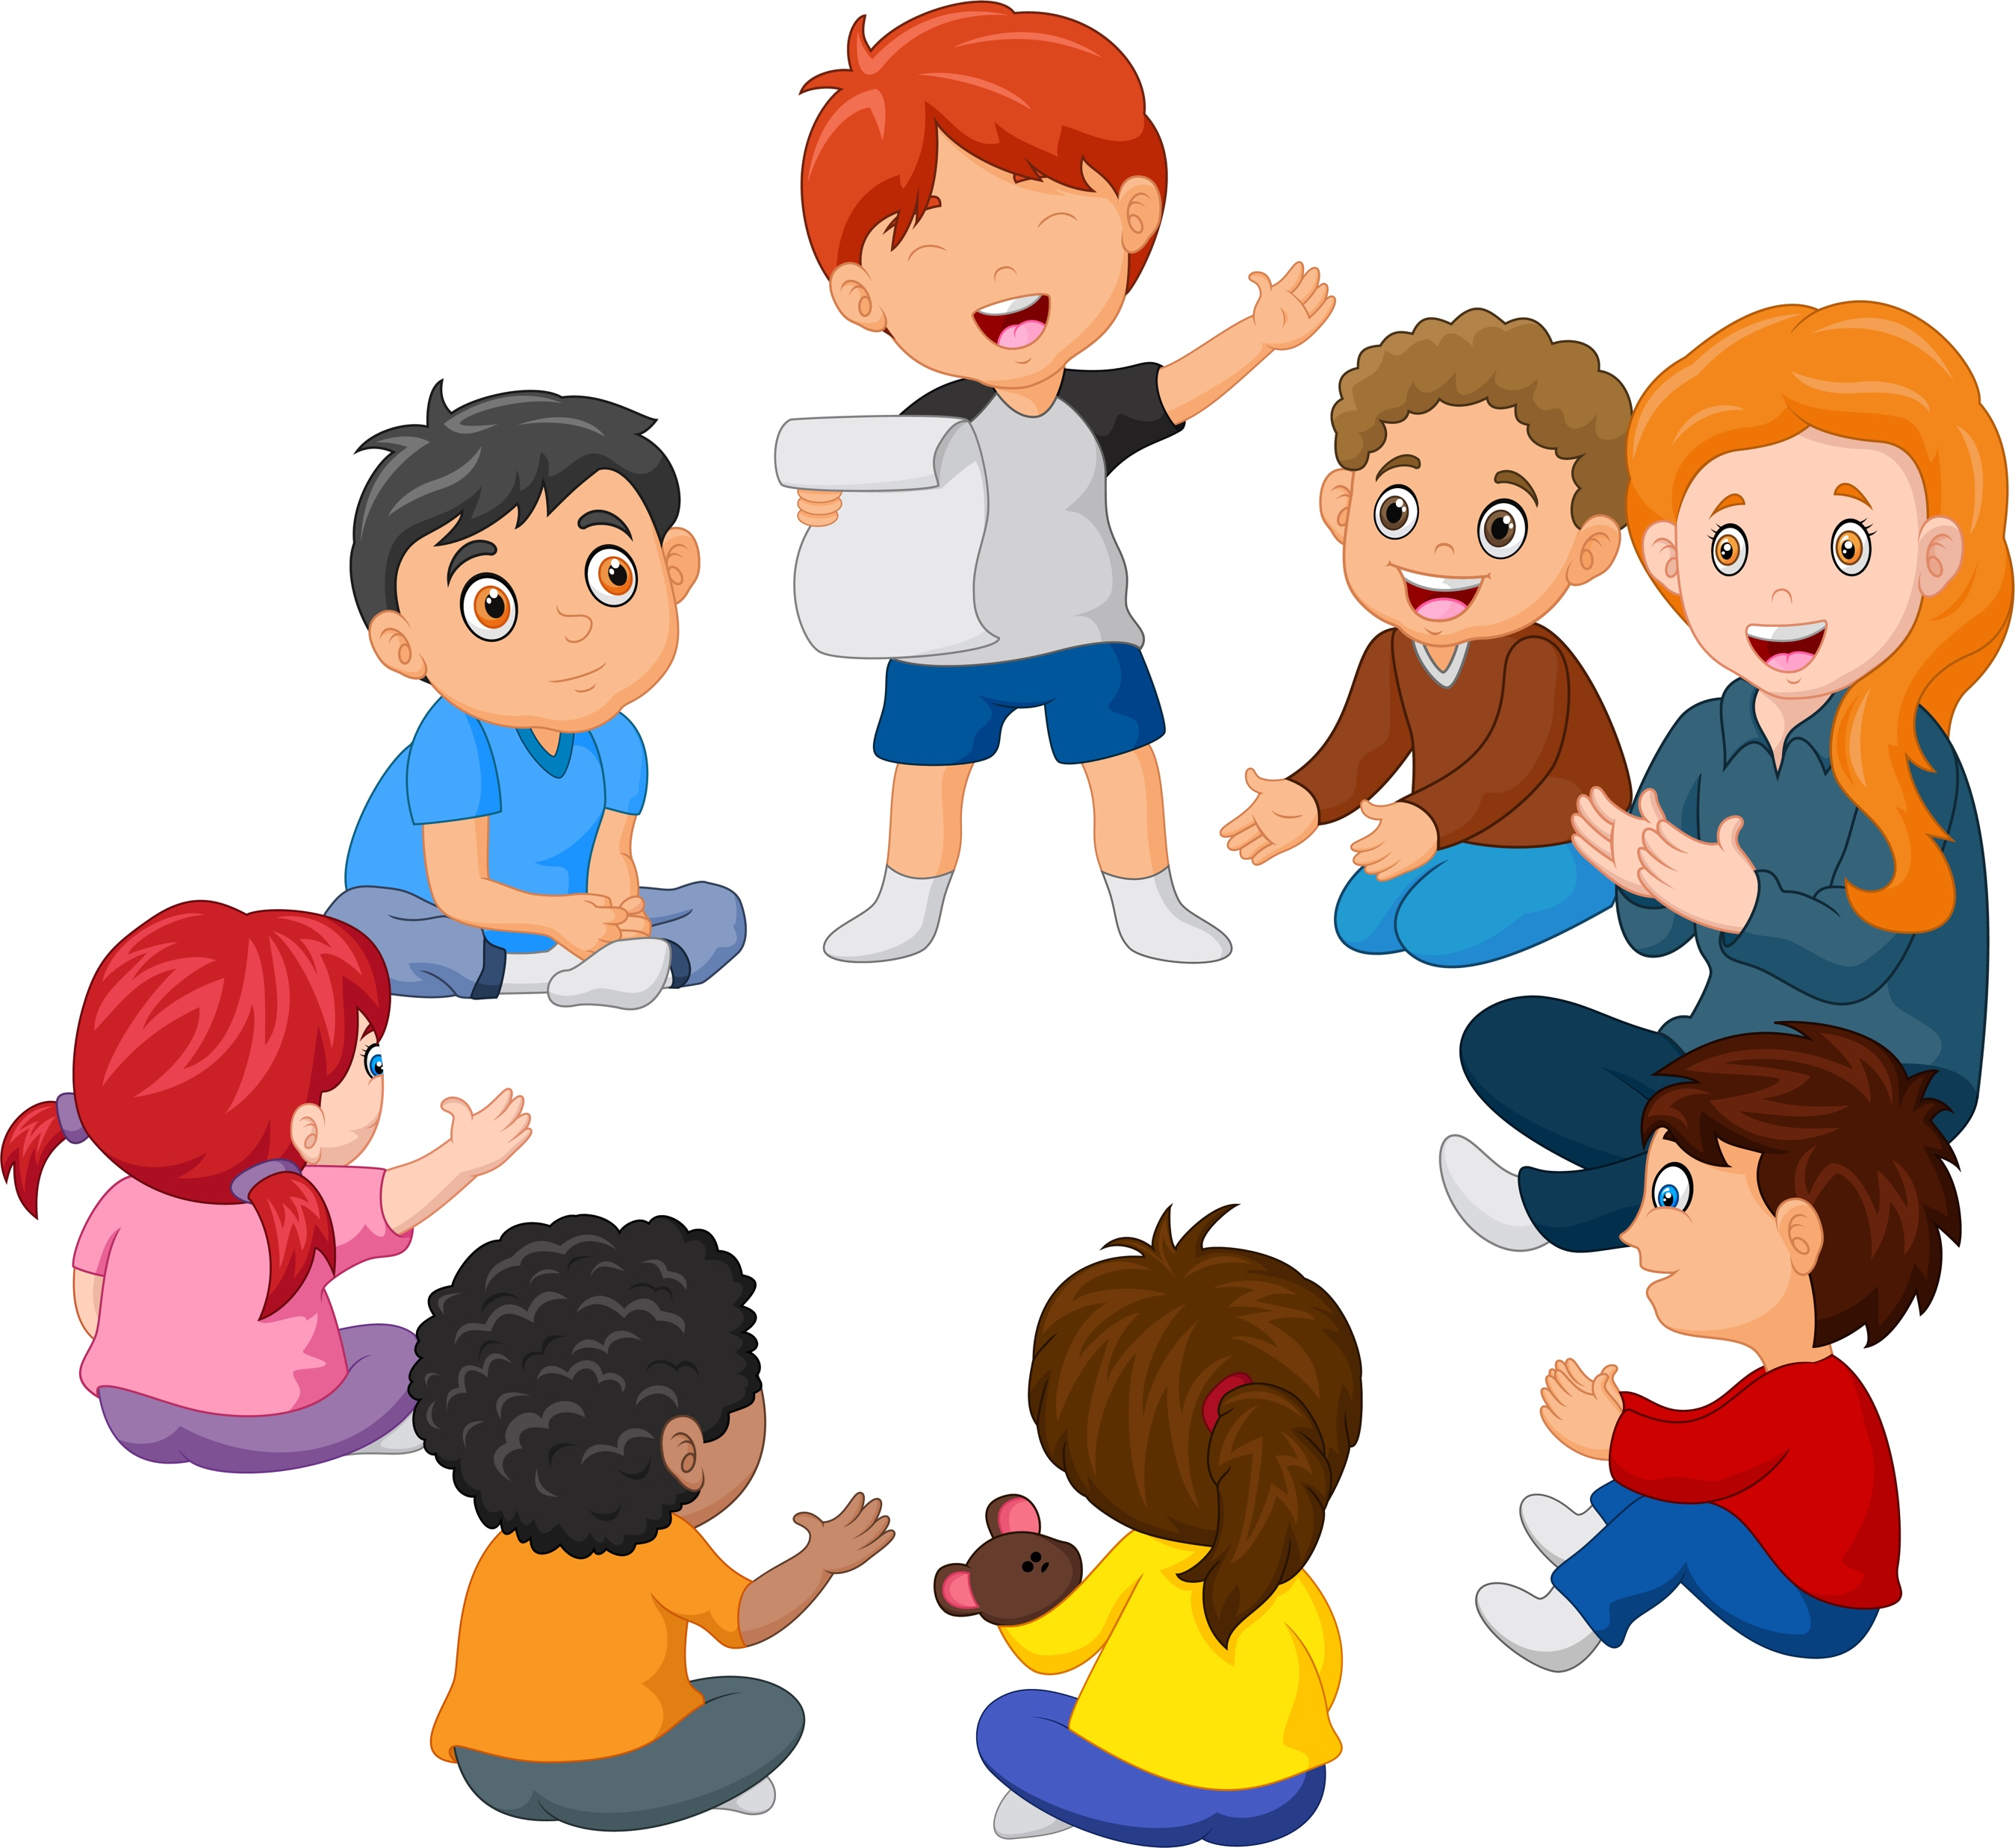
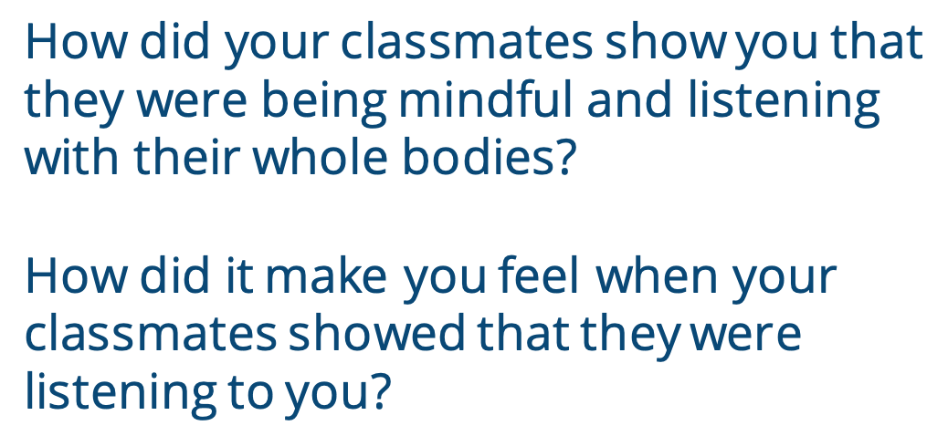
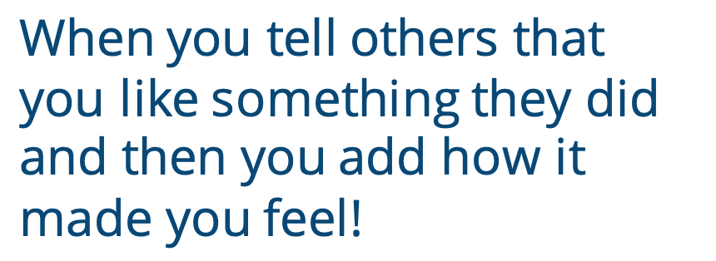
Positive Feedback
How did your classmates show you that they were being mindful and listening with their whole bodies?
How did it make you feel when your classmates showed that they were listening to you?
When you tell others that you like something they did and then you add how it made you feel!
Notes:
Instructor Notes:
Bring the students back together. Ask a couple questions to reflect on the activity, including the following:
How did your group members show you that they were being mindful and listening actively?
How did it make you feel when your group members showed that they were listening to you?
Tell the class that these comments are an example of “positive feedback.”
In addition to listening, positive feedback is another way to show people they care.
Click twice and review and/or explain that when you praise someone and then you add how it made you feel, it’s called giving positive feedback. Positive feedback is a great way to let others know how they make you feel when they are good to you.

Slide 20
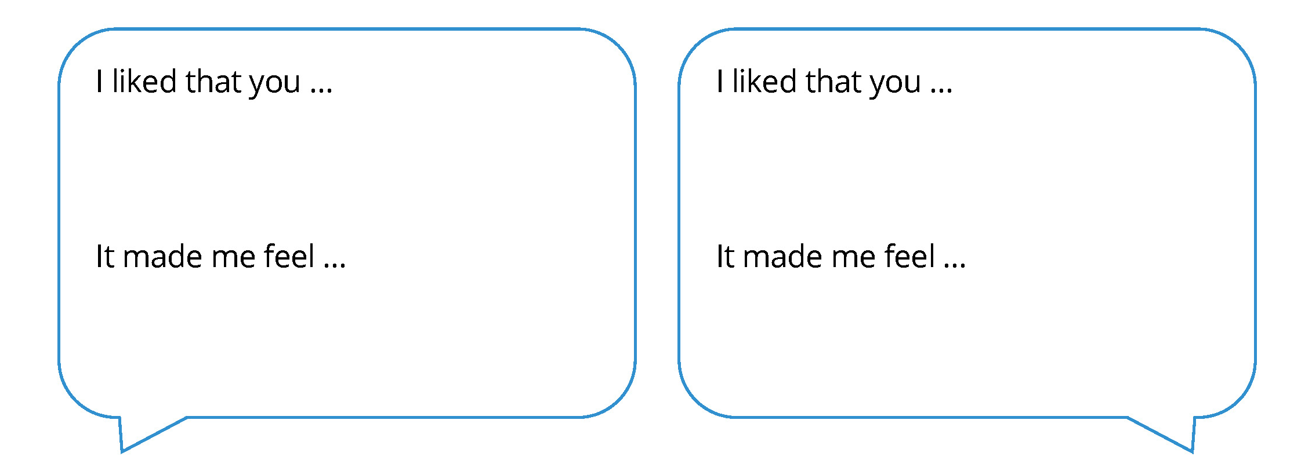
Notes:
Instructor Notes:
Distribute two or three speech bubbles from Handout 8: Positive Feedback to each student. Students should receive one bubble for each member of their group, not including themselves.
Click once and explain that students will use these speech bubbles to share positive feedback with their group members.
Encourage each student to think more about how their classmates worked together to tell the story, listened as they were storytelling, or maybe even helped them when they were stuck.
They should then record this positive feedback on their speech bubbles.
Before students begin, it may be helpful to provide the class with an example. Try to use the sentence stems to share positive feedback for the entire class, such as: “I liked that everyone focused with their eyes, their ears, and their energy throughout the storytelling. This made me feel proud!”
Then move around the room as students work and help anyone who may need assistance thinking of positive feedback for a peer.
Once students have completed their speech bubbles, instruct them to deliver their positive feedback blurbs to one another.
Then bring the class back to the circle or semicircle, and encourage students to spend a moment reviewing the positive feedback they received.
Remind the class that positive feedback is a great way to learn how to become a better friend and a better person. They just learned how some of their actions made their peers feel, and they should do their best to continue acting this way.

Slide 21
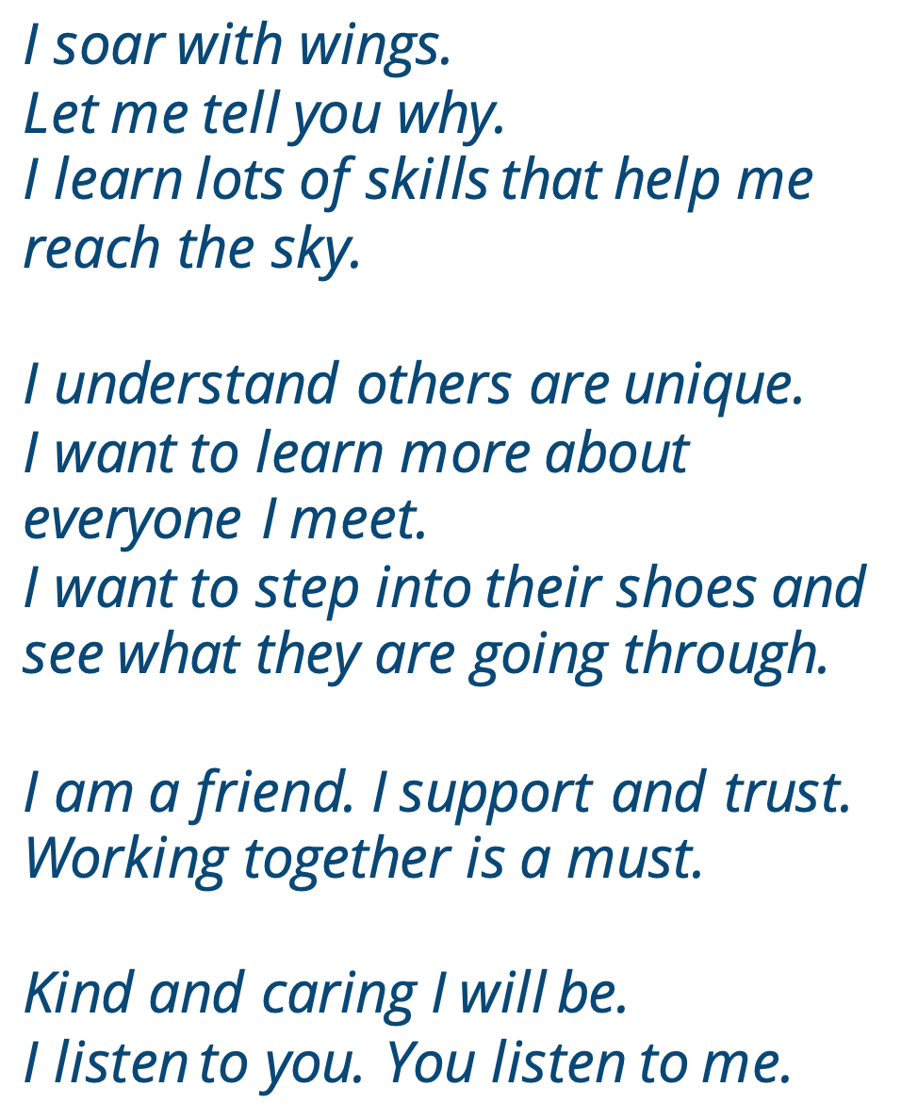

Notes:
Instructor’s Note:
Wrap up by clicking to display the full Words to Live By excerpt on which students have focused over the past several sessions. Encourage the class to join you as you read it aloud.
Remind students how being mindful and focused can help them better understand themselves and those around them and challenge them to keep these Words to Live By in their minds as they spend time with others both inside and outside of school.

