Slide 1





Slide 2
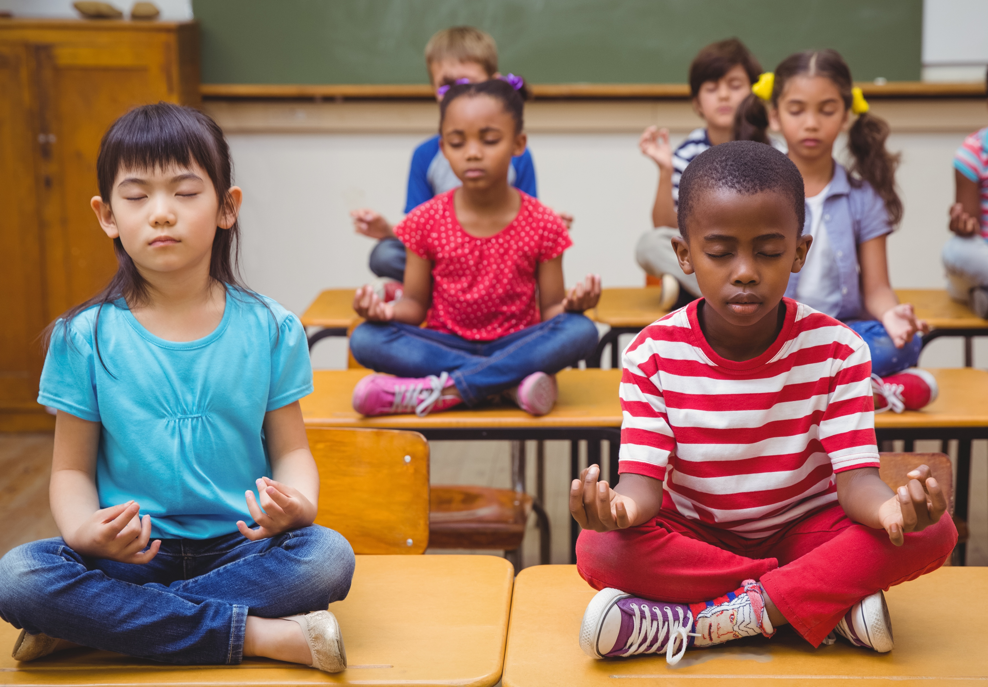

Notes:
Instructor Notes:
Begin by encouraging students to find a comfortable area in the classroom where they can sit quietly.
Once everyone is seated, ask them to close their eyes.
Lead the class in taking three deep breaths: In and out. In and out. In and out.
Then instruct students to keep their eyes closed while you guide them through the following prompts:
As you breathe in and out, think about what you can hear. Do you hear any loud noises? Do you hear any quiet sounds? Is there anything you can just barely hear? Keep your eyes closed and focus on all of the sounds you can hear.
Allow about 15 quiet seconds to pass before moving on the next prompt.
Now think about what you can feel. As you sit on the floor, what is touching your skin? Can you feel the ground? Can you feel your clothing? What does your skin feel like? Keep your eyes closed and focus on everything you can feel.
Allow about 15 quiet seconds to pass before moving on the next prompt.
Slowly, open your eyes and look up. Without moving your eyes around too quickly, focus little-by-little on everything you can see.
Allow about 15 quiet seconds to pass before moving on.

Slide 3

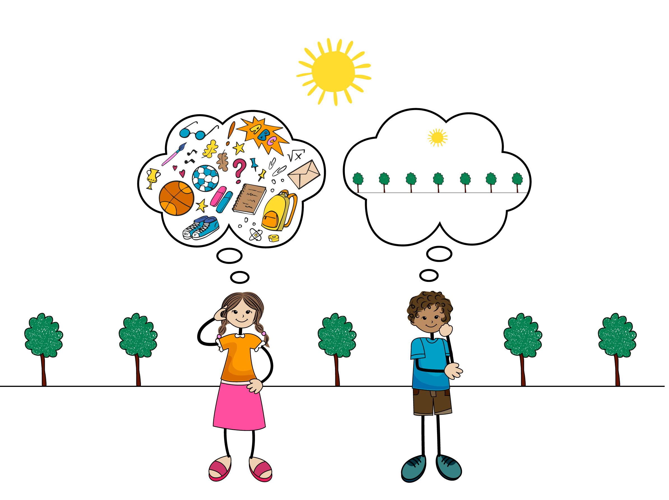
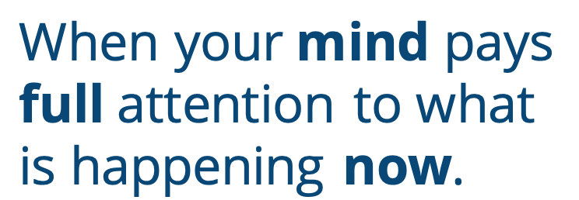
When your mind pays full attention to what is happening now.
Notes:
Instructor Notes:
Ask the class to reassemble and sit on the floor in a circle or semicircle. Join the students by sitting at their level.
Click once to reveal the word Mindful.
Click again and tell students that when you are mindful, your mind pays full attention to what is happening right now – not what happened before or what is happening later. You slow down, take your time, and focus on what you are doing.
Ask students:
Were you able to only think about what you heard, felt, or saw during the opening activity?
Why or why not?
Was it hard not to think about other things?
Explain that if students were able to turn off their thoughts and focus only on what they were hearing, feeling, or seeing, they were being mindful—even if it wasn’t for the entire time! Being mindful takes practice, and every little bit counts.

Slide 4


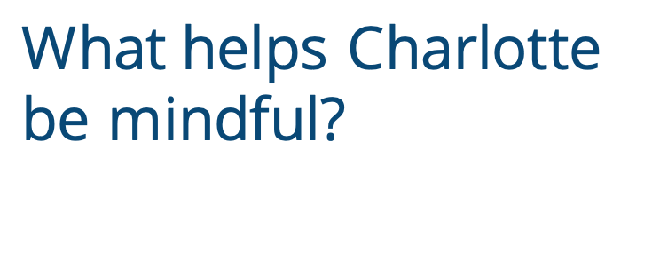
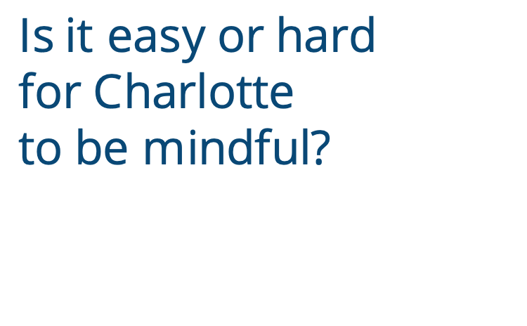
What helps Charlotte be mindful?
Is it easy or hard
for Charlotte
to be mindful?
Notes:
Instructor Notes:
Tell the class that you are about to read a book called Charlotte and the Quiet Place by Deborah Sosin.
Click once, and explain that as you read you would like students to think about whether it is easy or hard for the main character to be mindful.
Begin to read the story or project a version of the video read-aloud (from 1:05 to 9:46).
Partway through—after reading “No!’ Charlotte yells. “I have to find a quiet place!” —ask students to share their answer to your focus question.
Click twice before you continue reading the second half of the book. As you read this time, ask the class to listen for: What helps Charlotte be mindful?
When the story is finished, discuss this second question.
Help students understand that even if Charlotte couldn’t find a spot that was actually quiet, she learned how to be quiet in her mind. When she pictured a quiet place, she could block out everything else, be mindful, and focus on “now.”

Slide 5


What are you thinking about?
Where is your quiet place?
-
-
-
-
-
-
-
-
-
-
-
-
-
-
-
-
Notes:
Instructor Notes:
Acknowledge again that learning how to quiet our mind and focus on what is happening right now is difficult, but it can be done if we try!
Ask students to brainstorm: As you sit here right now, what are you thinking about?
Kick off the brainstorming with something else that may be on your mind—such as a lesson you are going to teach later or a conversation you had with a friend the day before.
As students share their thoughts, record them in the bullets inside the slide’s thought bubble.
Quietly cross off or delete each thought, one at a time. As you do, encourage students to “turn off” these thoughts in their mind.
Click twice and ask students to close their eyes and picture their own quiet place. Explain that this place can be real or imaginary.
As they keep their eyes closed, ask students to explore this quiet place in their mind. What do they see? What do they hear?
Ask students to open their eyes and think-pair-share* their answer to: How do you feel right now?
*In a think-pair-share, students think about the question independently, discuss their answers with a partner, and then share their thoughts with the larger class.
Explain that when we can block out all the other noise and thoughts in our minds, it becomes a lot easier to think about our own feelings.
Distribute one small square from Handout 1: My Quiet Place to students, and instruct them to spend the next five minutes drawing a picture of the quiet place they just envisioned in their mind. Explain that students will use this image to help them find their quiet place in the future!
As they finish, have students use masking tape to secure the image to their desk or another location where they will see it frequently.
Moving forward, remind students to glance at their drawing and close their eyes whenever they need to refocus.

Slide 6
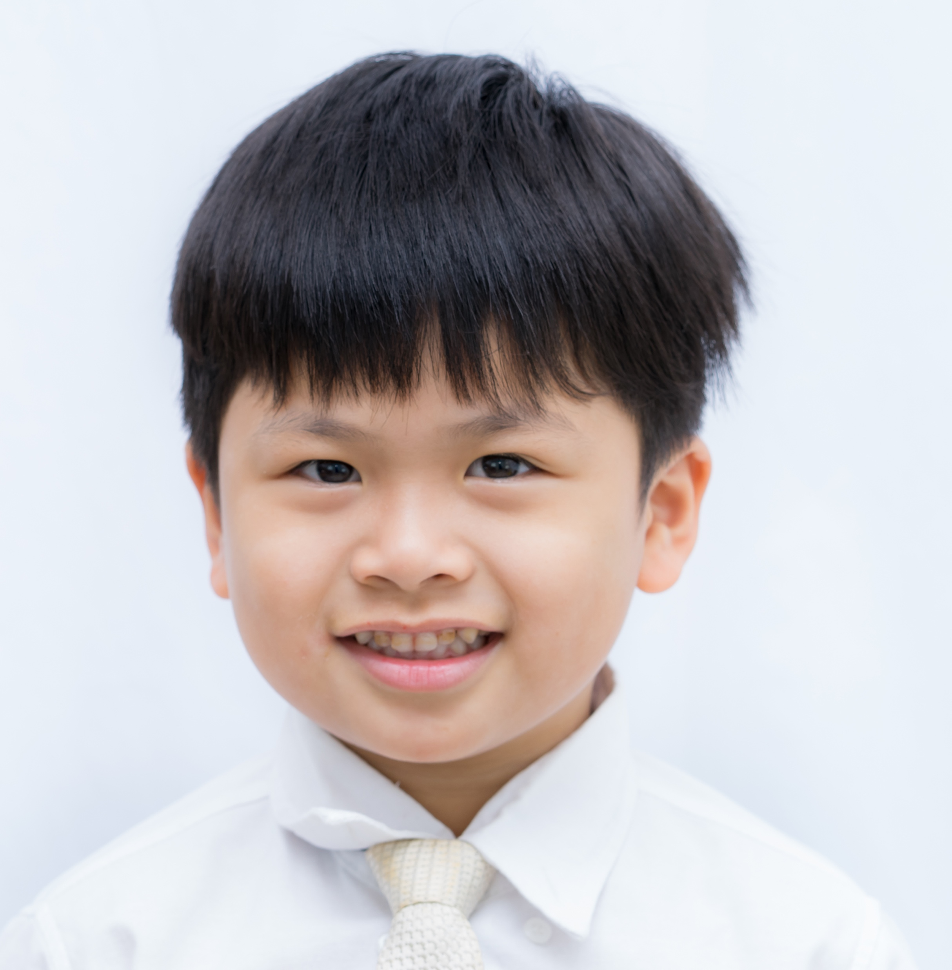

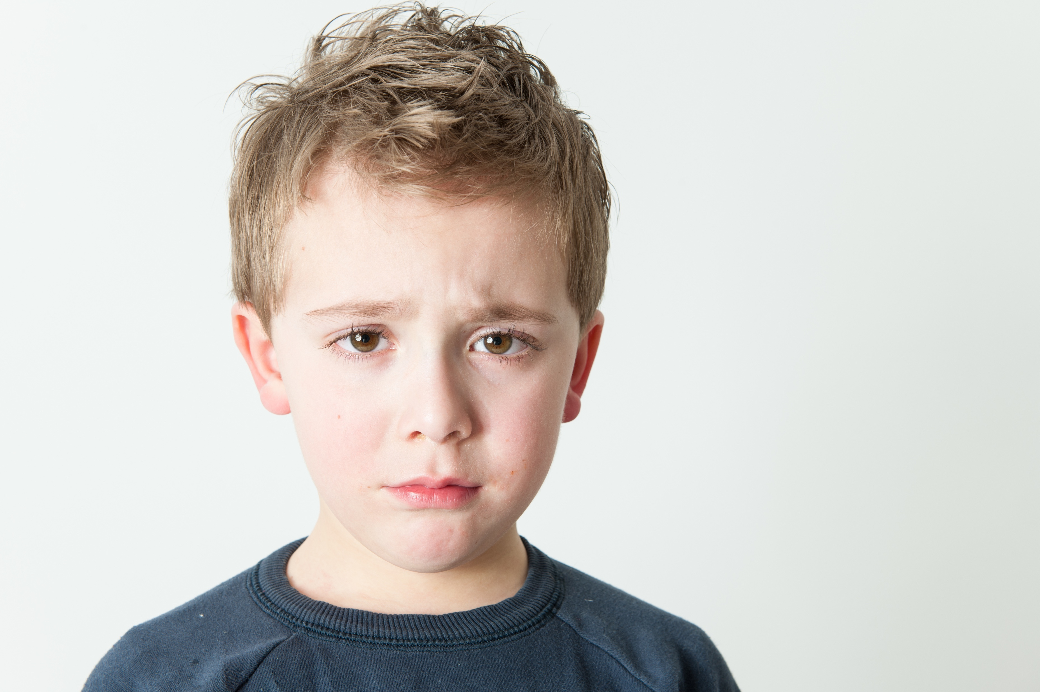
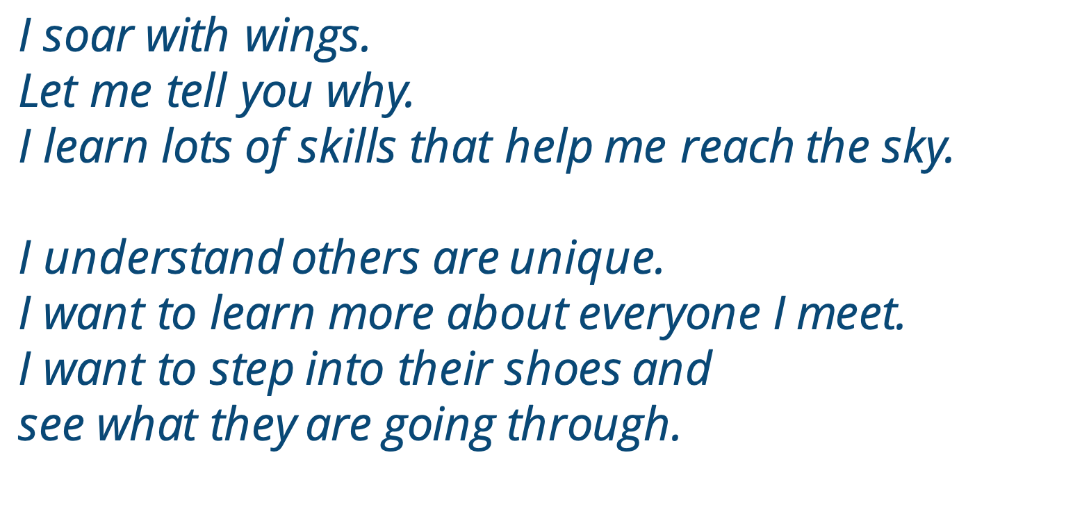
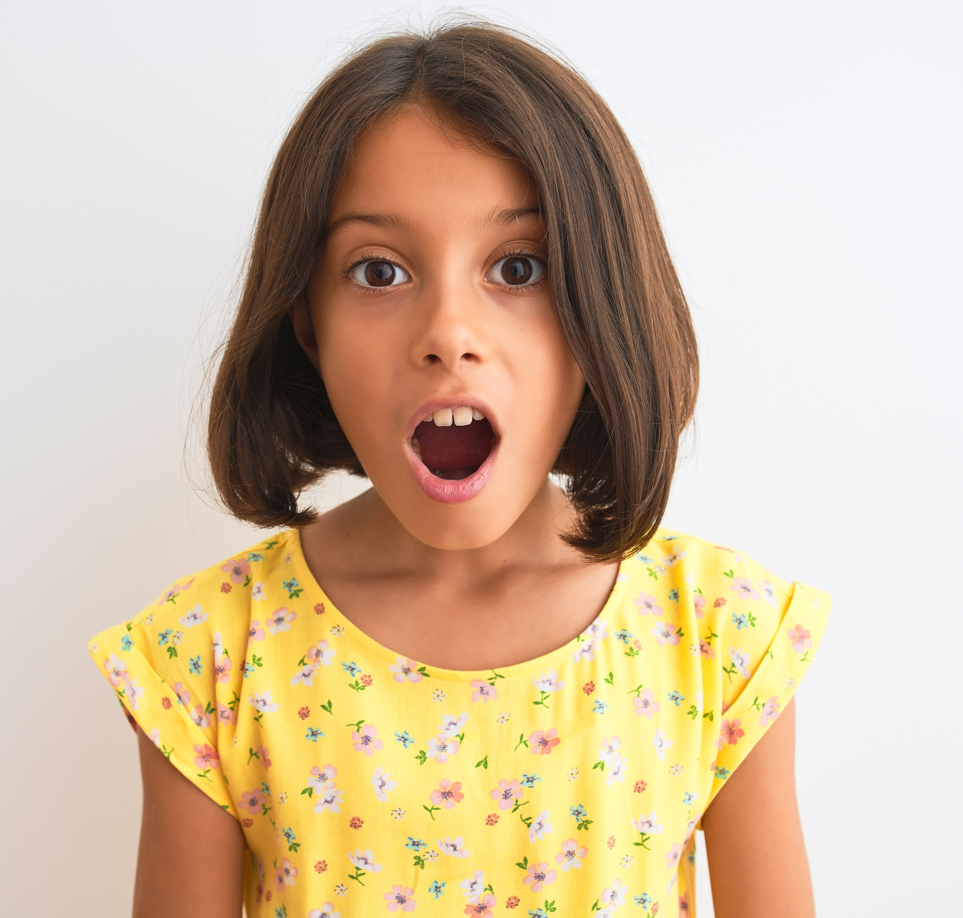
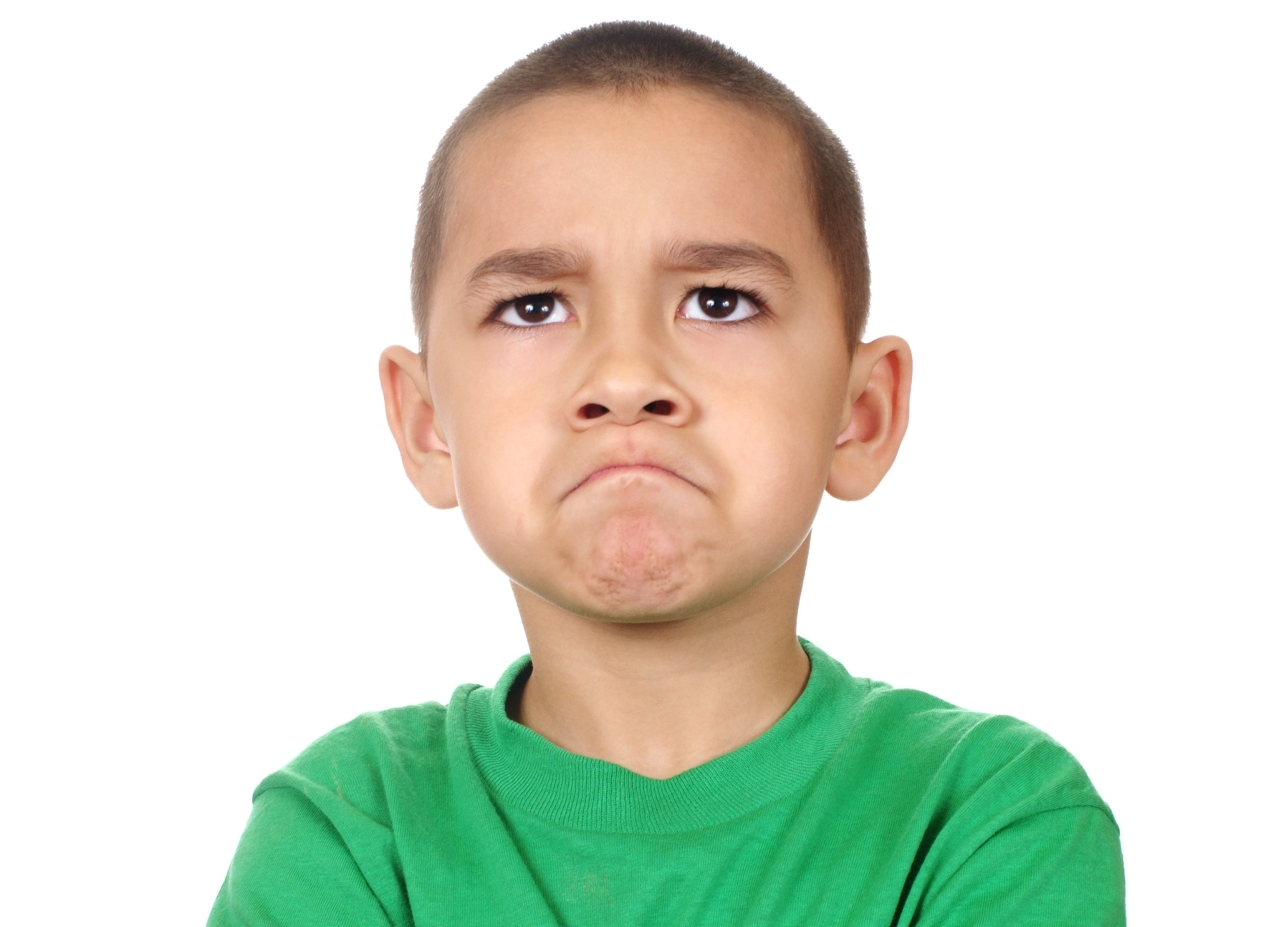
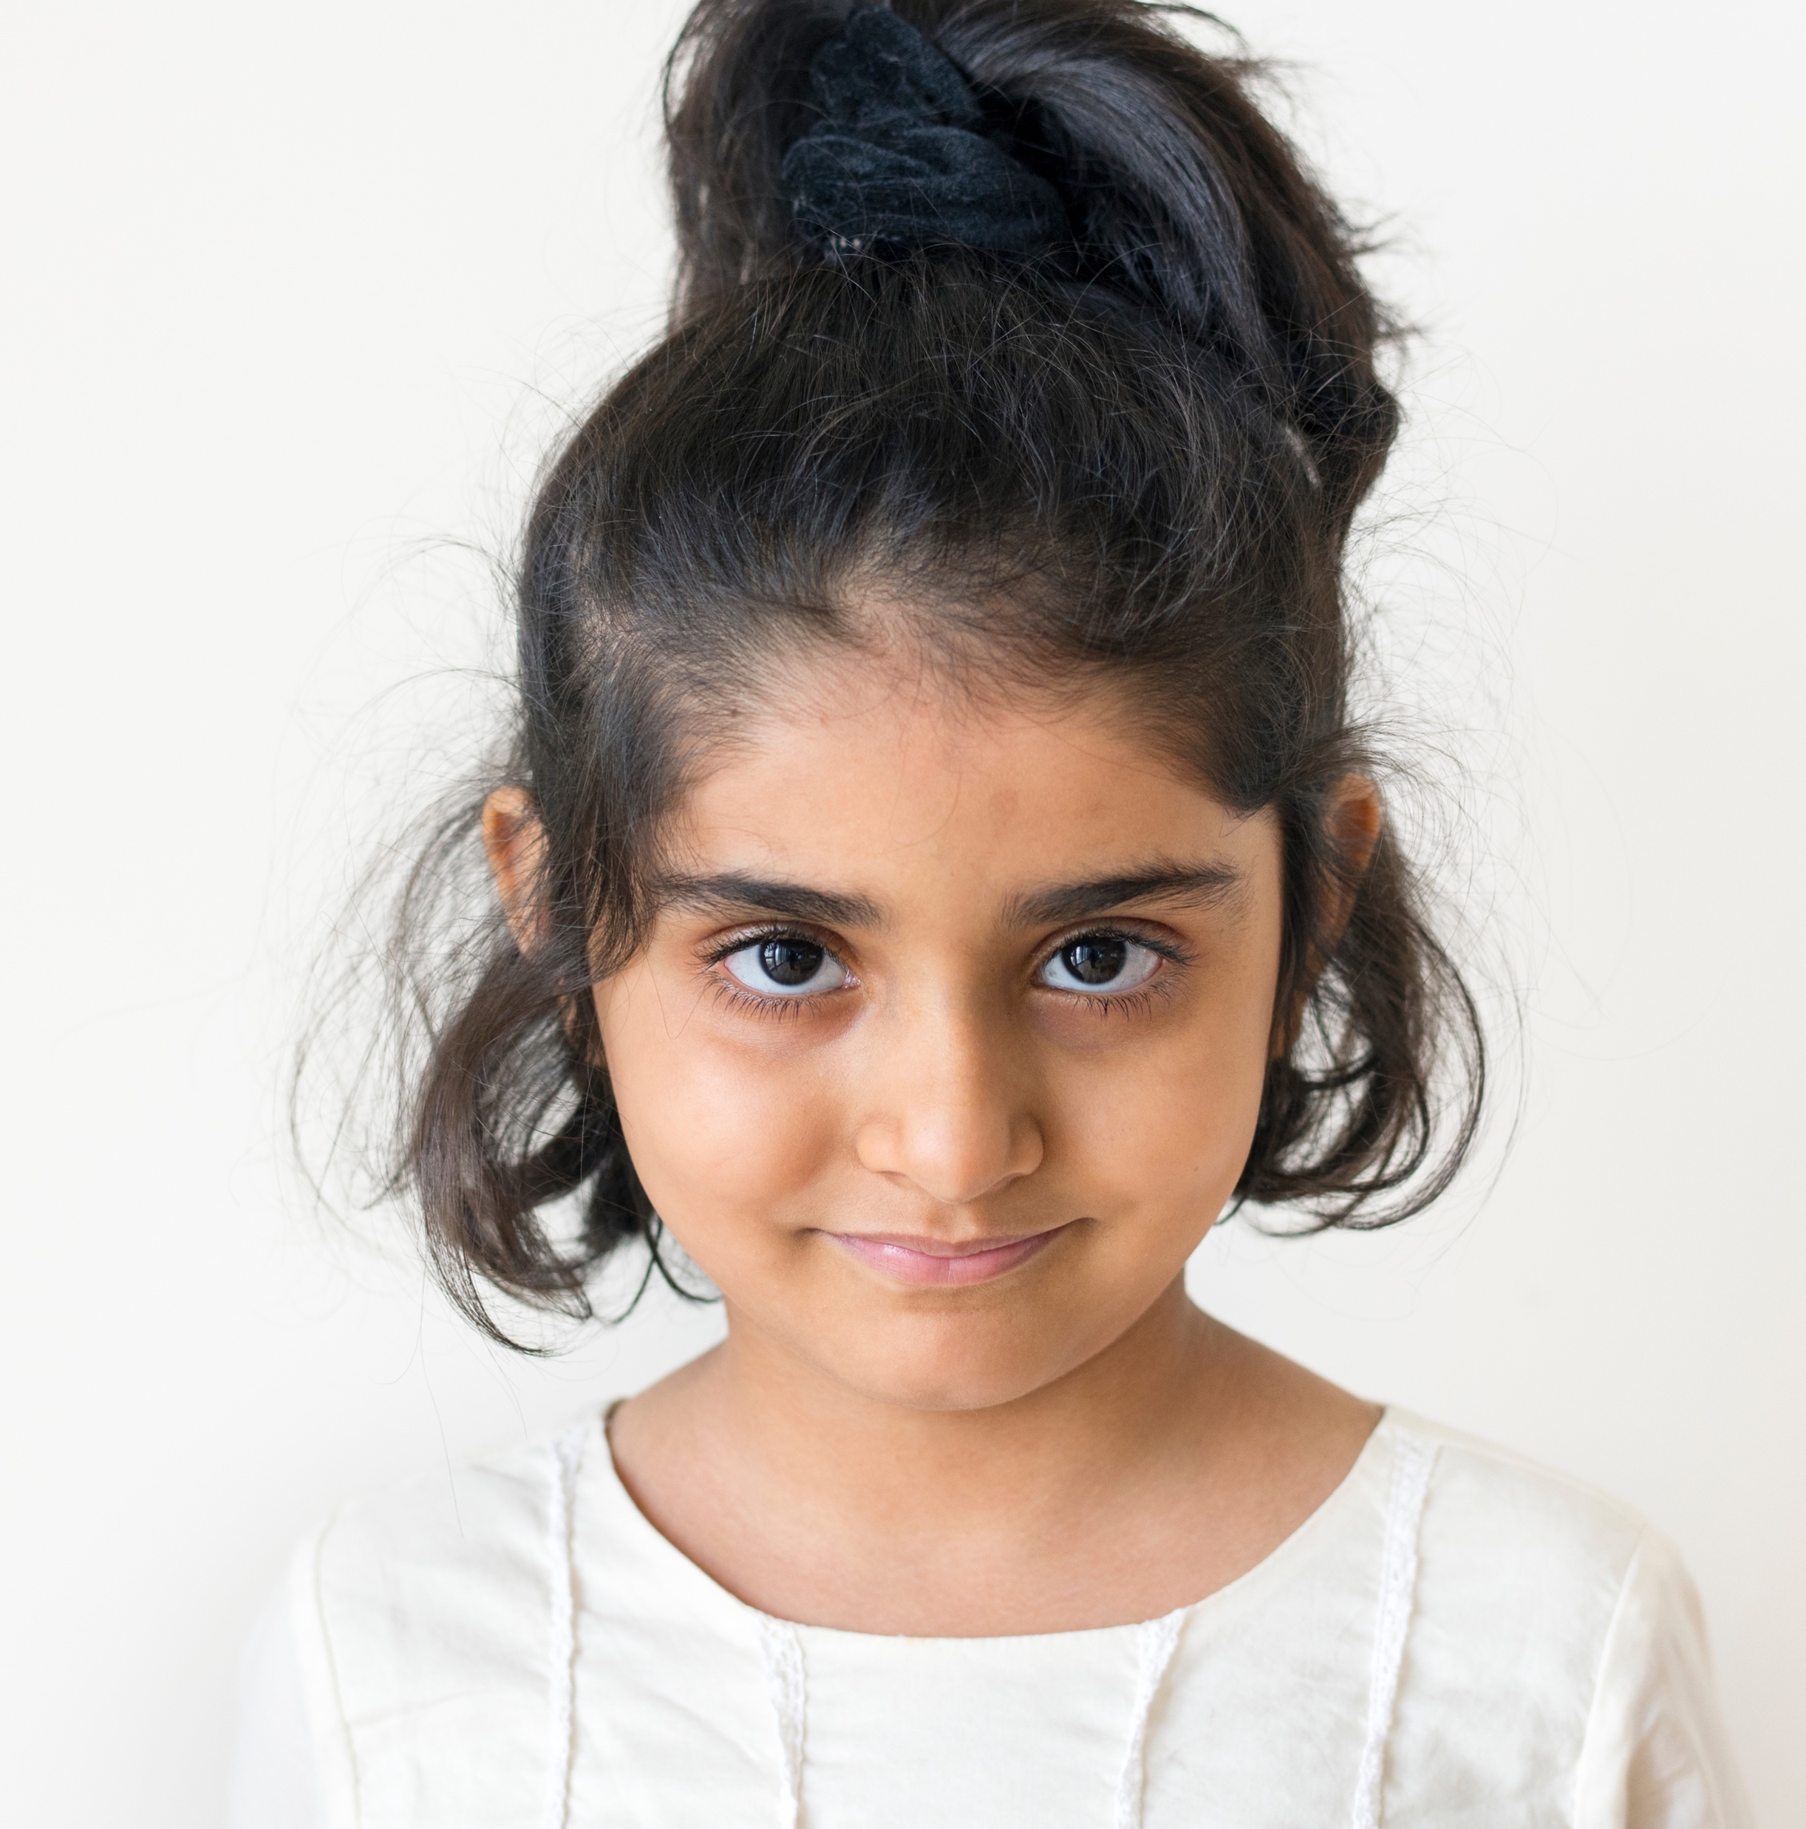

I soar with wings.
Let me tell you why.
I learn lots of skills that help me reach the sky.
I understand others are unique.
I want to learn more about everyone I meet.
I want to step into their shoes and
see what they are going through.
Notes:
Instructor Notes:
Bring the class back to a circle or semi-circle and click to display and read the Words to Live By excerpt aloud.
Explain that students are about to see how being mindful can help them better understand others, learn more about everyone they meet, step into others’ shoes, and understand what they are going through.

Slide 7

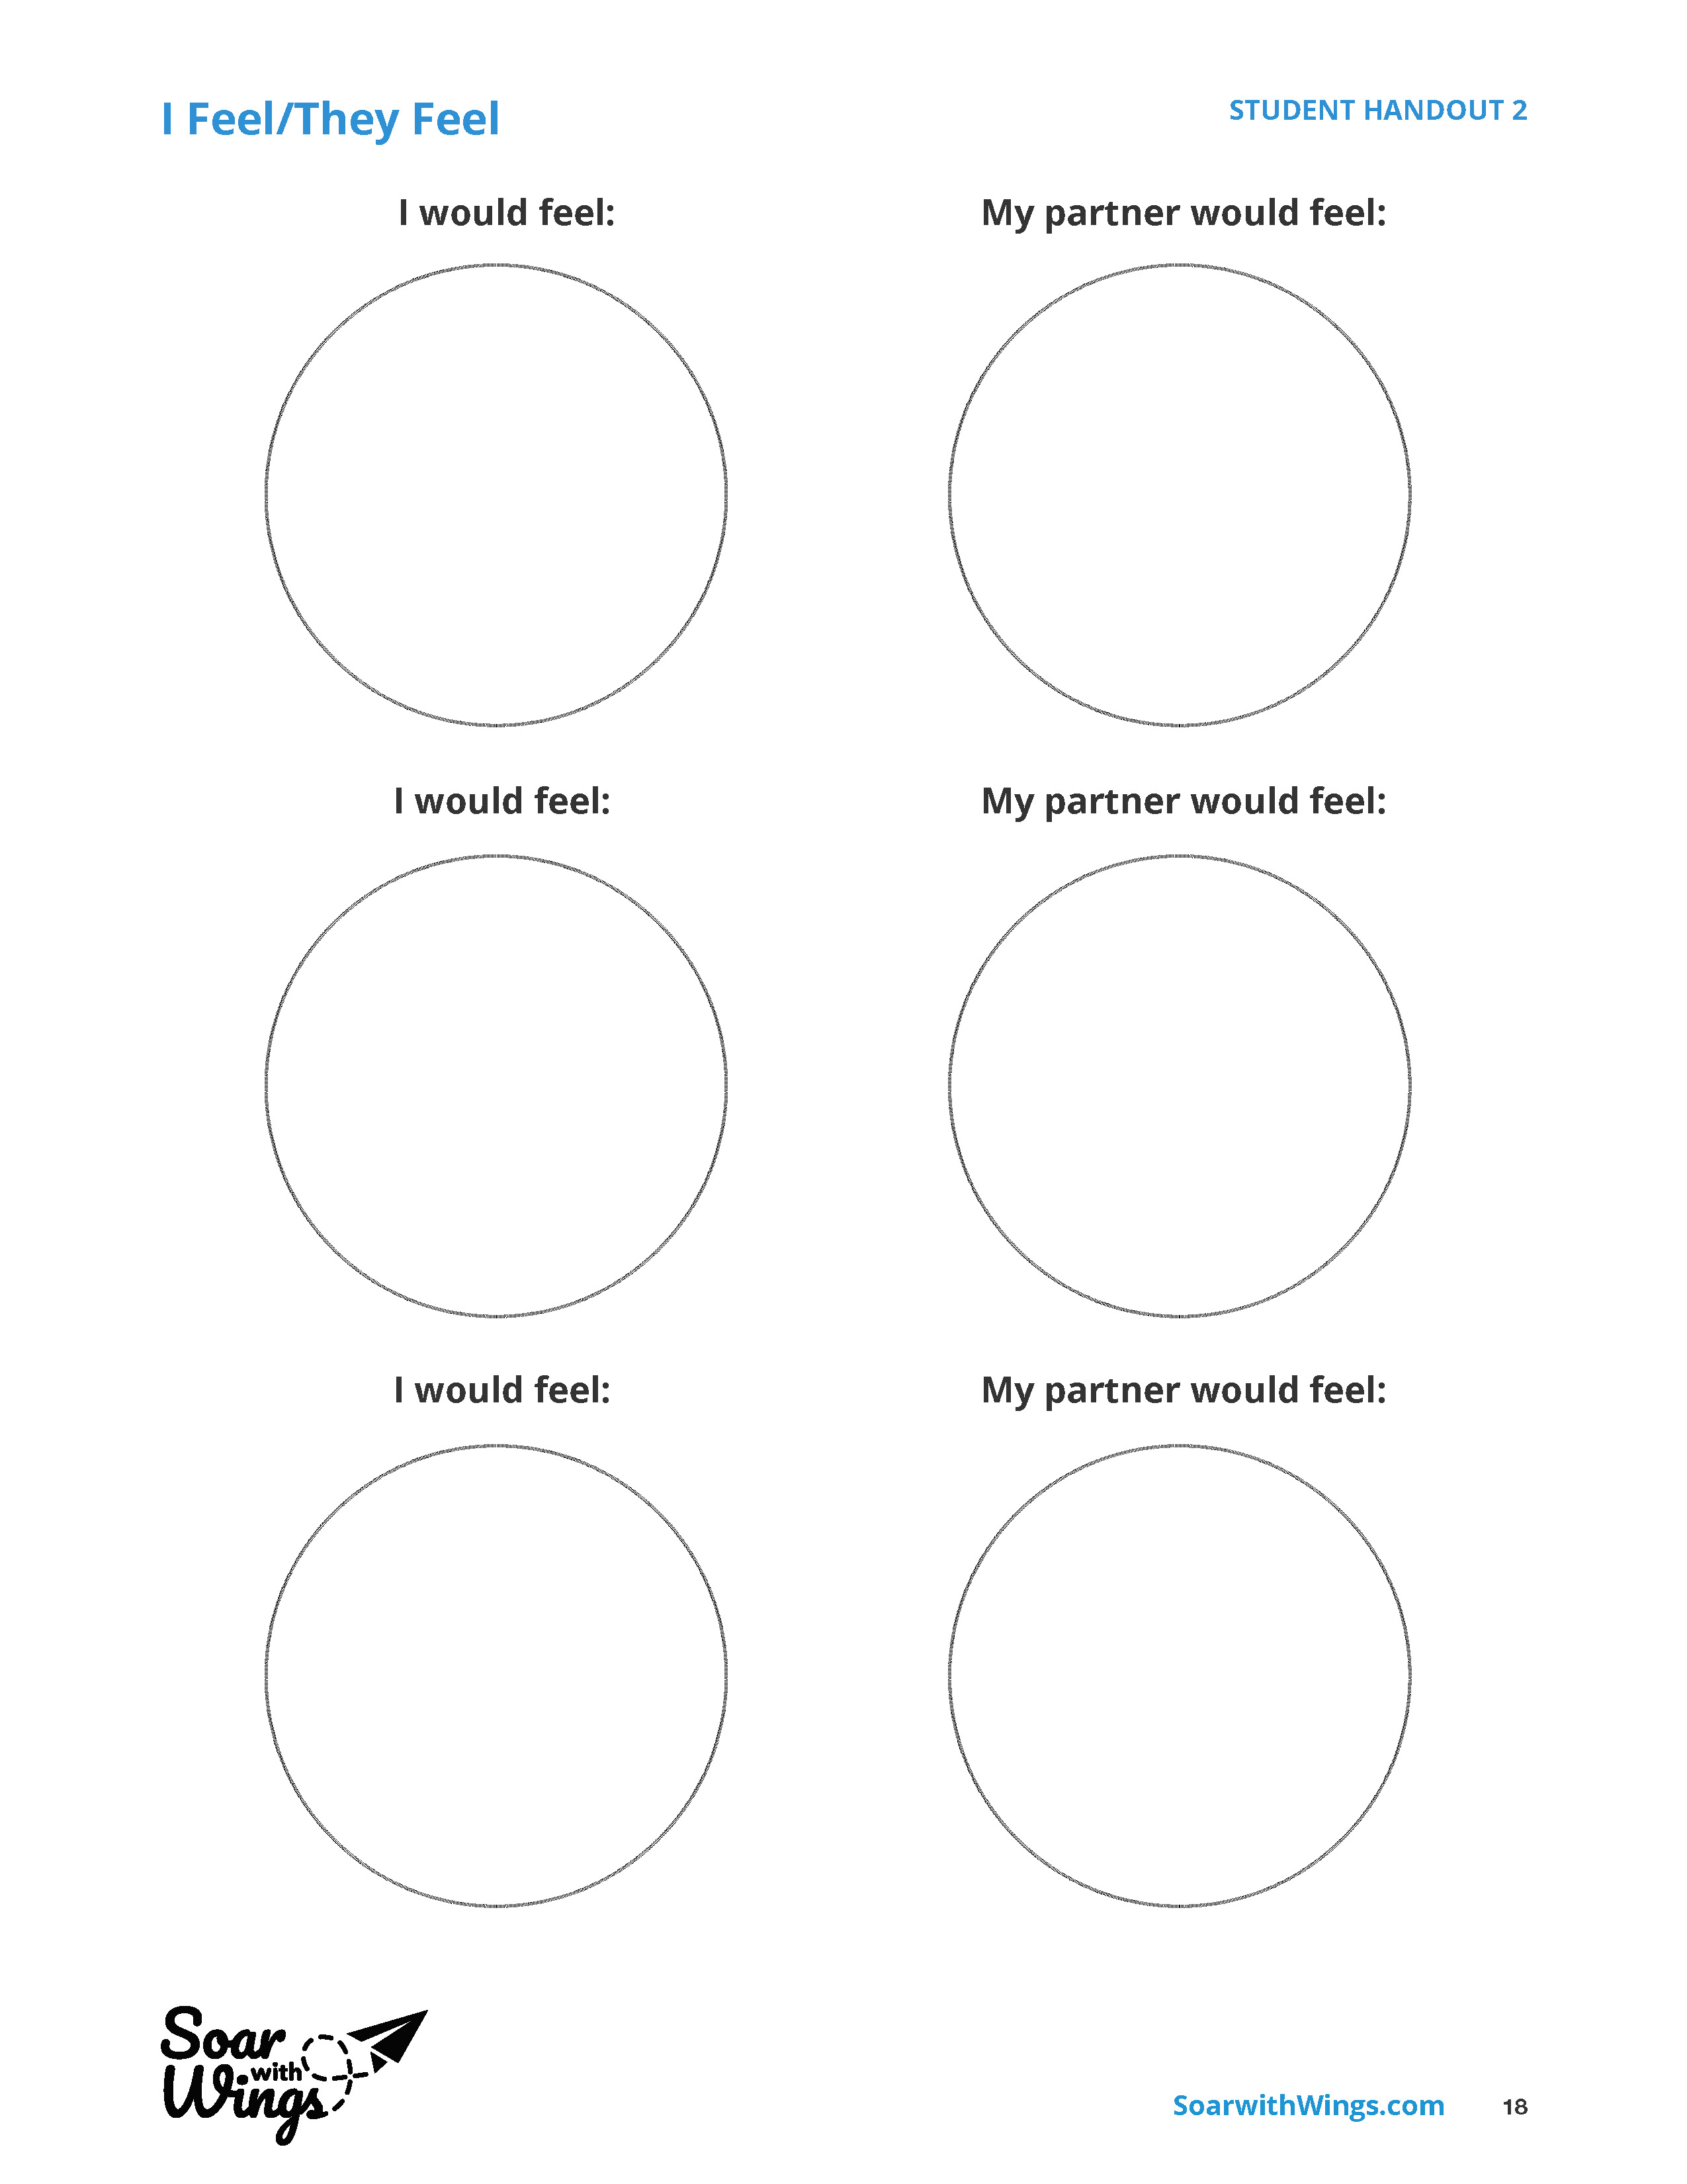
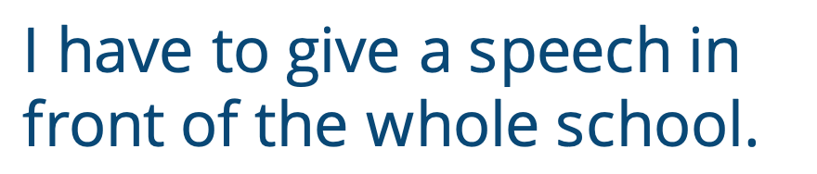
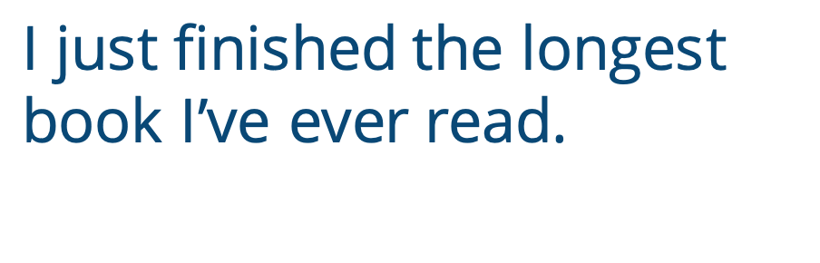
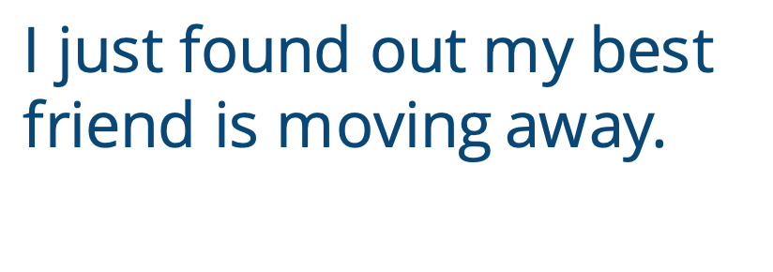
I have to give a speech in front of the whole school.
I just finished the longest book I’ve ever read.
I just found out my best friend is moving away.
Notes:
Instructor Notes:
Pair all students with a partner, and instruct pairs to sit back-to-back.
Distribute one Handout 2: I Feel/They Feel to each student.
Explain that you are about to describe a few different situations. As you do, students should close their eyes, quiet their thoughts, be mindful, and focus on how they may feel if they were in this situation.
Ask students to close their eyes as you click and read: I just found out my best friend is moving away.
After focusing their thoughts, ask students to open their eyes and draw a face on their handout that illustrates how they would feel if they were in this situation.
Instruct the pairs to turn their bodies around and face each other.
Each student should:
Share the face that they drew and explain why they would feel this way if their best friend moved away.
Draw a picture in the handout’s second column that illustrates how their partner said they would feel in this situation.
Click twice to repeat with each of the following two scenarios:
I just finished the longest book I’ve ever read.
I have to give a speech in front of the whole school.

Slide 8
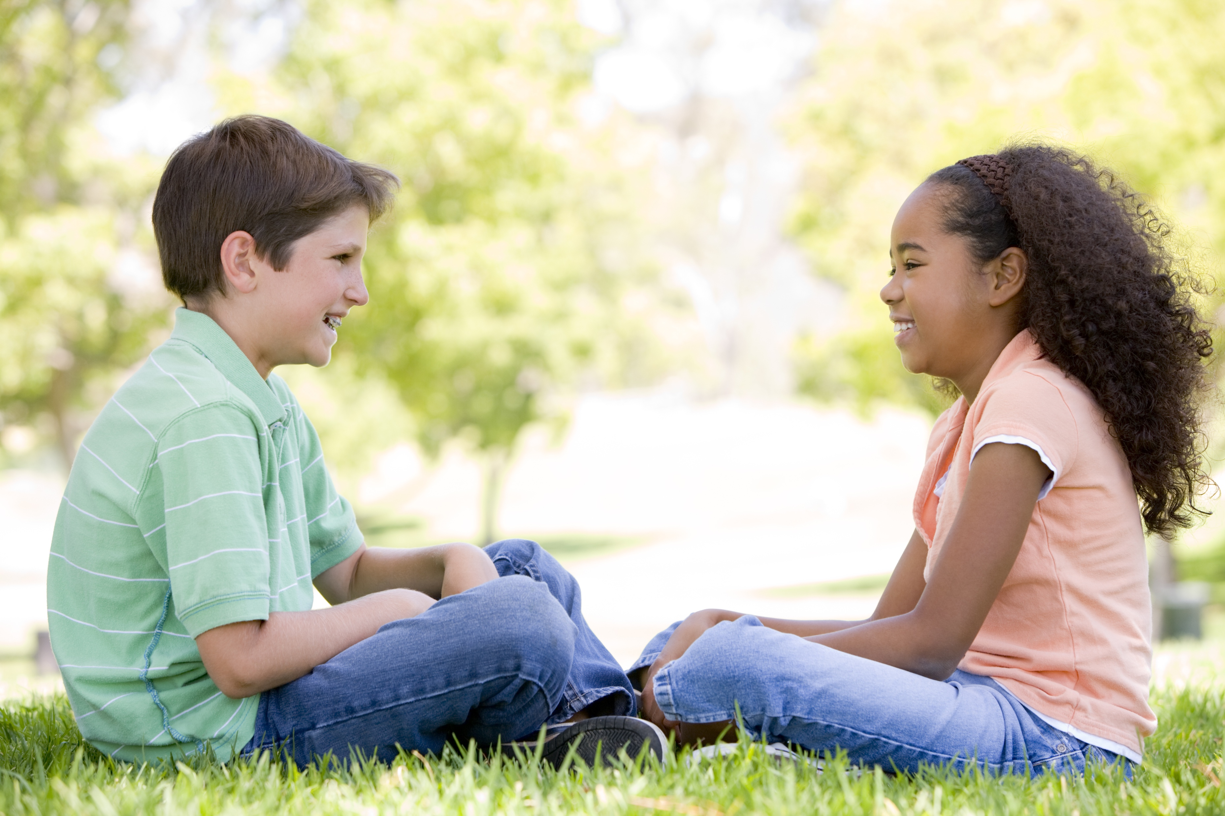
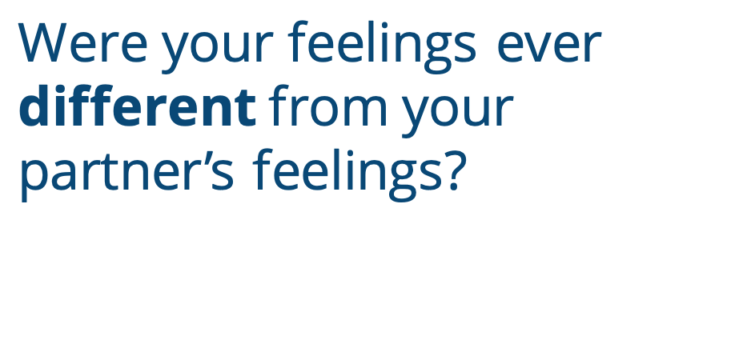
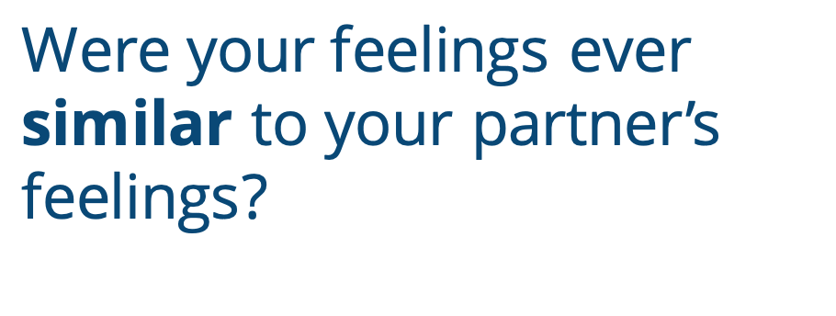
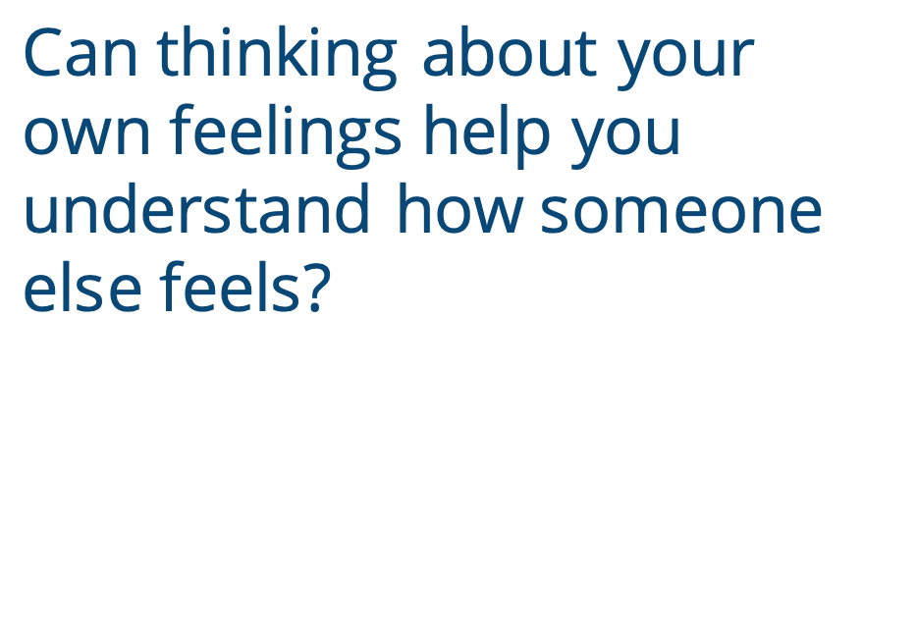
Were your feelings ever similar to your partner’s feelings?
Were your feelings ever different from your partner’s feelings?
Can thinking about your own feelings help you understand how someone else feels?
Notes:
Instructor Notes:
Bring the class back together to discuss the activity.
Ask:
Were your feelings ever similar to (or like) your partner’s feelings?
Click twice.
Were your feelings ever different from your partner’s feelings?
Click twice.
Can thinking about your own feelings help you understand how someone else feels?
Be sure students understand that while everyone is different and unique in their own way, we also have some similarities. Being mindful of our own feelings can help us begin to think about why others feel the way they do—even if they feel differently!

Slide 9
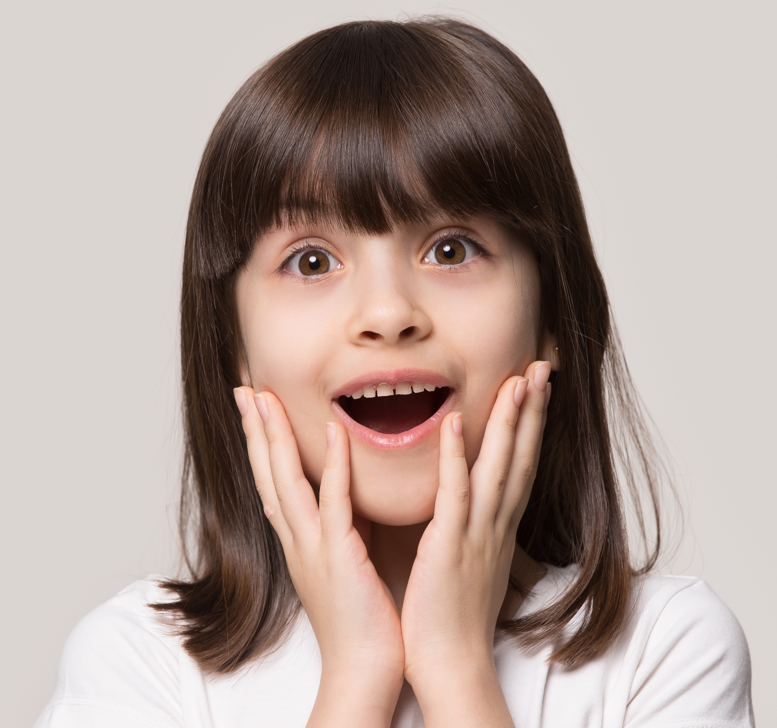
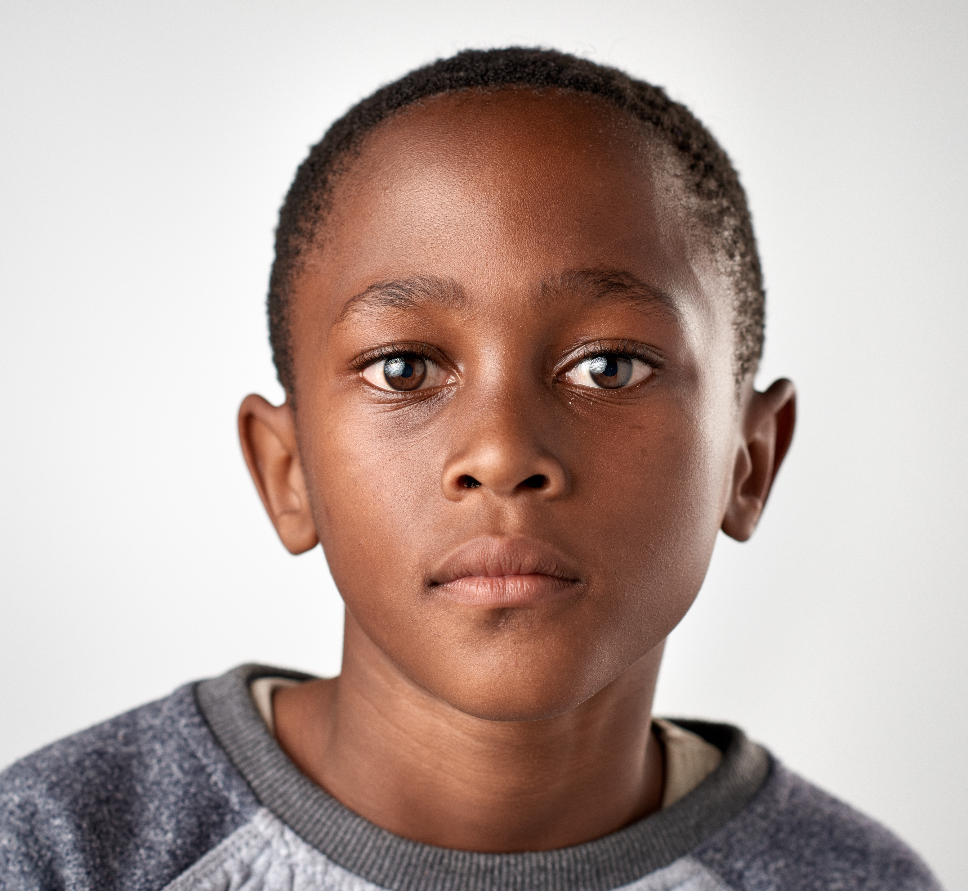

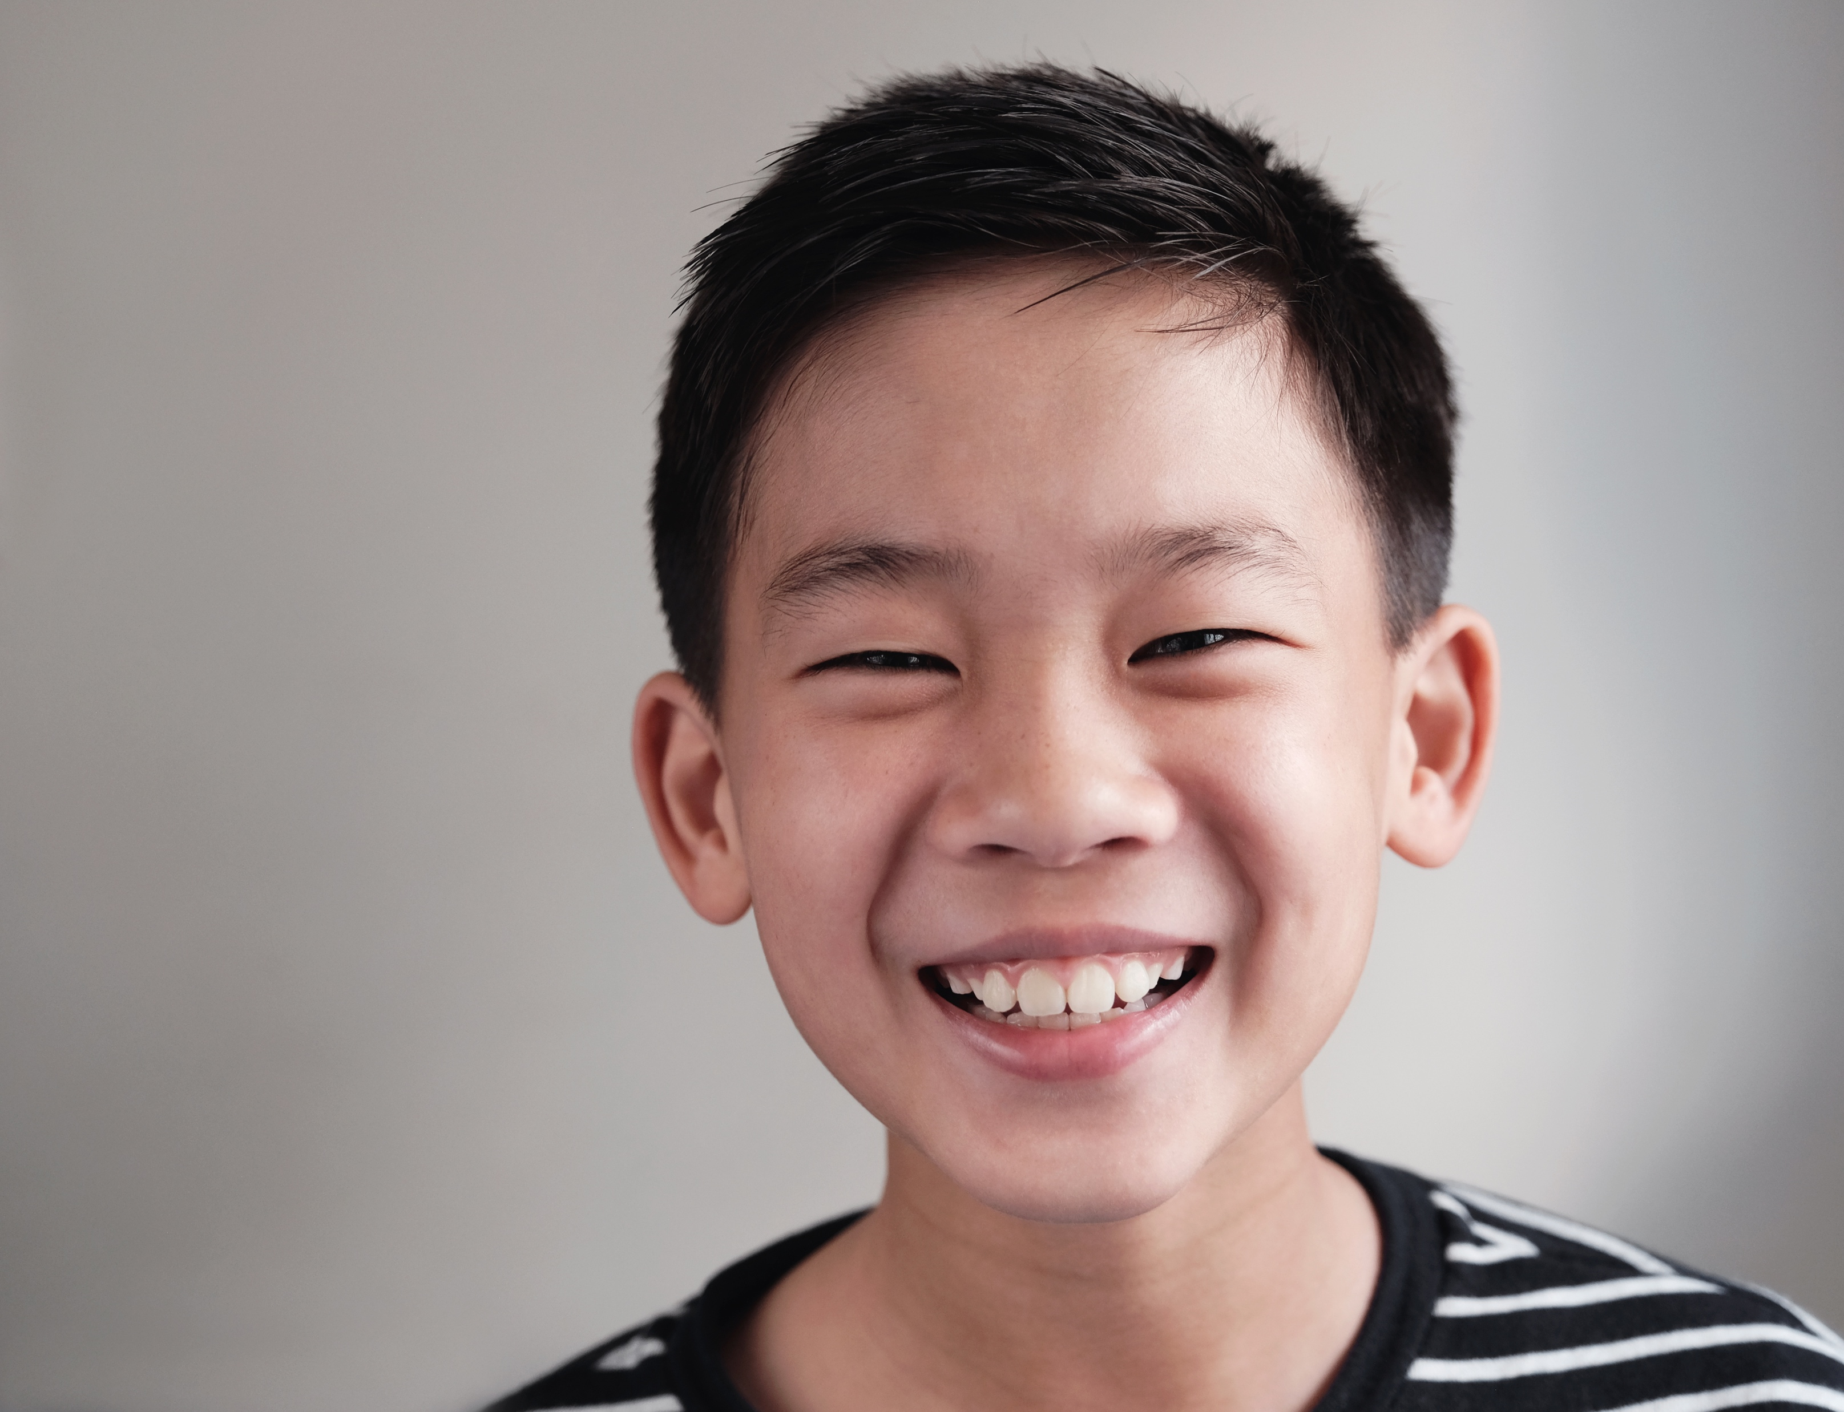
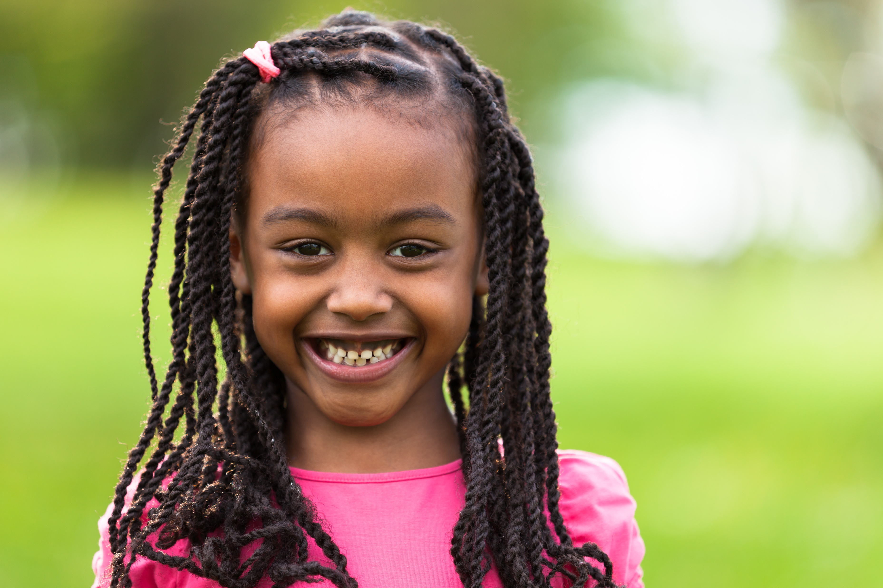


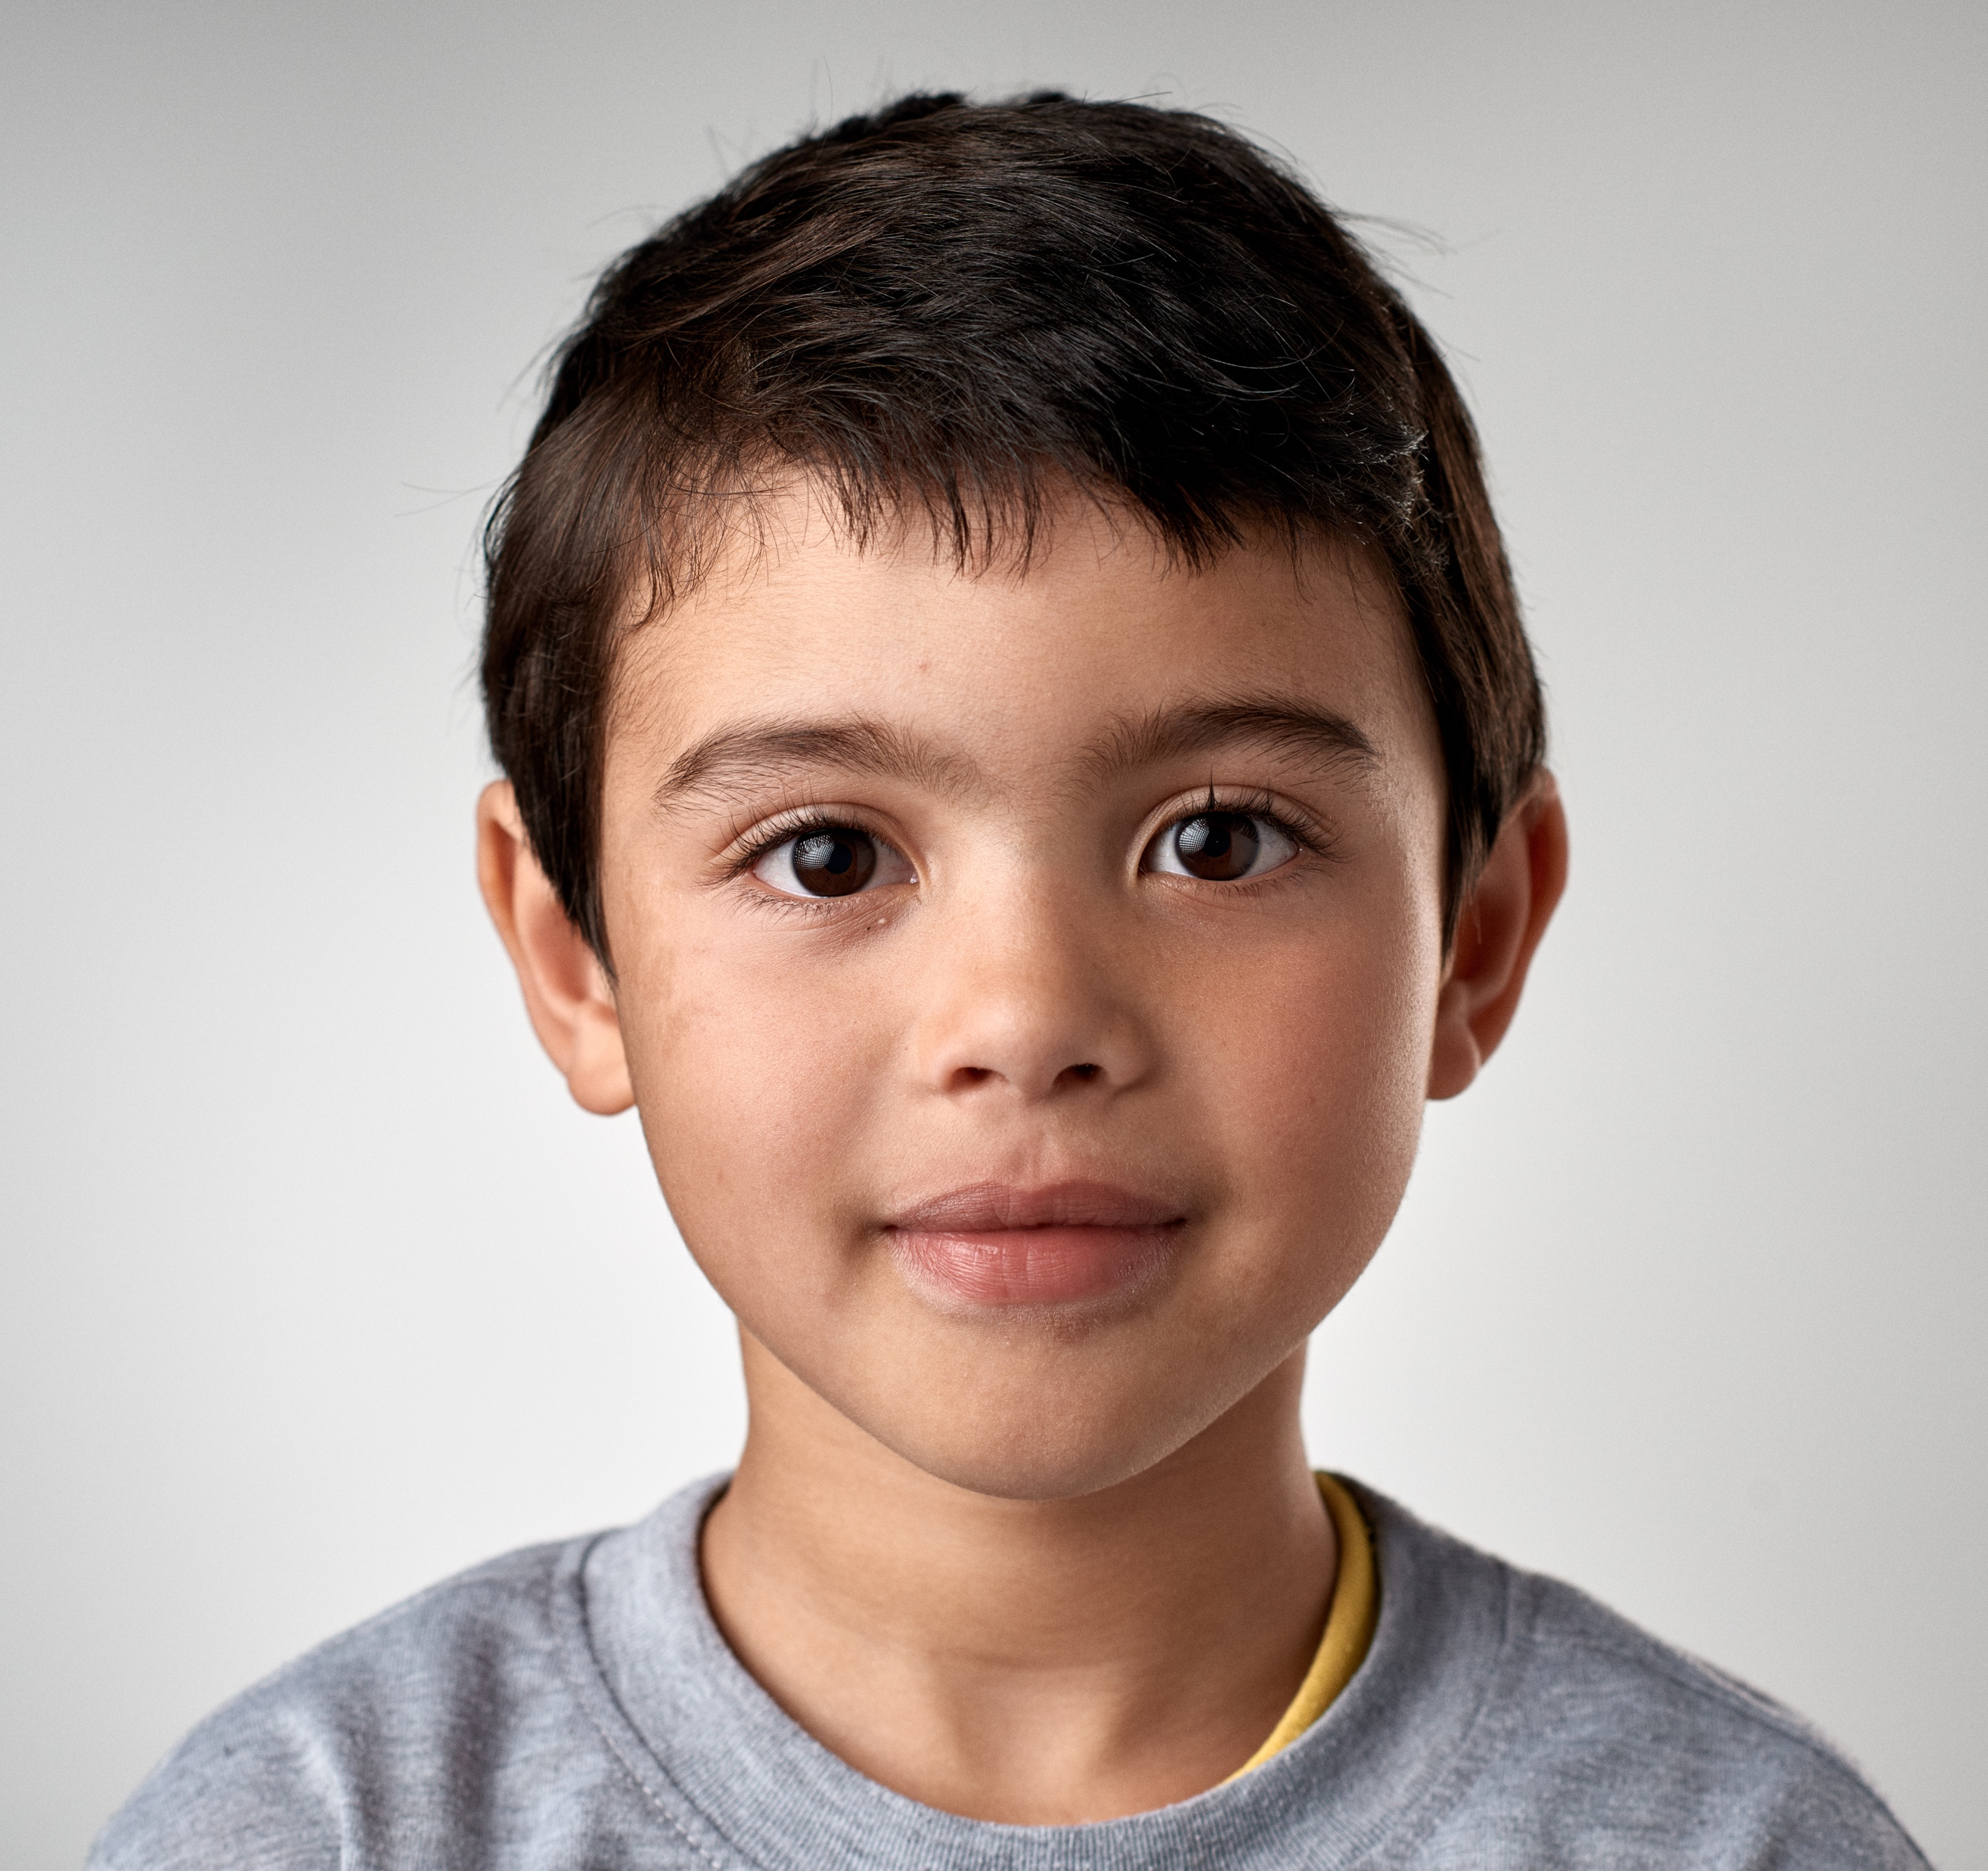
Notes:
Instructor Notes:
Begin the second session by asking the class to sit on the floor in a circle or semicircle and join the students by sitting at their level.
Read the Words to Live By excerpt aloud:
I soar with wings.
Let me tell you why.
I learn lots of skills that help me reach the sky.
I understand others are unique.
I want to learn more about everyone I meet.
I want to step into their shoes and
see what they are going through.
Click once and ask students: What does it mean to be unique?
Review and/or explain that when you are unique, you are one of a kind! Even though you may have similarities that make you like other people, you also have unique qualities that make you different!

Slide 10




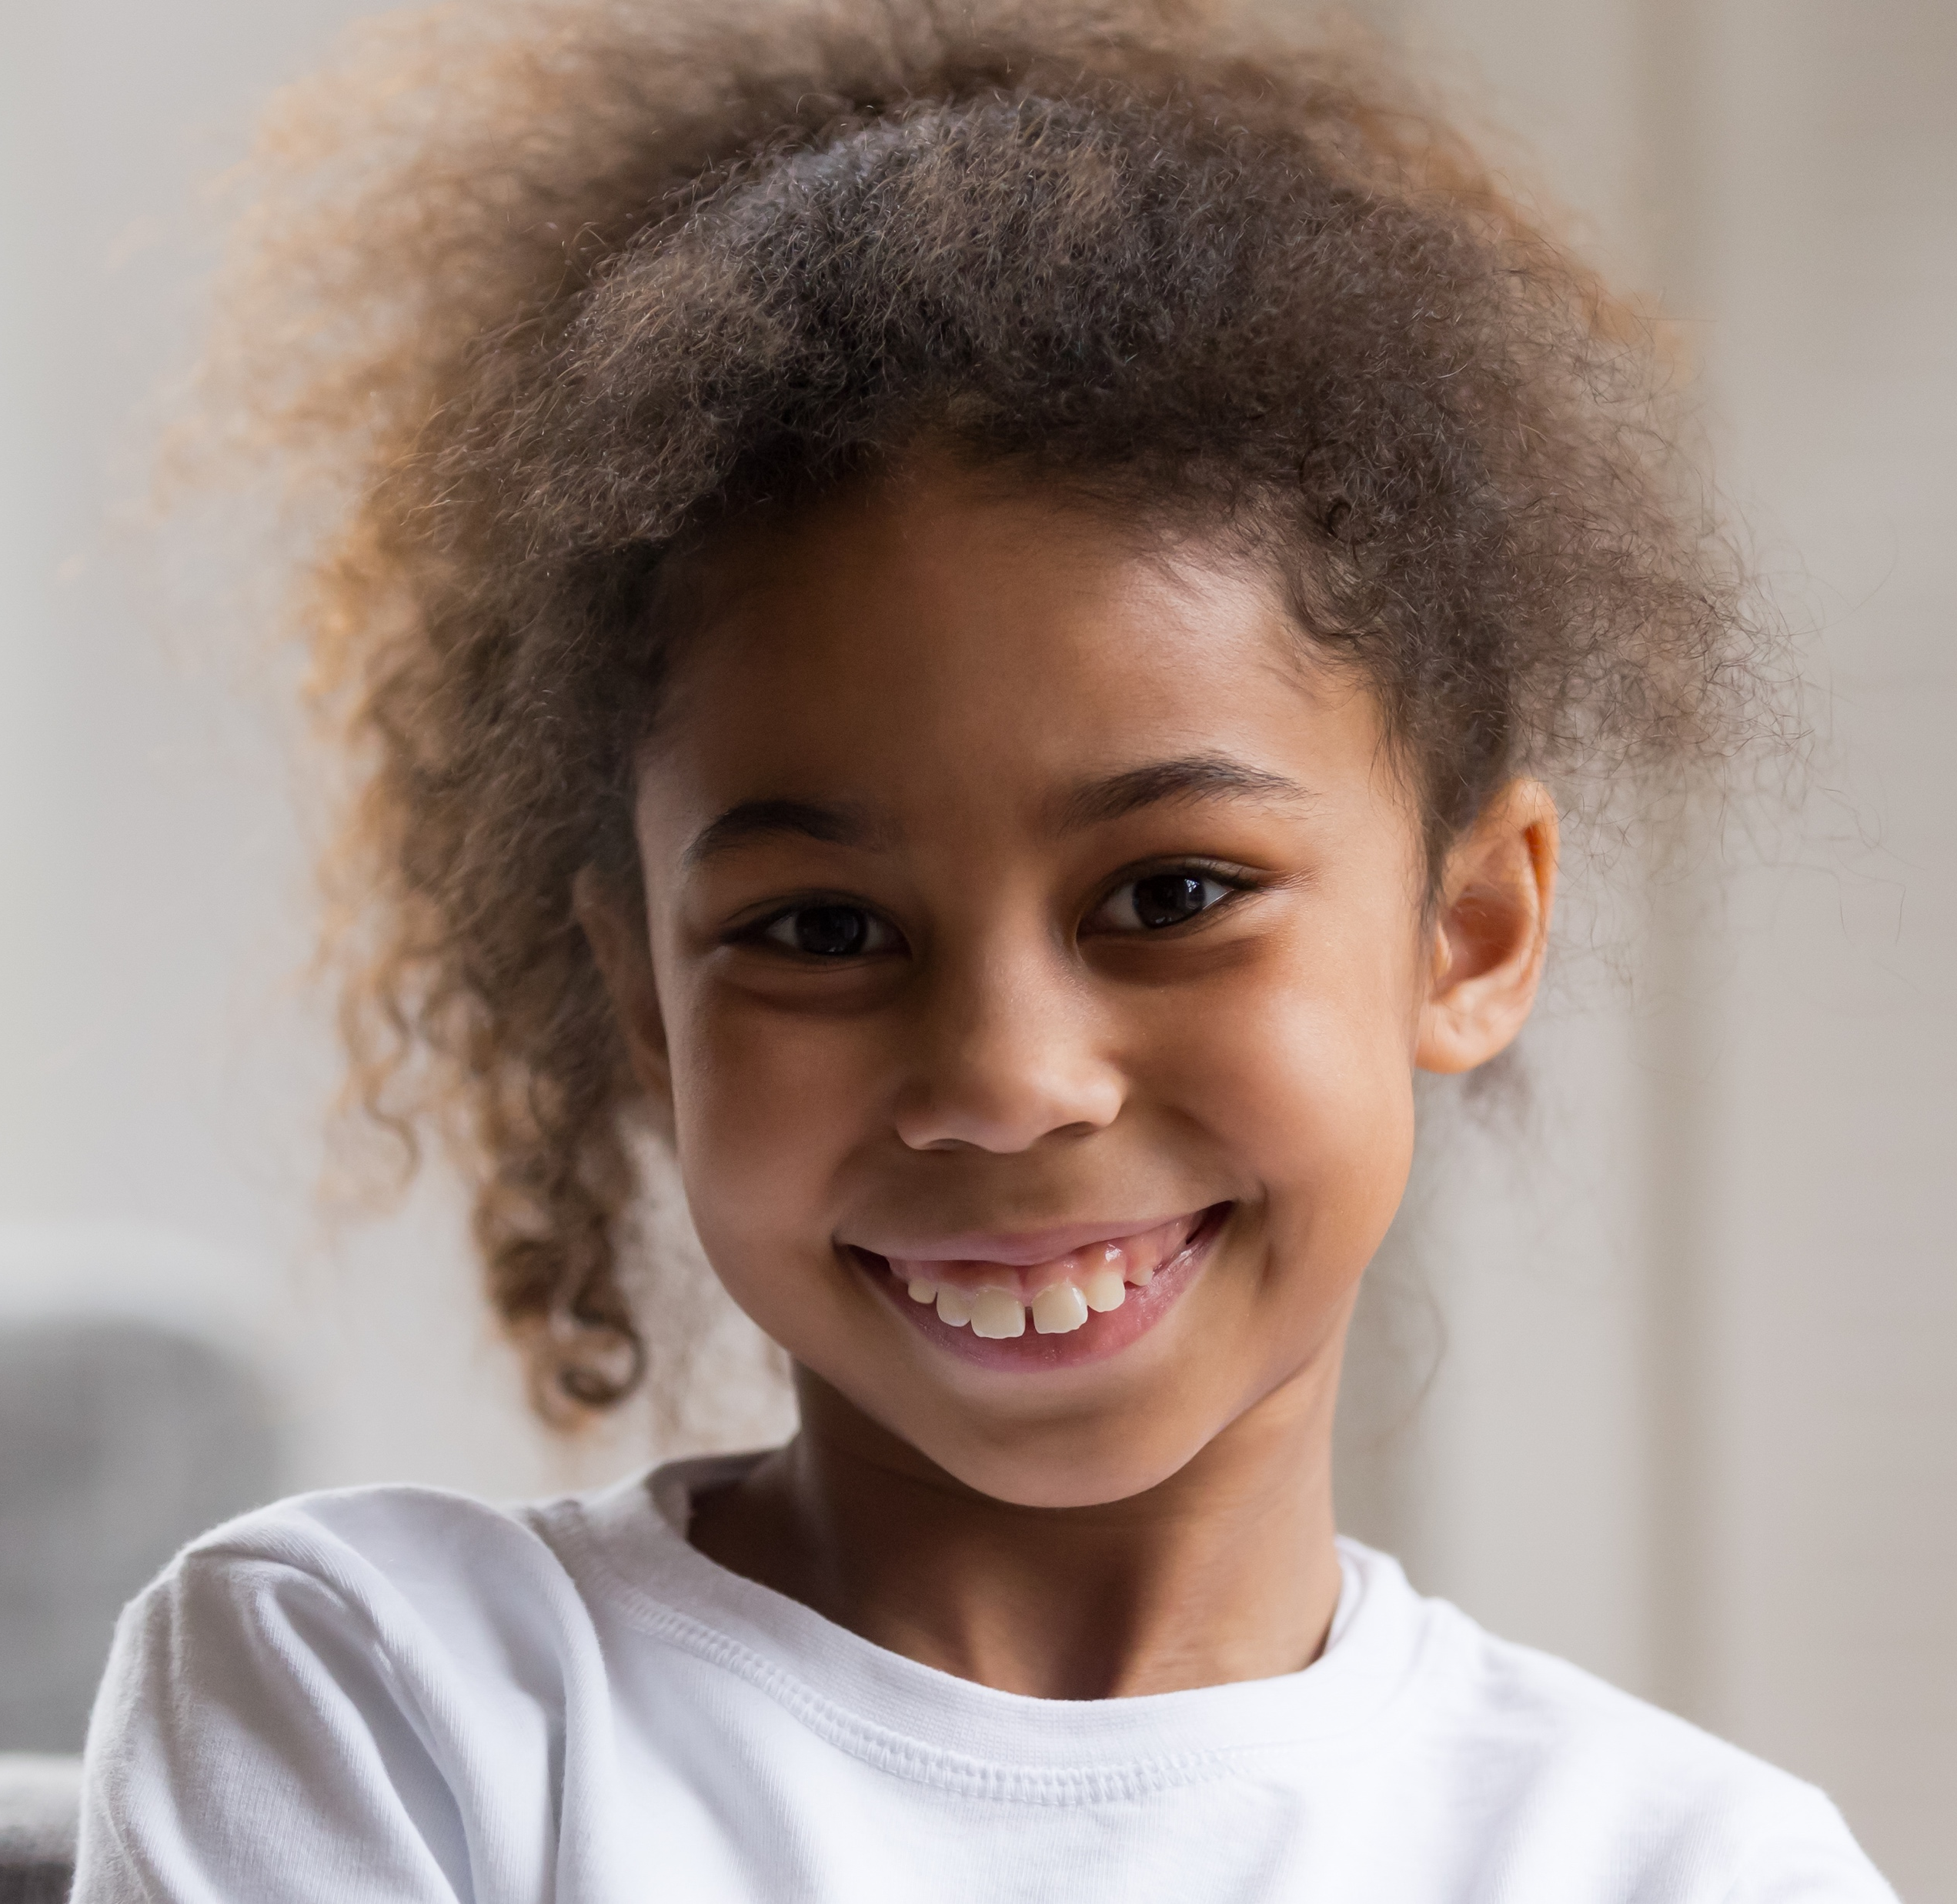




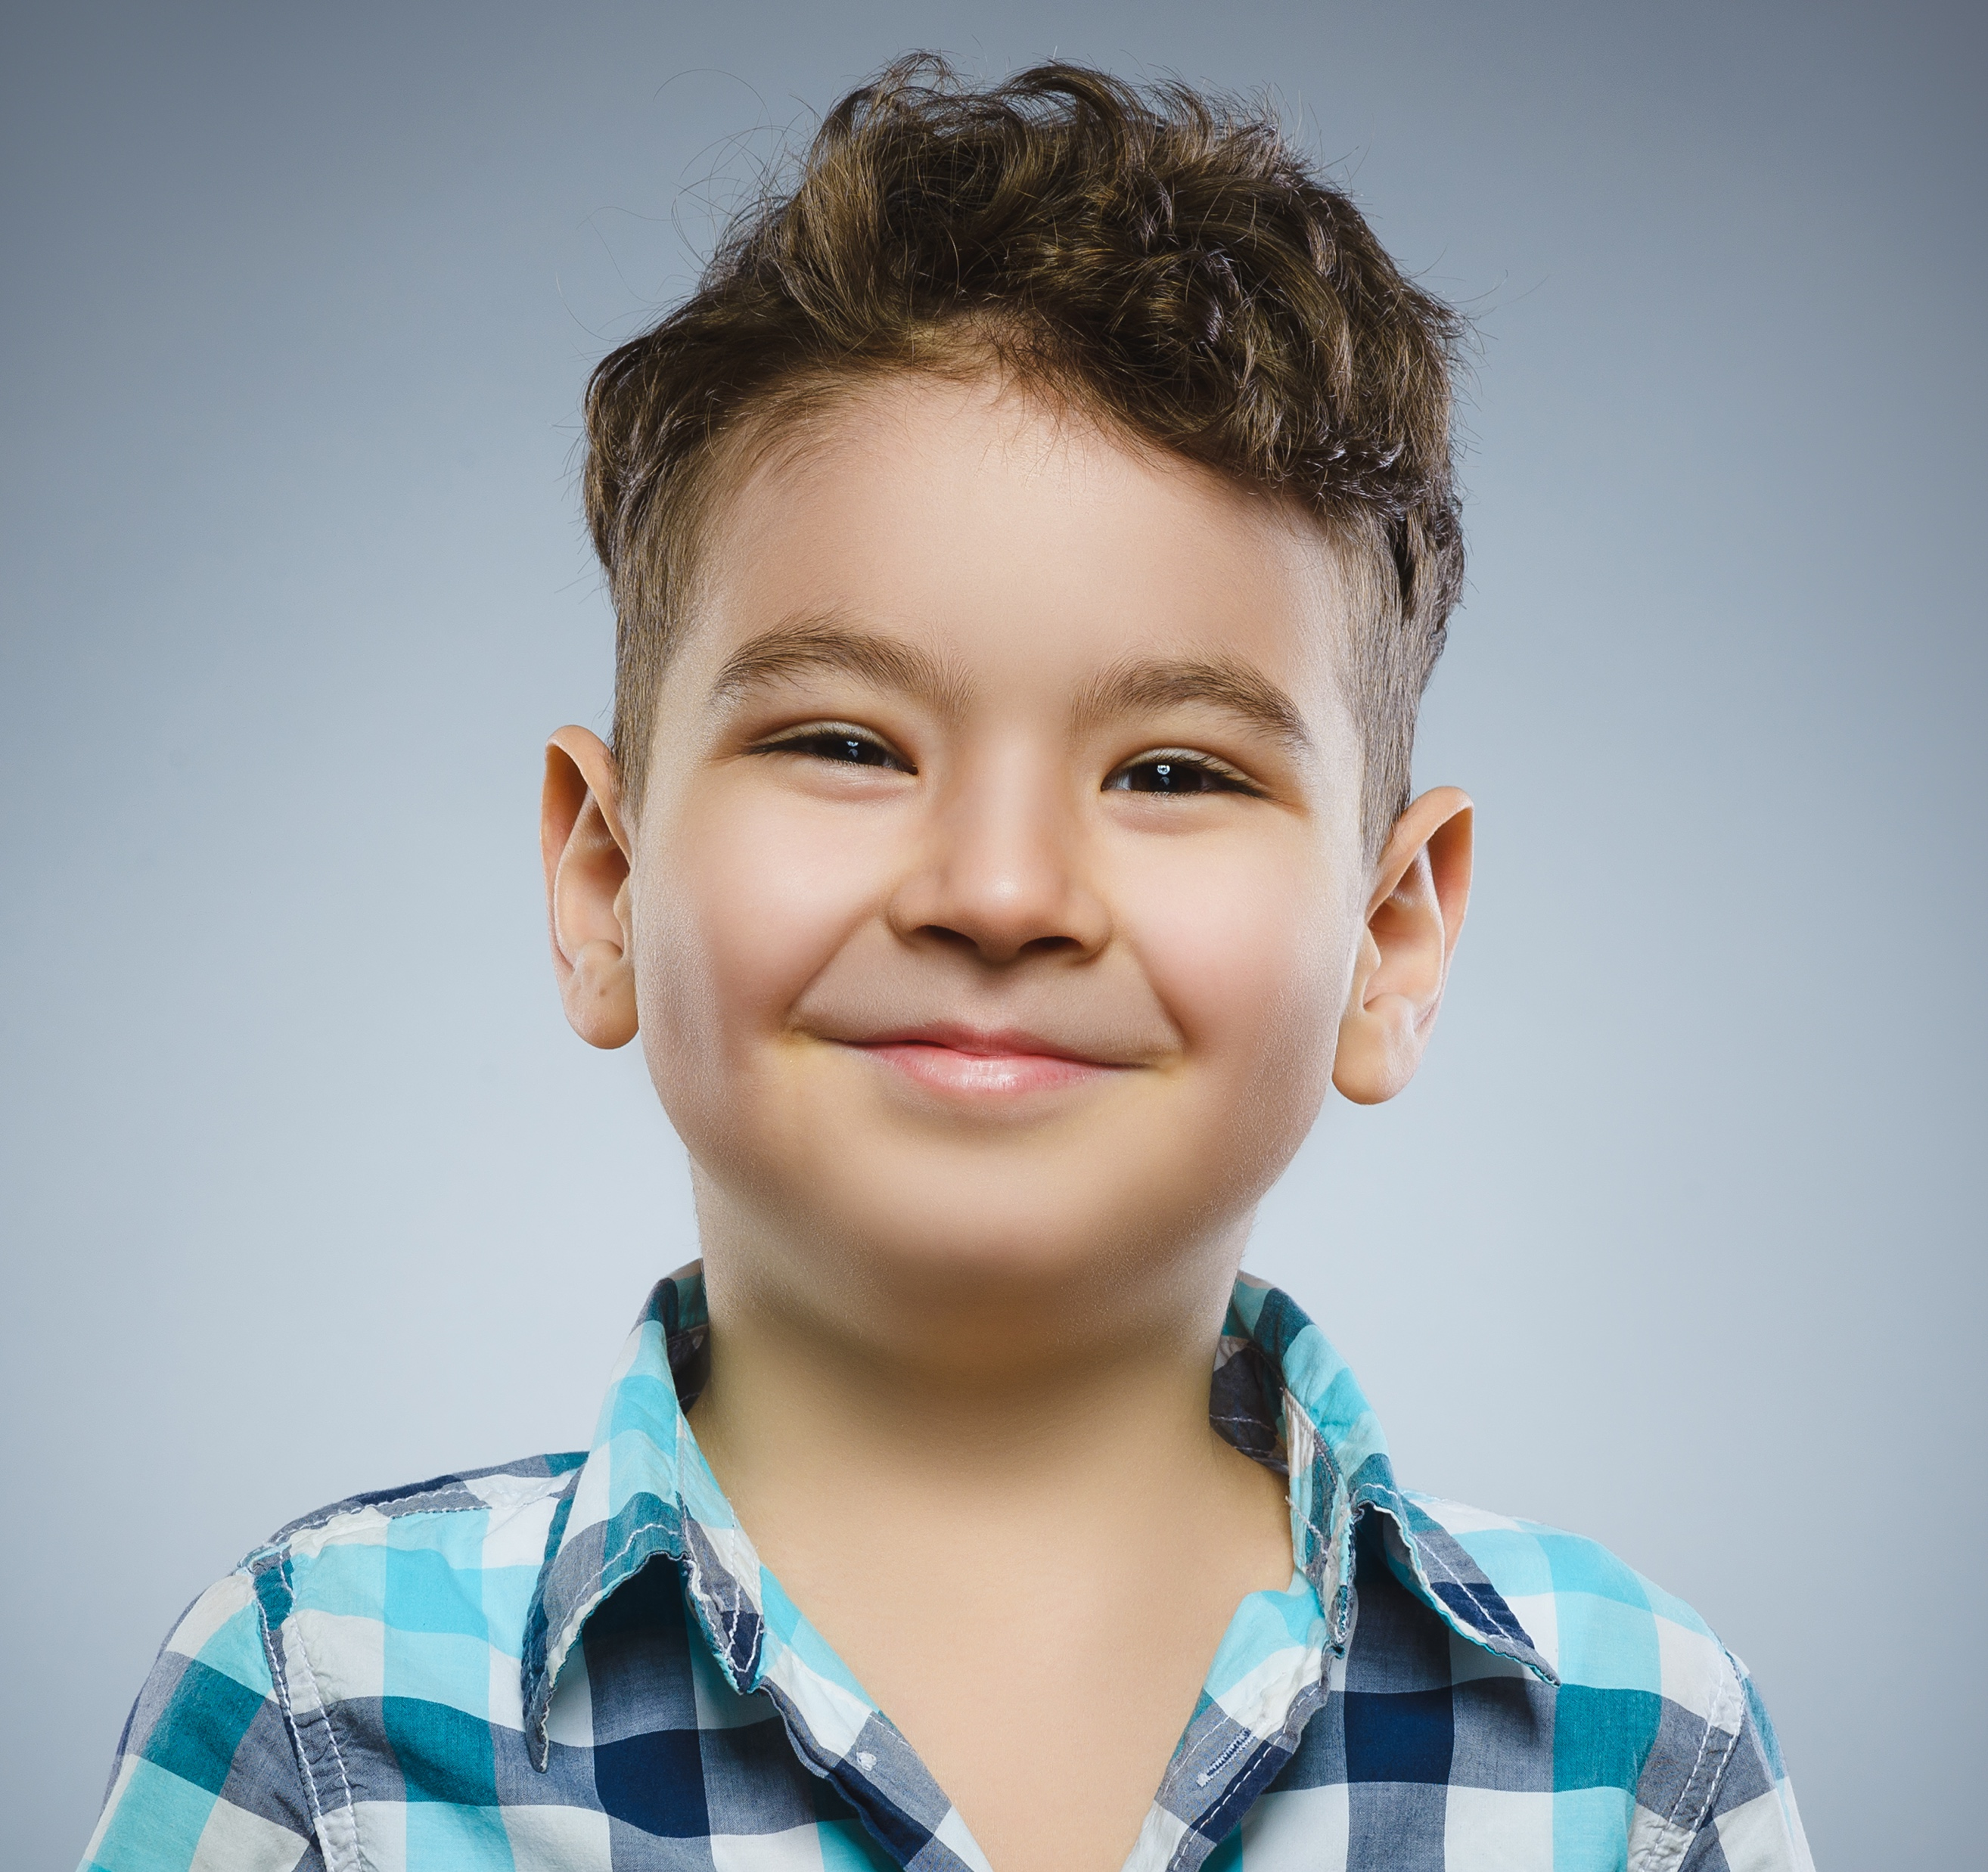
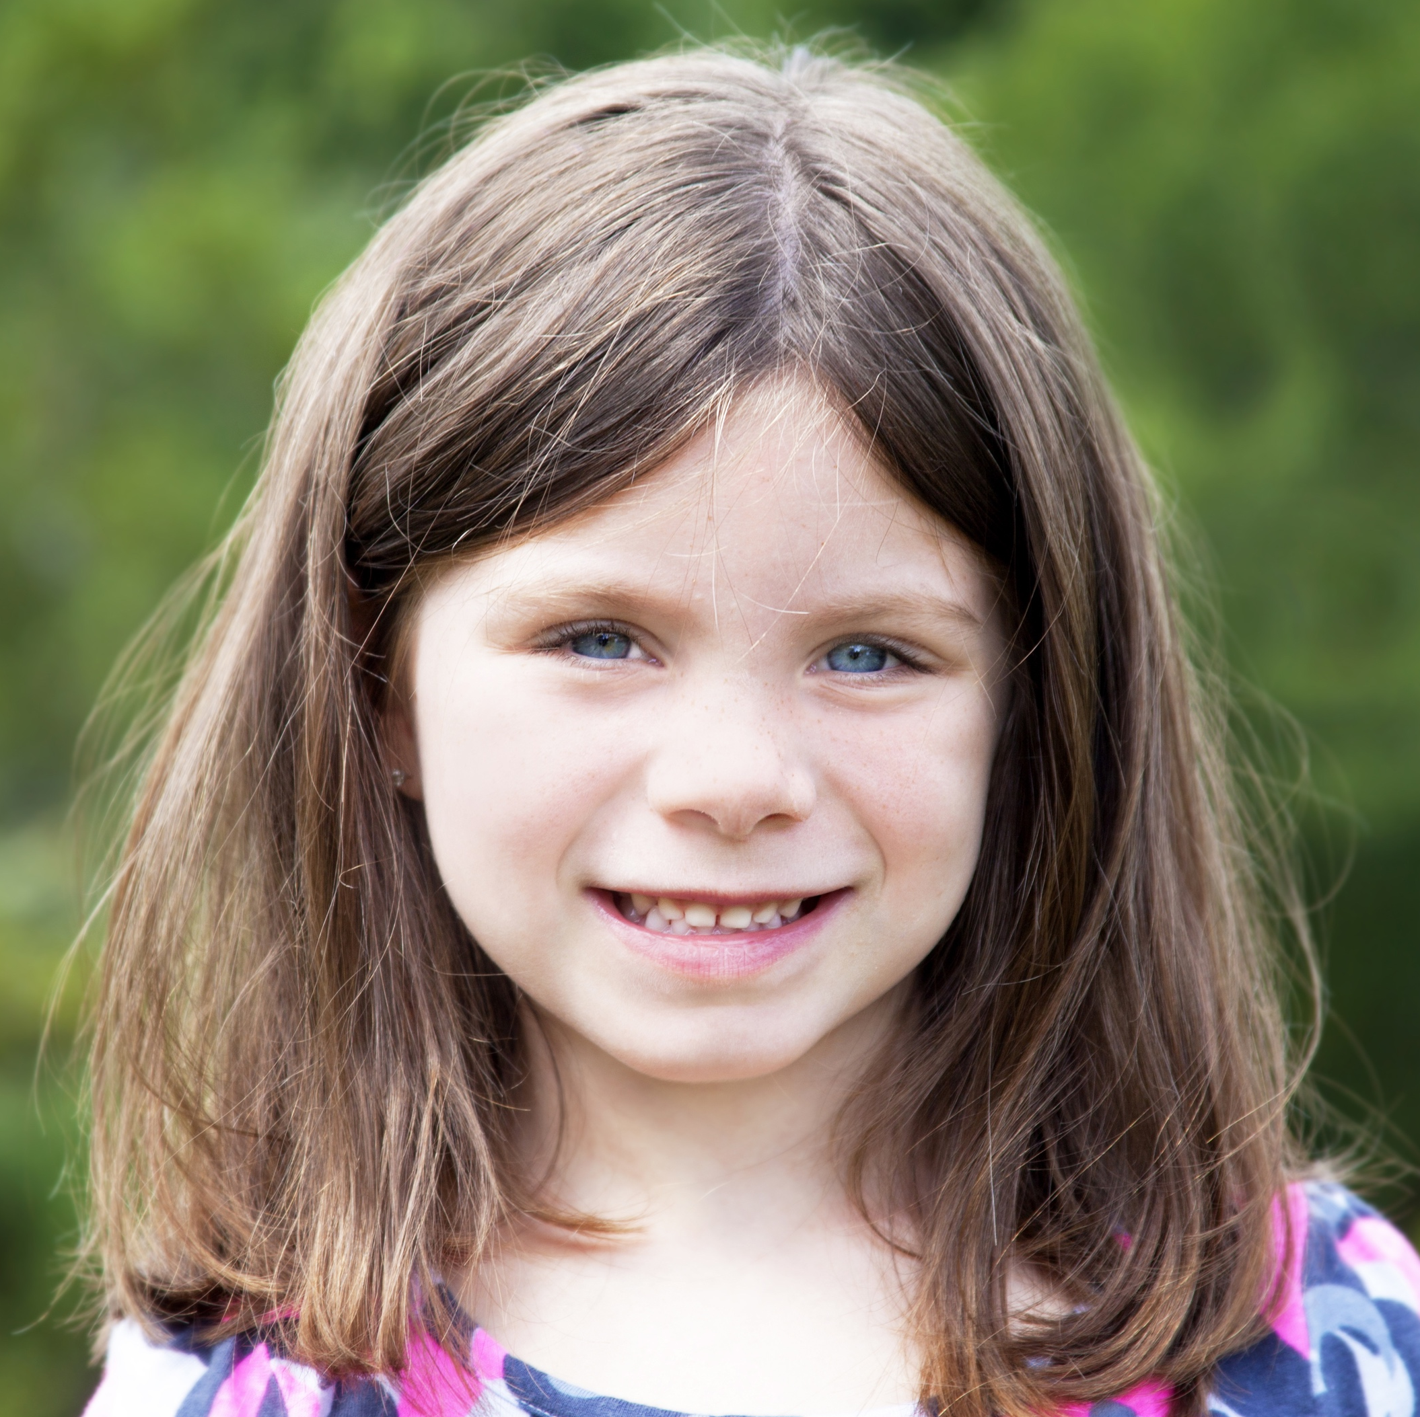
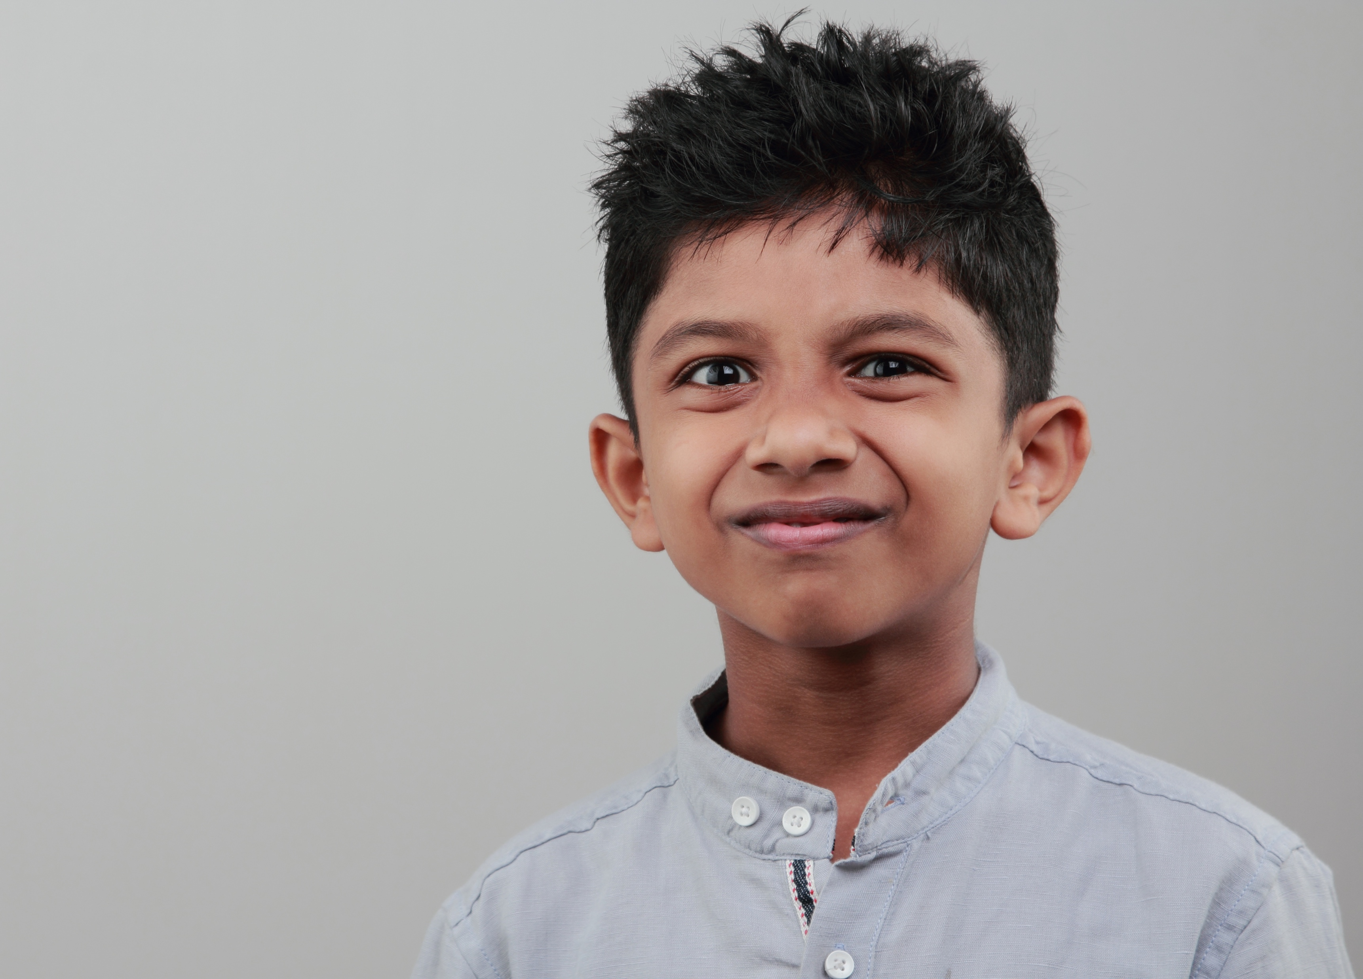
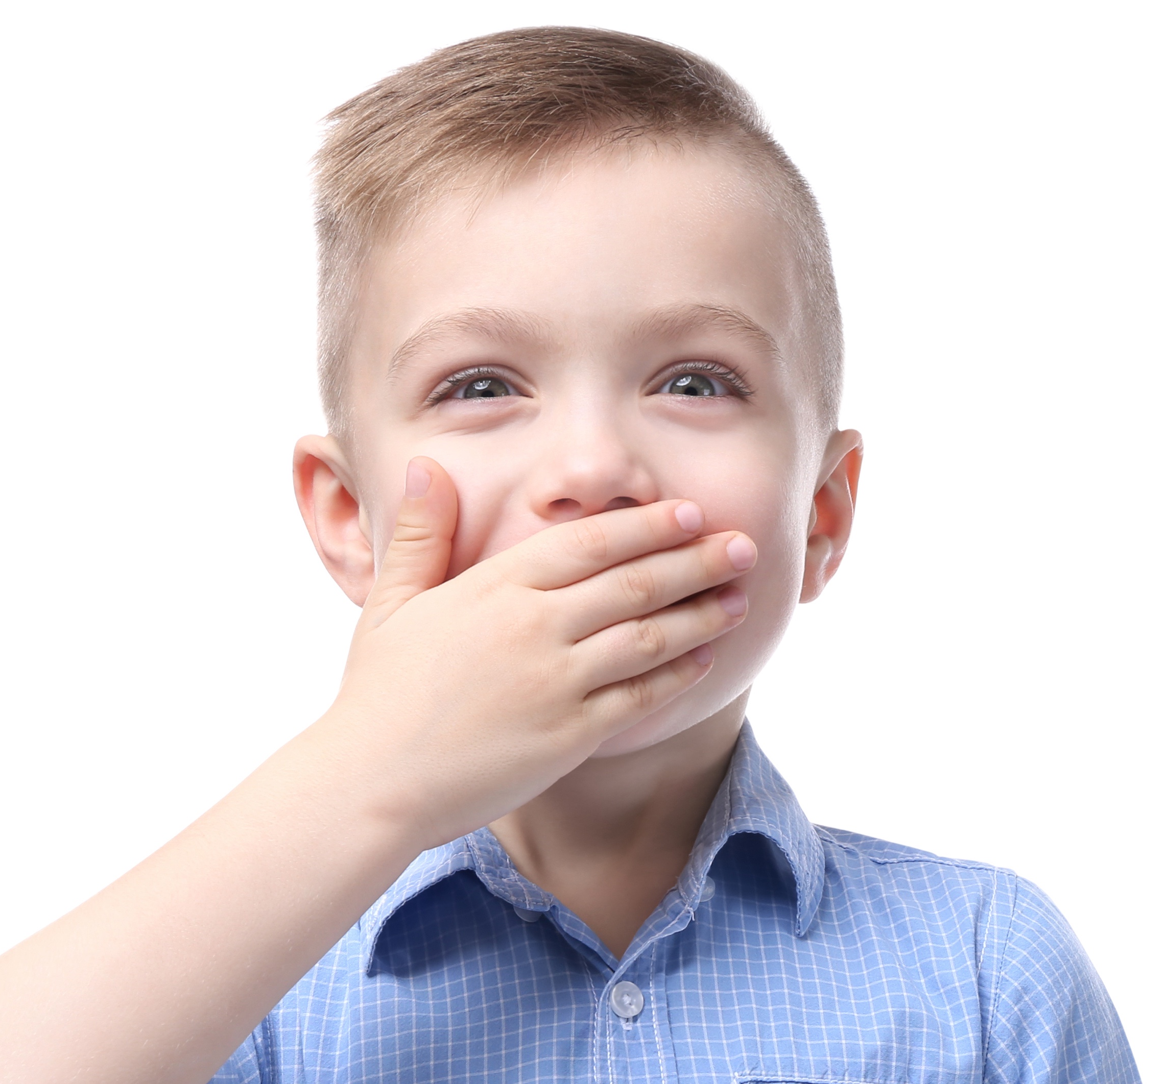
Is everyone unique?
We are all unique!
Notes:
Instructor Notes:
Tell the class that you are about to read a book called We’re All Wonders, by R.J. Palacio.
As you read, ask students to consider: Is everyone unique?
Read the story or play a version of the video read-aloud.
When the story is complete, discuss:
How was Auggie, the main character, unique?
How were the other people in the book unique?
Why is it not okay to make someone feel bad for being unique?
Click twice, and be sure to explain that everyone is unique in different ways! It is never okay to make someone feel bad for their differences.
Sometimes, it can be hard to understand people who are different from us—but that just means we need to learn more about them!

Slide 11

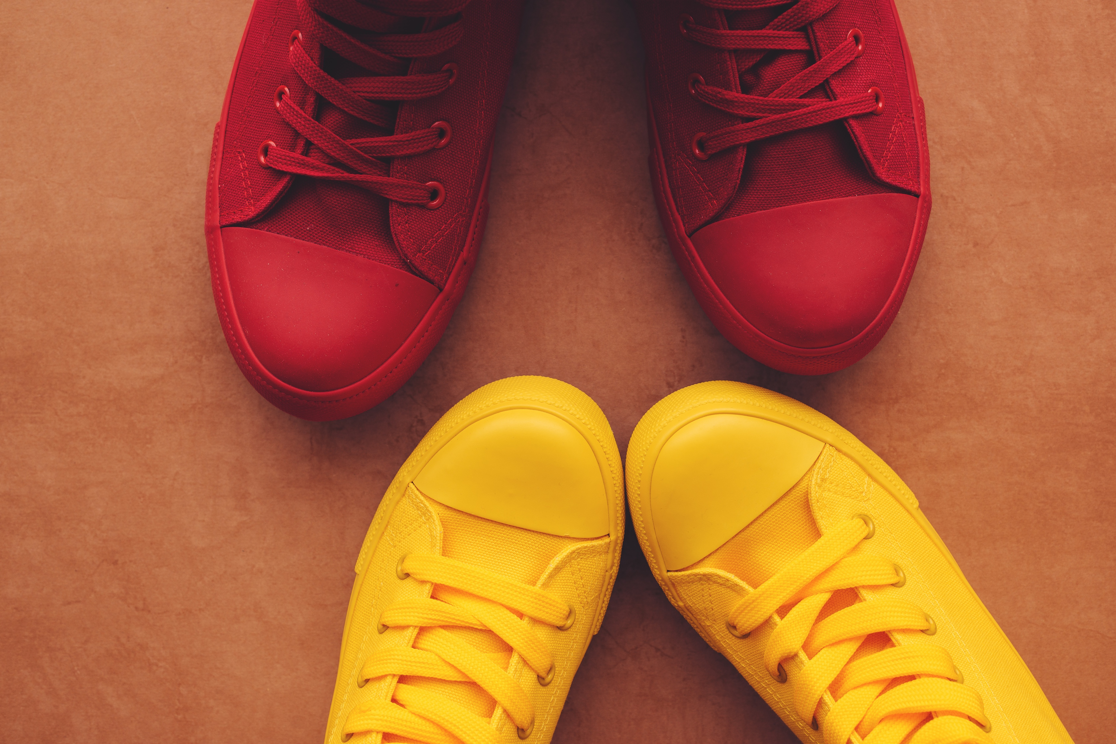
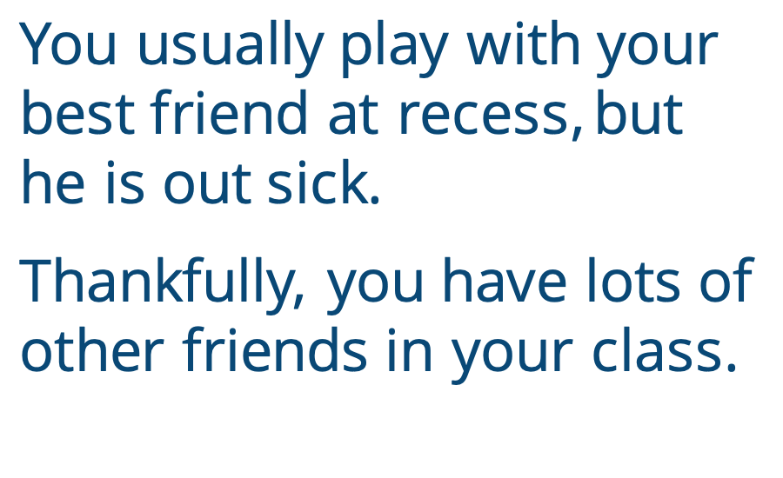
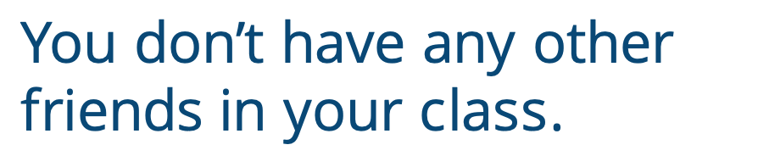
You usually play with your best friend at recess, but he is out sick.
Thankfully, you have lots of other friends in your class.
You don’t have any other friends in your class.
Notes:
Instructor Notes:
Tell students that one way to better understand others is to try to put ourselves in their shoes.
Review and/or explain that when you think about what someone else is seeing, thinking, and feeling, you are putting yourself into someone else’s shoes!
Distribute one Handout 3: Shoe Prints to each student.
Then ask students to stand, and pair students with each other.
Instruct students to stand facing their new partners.
Instruct each student to place their handout on the floor in front of them, and stand on top of the handout’s shoe prints.
Click to project a scenario on the board, and ask students to consider how they would feel in this situation:
You usually play with your best friend at recess, but he is out sick. Thankfully, you have lots of other friends in your class.
Encourage students to tell their partner what they may think or feel if they were in this situation.
Instruct students to swap sides with their partner, so they are now standing on their partner’s shoe prints.
Click to project the next scenario, and explain that students should now pretend they are in someone else’s shoes. Then read:
You usually play with your best friend at recess, but he is out sick. You don’t have any other friends in your class.
Again, encourage students to tell their partner what they may think or feel in this situation.
Collect Handout 3 and ask students to rejoin the circle or semi-circle.
Say: “You just pretended to stand in two different pairs of shoes. When your friend was out sick, did you feel the same in both pairs of shoes? Why or why not?”
Explain that standing in someone else’s shoes can be very different from standing in your own—even if it looks similar on the outside.
For this reason, it is important to do our best to understand what other people are going through. When we are mindful of everyone’s feelings, we can be as supportive and kind as possible!

Slide 12
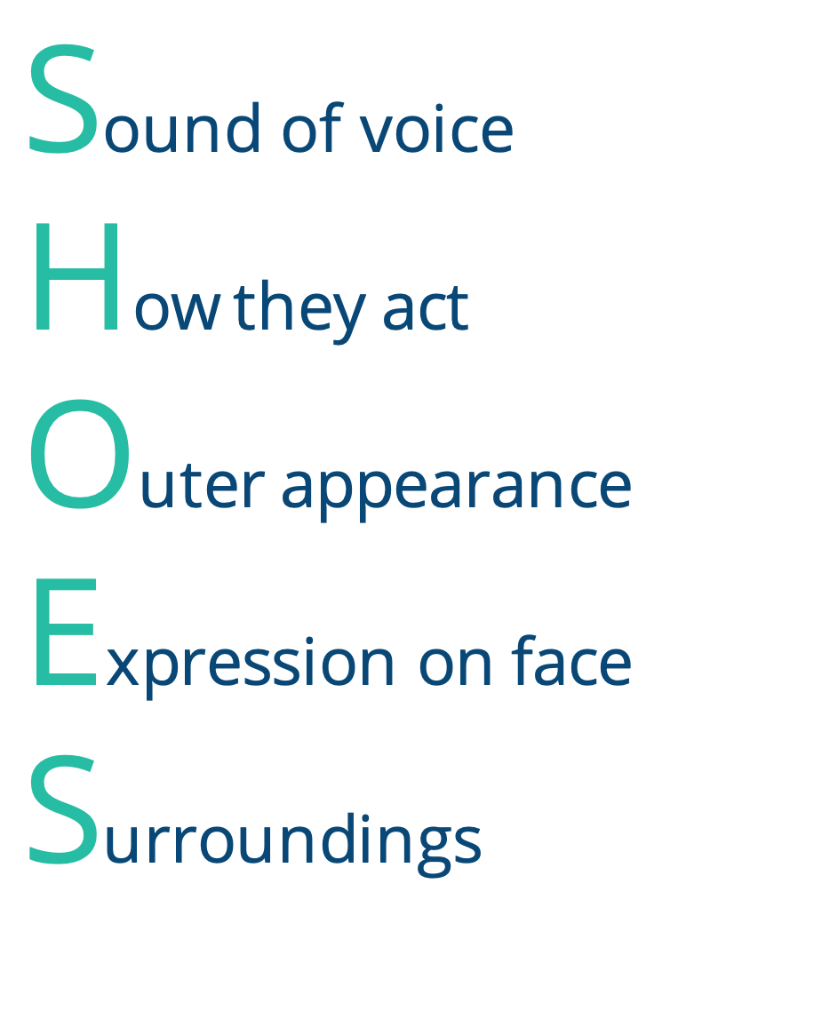
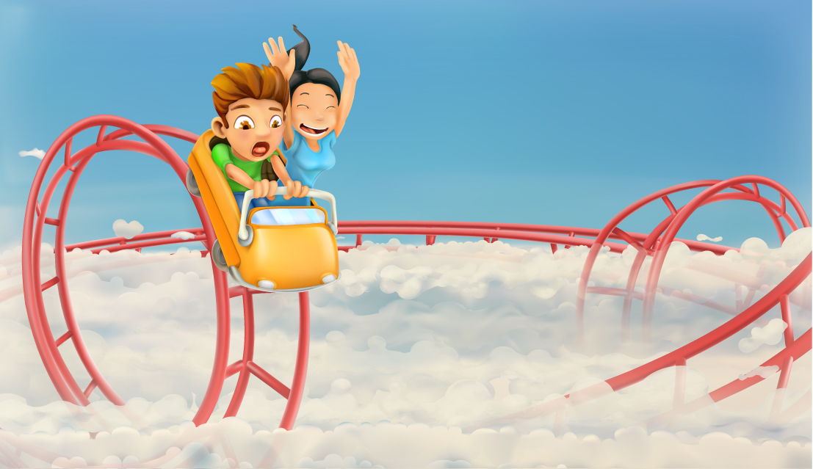
Notes:
Instructor Notes:
Review and/or explain that each letter in the acronym SHOES can help us understand what someone else is seeing, thinking, and feeling. We can even use it to better understand ourselves!
Note: If students already completed the K-2 Time to Create digital lesson bundle, they should remember the SHOES acronym. Regardless, the following activity will help them take a deeper dive into this subject.
Click once to fill in the final S with Surroundings.
Remind students that Surroundings means where they are and who they are with.
Ask the class to pretend that they are at an amusement park with their friend’s family, and they are in line to go on the biggest roller coaster they have ever seen. It even goes upside down!
Ask students to close their eyes and focus on how they may feel in these surroundings.
Click and ask: How might your voice sound?
Explain that hearing the sound of our own voice or listening to the sound of someone else’s voice can help us understand how that person is feeling.
With their eyes still closed, ask students to raise their hand if they would like to demonstrate how their voices might sound as they wait in line.
Call on a few students to share.
Click and ask: How would you act?
Explain that what you do with your arms, your hands, your legs, or your feet can give clues about your feelings.
With their eyes still closed, ask students to demonstrate what they would be doing with their bodies if they were waiting in line.
Click again and follow up with: What would your outer appearance look like? In other words: What would you look like on the outside?
Explain that there are certain clues in a person’s outer appearance that can help us understand how they feel on the inside.
Ask students to quietly picture how they would look as they waited for the roller coaster. Would they be turning red, shaking, standing very still, or maybe even sweating?
Finally click and ask: What might your face look like?
This time, ask students to open their eyes and show you how their eyebrows, eyes, and mouth may look as they waited in line for the upside-down roller coaster.
Ask students to return their faces to normal.
Point to the completed SHOES acronym on the slide and congratulate the class on doing a great job demonstrating what it would be like to wait for this upside-down roller coaster in their own shoes.
Explain that when we are mindful of what it feels like to be in our own shoes, it is easier to step into someone else’s shoes and try to understand how they feel!
Suggest adding which letter fills in for each click, similar to the notes above for “surroundings”

Slide 13
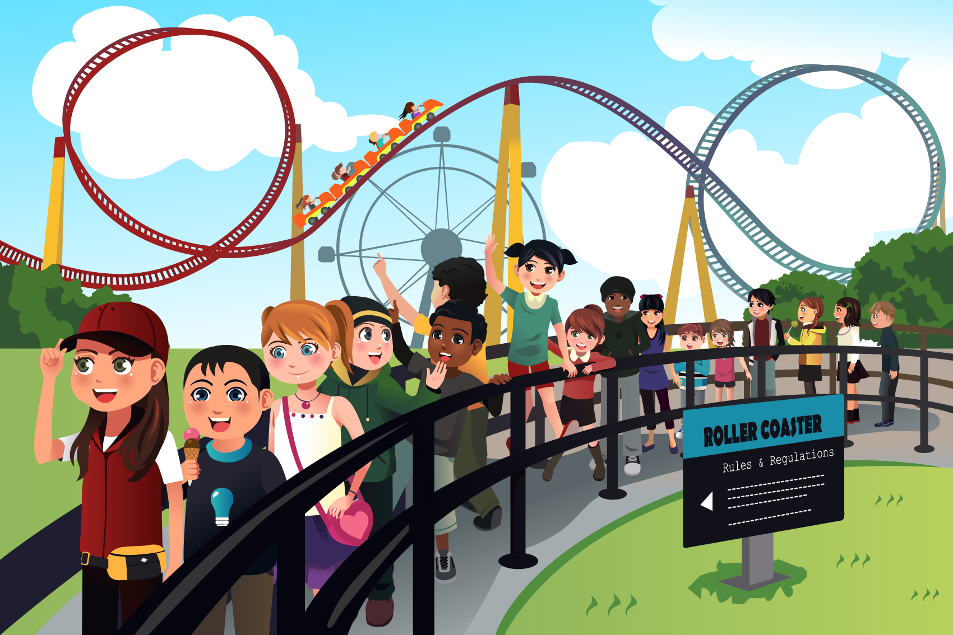
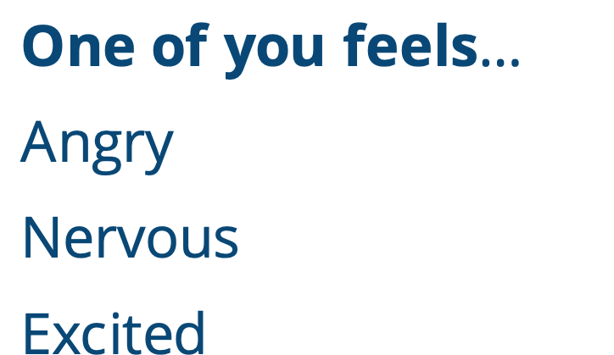
One of you feels…
Angry
Nervous
Excited
Notes:
Instructor Notes:
Divide the class into as many groups of three as possible. If there are one or two students remaining, you can add them to existing groups to make a couple groups of four.
Click once and ask groups to imagine that they are now in line together to go on the same big roller coaster. Tell groups to imagine that:
One of you is angry because you don’t want to ride.
One of you is very nervous about going upside down.
One of you is extremely excited because you’ve been hoping to ride a roller coaster for a long time.
Give groups a moment to quietly decide who will be angry, who will be nervous, and who will be excited. Have groups give you a thumbs up once they have decided.
Then distribute one strip from Handout 4: SHOES Strips to every group and read each one aloud as you pass them out.
Explain that as each group pretends that they are waiting in line for the roller coaster, they will focus on the SHOES letter that they just received. They will then act out this SHOES letter so the rest of the class can guess who is angry, nervous, and excited!
Give groups a few minutes to prepare a quick skit.

Slide 14
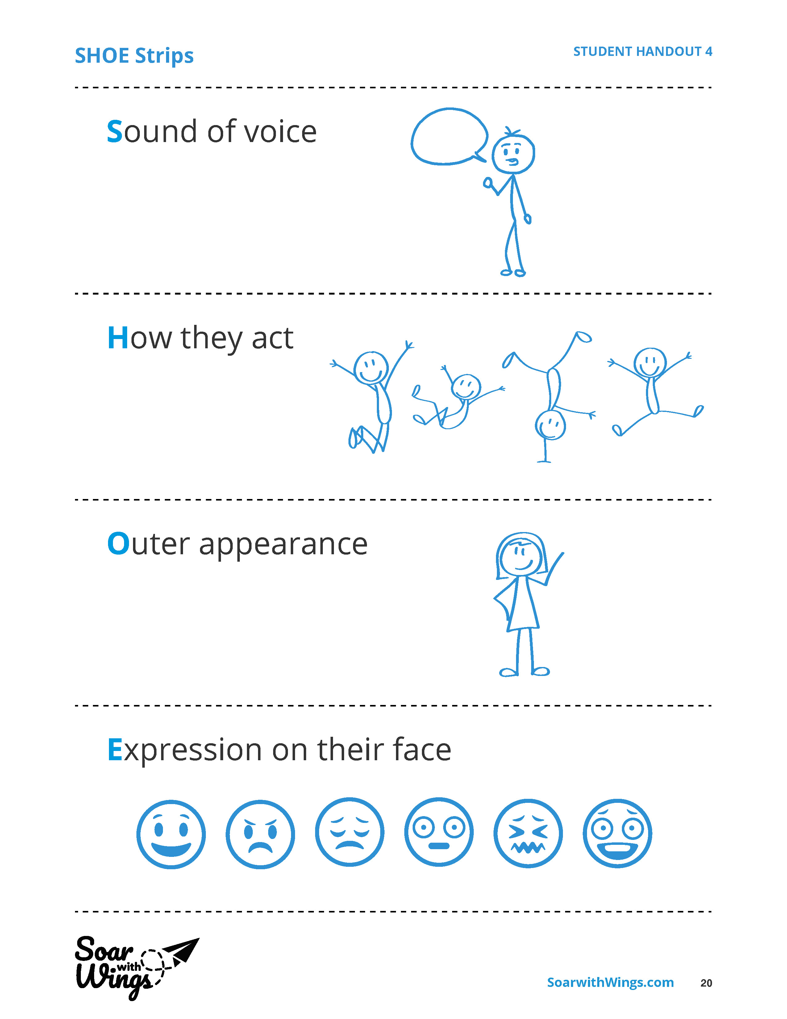
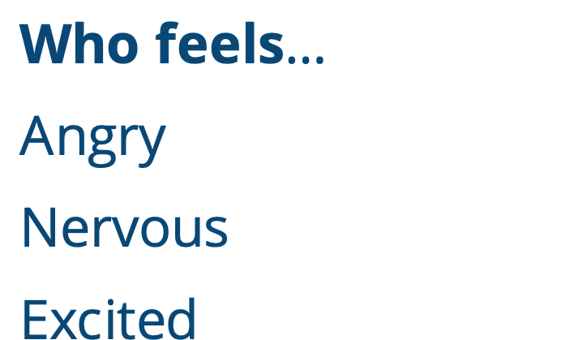
Who feels…
Angry
Nervous
Excited
Notes:
Instructor Notes:
Bring the class together and direct their attention to the SHOES acronym on the board.
Explain that the final S is already filled in because everyone already knows the surroundings: They are in line for a roller coaster at an amusement park, with a few different friends. Being mindful of this surrounding is important, because it will help them understand how everyone is feeling. People may feel very differently, for example, if they were in line at the grocery store!
Click once and distribute the three different emotion cards from Handout 5: In Your SHOES to each student. Challenge students to be mindful and focus on the skits as they try to figure out which actor is angry, excited, and nervous in each one.
Then click to fill in the first S, and:
Invite groups who focused on Sound of Voice to present their quick skit, and remind the audience members to focus especially on clues from the sound of the actors’ voices as they try to figure out each actor’s emotions.
When each skit is complete, ask the actors to step forward one at a time.
As they do, the audience members should think about the clues they noticed, and hold up the emotion card that matches each actor.
Ask the actors to share their emotion!
If there are any discrepancies between what the students guessed and the emotion they were acting out, discuss why students guessed the emotion they did as well as what the actor intended.
Explain that we are not always perfect when we put ourselves in someone else’s shoes. The important thing is that we do our best to understand.
Click once more each to add the H, O, and E to the slide and continue the same presentation process for each group.
Wrap up by explaining that when we try to put ourselves in someone’s shoes, we may feel like a detective as we look for clues to help us understand how someone else feels. Some parts of collecting these clues is easy, while some parts are harder—so it’s helpful to collect as many clues as possible!
The S does not appear to be filled in on slide 13, it is filled in on slide 11.

Slide 15

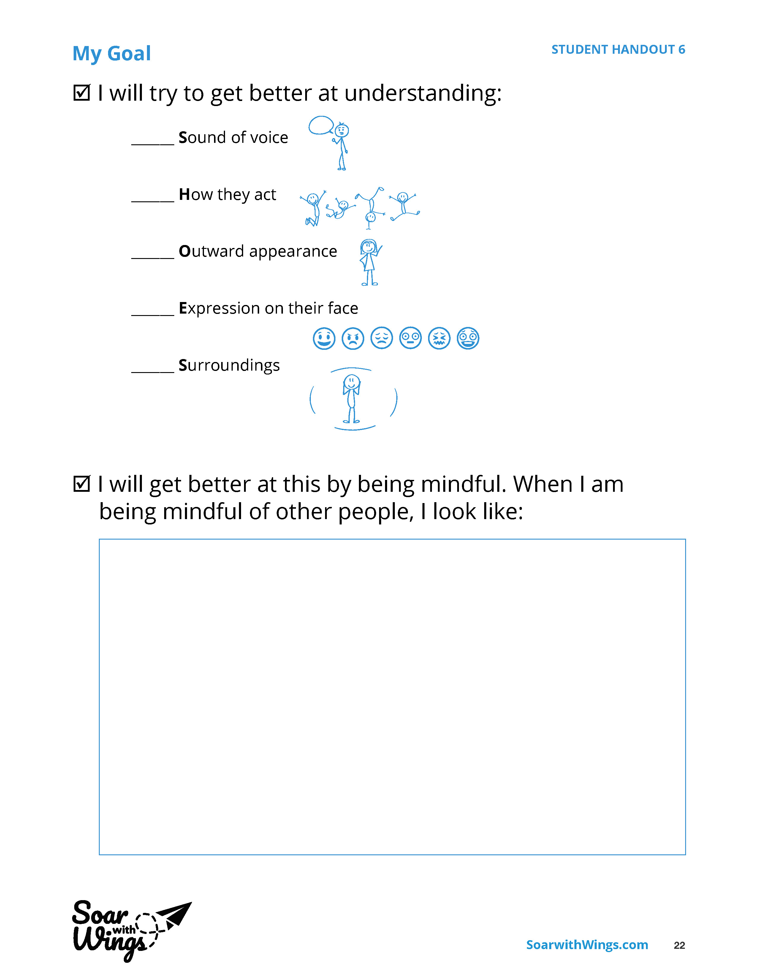
Notes:
Instructors Note:
Tell students that if they continue to practice putting themselves in others’ shoes, it will get easier!
Explain that students will now think about the one letter of SHOES that they seem to find the trickiest and set a goal to help them get better at finding and understanding these clues.
Distribute one Handout 6: My Goal to each student.
Review the text on the top half of the handout, and encourage students to check one SHOES area that they want to improve.
Read the second half of the goal sheet and explain that an easy way they can work on this skill is to be mindful when they are with others. If they are focused on the other person—especially on the sound of their voice, how they act, what they look like, etc.—and don’t let their mind wander, they should be able to pick up more and more clues!
Give students a few minutes to draw what it looks like to be mindful of others in the box provided.
Hint: Being mindful when you are with others means you are not distracted by other things. You are looking at the person and paying attention to only them!
Regroup and challenge the class to work on their goal for the rest of the day. They should be mindful and practice putting themselves into other people’s shoes whenever possible!
Conclude by reminding the class that if students ever feel overwhelmed, they can take a moment to picture their quiet place. It should then be easier to focus on their goal!
Note: Students will be asked to think about their goal progress at the beginning of next session, so either encourage students to put their goal sheets in a safe place or collect them for safe keeping.

Slide 16
Notes:
Instructor Notes:
Begin the third session by asking students to take out their Handout 6: My Goal sheet (or distribute it back to students). Then encourage the class to sit on the floor in a circle or semicircle and join the students by sitting at their level.
Briefly review the SHOES acronym letter by letter.
As you read each part, ask students to raise their hand if they were working on this letter. Encourage these students to share what they have done since last class session to be more mindful of this part of SHOES.
Once several students have shared, challenge students to continue their hard work!

Slide 17
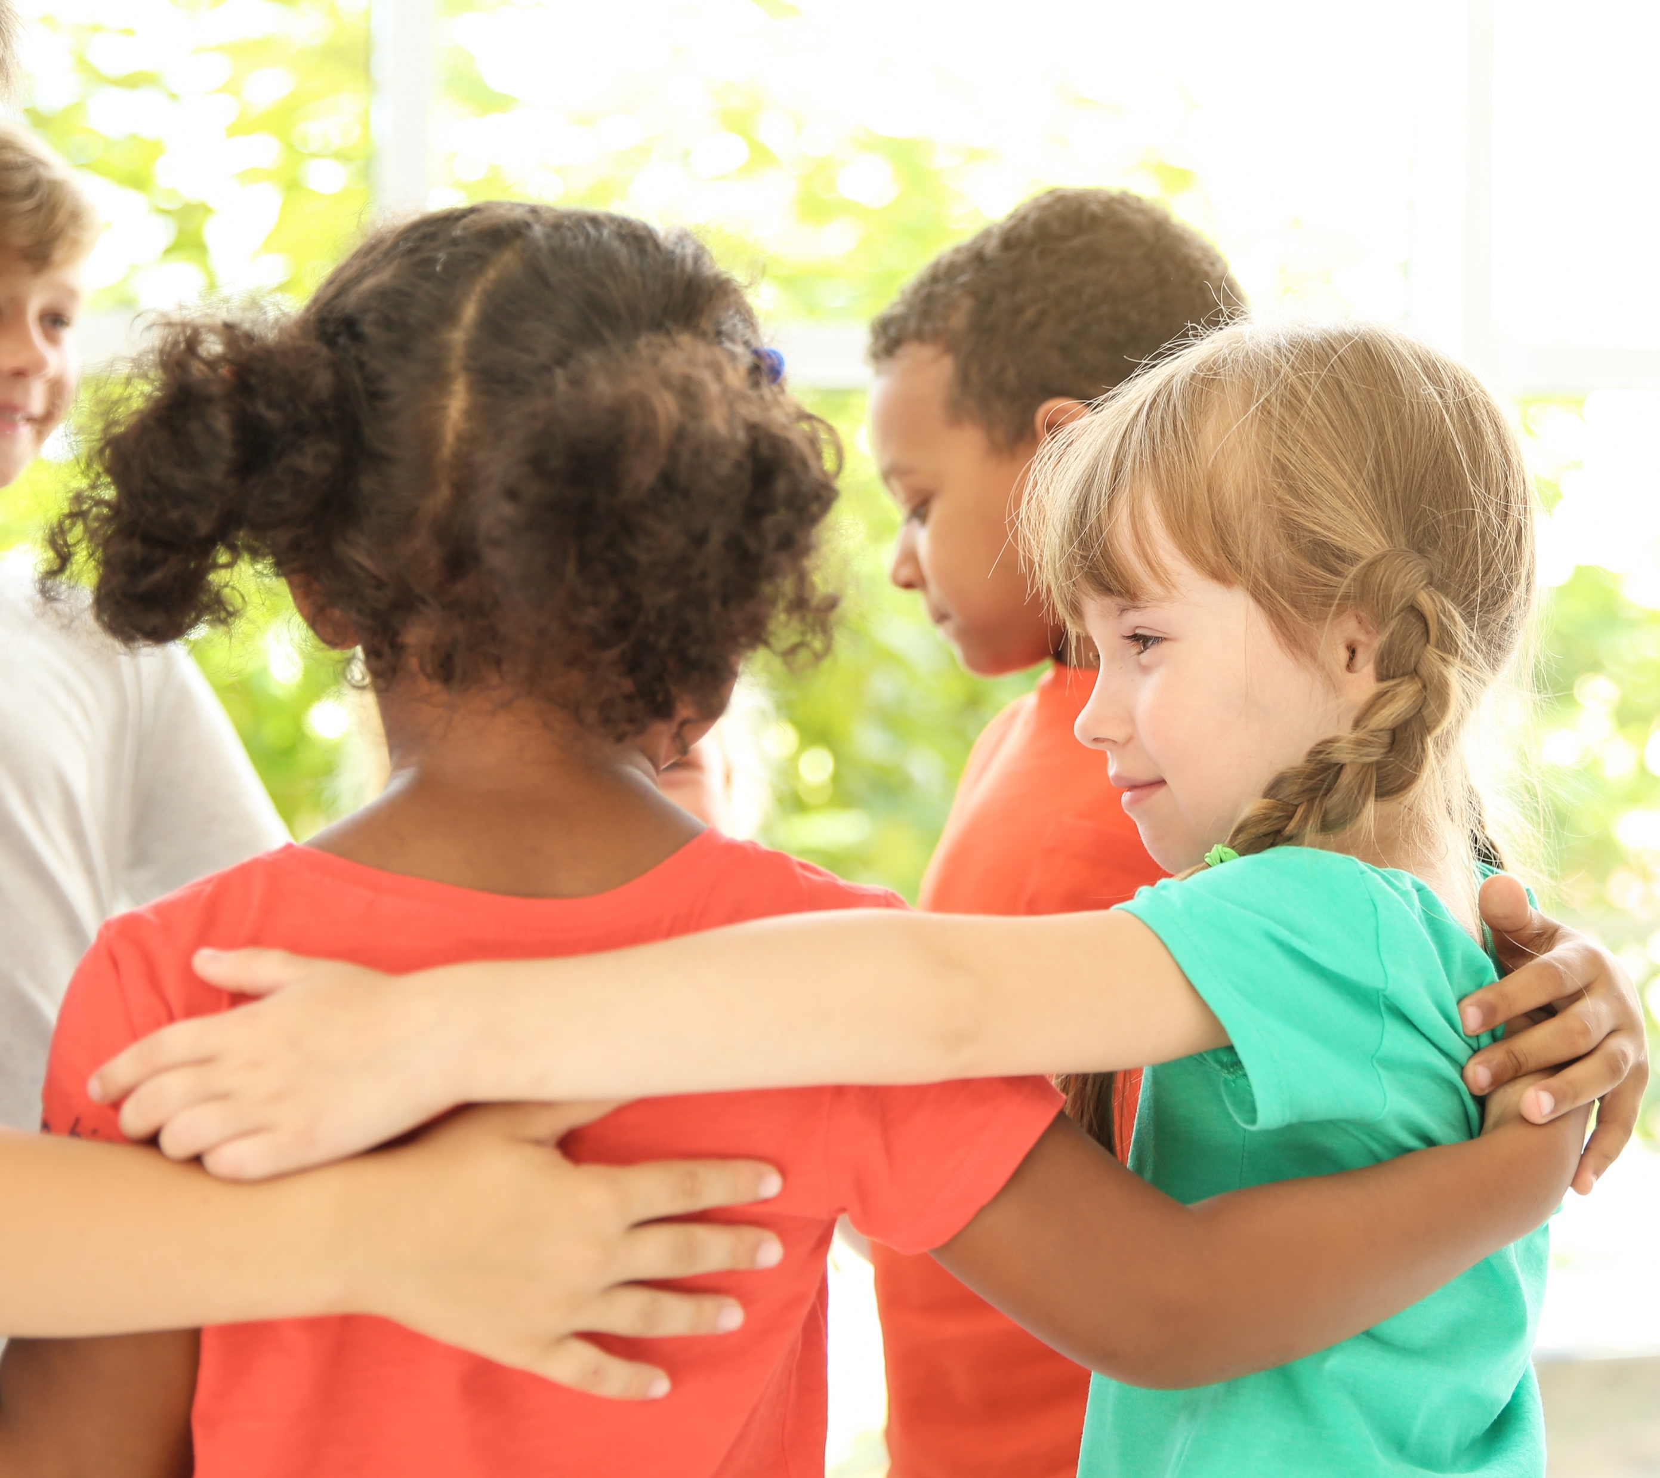
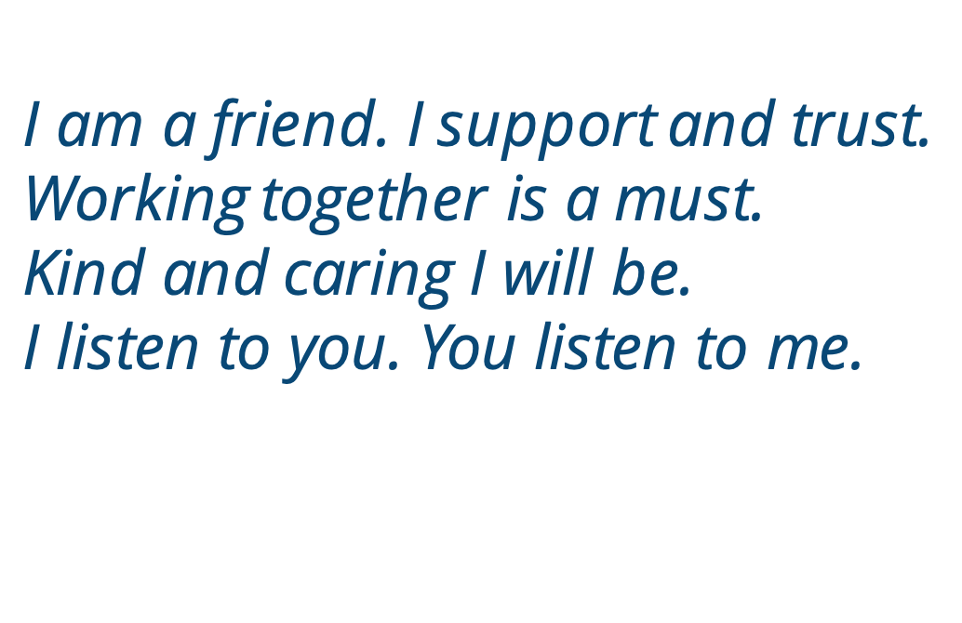
Notes:
Instructor Notes:
Explain that while being able to put ourselves into other people’s shoes is one important way to understand others, there are also other ways to treat others well and with respect.
Click to project and read the following Words to Live By excerpt aloud.
Ask students: According to these Words to Live By, what are some other ways that we can treat others well and be a good friend?

Slide 18

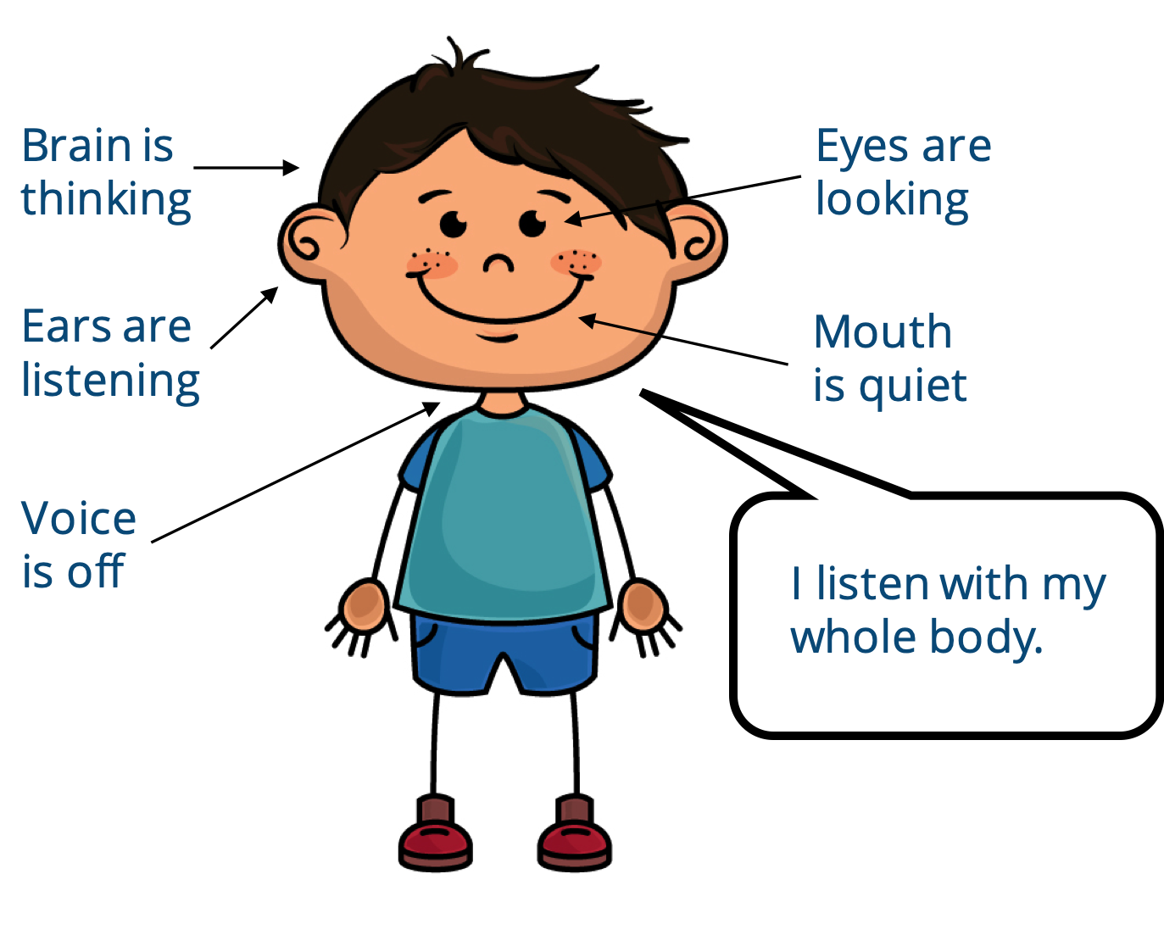
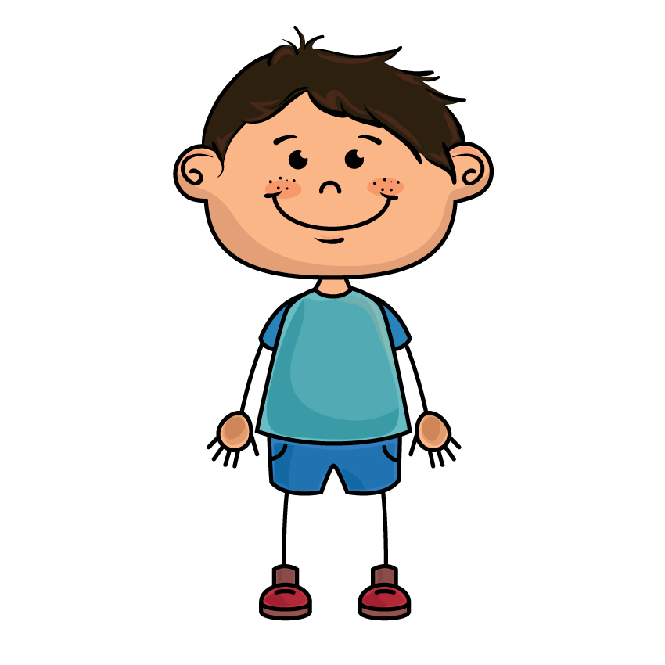
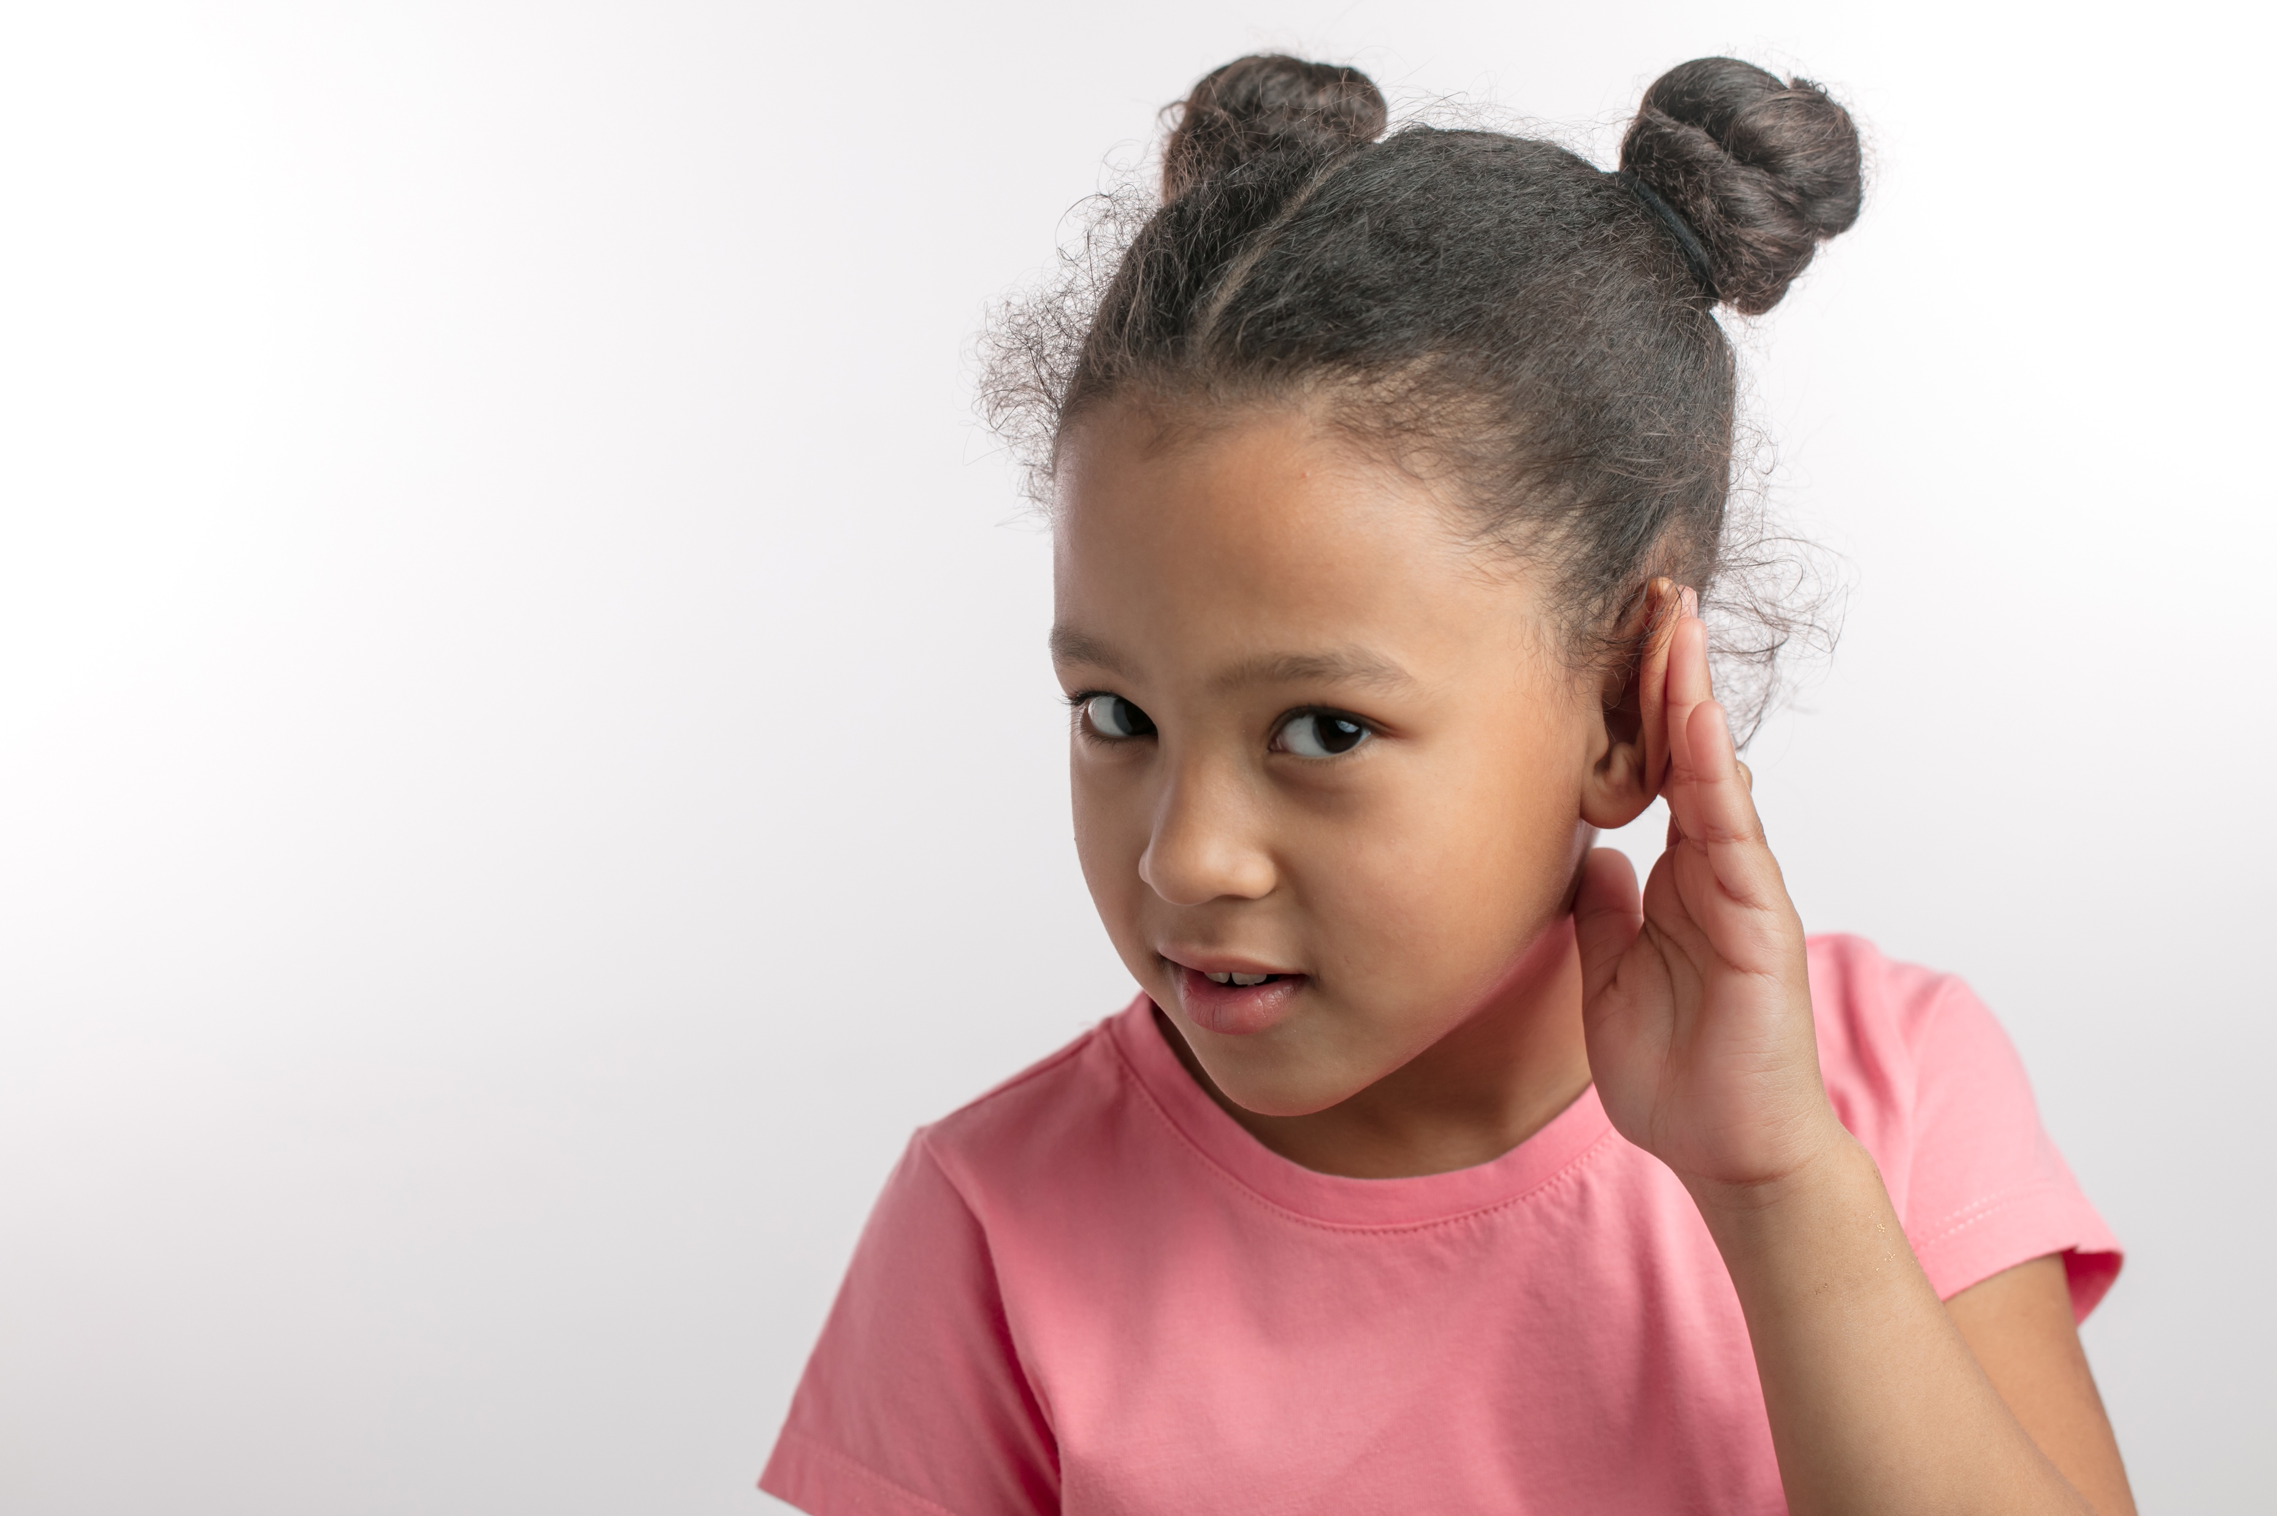
Brain is
thinking
Eyes are looking
Ears are
listening
Mouth
is quiet
Voice
is off
I listen with my whole body.
Notes:
Instructor Notes:
Review and/or explain that one way to treat others well and with respect is to listen. When you listen, you are taking time to understand the other person.
Acknowledge that students already know at least some of the skills they need to be a good listener.
To prove it, ask students to pretend that they’re not listening. What would they look like?
Explain that this is the main difference between hearing and listening. Explain to students that you can hear the sound I’m making when I talk, but if you aren’t focused on what I’m saying then you aren’t really listening.
Explain that an easy way to listen—and show you are listening—is to listen with your whole body.
Click twice to project what whole body listening looks like.
As you explain each part, ask students to shift from their non-listening position to the whole-body listening position being described:
Eyes are looking.
Ears are listening.
Mouth is quiet.
Brain is thinking.
Voice is off.
Ask students:
“How is this position different from your non-listening position?”
“How may this help you be a better listener?

Slide 19

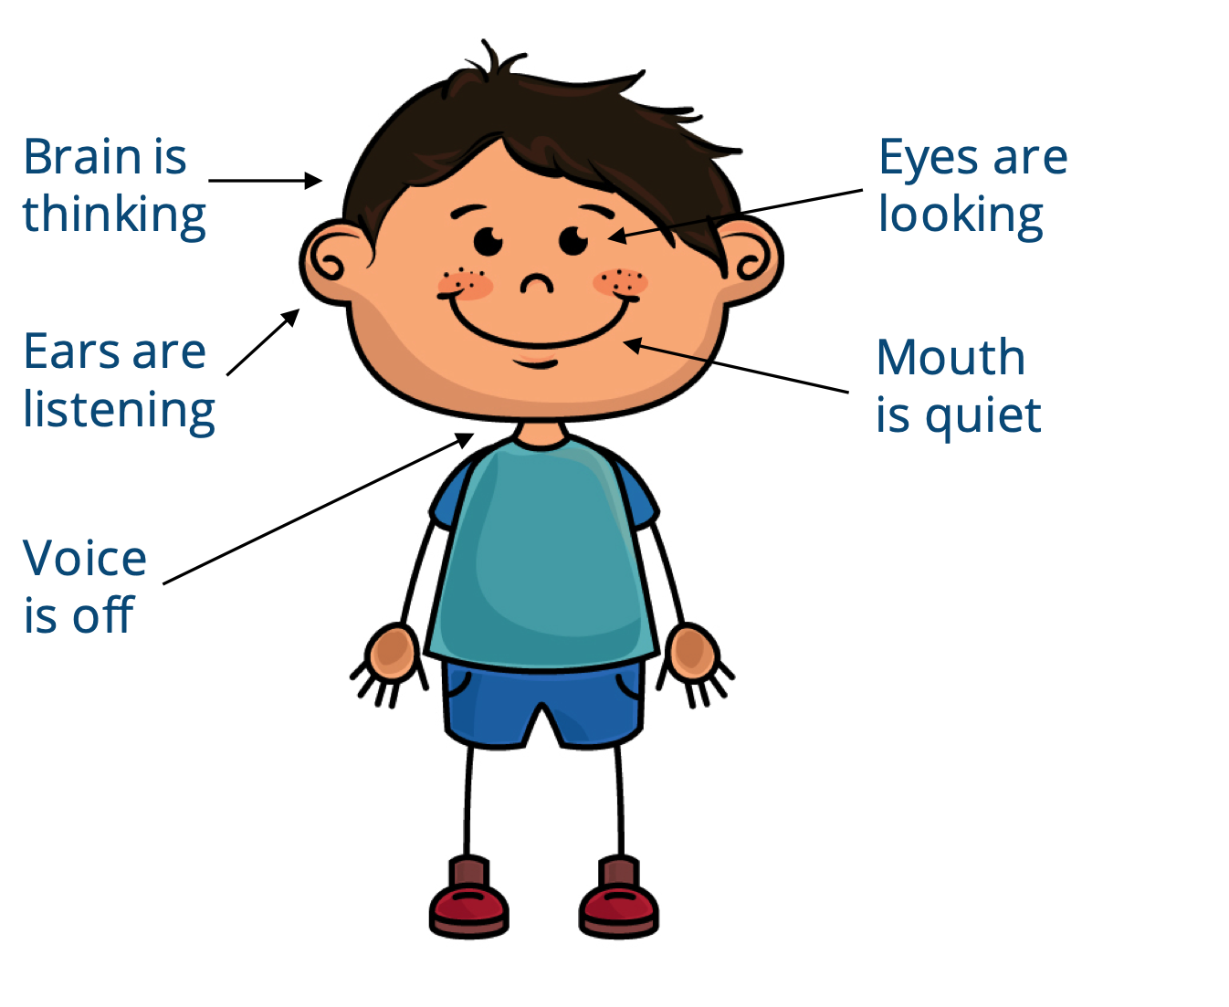
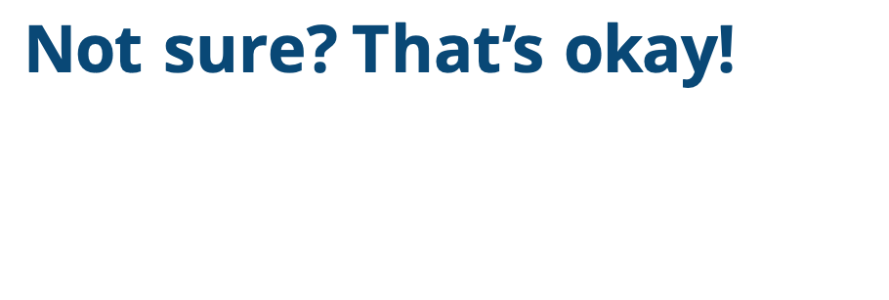

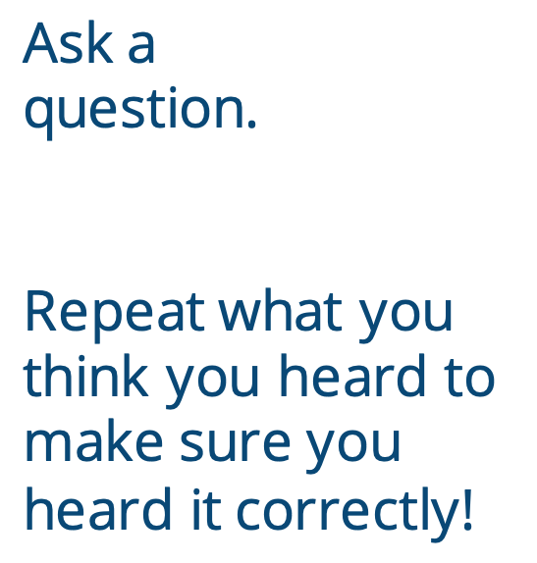
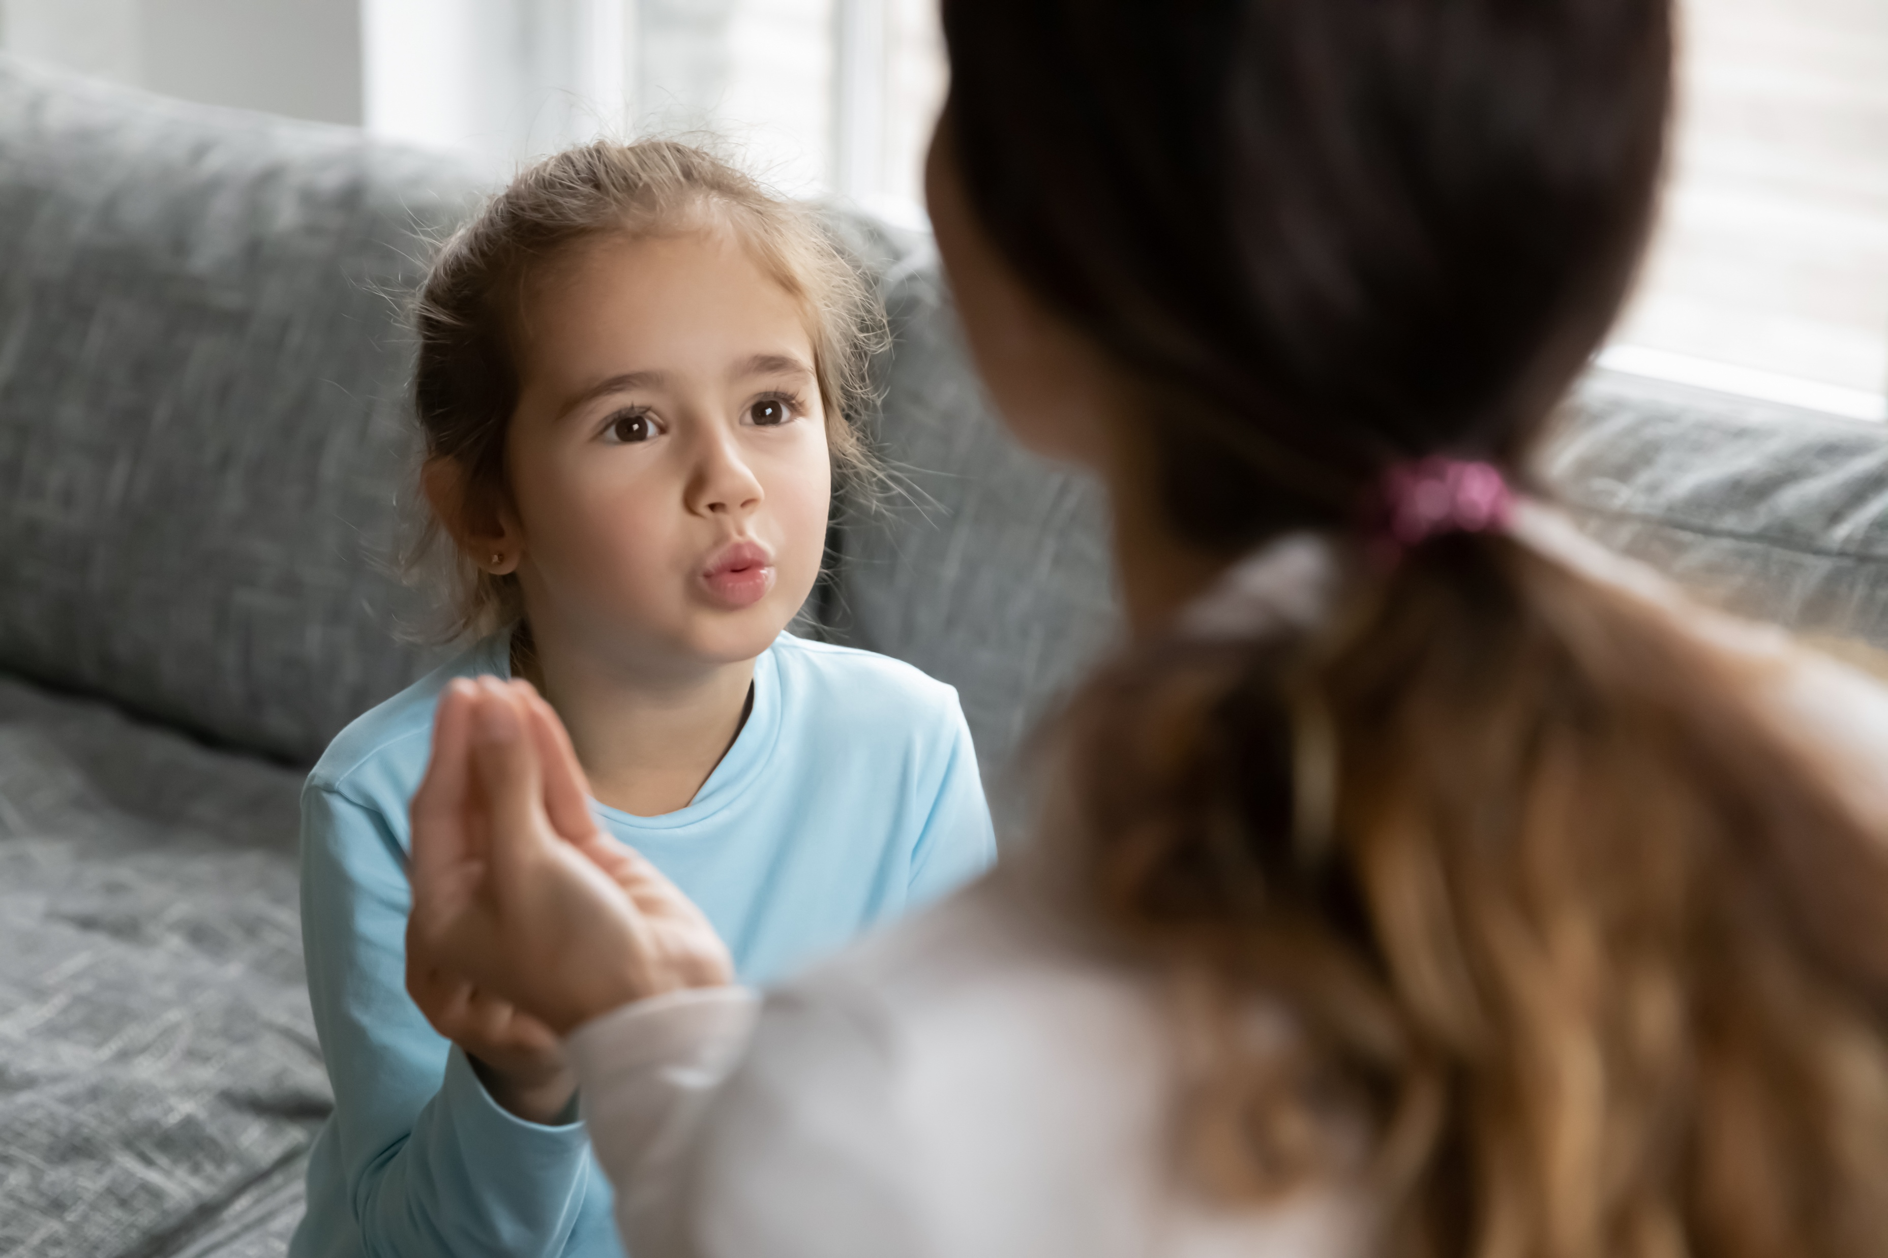
Not sure? That’s okay!
Ask a
question.
Repeat what you think you heard to make sure you
heard it correctly!
Notes:
Instructor Notes:
Explain that students are going to practice whole body listening.
Pair up students, and instruct them to sit facing each other with a pencil in hand and a notebook or clipboard to lean on.
Pass out one strip from Handout 6: Whole Body Listening Challenge to each student and instruct students to hide their card from their partner.
Explain that each partner will take turns describing their image to the other student so their partner can try to recreate it in their blank square.
As one partner describes their drawing, the other partner should listen with their whole body, and then follow their partner’s directions.
Click once and explain that if a student is ever unsure about something their partner says, they may either:
Ask a question.
Repeat the statement to make sure they heard it correctly.
When one drawing is complete, partners should then swap roles.
When both partners are done, encourage them to show each other what they have drawn and see how close it is to the original image!

Slide 20
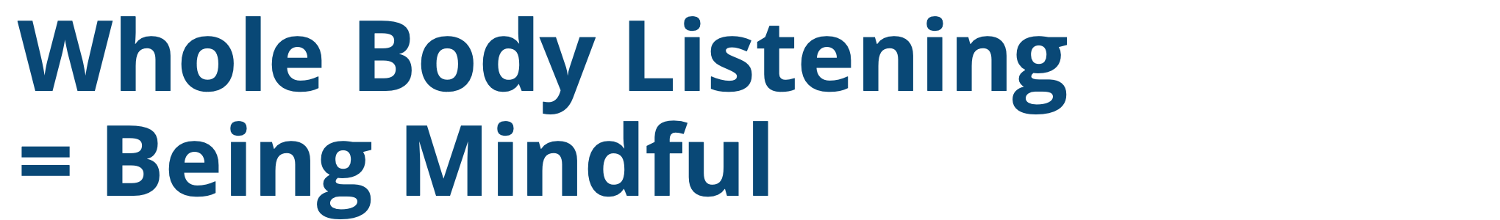
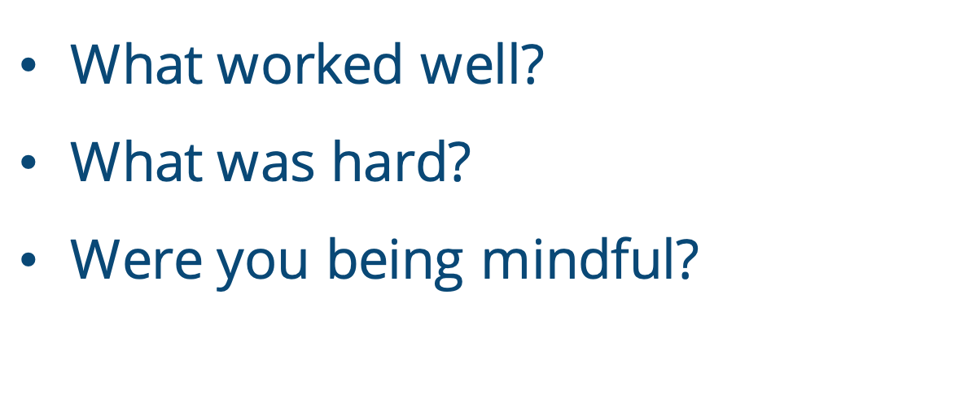

What worked well?
What was hard?
Were you being mindful?
Notes:
Instructor Notes:
Bring the class back together in a circle or semicircle and discuss the activity:
What worked well?
What was hard?
When you are listening with your whole body, were you being mindful? Why or why not?
Click once and be sure students understand that both whole body listening and mindfulness relate to focusing your attention on one thing at a time. When you are listening to someone with your whole body, you are being mindful of what that person is saying!
Ask students to raise their hand if they have ever felt like someone wasn’t listening to them.
Invite students to think-pair-share: How did this make you feel?
Explain that when you are mindful and listen with your whole body, you are doing your best to try to understand the other person. When you do this, you are showing them that you care.

Slide 21




Once upon a time, there was a student
named Chris…
Chris owned a pair of magical shoes!
Shoes
Notes:
Instructor Notes:
Tell the class that they are going to practice listening with their whole body and being mindful one more time as they work together to tell a story!
Divide students into pairs, and give each pair two cards from Handout 8: Story Cards. It’s okay for some pairs to have the same cards as others.
Tell students that they should not show their cards to the other pairs!
Click once to reveal on the slide: “Once upon a time, there was a student named Chris…”
Explain that the class is now going to work together to come up with a story about Chris. To do this:
The class will go around in a circle and add to the story one pair at a time. (Each pair can be allowed a few seconds to confer before they add their part.)
Each time a pair speaks, they should use one of their cards .
As they use a card, they should place it on the floor in front of them.
Pairs may add one sentence to the story or a few sentences as long as they incorporate one of their cards!
Help students understand by providing an example:
Click once and bring students’ attention to the sneakers card on the slide.
Click again and explain that if it was their turn, they could put this card down, and add on to the story with: “Chris owned a pair of magical shoes.”
Explain that this line makes sense and adds your sneakers card to the story!
Then explain two other important rules:
Everything that you say should be connected to what was said before. In order to do this, you have to be mindful and listen with your whole body.
Try to step into your classmates’ shoes. If it looks like someone needs help, be ready to give them a suggestion!
After answering any questions, begin the storytelling with one pair and then proceed around the circle. If it seems like a pair needs help, encourage them to share their cards with the class and ask for other students to provide suggestions.
Lead the class through the activity at least until every pair has had a chance to share, and continue to reiterate the importance of whole body listening.

Slide 22





Positive Feedback
How did your classmates show you that they were being mindful and listening with their whole bodies?
How did it make you feel when your classmates showed that they were listening to you?
When you tell others that you like something they did and then you add how it made you feel!
Notes:
Instructor Notes:
Bring the class back together, and ask a couple questions to help students reflect on the activity:
How did your classmates show you that they were being mindful and listening with their whole bodies?
How did it make you feel when your classmates showed that they were listening to you?
Click twice and tell the class that these comments are an example of positive feedback.
In addition to listening, positive feedback is another way to show people that you care.
Review and/or explain that when you tell others that you like something they did and then you add how it made you feel, it’s called giving positive feedback! Positive feedback is a great way to let others know how they make you feel when they are good to you.

Slide 23

Notes:
Instructor Notes
Distribute one speech bubble from Handout 9: Positive Feedback to each student.
Click once and explain that students will use these speech bubbles to share positive feedback with their partner.
Encourage each student to think about something their partner did during the storytelling activity that they liked. For example, maybe they listened with their whole bodies or maybe they helped them when they were stuck!
Review the text on the speech bubbles and encourage students to write or draw their feedback in the space provided after “I like that you…”. Then, under “It made me feel…”, they can draw how this action made them feel in the face outline and/or describe the emotion in words.
Rotate around the room as students work and help anyone who may need help thinking of positive feedback about their partner.
Once students have completed their speech bubble, instruct students to deliver their positive feedback to their partner. As they do, they should explain what they have written or drawn and then give the speech bubble to their peer.
Bring the class back to the circle or semi-circle and encourage students to spend a moment reviewing the positive feedback they received.
Remind the class that this positive feedback is a great way to learn how to become better friends and better people. They just learned how their actions made their partner feel, and they should do their best to continue acting this way!

Slide 24


Notes:
Instructor Notes:
Wrap up by clicking to display the full Words to Live By excerpt on which students have focused over the past several sessions. Encourage the class to join you as you read them aloud.
Remind students that being mindful can help them better understand themselves and those around them, which will help them be a kinder person and friend. Challenge them to keep these Words to Live By in their minds as they spend time with others both inside and outside of school.

