Slide 1

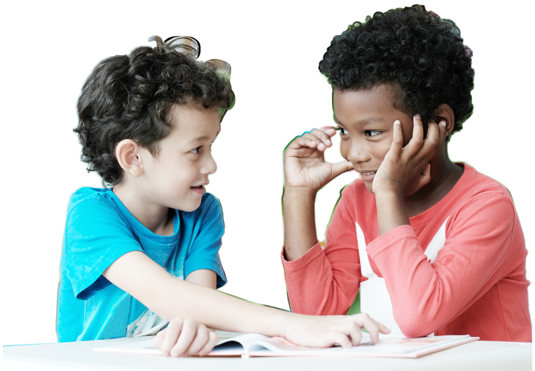
Time to Create
Grades 3–5
Digital Lesson

Slide 2
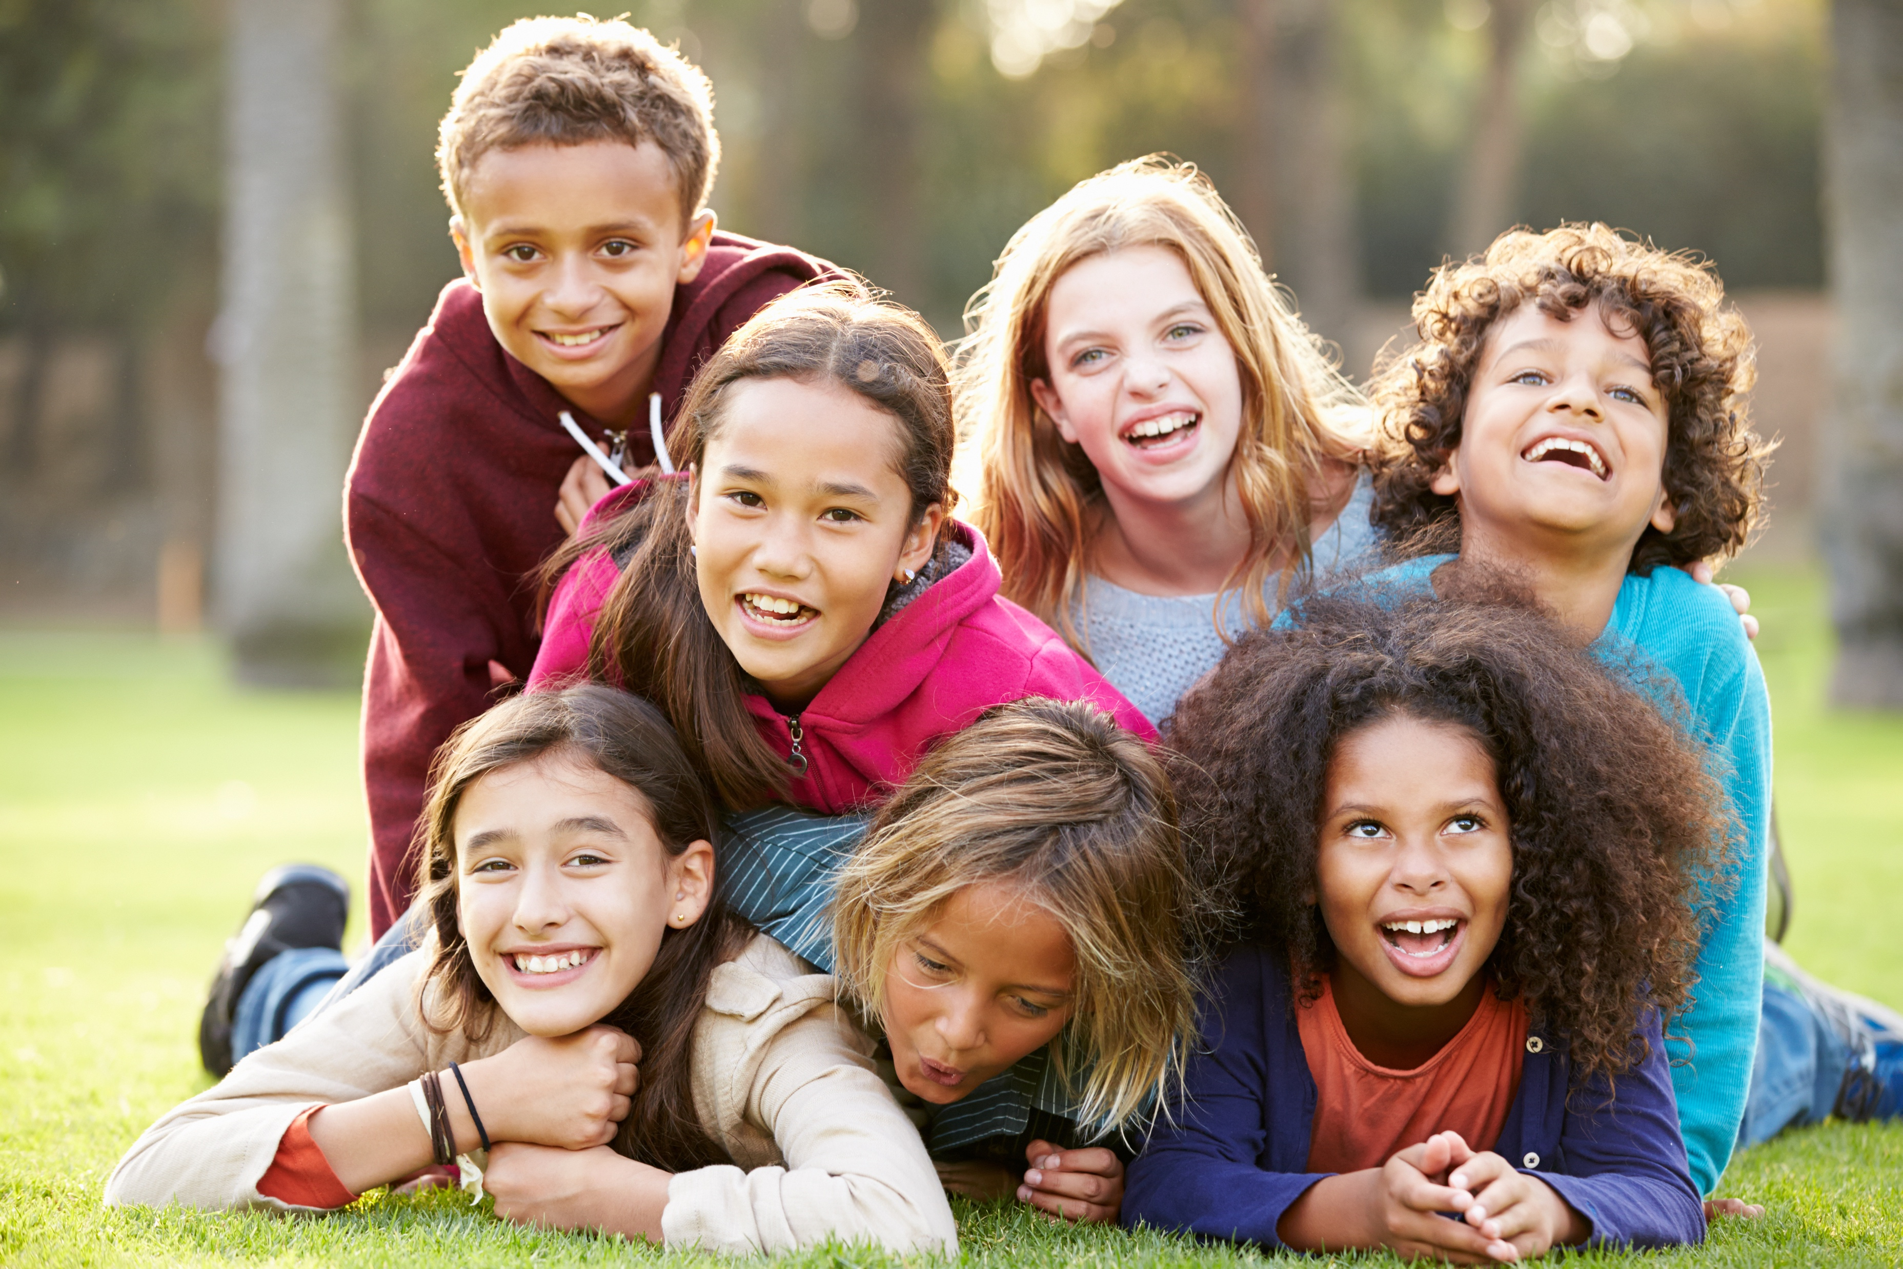
Who are YOU?
Notes:
Instructor Notes:
Instruct the class to sit on the floor in a circle or semi-circle and join the students by sitting at their level.
Click once to display the question: Who are YOU?
Explain that while this may seem like a funny question since the class already knows each other, you are challenging each student to really think about what makes them special.
Pass out Handout 1: I am… to each student. Tell students that they are going to make a collage—or a piece of artwork made up of many different words and pictures—that represents them and answers this question.
Explain that students should:
Write their name in the center of the handout.
Look through the collage materials and cut out words and images that help explain what makes them special.
Glue these cut-outs to their handout.
Explain that how they organize their collage is up to them. Some students may want the images to overlap, while some may want them spaced evenly. The design choice is theirs!
Pass out the collage materials, glue sticks, and scissors.
Tell the class that they will have about 10 minutes to create their collage and encourage them to begin creating!

Slide 3
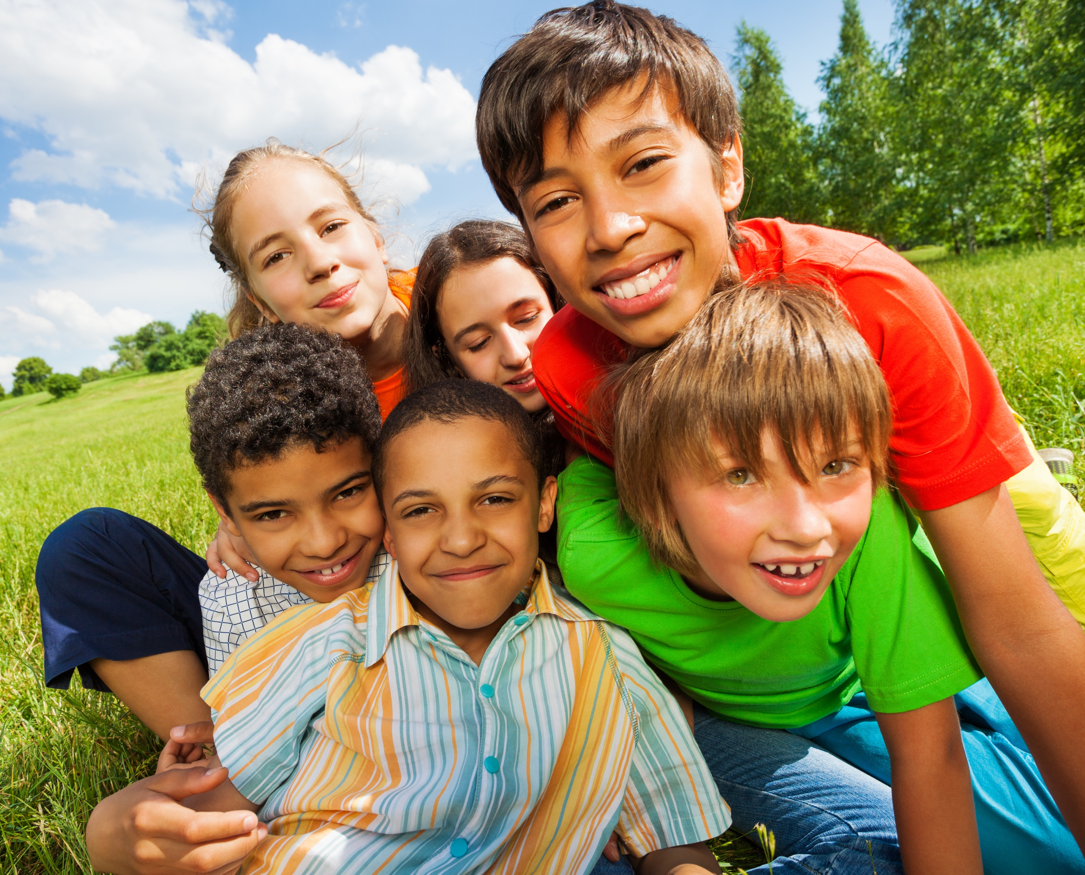
Who are YOU?
I understand others
are unique.
I want to learn more about everyone I meet.
I want to step into
their shoes
and see what they are going through.
Unique:
to be one of a kind
and unlike anyone else!
Notes:
Instructor Notes:
Have the class sit back on the floor in a circle or semi-circle, with their collages on the floor in front of them.
Click once to display the portion from the Wings Words to Live By and read it aloud.
Repeat, “I understand others are unique, I want to learn more about everyone I meet.”
Click once to display the word “unique” and ask for student thoughts on what this word means.
Click again to display the definition: to be one of a kind and unlike anyone else!
Then prompt students to examine their own collage and think about how their collage demonstrates that they are unique.
Once they have thought about it for a moment, encourage students to share their collage with the person next to them and explain how the words and pictures represent them (and nobody else!).
Then invite each student to hold their collage out in front of them so the class can look around the circle, view the unique work that their classmates have created, and begin to learn more about their peers.

Slide 4
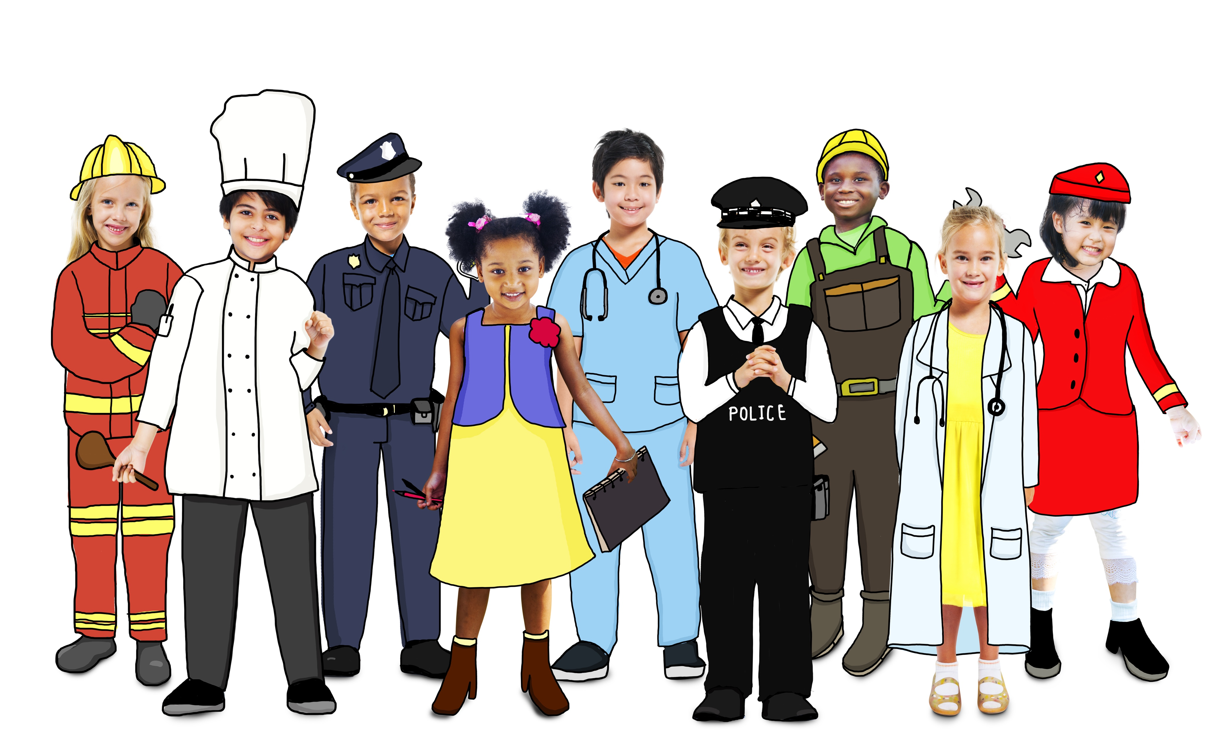
How are you different from someone else?
Notes:
Instructor Notes:
Ask students to continue holding their collages in front of them and emphasize how different and unique each collage is from the next.
Ask, “How are you different from someone else?” Encourage students to look at each other’s collages and then call on several students to share their thoughts.
If a student brings up physical differences, acknowledge that everyone certainly does have unique looks—but tell the class that you would like to focus on our “inside” differences.
Summarize the differences that students came up with and wrap up by concluding that in addition to how we look, we also all have different personalities and interests!

Slide 5
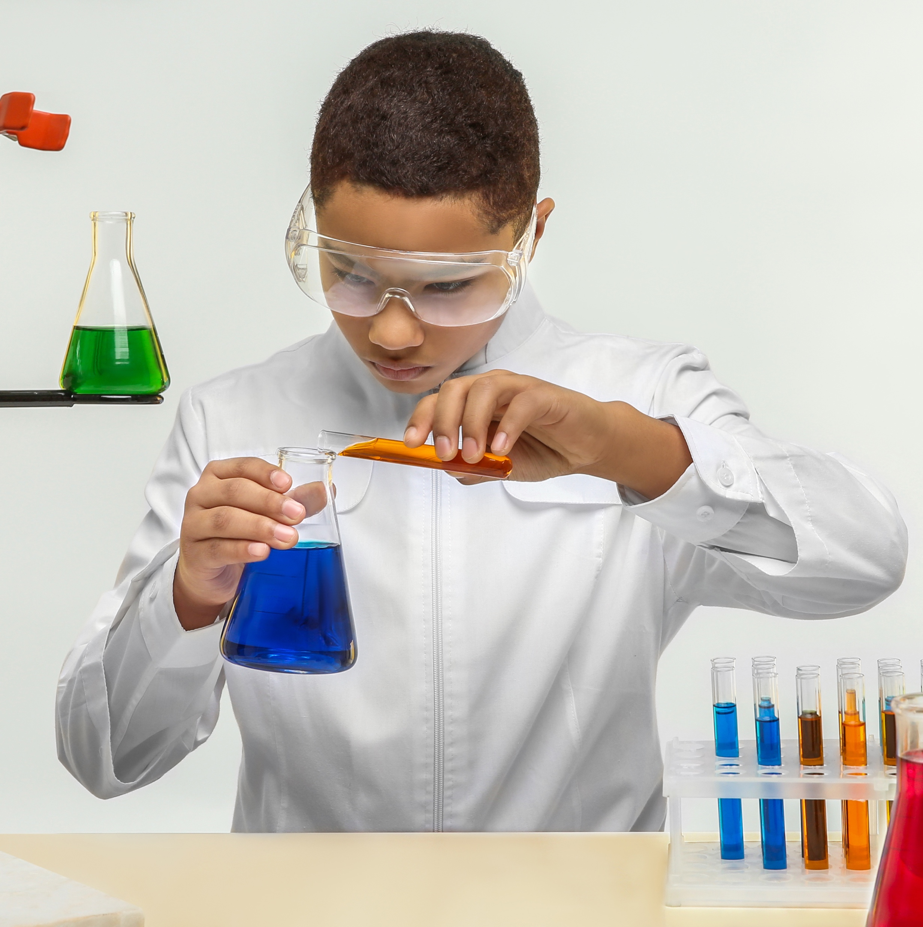

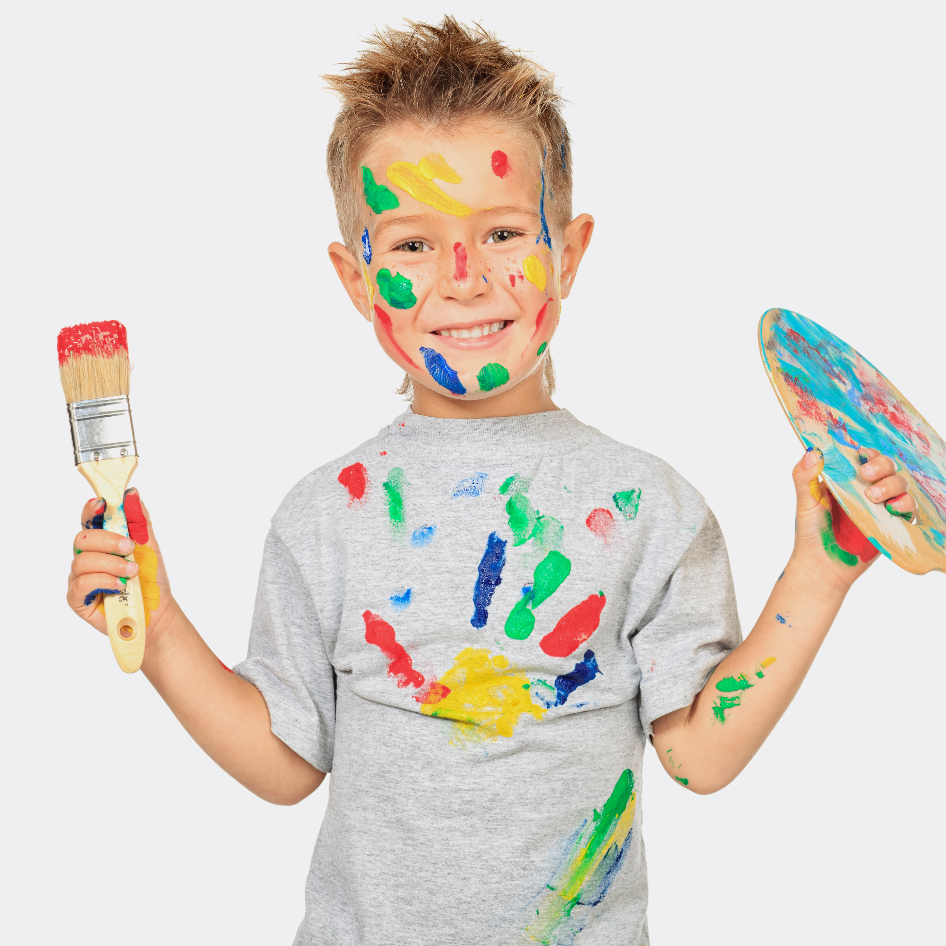

good
Why is it to be unique?
Notes:
Instructor Notes:
Ask, “When you think about the words “unique” and “different”, do you have positive or negative thoughts?” Encourage all students to give a thumbs up, thumbs down or thumbs to the side to indicate their feelings and then call on a few students to share their reasoning.
After hearing students’ immediate reactions, explain that even though our differences may mean that we have to work a little harder to understand each other, our uniqueness is a very positive thing!
Click once and ask students to think-pair-share* about why our differences are a positive (or good) thing.
*In a think-pair-share, students think about the question independently, discuss their answers with a partner, and then share their thoughts with the larger class.
Once several students have shared, make sure students have considered that differences are positive because they give us the opportunity to learn from others.
Ask, “When have you learned something from someone who is different than you?”
If helpful, try to jumpstart student responses by sharing an experience of your own, or something along the lines of: “One of my best friends growing up was from _______. From her and her family, I learned how to say some words in ________ and I got to learn all about __________ food and cooking!

Slide 6
We’re all different and that’s OK!
O
ffer your ideas and listen to others.
K
eep an open mind and learn
from others.
Notes:
Instructor Notes:
Click once to display: “We’re all different and that’s OK!” and read the phrase aloud.
Click once and explain that each letter in “OK” reminds us that when we meet new and different people, we should try to learn more about them.
Click again and explain that the O stands for “Offer your ideas and listen to others”.
Explain that not only do we need to speak up and share our own thoughts and ideas, but we need to really listen to what others say!
Ask and discuss, “Why is it important to listen to someone else’s point of view?”
Then click again and explain that the K stands for “Keep an open mind and learn from others”.
Ask, “What does it mean to have an “open mind”?”
Be sure students understand that when you have an open mind, you don’t make decisions about people or ideas ahead of time. You are willing to listen to, consider, and accept new ideas. When you have an open mind, you are happy to see what new things you can learn.
Summarize by telling students when we listen to others and have an open mind, we can learn all kinds of things from people who are different from us!

Slide 7

We’re all different and that’s OK!
Write your interview questions.
Interview your partner.
Create a book cover that shows how your partner is unique!
Notes:
Instructor Notes:
Explain that for the rest of class students will be working in pairs to learn more about one of their peers.
Divide students into groups of two. If there is an odd number of students, there should be one group of three. If possible, place students into pairs with students they may not know well.
Click to explain that students will be completing three tasks:
First, they will create interview questions to get to know their partner better.
Next, they will interview their partner.
Then, they will use what they have learned to create a book cover for a pretend book (a biography!) that is all about their partner. Their book cover must show how their partner is unique.
Distribute Handout 2: Interview Guide to each student and review the directions together. As you do, talk through a couple sample interview questions, such as: What is your favorite thing to do in your free time? Or: What kind of food do you dislike the most? Remind students that the goal is to discover unique qualities about their classmate!
Explain that once students are done interviewing their classmate, they will then move on to creating a book cover about them. Hold up a few sample books and ask for students to describe what each one includes. Ensure students understand that book covers contain a title and an image that helps the reader learn about the story inside.
Then click once to project Handout 3: Book Cover. Read the directions aloud and explain that students will use what they learn from their interviews to create this book cover.
Tell the class that once their interviews are complete, they should raise their hands and you will give them a Book Cover handout.

Slide 8
We’re all different and that’s OK!
Write your interview questions.
Interview your partner.
Raise your hand when your interviews are complete.
Begin your book cover!
Notes:
Instructor Notes:
Encourage students to begin their interviews and tell them to check the directions on the slide if they need a reminder of the order in which they should complete their work.
As students raise their hand to tell you they are done with their interviews, quickly scan their interview answers and ensure that they contain content they can use to create a book cover that shows how their peer is unique. If not, provide a few additional question recommendations.
Then distribute Handout 3: Book Cover to each student.
If any groups have not begun their book covers once there are 15 minutes left in the session, prompt them to finish up their interview questions and get started.

Slide 9

I understand others are unique.
I want to learn more about everyone I meet.
Notes:
Instructor Notes:
When there are about five minutes left, conclude this session with a library walk.
Instruct each student to display their book cover around the classroom. (It’s fine if it is still in draft form!)
Then lead students in walking around the classroom quietly, like they are in a library, so they can look at the book covers their peers have created. As they do so, encourage them to think about how their peers are unique and what they can learn about each of their classmates.

Slide 10
One Inch Tall by Shel Silverstein
If you were only one inch tall,
you'd ride a worm to school.
The teardrop of a crying ant
would be your swimming pool.
A crumb of cake would be a feast
And last you seven days at least,
A flea would be a frightening beast
If you were one inch tall.
If you were only one inch tall,
you'd walk beneath the door,
And it would take about a month
to get down to the store.
A bit of fluff would be your bed,
You'd swing upon a spider's thread,
And wear a thimble on your head
If you were one inch tall.
You'd surf across the kitchen sink
upon a stick of gum.
You couldn't hug your mama,
you'd just have to hug her thumb.
You'd run from people's feet in
fright,
To move a pen would take
all night, (This poem took fourteen
years to write–'Cause I'm just one
inch tall).
Notes:
Instructor Notes:
Invite students back to your circle or semi-circle with their sketch.
Instruct each student to hold their drawing facing outward so the class can look around the circle and see what their peers have created.
Then click once and explain that one part of understanding someone else’s perspective is understanding what they see, just like they considered during this activity.
Click again and explain that another important part of understanding someone else’s perspective is thinking about what this other person may be thinking or feeling.
Ask, “Based on what you know about this one-inch-tall person, what do you think they may be thinking or feeling?” Encourage students to refer to clues from the poem or their own drawing to help support their ideas.

Slide 11
I see…
I feel… I think…
Notes:
Instructor Notes:
Tell students that you are going to challenge them to consider perspectives one more time, but this time there will be two perspectives to think about!
Click once and ask students to consider the perspective of each person in the cartoon.
Prompt students to think about:
What does the person on the island see? What may this person be thinking? What may this person be feeling?
What does the person on the boat see? What may this person be thinking? What may this person be feeling?
Wrap up by concluding that even though these two people may initially look like they’re in similar situations since they’re both in the middle of the ocean, their perspective (what they see, think, and feel) couldn’t be more different!

Slide 12
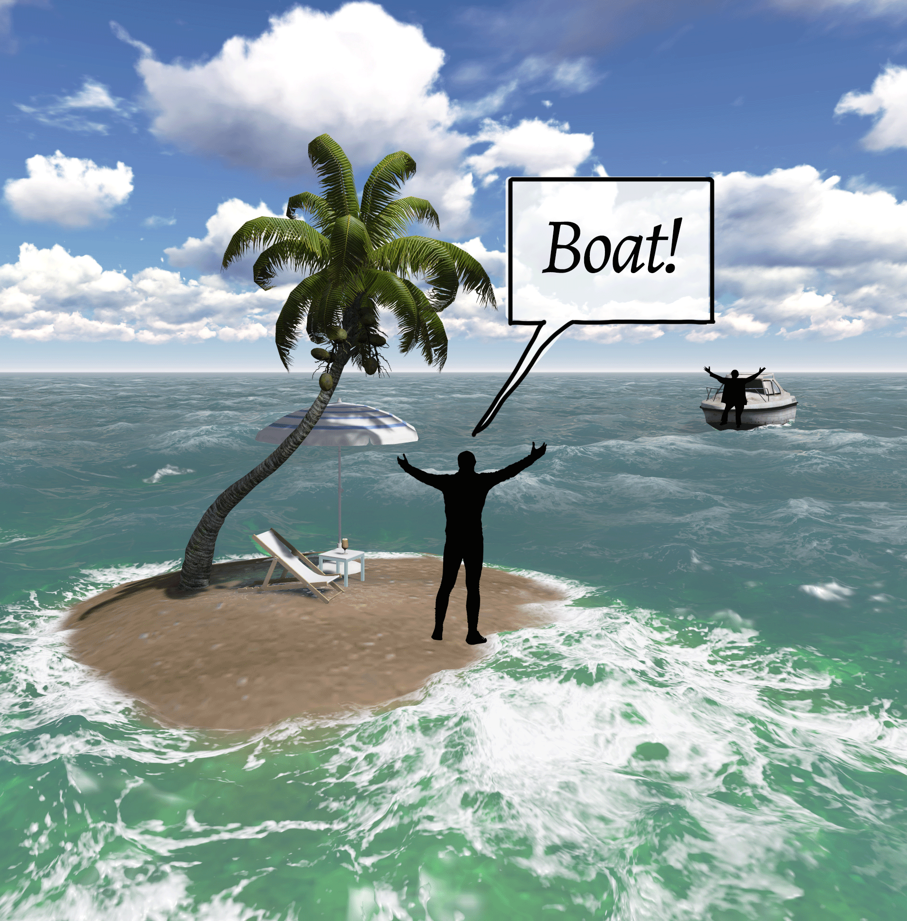
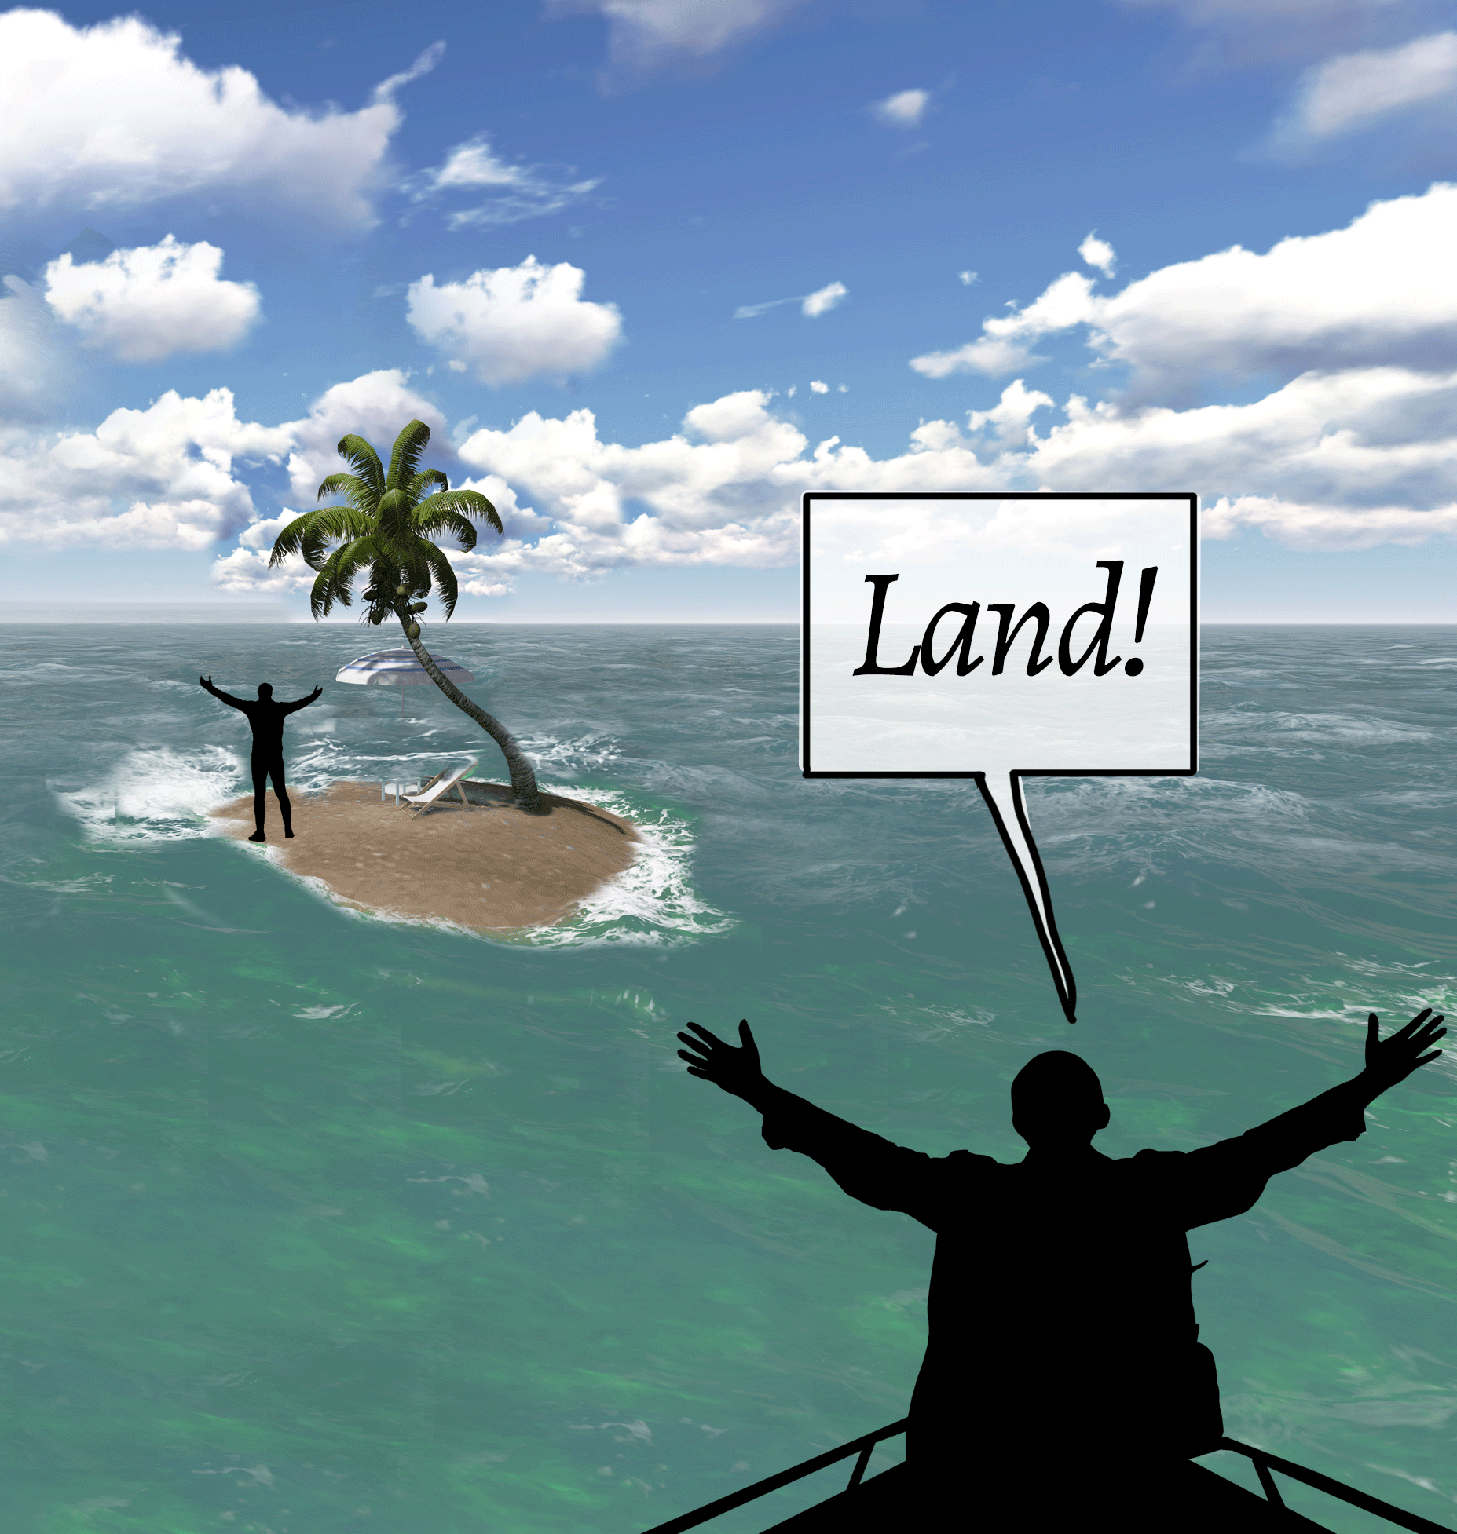
Notes:
Instructor Notes:
Tell students that you are going to challenge them to consider perspectives one more time, but this time there will be two perspectives to think about!
Click once and ask students to consider the perspective of each person in the cartoon.
Prompt students to think about:
What does the person on the island see? What may this person be thinking? What may this person be feeling?
What does the person on the boat see? What may this person be thinking? What may this person be feeling?
Wrap up by concluding that even though these two people may initially look like they’re in similar situations since they’re both in the middle of the ocean, their perspective (what they see, think, and feel) couldn’t be more different!

Slide 13
Step into their SHOES
I understand others are unique.
I want to learn more about everyone I meet.
I want to step into their SHOES
and see what they are going through.
Sound of voice
How they act
Outer appearance
Expression on face
Surroundings
Notes:
Instructor Notes:
Explain that when you consider someone’s perspective and think about what someone else is seeing, thinking, and feeling you are putting yourself into someone else’s shoes.
Click once to reveal and reread this portion of the Words to Live By.
Explain that when we step into someone else’s shoes and try to understand how he or she is feeling, we are able to be as supportive and kind as possible.
Point to the word “SHOES” in the Words to Live By and explain that each letter helps us remember how to actually step into someone else’s shoes.
Click to remove the Words to Live By.
Click once more and tell students that the S stands for Sound of their voice.
Ask, “Do they sound excited? Nervous? Frustrated? Confident?”
Click once to reveal the cartoon again and ask students to share: How do they think these two characters would sound?
Ask student volunteers to say, “Boat!” and “Land!” in a tone of voice that portrays how they may feel.
Click again and explain that H stands for How they act.
Explain that what you do with your arms, hands, and legs is your body language.
Ask, “Based on the body language of the two people in the cartoon, how do they seem to feel?”
Then ask all students to demonstrate what their arms, hands, and legs might do when they feel nervous, frustrated, and confident.
Click another time and say that O stands for Outer appearance.
Explain that outer appearance refers to what they look like on the outside. Ask, “What do they look like? Are they turning red, shaking, sweating, slouching, or standing up straight?”
Explain and demonstrate that if you were excited, you might sit or stand up very straight. You even might tap your foot because you can’t sit or stand still!
Then ask students to show you how they may look when they are nervous, frustrated, and confident.
Click again and say that E stands for Expression on their face. Ask, “What does their face look like? What expression are their eyes or their mouth making?”
Ask for the entire class to make a face that shows excitement.
Then ask the class to look around at each other and note that everyone shows excitement a little differently!
Continue by asking all students to show what their face may look like when they are nervous, frustrated, and confident.
Finally, click one more time and explain that S stands for Surroundings: Where they are and who they are with.
Explain that sometimes noticing where the person is or who they are with can help us understand what they are feeling, especially if we combine it with the other parts of SHOES.
Ask, “How do the surroundings in this cartoon help us better understand what these characters are feeling?”
Then ask the following:
If you see someone is with a lot of other people who they don’t really know and they are crossing their arms, blushing, and looking down, how might they feel?
Or, if someone is with a lot of other people, and they are smiling, laughing and jumping up and down, how might they feel?
Wrap up by telling students that when you think about all the letters in SHOES, you are able to really step into someone else’s shoes and look at the world from their perspective.

Slide 14
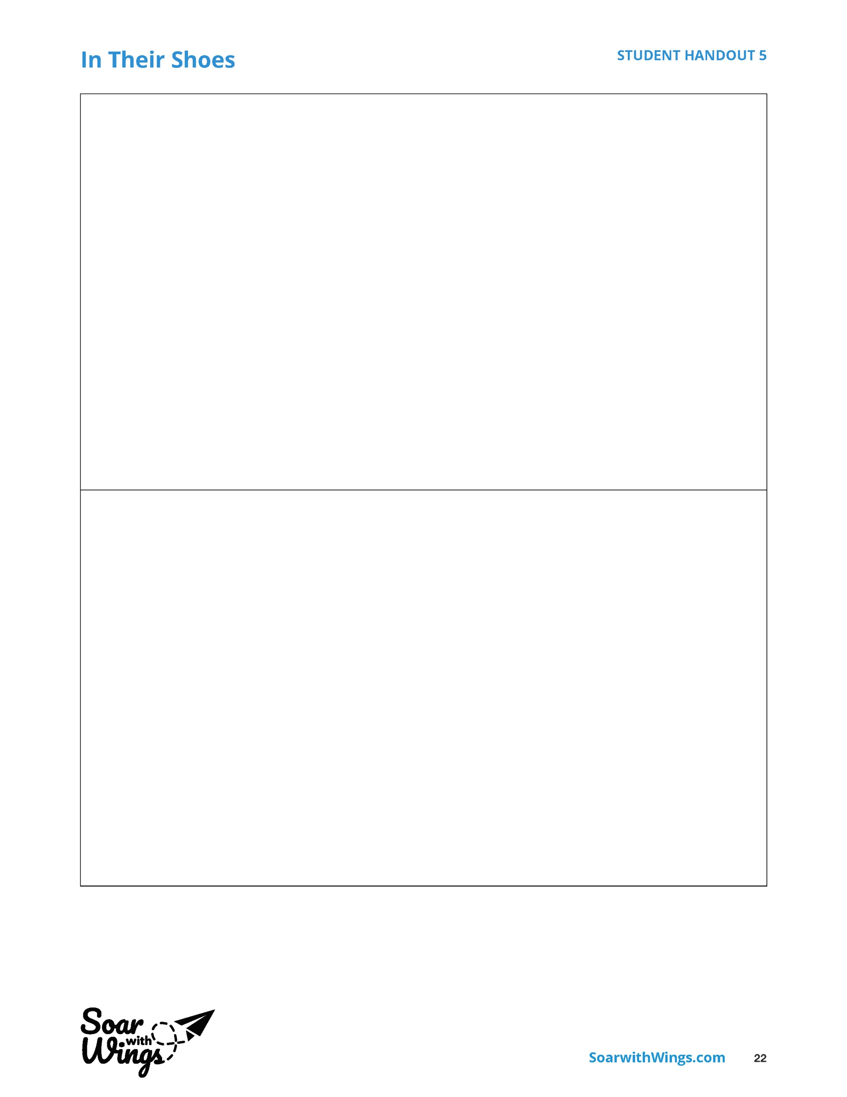
Step into their SHOES
Sound of voice
How they act
Outer appearance
Expression on face
Surroundings
Notes:
Instructor Notes:
Click once to reveal the blank comic outline and explain now that students know how to put themselves into someone else’s shoes they are going to create their own comic!
Explain:
Like the island comic, students will choose one scene or setting where two people could be feeling or thinking very differently.
In the top square, students should draw the comic panel from the shoes of one person in the scene, complete with a thought or speech bubble.
In the bottom square, students should draw a second panel from the shoes of another person in the scene, complete with another thought or speech bubble.
Ask students to help you brainstorm a list of places where their comic could take place and record their ideas on the board or a piece of chart paper.
The sky is the limit, but possibilities include: recess, lunch, in class, at home, on the bus, at the mall, at the park, etc.
Then click twice to remove the comic outline and replace it with the SHOES acronym. Encourage students to refer to the acronym as they create their comic so they can truly put themselves in each of their characters’ shoes.
Then distribute Handout 5: In their Shoes to each student and tell them to get started!
*Tip: Some students may benefit from brainstorming additional ideas with their classmates before beginning to work on their own.
When there are about 20 minutes left in the class session, give students a reminder that they have 5 minutes left to work.
When there are about 15 minutes left in the class session, encourage students to look around the room and make eye contact with someone with whom they may not normally work. They should then share their comic with this person and see what they can learn!

Slide 15
    My SHOES Goal:
    I will step into someone else’s shoes the next time ________________________________________.
    I will step into their shoes by _________________.
When should you have stepped into someone else’s
but didn’t?
When has someone stepped into your ?
Notes:
Instructor Notes:
Instruct students to join you back in a circle or semi-circle.
Click once and explain that students are now going to apply what they have learned to their own lives.
Ask students to think-pair-share a time when someone stepped into their shoes and really tried to understand how they were feeling.
If needed, kick off with an example such as, “Someone stepped into my shoes when they could see I was really nervous about _______. They gave me a hug and promised me everything would be okay!”
Click twice, then encourage students to Show Their ID* and think about a time when they should have stepped into someone else’s shoes but didn’t.
* If students have not yet learned this term from the Responsible Decision-Making lesson, simply remove it.
Begin with a personal example, such as, “I remember a time when my friend tripped and I laughed. His face turned red and he looked down. If I had stepped into his shoes, I would have known from his expression that he was embarrassed and upset.” Then ask a couple volunteers to share their own examples, without using names.
Click two more times. Then pass out Handout 6: My Goals to each student and explain that for the time remaining in class, they will create their own SHOES goal by following these steps:
Draw an outline of someone else’s shoe. (In other words: a shoe that does not look like one you would normally wear!)
Somewhere within the design of the shoe, write the following sentence starters to create your own goal:
I will step into someone else’s shoes the next time_________________.
I will step into their shoes by __________________________________.
*Tip: Tell students that these sentences could be included anywhere in the shoe: in the laces, on the sole, on the side, etc.
Help students kick-off their goal-setting by explaining how you may fill in the sentence starters. Model your thought process out loud by saying, “I just shared that I wished I had stepped into someone else’s shoes when my friend tripped and I laughed. So, for my goal, I may say, “I will step into someone else’s shoes the next time I see someone do something that I want to laugh at. I will do this by looking at the other person’s facial expression and body language so I can figure out how they might be feeling.”
Answer any questions and then instruct students to use the coloring materials and begin their goal-setting. If you think it will be helpful for students to discuss their goal with a peer before working individually, encourage them to do so.

Slide 16
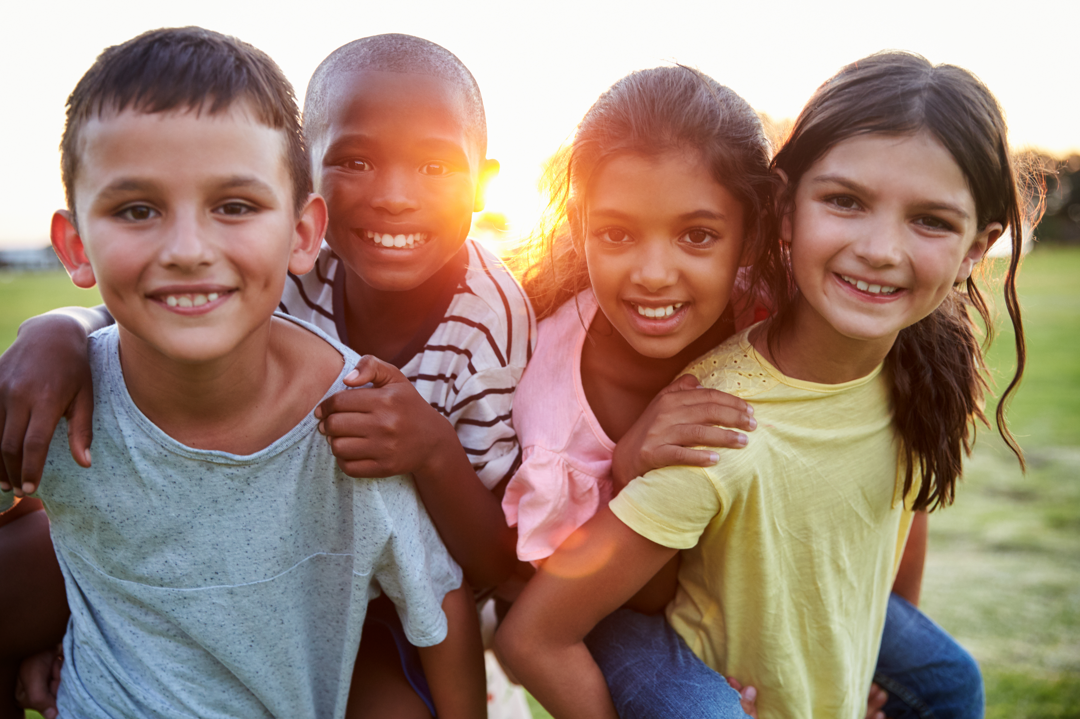
I understand others are unique.
I want to learn more about everyone I meet.
I want to step into their shoes
and see what they are going through.
Notes:
Instructor Notes:
When there is just a minute or so left in class, collect students’ completed shoes goals so you can later display them around the classroom. Or, if this is not possible, try to incorporate time for goal-sharing into the next several sessions!
Then conclude by asking the class to join you in reading the Words to Live By stanza aloud that you have covered over the last two sessions.

Slide 17

Notes:
Instructor Notes:
Begin with a class graffiti board centered around the word Friend, by asking all students to draw a quick sketch or write a few words on the board that demonstrate the qualities they look for in a friend. If you are using a smart board, students can draw directly on this slide. If not, rewrite “Friend” on the white board or a piece of chart paper and have students sketch/write around it.
*Tip: If possible, have several students draw at the same time to quicken the process.
Once everyone has contributed, assemble students on the floor in circle or semi-circle in an area where the class graffiti board is visible and join the students by sitting at their level.
Give students a moment to observe the graffiti board. As they do, encourage them to think about the similarities and differences between everyone’s contributions.
Ask, “Do we seem to agree or disagree on the qualities that make up a friend? Why?”

Slide 18
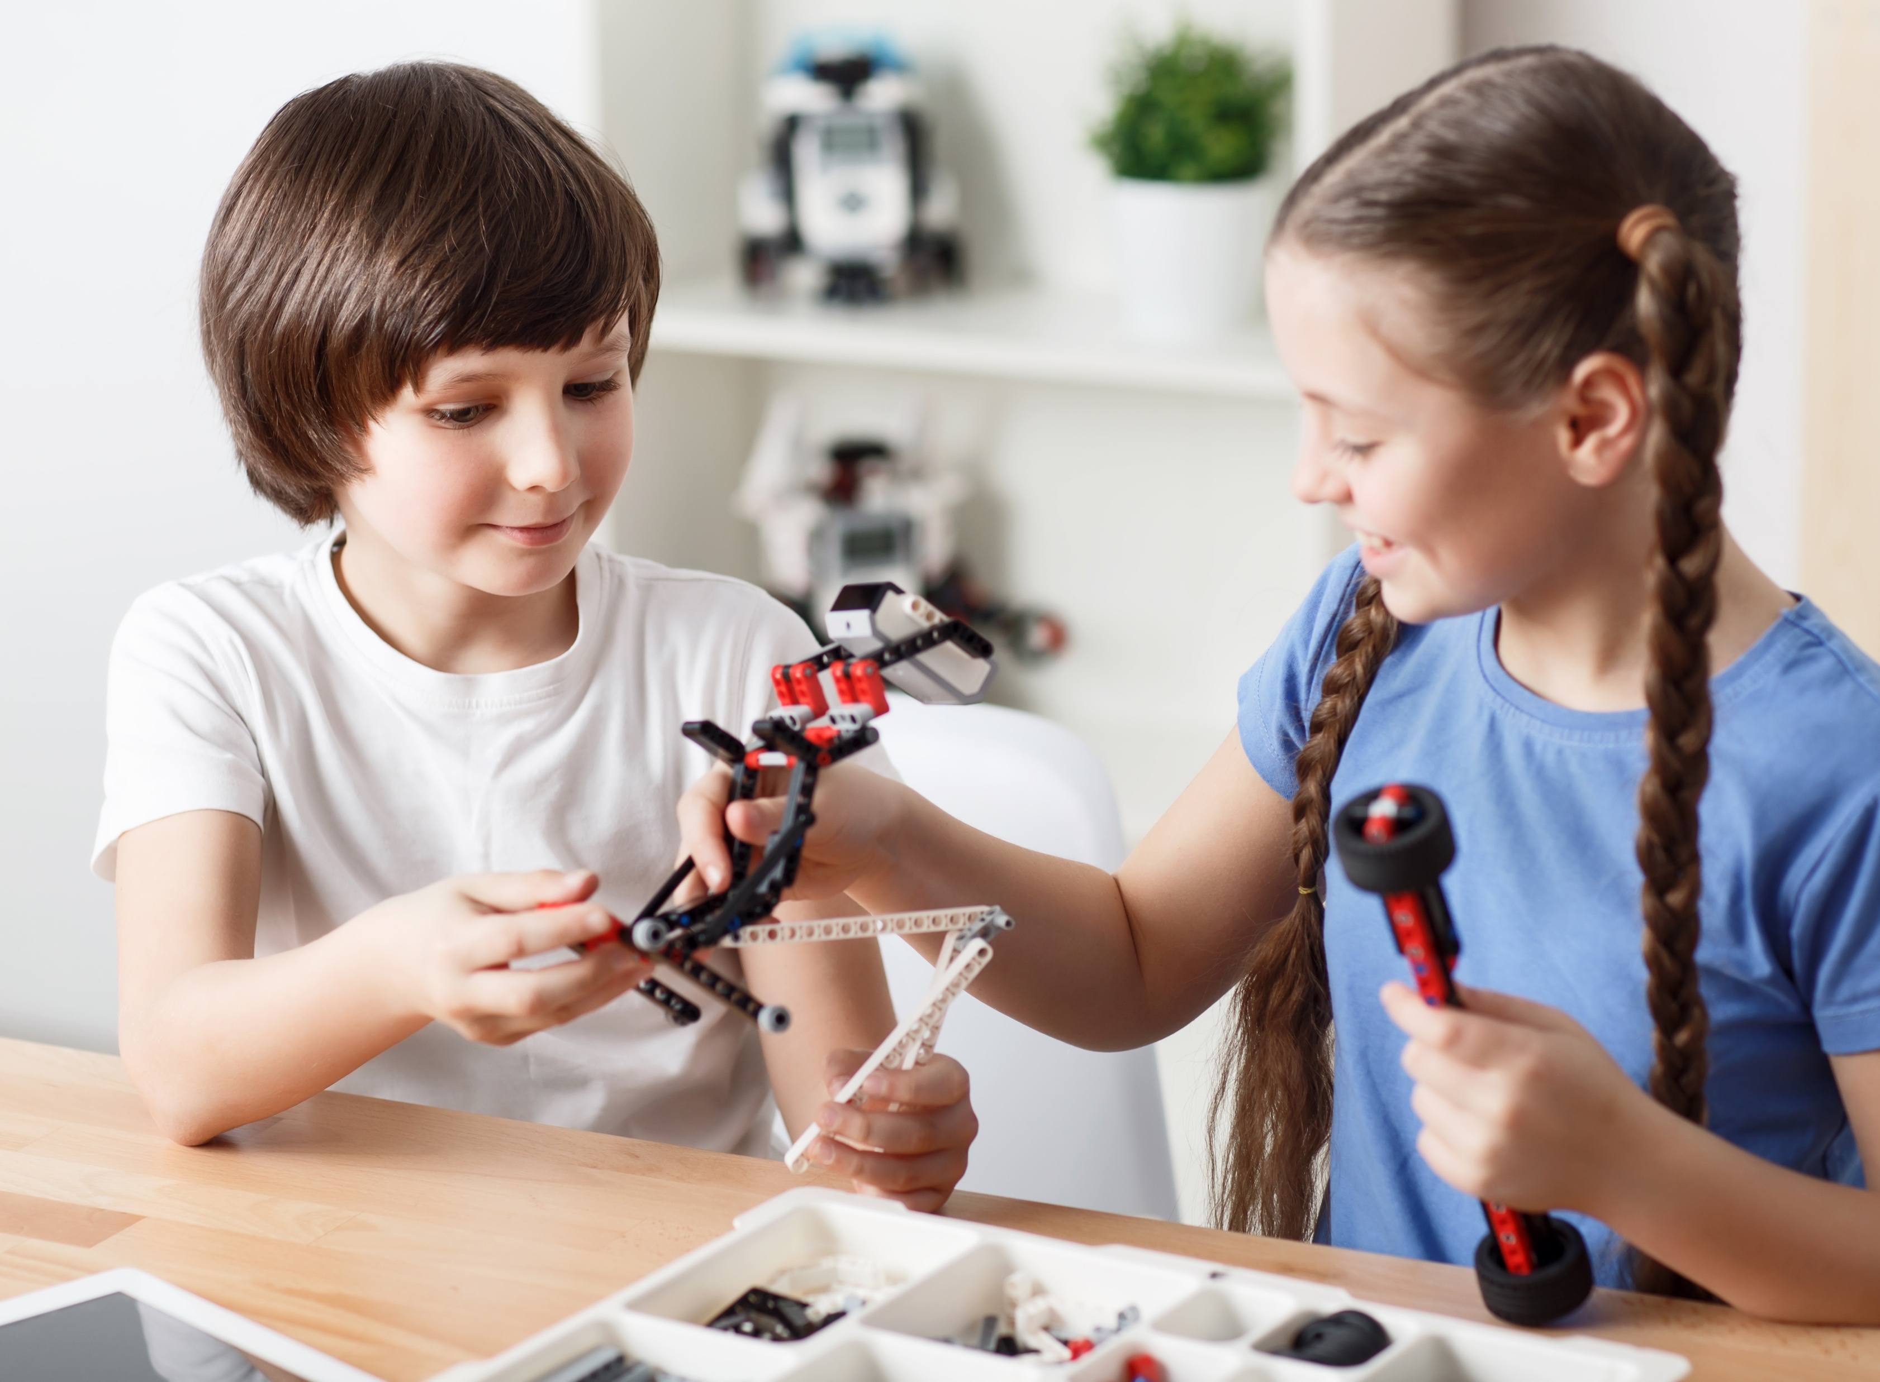
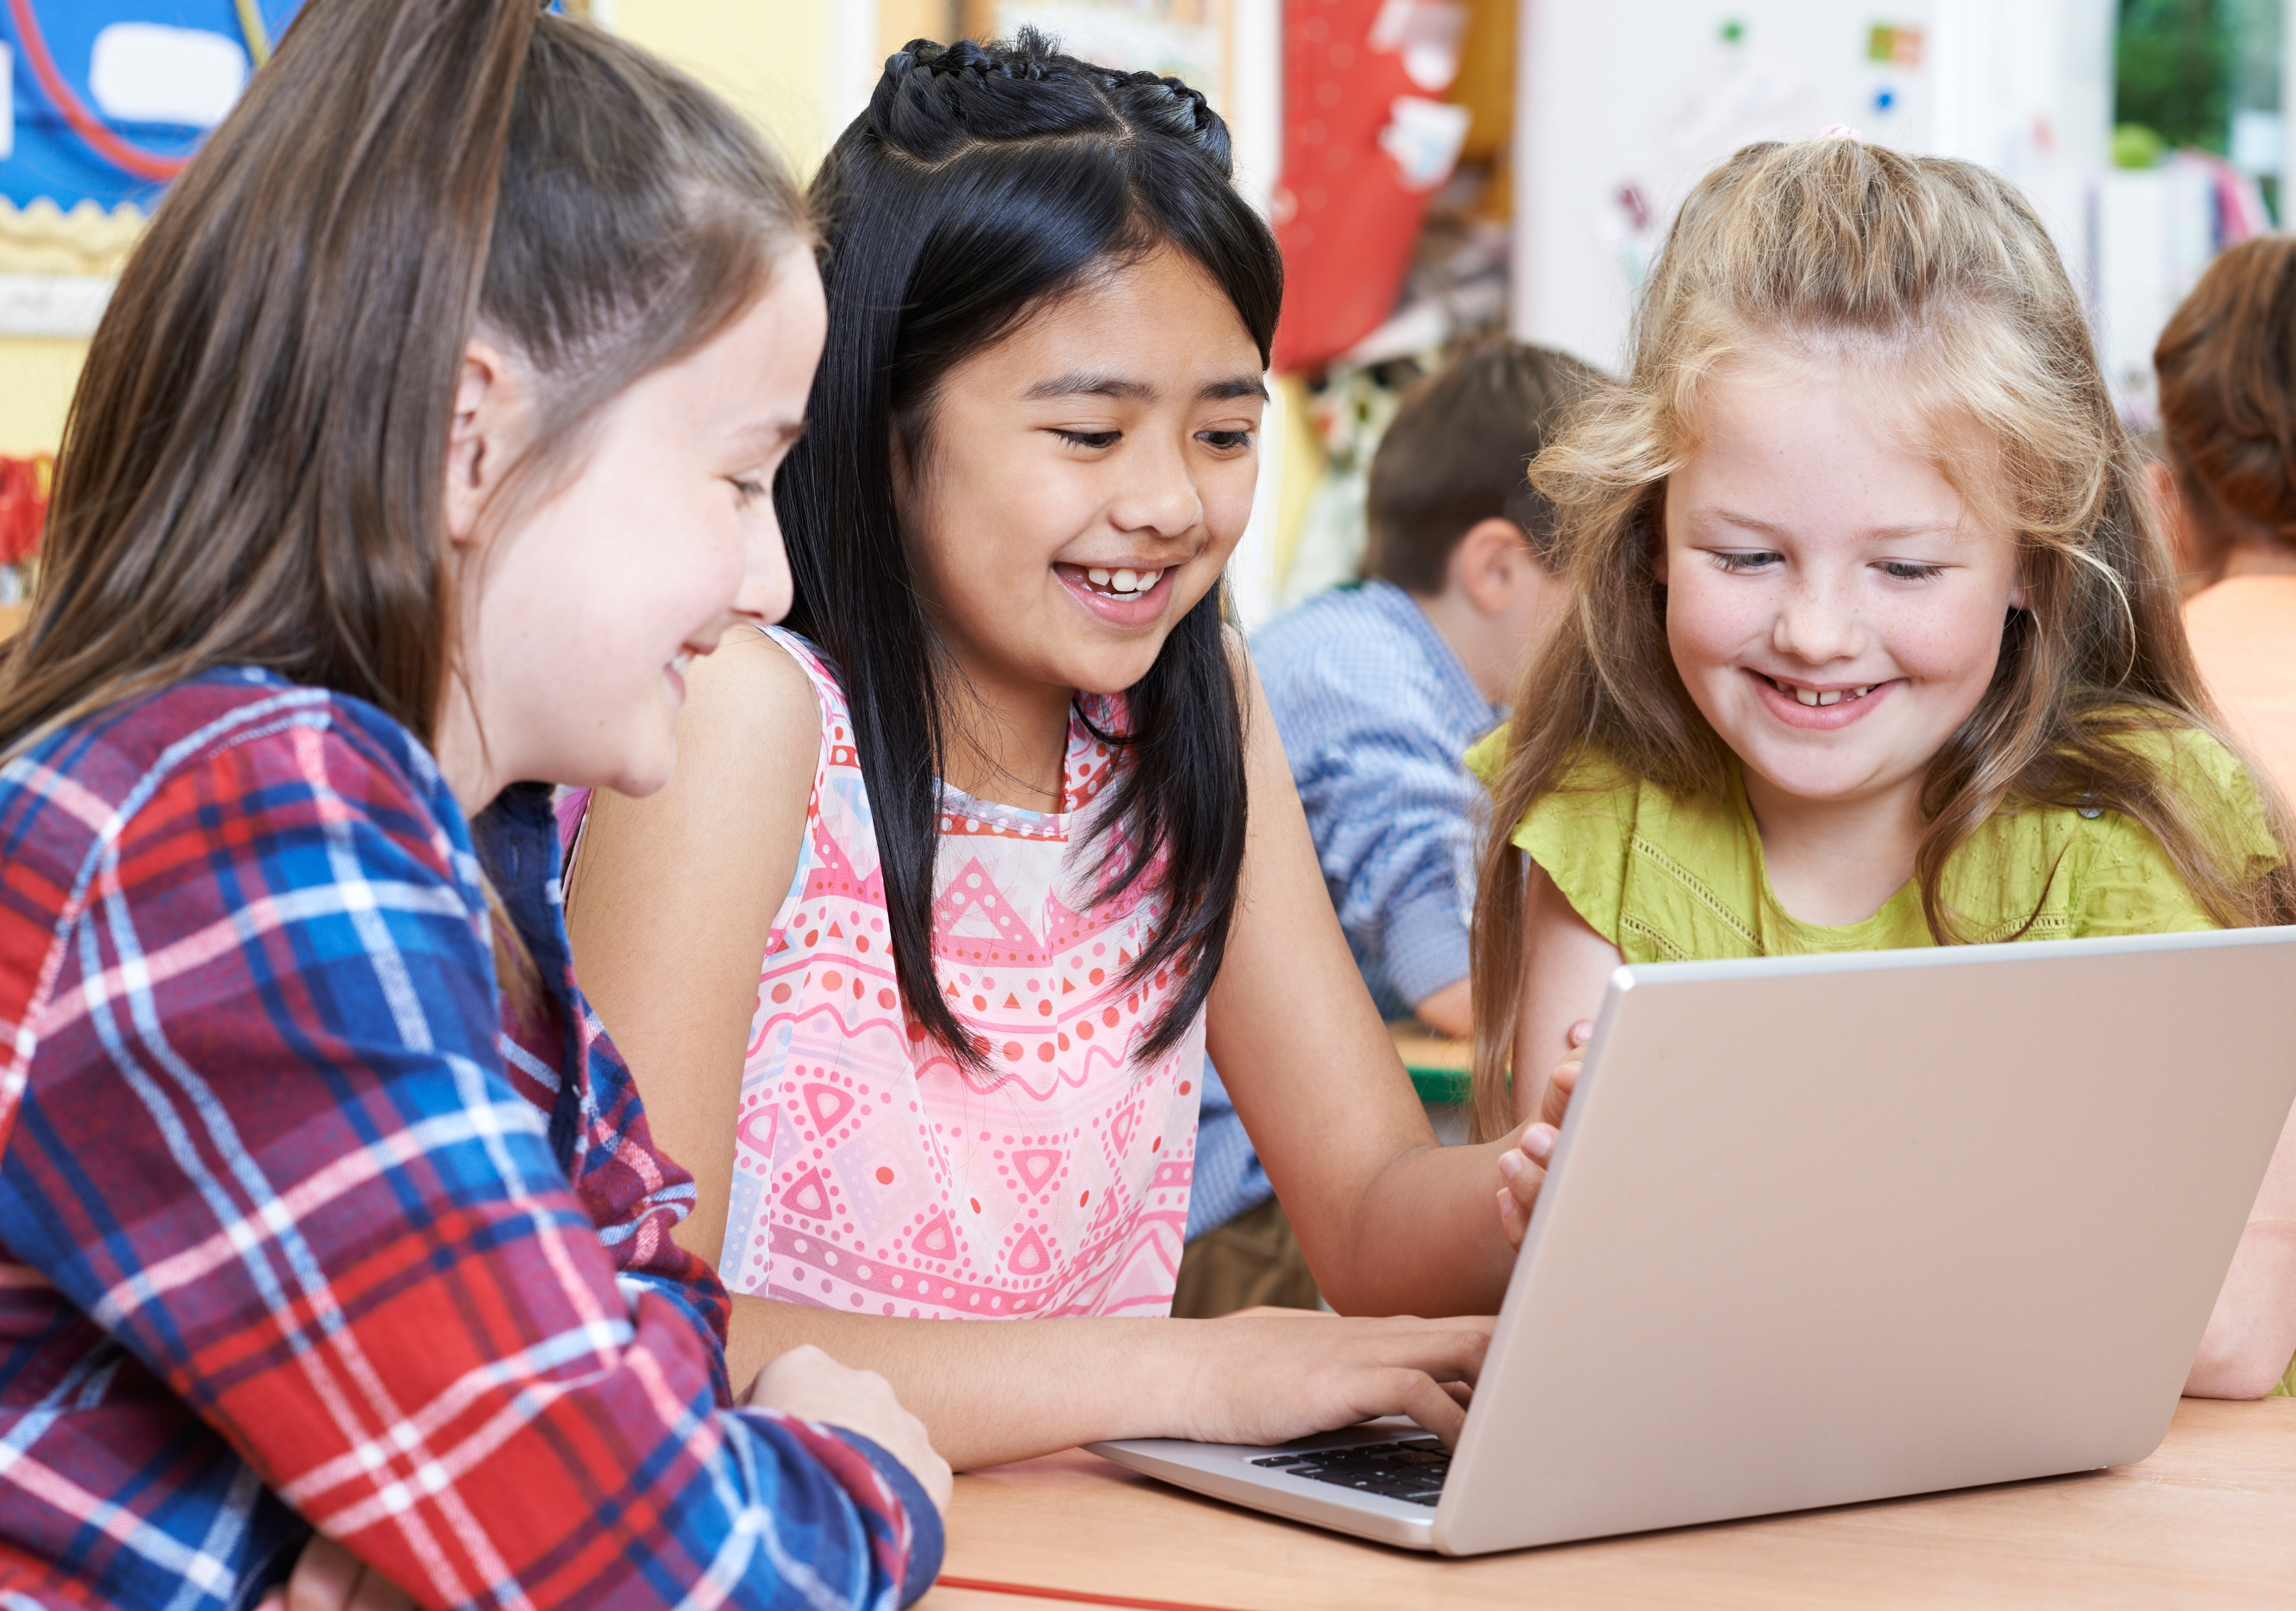

I am a friend. I support and trust.
Working together is a must.
Notes:
Instructor Notes:
Click to project the next verse of the Wings Words to Live By and read it aloud.
Explain that in order to have good relationships with others, it is important to treat everyone with respect. This means that you act like a friend, you support (or help others), you trust others, and you work together.
Ask students to raise their hands if they agree that it is important to treat others this way.
Then ask them to raise their hands if they think it can be hard to always treat others this way.
Share that, thankfully, you have a few tips to make this a little easier!

Slide 19
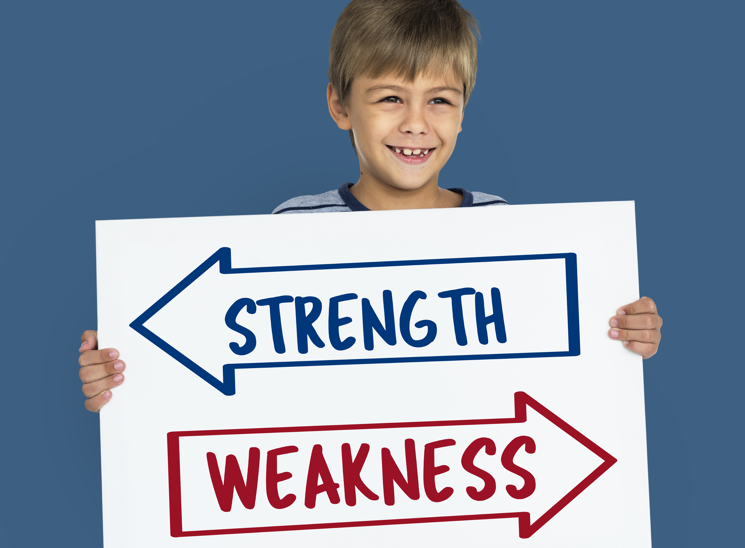

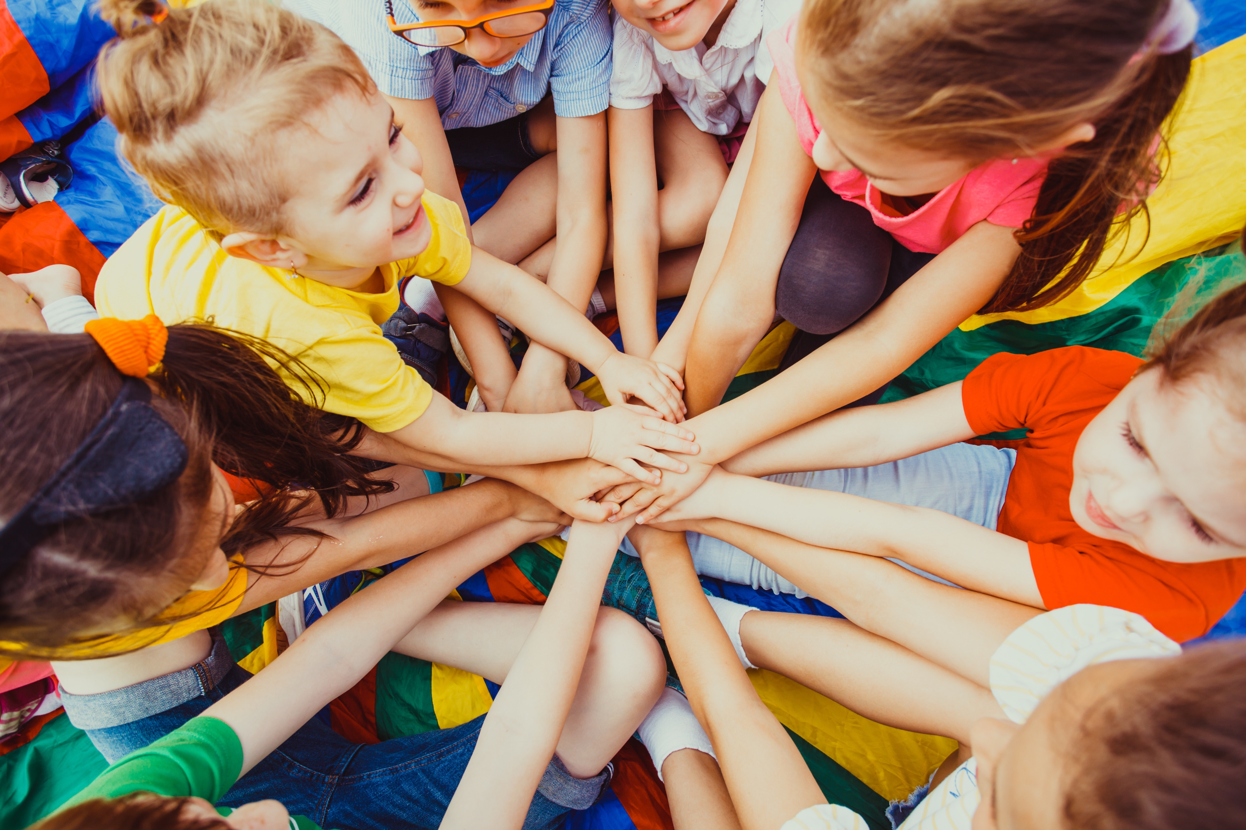
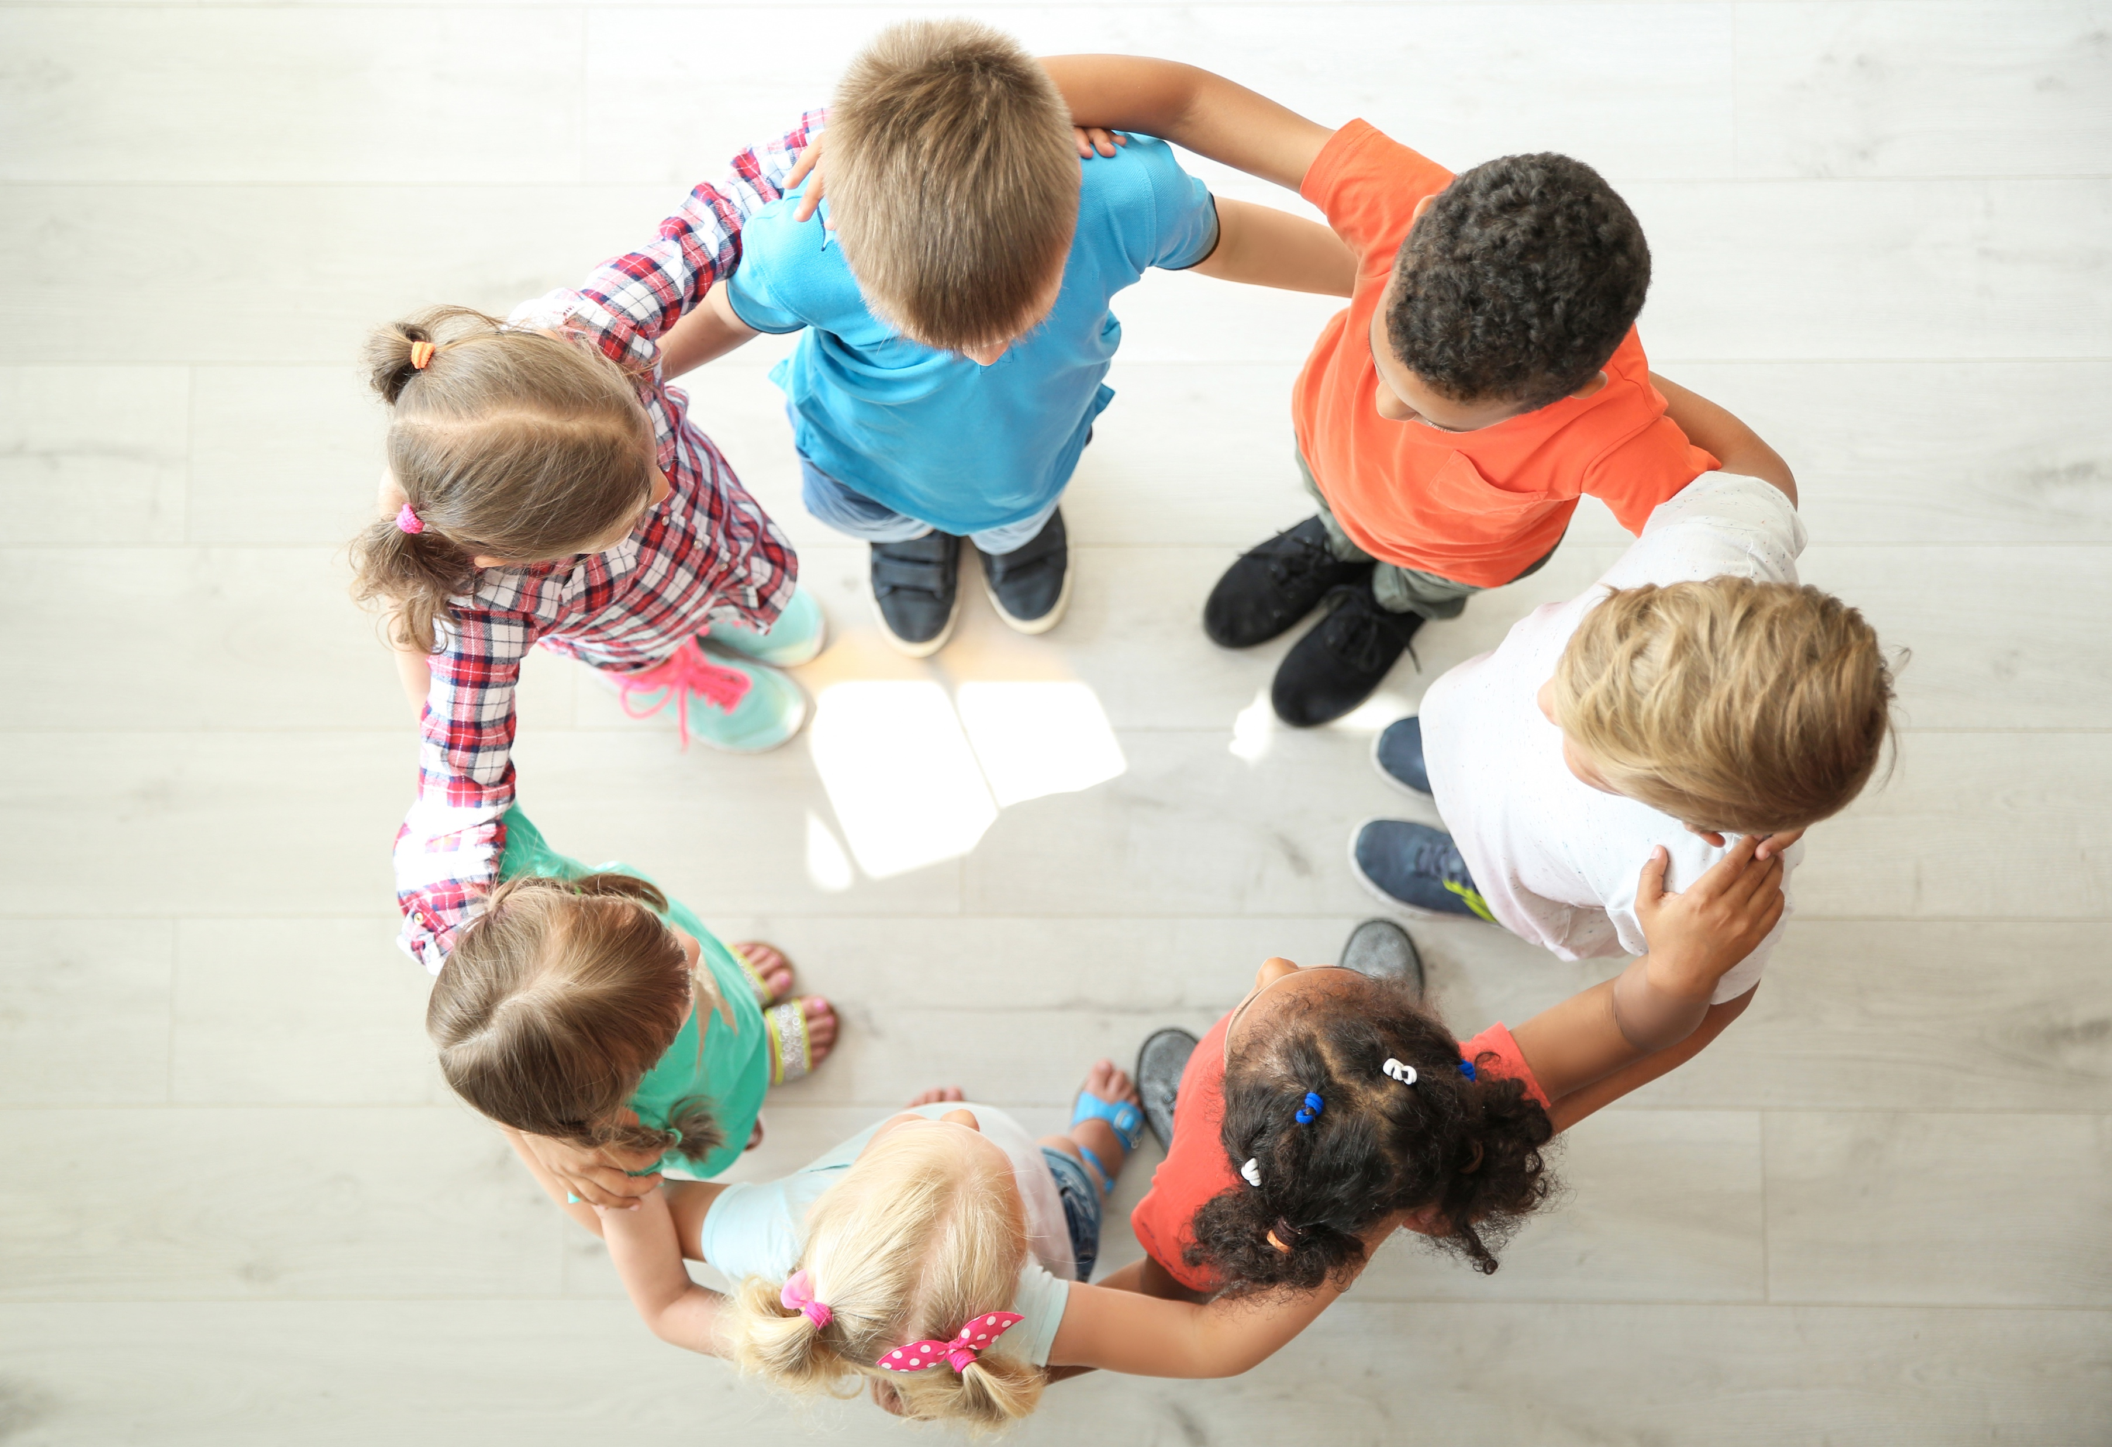
T
ell our strengths and weaknesses.
ct as one…win and lose together!
ake sure everyone is included.
E
xpress (say) words kindly.
A
M
Notes:
Instructor Notes:
Point to the word “TEAM.” Explain that like “OK” and “SHOES”, the letters in “TEAM” can be used to help you work together as a team.
Ask students to pretend they are on a basketball team.
*Tip: If another sport is more popular with your students, feel free to substitute!
Click once and explain that T stands for “Tell our strengths and weaknesses.”
Ask, “If we’re on a basketball team, why would it be helpful to tell our teammates and coach what we’re good and not-so-good at?”
Click again and explain that E stands for “Express words kindly.”
Encourage students to think-pair-share. Ask, “Why would you want to express words kindly and speak nicely to your coach and teammates?”
Click once more and say that A stands for “Act as one…win together and lose together.” Explain that this means we don’t blame people for their mistakes or our mistakes! This also means that whatever happens as a result of the team working together is the responsibility of everyone and not just one person. If they scored it was because of the team’s effort and not just the person who made the shot.
Ask, “If someone missed a basket and you lost the game, why shouldn’t you blame this person? Or, if you made the winning basket, why shouldn’t you take all the credit?”
Click one final time and say that M stands for “Make sure everyone is included.”
Encourage students to think-pair-share. Ask, “How do you feel if you’re left out? Why is it important for everyone on your team to be included?”

Slide 20

TEAM work time!
T ell our strengths and weaknesses.
E xpress (say) words kindly.
A ct as one…win and lose together!
M ake sure everyone is included.
  When it is your turn, secretly pick a card.
  Help your team guess what you picked by silently sketching a picture (using no words or letters)!
  The rest of your team will work together to take one guess about the part of TEAM that you are drawing.
  If they guess the correct letter, your team keeps the card. If your team guesses the wrong letter, put the card back in the pile.
  A new person picks a card and starts drawing.
  Each team should try to keep as many cards as possible in six minutes!
Notes:
Instructor Notes:
To help the class better understand the meaning of TEAM and to practice being part of a team, explain that the class is going to play a group game similar to Pictionary.
Each group will receive a stack of cards (show students what the cards from Handout 7: TEAM cards look like) and a few pieces of blank paper.
Then click once and read through the rules:
When it is your turn, secretly pick a card.
Help your team guess what you picked by silently sketching a picture, using no words or letters!
The rest of your team will work together to take one guess about the part of TEAM that you are drawing.
If they guess the correct letter, your team can keep the card. If your team guesses the wrong letter, put the card back in the pile.
A new person picks a card and starts drawing.
Each team should try to keep as many cards as possible in six minutes!
Before the students begin, model the directions:
Secretly select a card and draw a picture on the board that illustrates the card you selected.
Then facilitate the class in working together to take one guess about which part of TEAM you are illustrating!
Consider nominating a team speaker to discuss with the team the guess and then articulate their guess.
Once students seem to understand the rules, divide the class into groups of four and distribute the precut cards from Handout 7: TEAM cards and a few blank pieces of paper to each group.
Start the timer on the slide and say, “Go Teams!”

Slide 21
TEAM work
Kind and caring I will be.
I listen to you. You listen to me.
What went well when you were working as a TEAM?
Focus: Look at the person who is talking and don’t interrupt.
What was hard about working
as a TEAM?
Figure it out: Ask questions if you don’t understand.
Follow through: Show that you understand!
Notes:
Instructor Notes:
Once six minutes have passed, bring the class back together in a circle or semicircle for a moment of reflection.
Click once and ask, “What went well when you were working as a team?”
Then click again and ask, “What was difficult about working as a team?”
Acknowledge that communicating, which includes speaking and listening, is not always easy!
Click twice to display and read the final stanza of the Wings Words to Live By:
Kind and caring I will be.
I listen to you. You listen to me.
Explain that it is easier to be kind and caring when you listen, because you are taking time to understand the other person.
Click once more and tell students that the next time they work with others, they can be better listeners if they:
Focus: Look at the person who is talking and don’t interrupt.
Figure it out: Ask questions if you don’t understand.
Follow through: Show that you understand!
Ask the class for suggestions on hand signals or motions to remember these three Fs and try to agree on one set of gestures.
Then read through the three Fs one more time and ask the students to join you in the gestures they selected.
Reiterate that when you focus on what someone is saying, figure it out when you don’t understand, and follow through to show when you do understand, it is easier to listen and understand others!

Slide 22
TEAM work time
Create a poster for our school that:
1. Shows the importance of working together.
2. Gives at least one tip about how to work as a TEAM.
Remember to…
Focus
Figure it Out
Follow Through
Notes:
Instructor Notes:
Tell the class that they are going to spend the rest of the session focusing, figuring it out, and following through as a team!
Explain that the groups of four who were working together before will now work together again as a team. However, this time they will be creating their own piece of artwork: a poster that will be hung in their school that (click to reveal):
Shows the importance of working together.
Gives at least one tip about how to work as a team!
Explain that the overall goal of the poster is to teach their peers how to have better relationships with others by working as a team.
Tell the groups that how they get these two points across is up to them. But no matter what, before they start writing and drawing, they need to discuss what their poster will look like.
Click once more and explain that, as groups discuss their ideas, you will be looking for teams who are focusing, figuring it out, and following through! Once everyone agrees with the overall idea, groups can then begin creating their poster.
Deduct about five minutes from the time remaining in the session and tell students they will have about this much time to create at least a rough draft of their poster.
Then give each group a poster board and encourage them to get to work.
As students work together to create their poster, rotate among the groups. Provide suggestions and positive feedback relating to how each group is working together as a team.
When there are 10 minutes left in class, give a 5-minute warning.

Slide 23
Positive
Feedback
When you did _____________,
I felt___________!
Notes:
Instructor Notes:
Bring students back to their semi-circle or circle and conclude with a round of positive feedback.
Explain that you are going to try to hang these posters around the school so that their classmates, as well as younger and older students, can learn more about how to treat each other with respect and be part of a team.
Then share positive feedback, such as, “Seeing and hearing everyone work together as a team today made me feel very proud.”
Explain to students that when you tell others that you like something they did and then you add how it made you feel it’s called giving positive feedback.
Ask students to give you a thumbs up if they enjoy receiving compliments.
Explain that if we enjoy receiving compliments and getting praise from someone, we can help others feel the same way by praising them for what they do.
Explain that giving positive feedback is a great way to let others know how they make you feel when they are good to you. It tells others the positive effects of their actions!
Click once and encourage students to think about the work they just completed with their team and ask if anyone has positive feedback about a team member or team members that they would like to share. As they do, guide students in sharing what their teammate(s) did and how it made them feel.
*Tip: Purposely only choose a few students to share so that students do not feel left out if their name is not mentioned.
Tell the class that when we receive and give positive feedback, we learn how to become better friends and people!
Challenge each student to brainstorm positive feedback that they can give every member of their team and ask them to share it with this person before the end of the school day!

Slide 24
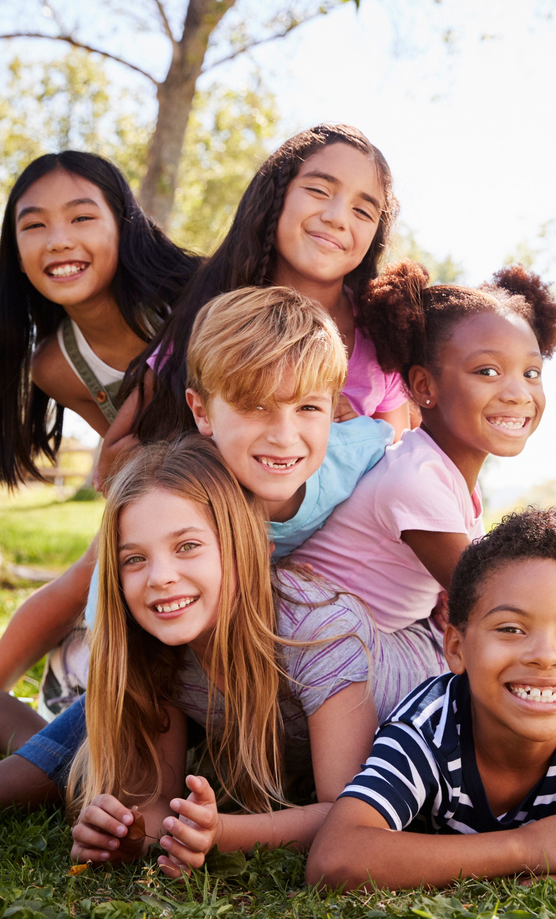
I understand others are unique.
I want to learn more about everyone I meet.
I want to step into their shoes
and see what they are going through.
I am a friend. I support and trust.
Working together is a must.
Kind and caring I will be.
I listen to you. You listen to me.
Notes:
Instructor Notes:
Wrap up by clicking to display the verses of the Wings Words to Live By on which students have focused over the past three sessions and ask the class to read them aloud with you.
Conclude by reminding students to keep these verses in mind every day as they work, play, and spend time with others!

