Slide 1


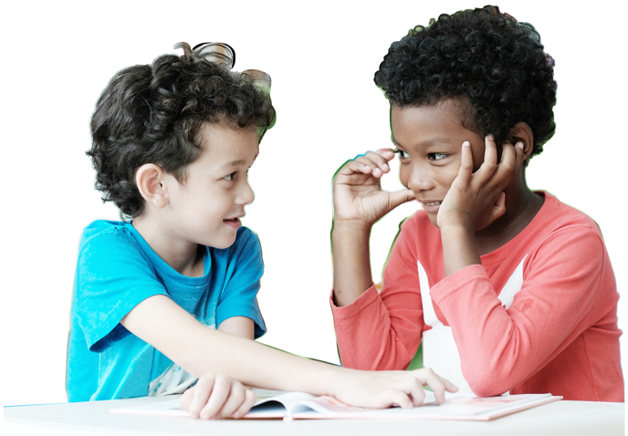
Time to Create

Slide 2
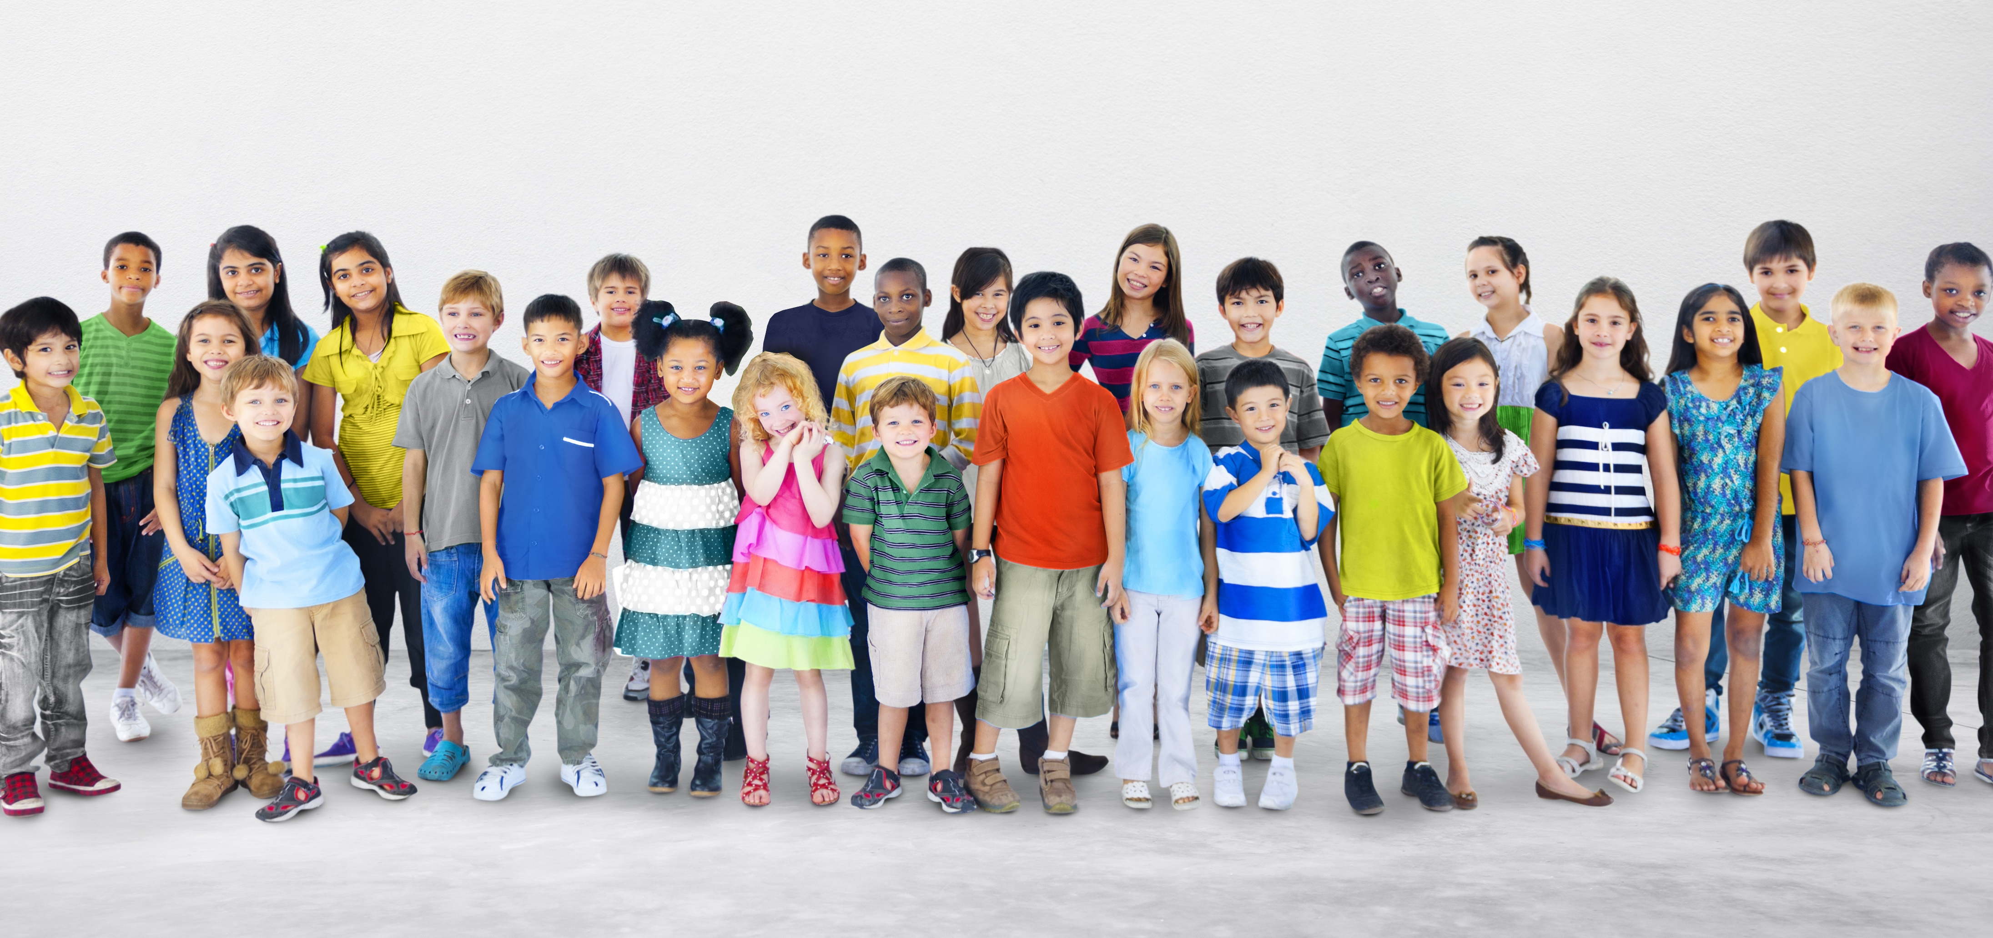
Who are YOU?
1. Tall
2. Loves
to read
3. Doesn’t like sports
4. Curly Hair
5. Friendly
OUTSIDE
INSIDE
INSIDE
OUTSIDE
INSIDE
Notes:
Image:
Image 1: Many children’s faces (like: https://spiritualmusclehead.files.wordpress.com/2014/08/diverse-children.jpg)
Design Notes:
Landing Slide: Image 1
1st Click: Add text
Instructor Notes:
Instruct the class to sit on the floor in a circle or semi-circle and join the students by sitting at their level.
Click once to display the question: Who are YOU?
Explain that while this may seem like a funny question since the class already knows each other, you are challenging each student to really think about what makes them special.
Pass out Handout 1: I am ME to each student. Tell students that they are going to make a collage—or a piece of artwork made up of many different pictures and words— that answers this question.
Share the directions by telling students to:
Write their name in the center of the handout.
Look through the collage materials and cut out images and/or words that help explain who they are and what makes them special.
Glue these cut-outs to their handout.
Explain that how each student organizes their collage is up to them. Some students may want the images to overlap, while some may want them spaced evenly. The design choice is theirs!
Pass out the collage materials, glue sticks, and scissors.
Tell the class that they will have about 10 minutes to create their collage and allow them to begin creating!

Slide 3
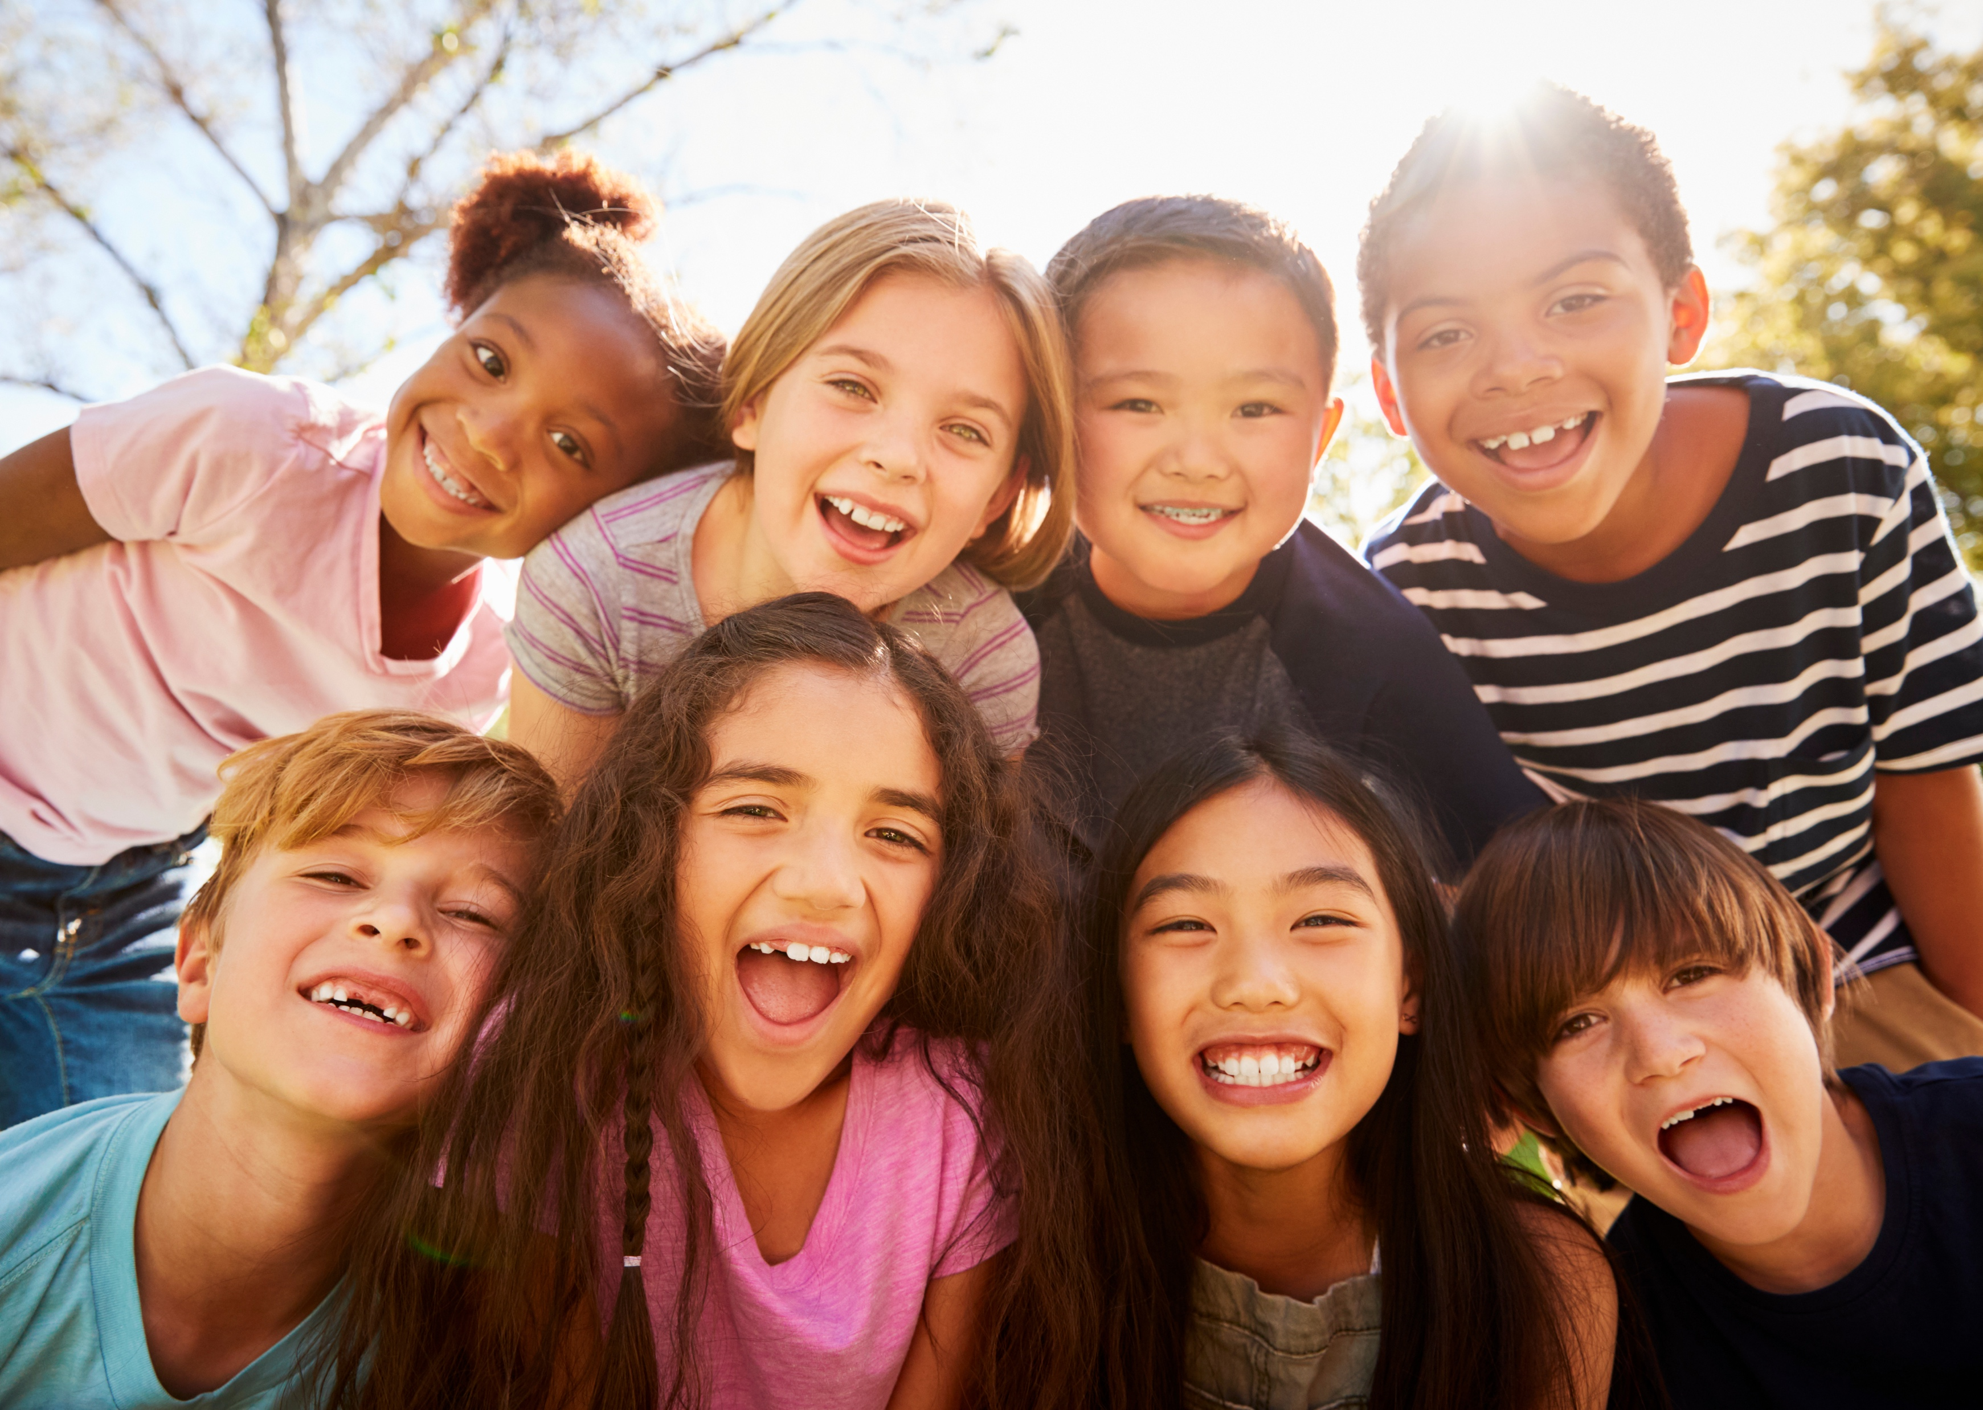
Who are YOU?
I understand others
are unique.
I want to learn more about everyone I meet.
I want to step into
their shoes
and see what they are going through.
Notes:
Image:
Image 1: Image of children’s faces, similar to Slide 1, but different
Design Notes:
Landing Slide: header and image
1st Click: text on right side of screen
Instructor Notes:
Have the class sit back on the floor in a circle or semi-circle, with their collages.
Once you have joined them, ask students to share their collage with the person next to them and take a moment to explain how their collage shows that “I am ME!”
Then invite each student to hold their collage out in front of them, so the class can look around the circle and see the work that their classmates have created.
Click once to display the Wings Words to Live By and read them aloud.
Repeat “I understand others are unique, I want to learn more about everyone I meet” and ask students to raise their hand if they think they know what the word “unique” means.
Select one or two student volunteers to share their definition(s).
Then click once and explain that when we say others are “unique”, we mean that people are all very different. No two people are exactly the same and everyone is special in their own way!

Slide 4
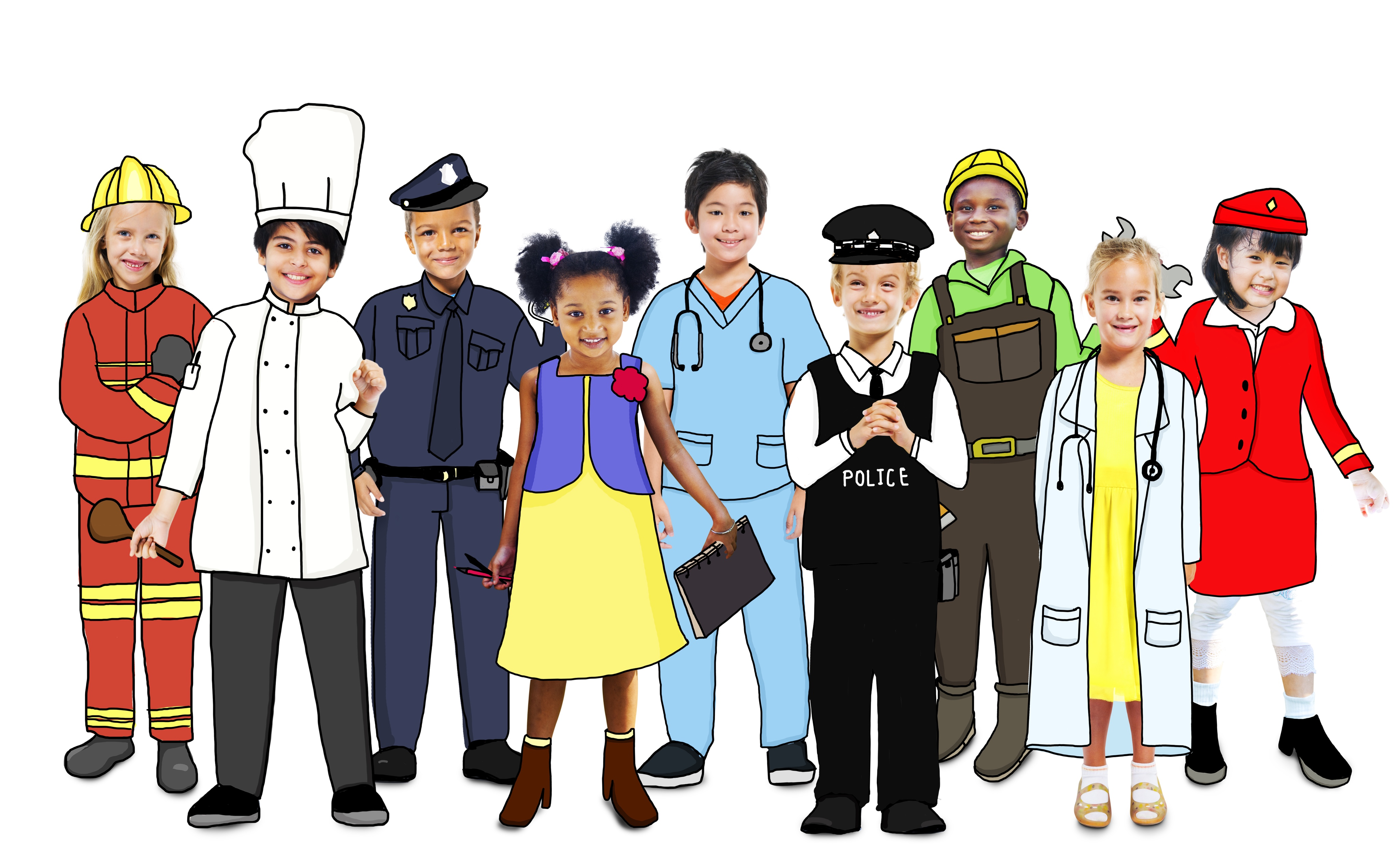
How are you different from someone else?
Notes:
Instructor Notes:
Ask students to hold up their collage in front of them one more time and observe how different each collage is from the next. Explain that this shows that we really are all unique and special in our own way!
Ask: How are you different from someone else? Allow several students to share their thoughts and encourage them to look at each other’s collages if they are stuck.
If a student brings up physical differences, acknowledge that everyone certainly does have unique looks—but tell the class that you would like to focus on our “inside” differences.
Summarize the differences that students came up with and wrap up by concluding that in addition to how we look, we also all have different personalities and interests!

Slide 5

Why is it great to be unique?
Notes:
Instructor Notes:
It’s read-aloud time! Explain that the class is about to read a book that has an important message about being unique.
As you read, ask students to think about the lesson that the book is trying to teach them.
Then read The Crayon Box That Talked by Shane Derolf or project the video read-aloud.
When the read-aloud is complete, discuss:
What do you think the author was trying to teach us?
Be sure that students arrive at the answer that the book focuses on appreciating our differences. When many different people (or crayons) work together, we have great (and colorful!) results.
When have you learned something from someone who is different from you?
If helpful, try to jumpstart student responses by sharing an experience of your own or something along the lines of: “One of my best friends growing up was from _______. From him and his family, I learned how to say some words in _____ and I got to learn all about _____ food and cooking!

Slide 6
We’re all different and that’s OK!
Notes:
Instructor Notes:
Click once to display “We’re all different and that’s OK!” and read it aloud.
Challenge students to think of a silent pose that shows one way they are unique and different from others. For instance, if a student loves to play soccer, she could stretch out her leg like she is kicking a ball!
Explain that in a moment, the class is going to repeat the phrase with you, except they will add two silent gestures:
When they say, “Different,” everyone will strike their own unique pose.
When they say, “OK,” everyone will drop their pose and give a big thumbs up!
Model this once by saying the phrase, striking your own pose, and then giving a thumbs up.
Then instruct all students to stand and join you in saying and gesturing, “We’re all different and that’s OK!”

Slide 7
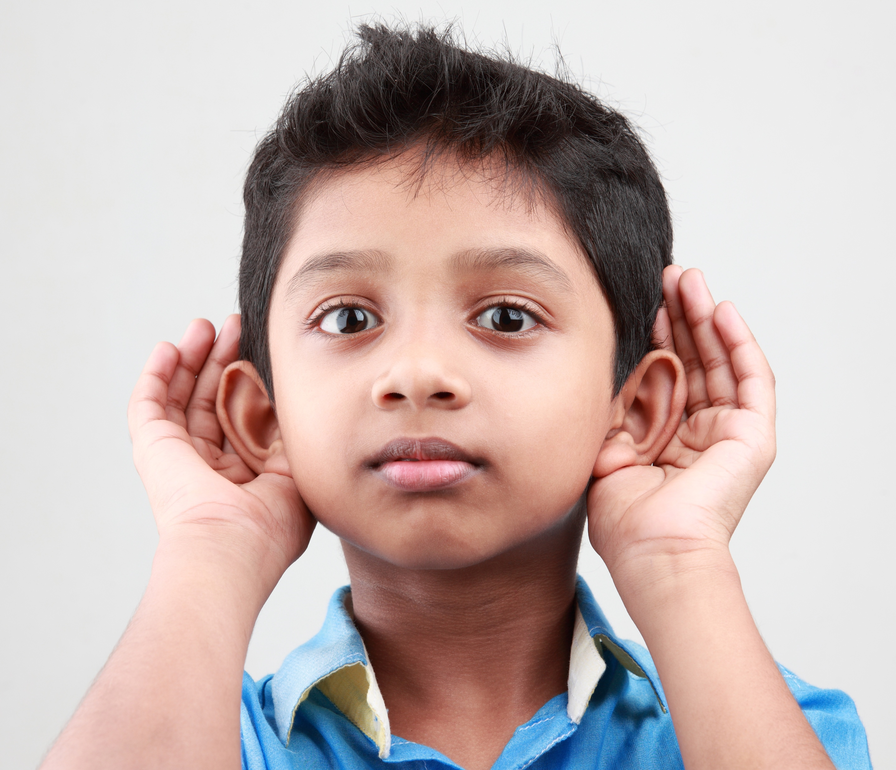
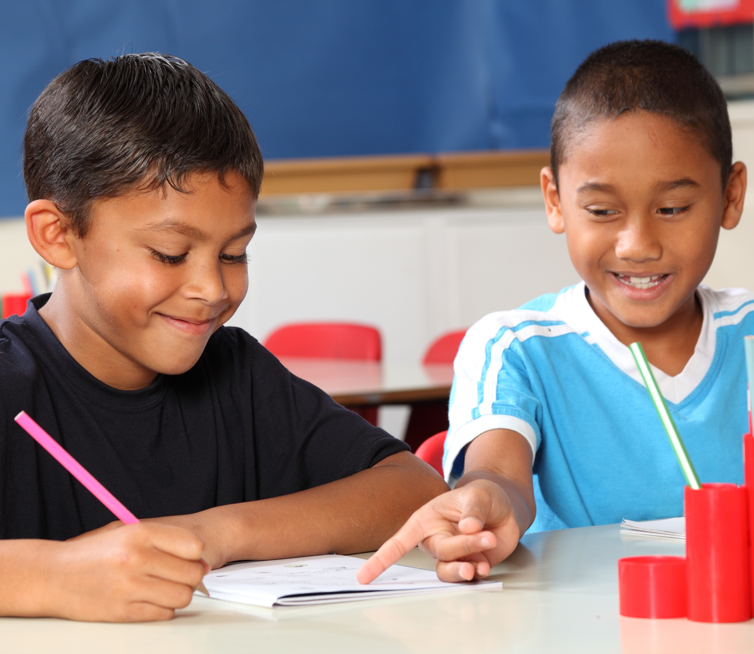
We’re all different and that’s OK!
O
ffer your ideas and listen to others.
K
eep an open mind and learn
from others.
Notes:
Instructor Notes:
Click once and explain that each letter in “OK” helps remind us that when we meet new and different people, we should try to learn more about them!
Click again and explain that the O stands for “Offer your ideas and listen to others”.
Explain that not only do we need to speak up and share our own thoughts and ideas, but we need to really listen to what others say!
Ask and discuss: Why is it important to listen to someone else’s point of view?
Then click again and explain that the K stands for “Keep an open mind and learn from others”.
Ask: What does it mean to have an “open mind”?
Be sure students understand that when you have an open mind, you are willing to hear new ideas and are happy to see what new things you can learn!
Summarize by telling students that when we listen to others and have an open mind, we can learn all kinds of things from people who are different from us!

Slide 8


We’re all different and that’s OK!
O
ffer your ideas and listen to others.
K
eep an open mind and
learn from others.
Notes:
Instructor Notes:
Explain that pairs of students will now work together to create a drawing…but it’s not just any drawing!
Hold up a copy of Handout 2: What Do You See? and explain that each pair will have to work together to make the line shown on the handout into a work of art!
Explain:
Their work of art can look like anything!
The only rule is that each pair must remember that (click once): We’re all different and that’s OK! So, each person must (click once) offer their ideas and listen to others and (click again) keep an open mind and learn from others.
Repeat that working together and remembering “We’re all different and that’s OK!” are the only rules.
Deduct 7-10 minutes from the time remaining in this session and tell students that they will have this much time to create their masterpiece.
Distribute drawing/coloring materials to each pair and instruct students to get started!
As the class works, encourage collaboration by helping students learn from each other with questions such as:
Do you have an idea?
What do you think?
Could you explain what you mean?

Slide 9
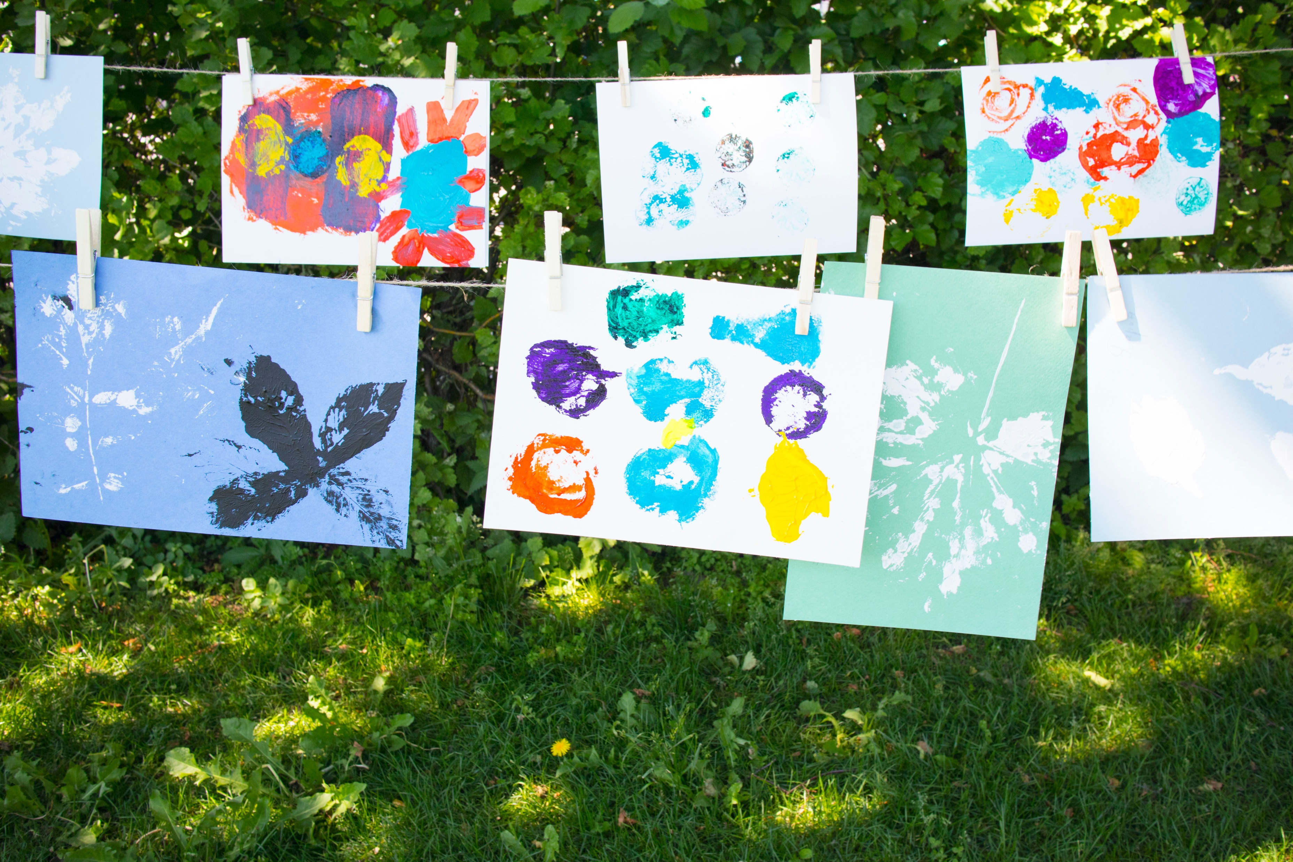
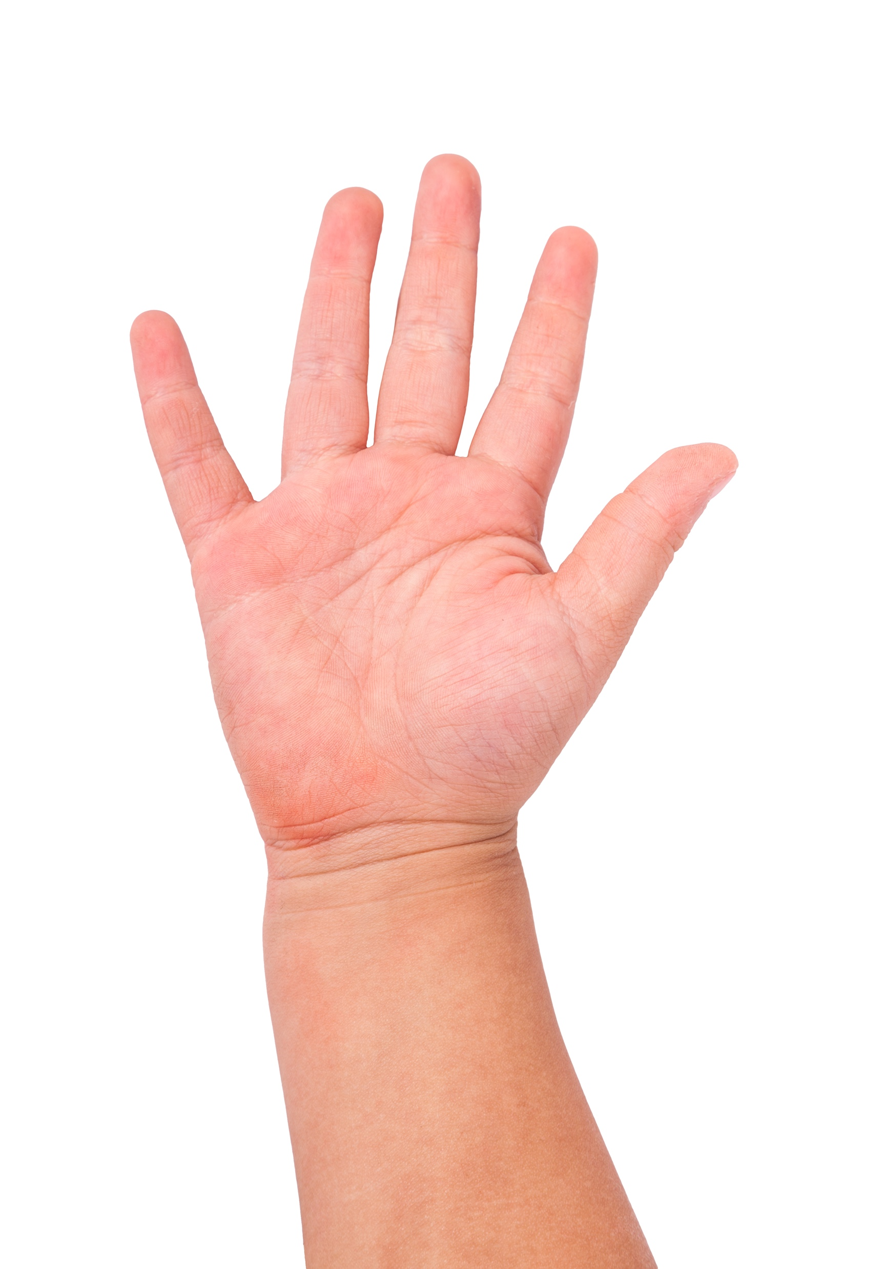
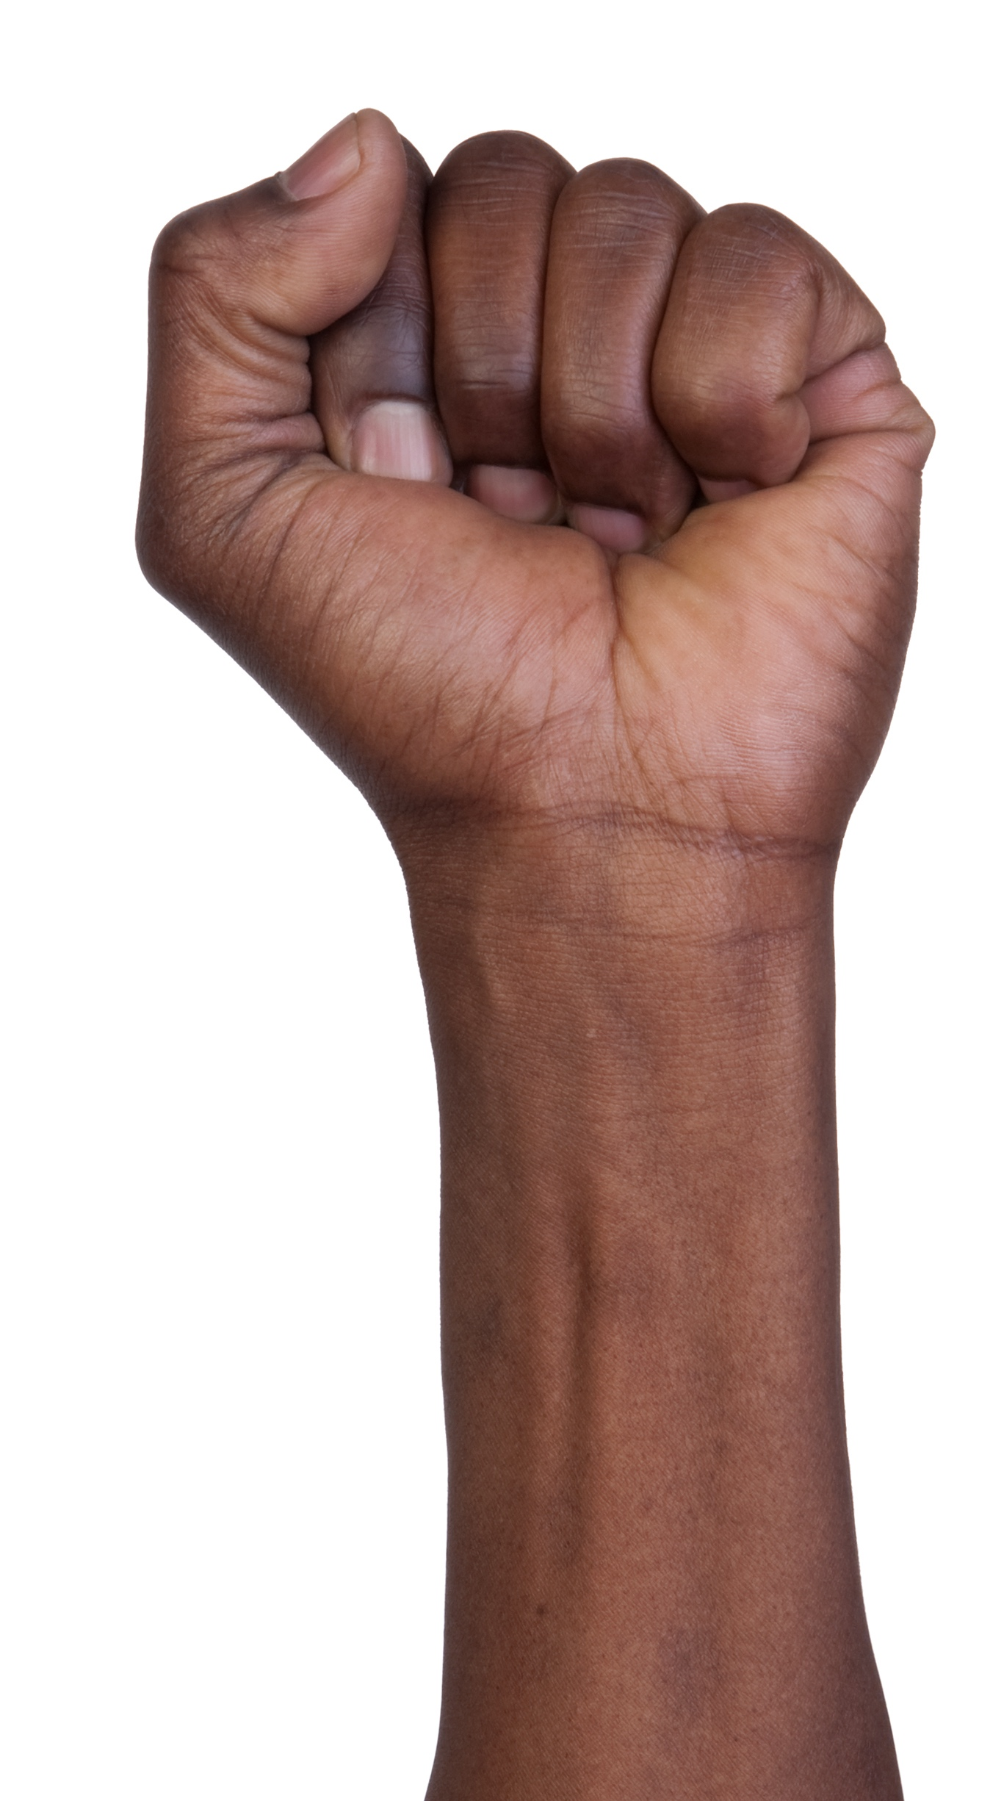
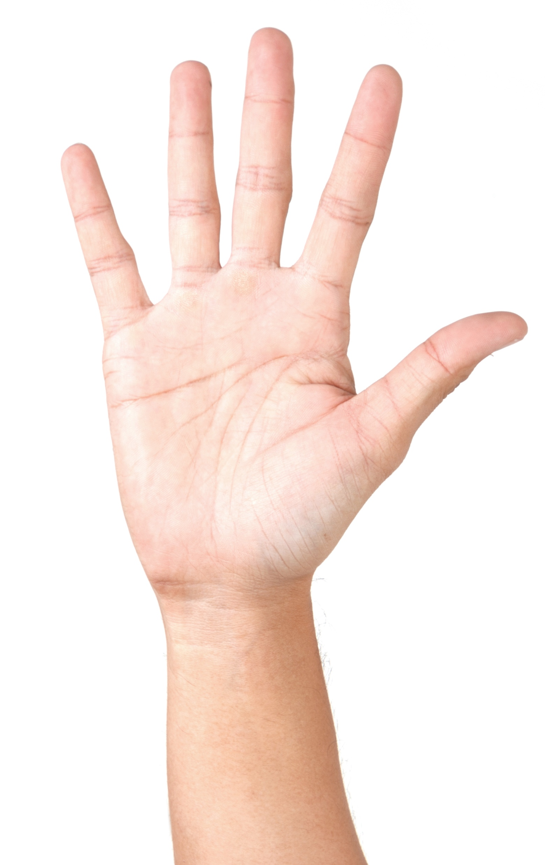
We’re all different and that’s OK!
Easy
So-So
Hard
Notes:
Instructor Notes:
When there are about 10 minutes left in class, bring the class back together in a circle or semicircle and join them at their level.
Instruct them to put their artwork on the floor in front of them, face down.
Before students share, debrief on the activity. Click once, and ask students to answer the questions you are about to pose by using their hands to indicate the following answers:
0 fingers (hold up a fist) = easy
5 fingers (one hand) = so/so
10 fingers (both hands) = hard
Then ask the class to indicate their answers to the three questions below. As you do, call on a few students to briefly explain their different responses.
Was it easy, so-so, or hard to offer your ideas?
Was it easy, so-so, or hard to listen to your partner?
Was it easy, so-so, or hard to keep an open mind?
Then, click twice, and invite every pair to hold up their artwork in front of them so students can look around the circle and view everyone’s piece.
Ask students to consider:
How are each of these the same?
How are each of these unique?
Conclude by saying, “Just as these drawings are alike because they all began with the same line, we are all alike because we are all people. But, just like these works of art, we are also all different and special in our own ways. We have our own feelings, ideas, and personalities.”
For this reason, it’s important for students to remember we are all different and that is OK. Ask the class to rise and join you in saying that and posing like they did earlier in the class period.

Slide 10
From my eyes, I see…
Notes:
Instructor Notes:
Begin the second session by instructing the class to sit on the floor in a circle or semi-circle and join the students by sitting at their level.
Click once to display an image of an animal scene.
Ask students to imagine: If the artist was standing somewhere while they drew this, where would they probably have been standing?
Guide students in understanding that the drawing was drawn from the perspective of someone who was standing in front of the scene. If the person was standing to the side, we would see the sides of the animals. Or if the person was standing behind the animals, we would see their backs!
Explain that a perspective is how someone looks at the world.
Help students build understanding of the meaning of perspective by challenging them to draw an object (or objects) from different perspectives. Place at least one 3-dimensional object where all students can see it (e.g., large teddy bear or toy truck).
Pass out Handout 3: From My Eyes, I See to each student.
Instruct students to look carefully at the object and quickly draw it in the top box of the handout. Tell students they will have about 5 minutes to complete their drawing (and they will not be graded on the quality of their drawing), so they should sketch and not worry too much about the tiny details.
After a few minutes, ask, “What would this object look like from a different perspective?”
Have students change their seats so they are sitting in a different part of the room. The goal is to change their perspective of the object they drew.
Challenge students to draw the object again from their new perspective in the bottom box on the handout.

Slide 11
I see…
I feel… I think…
Notes:
Instructor Notes:
After students are finished with their second drawing, invite the students back to the circle or semi-circle with their drawings.
Instruct them to turn to the peer on their right side and share their drawings. Then challenge them to figure out why their drawings look different even though they were drawing the same object.
Then click once and explain that one part of understanding someone else’s perspective is what they see, like they just practiced.
Click again and explain that another important part of understanding someone else’s perspective is thinking about what this other person may be thinking and feeling.
Instruct students to turn back to their partner and discuss why they think it might be helpful to try to see things from someone else’s perspective. Ask questions to encourage discussion such as, “Why might it be helpful to know how your friend feels about moving to a new house or going to the doctor or sharing their favorite toy?”

Slide 12
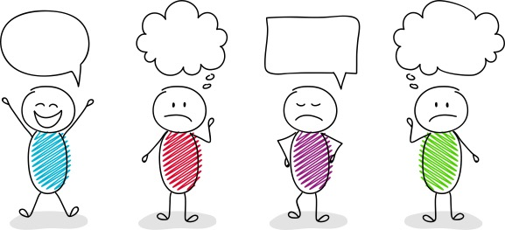
Step into their SHOES
I understand others are unique.
I want to learn more about everyone I meet.
I want to step into their SHOES
and see what they are going through.
I feel
excited.
I feel
nervous.
I feel
frustrated.
I feel
embarrassed.
S: Sound of voice
E: Expression on face
O: Outer appearance
H: How they act
S: Surroundings
Notes:
Instructor Notes:
Explain that when you consider what someone else is seeing, thinking, and feeling, you are putting yourself into someone else’s shoes.
Read the stanza from the Wings Words to Live By and emphasize the shoes portion.
Explain that when we step into someone else’s shoes and understand how he or she is feeling, we are able to be as supportive and kind as possible.
Point to the word “SHOES” in the Words to Live By and explain that each letter helps us remember how to actually step into someone else’s shoes.
Click to remove the Words to Live By.
Click once more and tell students that the S stands for Sound of their voice.
Click again and read aloud how the four stick figures are feeling. Explain that if we were to listen to the sound of their voice, we might be able to figure out how they are each feeling.
Demonstrate by saying, “I feel excited!” in an upbeat and quick tone.
Then help students form groups of three and instruct one student in every group to say each of the other emotions (I feel scared; I feel angry; I feel silly) in a tone that shows that they feel this way.
Then click twice and explain that H stands for How they act.
Ask students to help you figure out what you might do with your arms, hands, or legs if you were excited.
Then ask one student in each small group to demonstrate what their arms, hands, or legs might do when they feel scared, angry, or silly.
Click twice more and say that O stands for Outer appearance.
Explain that outer appearance refers to: What do they look like on the outside? Are they turning red, shaking, sweating, slouching, or standing up straight?
Explain and demonstrate that when you are excited, you might sit or stand up very straight. You even might tap your foot because you can’t sit or stand still!
Then ask one student in each group to model and explain what their appearance might look like when they are scared, angry, or silly.
Click two times and say that E stands for Expression on their face. In other words: What does their face look like? What expression are their eyes or their mouth making?
Ask for the entire class to make a face that shows excitement.
Then ask the class to look around at each other and note that everyone shows excitement a little differently!
Continue by asking all students to show what their face might look like when they feel scared, angry, or silly.
Finally, click two more times and explain that S stands for Surroundings: where they are and who they are with.
Explain that sometimes noticing where the person is or who they are with can help us understand what they are feeling, especially if we combine it with the other parts of SHOES.
Ask, for instance:
If you see someone is with a lot of other people who they don’t really know and they are crossing their arms, blushing, and looking down, how might they feel?
Or, if someone is with a lot of other people and they are smiling, laughing and jumping up and down, how might they feel?
Wrap up by telling students that when you step into someone else’s shoes, you should try to think about as many of these letters as possible!

Slide 13
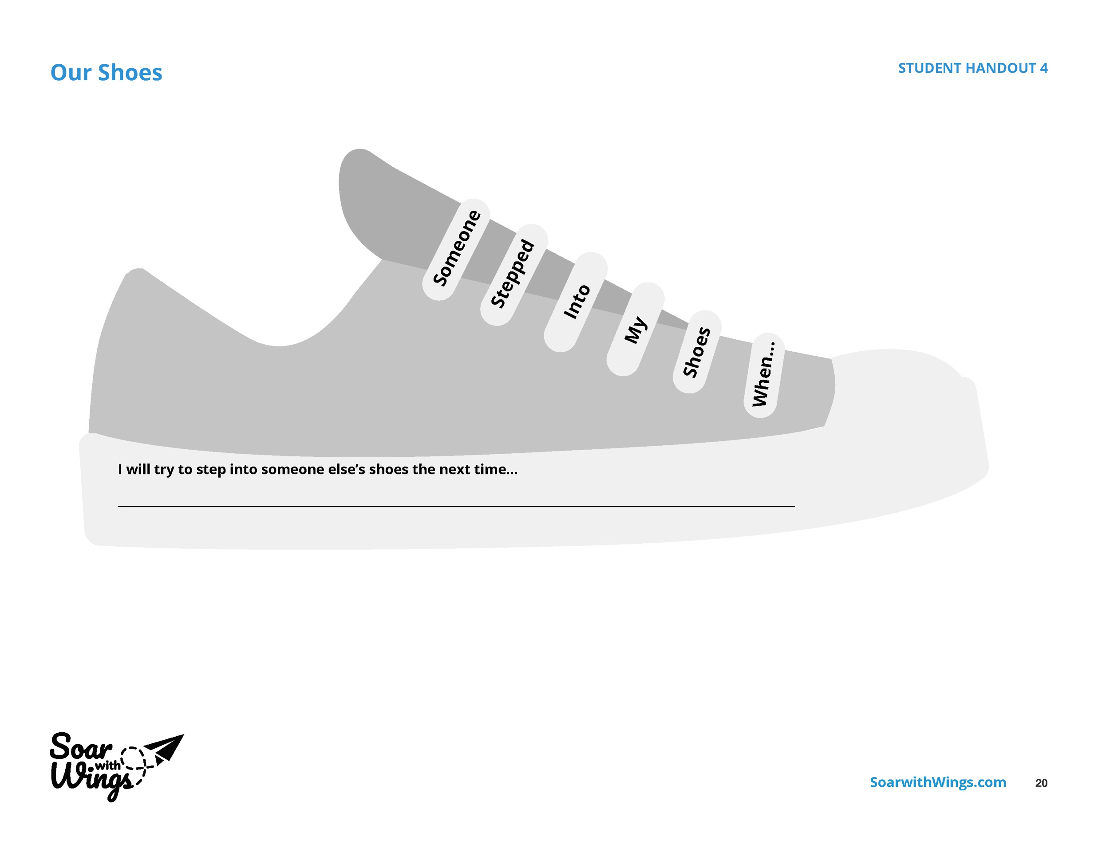
When has someone stepped into your ?
Notes:
Instructor Notes:
Click once and explain that students are now going to think about their own lives!
Ask students to think about a time when someone stepped into their shoes and really tried to understand how they were feeling.
Click once to display the shoe graphic and read the words on the laces: Someone stepped into my shoes when…
Encourage a couple students to share. If needed, kick off with an example like “Someone stepped into my shoes when they could see I was really nervous about _______. They gave me a hug and promised me everything would be okay!”
Then pass out Handout 4: Your Shoes to each student and encourage them to use the empty space in the shoe to draw a picture that illustrates a time when someone stepped into their shoes.
For now, tell the class to ignore the sentence starter on the sole of the shoe!
Deduct about 7-10 minutes from the end of class and tell students they will have about this much time to complete their drawing.

Slide 14
If I had stepped into your …
Notes:
Instructor Notes:
When there are about 7-10 minutes left in the session, instruct students to stop drawing.
Now that they have thought about a time when someone else has stepped into their shoes, encourage students to Show Their ID* and admit a time when they should have stepped into someone else’s shoes but didn’t.
* If students have not yet learned this term in the Responsible Decision-Making lesson, simply remove it.
Begin with a personal example, such as, “I remember a time when I was your age when my classmate asked if he could play with us, we all said no, and he started to cry. If I had stepped into his shoes, I would have noticed that he was lonely and shy.”
Ask a couple volunteers to share their own examples, without using names.
Then encourage all students to turn to a neighbor and share a time when they should have stepped into someone’s shoes.
Next, direct students’ attention to the sole of the shoe on the slide, and read the sentence aloud: “I will try to step into someone else’s shoes the next time…”
Encourage students to think about the experience they just shared and write a few words that explain how they can do better next time.
Model this by relating back to your own example. For instance: “I will try to step into someone else’s shoes the next time…someone asks if they can play. I will say, “Yes!”
Answer any questions and then encourage students to begin their goal-setting. If you think it will be helpful for students to discuss their goal with a peer before working individually, encourage them to do so.

Slide 15
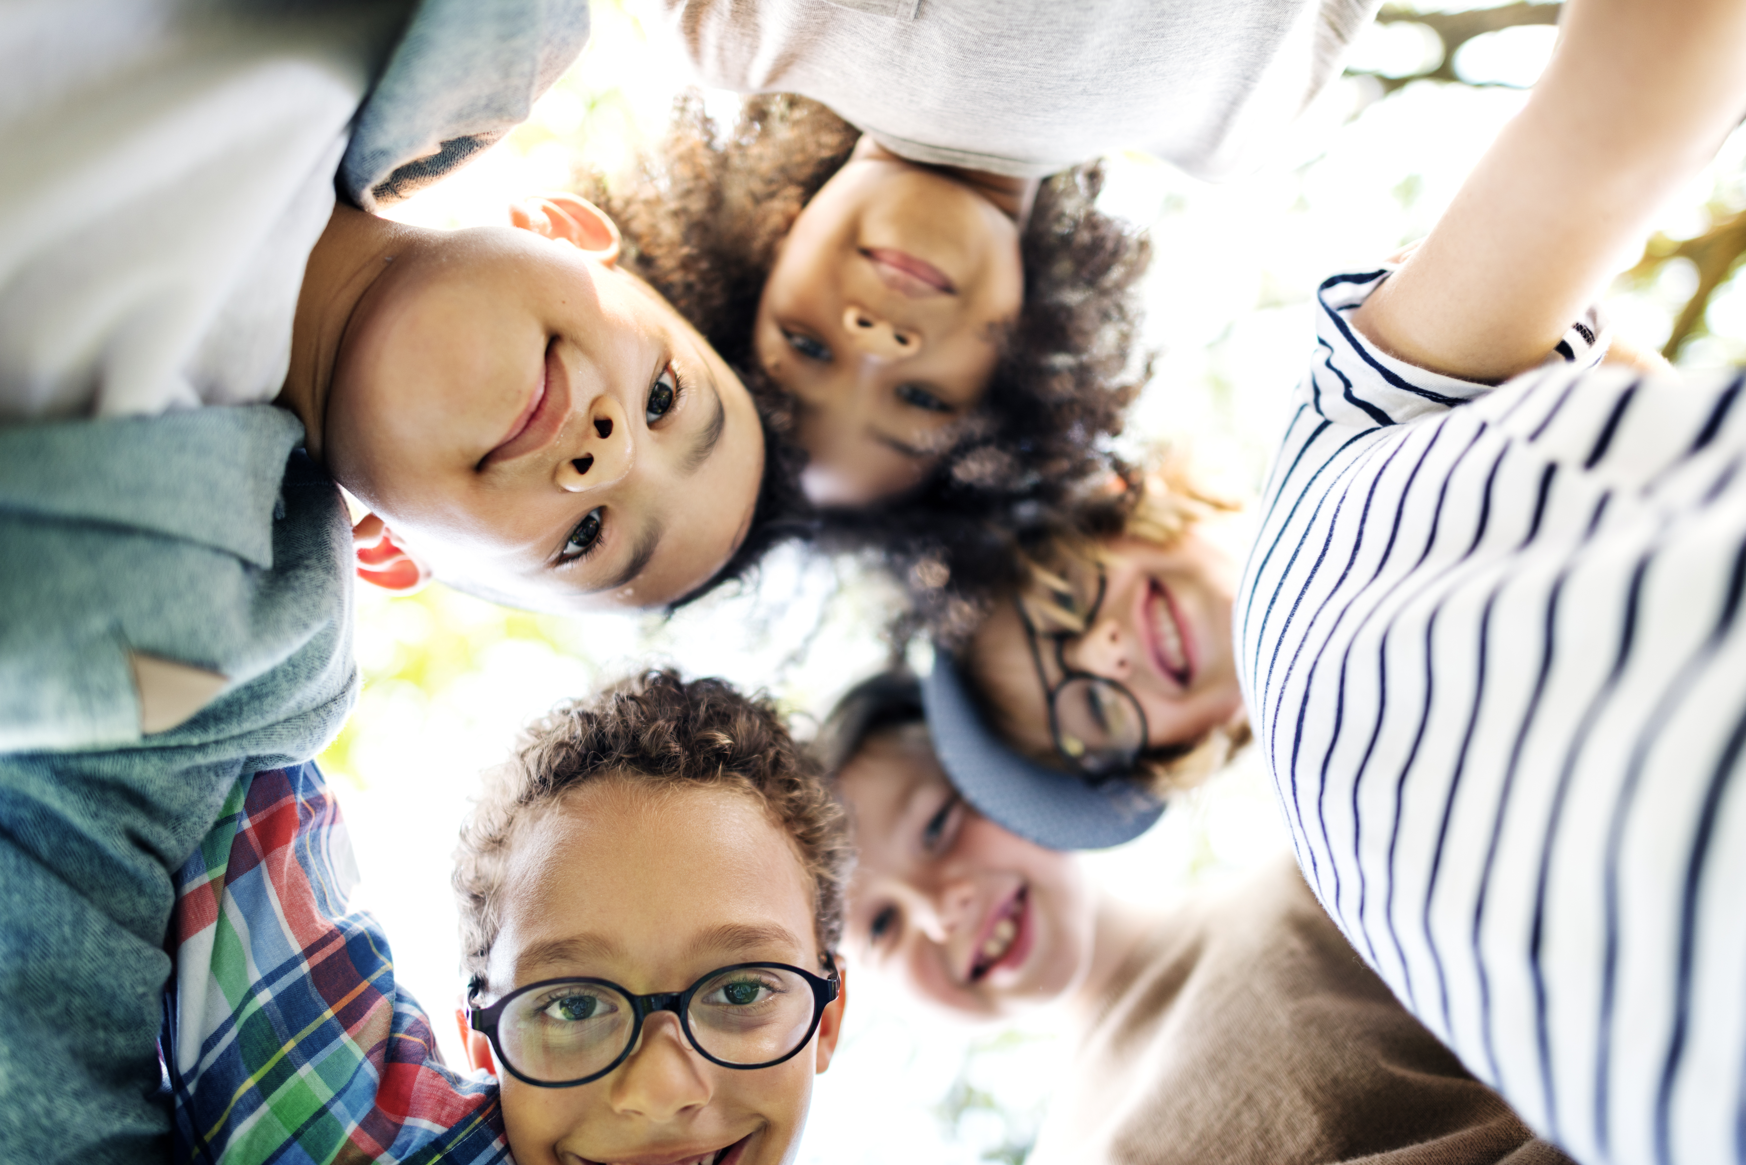
I understand others
are unique.
I want to learn more about everyone I meet.
I want to step into their shoes
and see what they are going through.
Notes:
Instructor Notes:
Conclude by displaying and reading the portion of the Words to Live By that you have covered over the last two sessions. Encourage students to join you as you read it aloud.
If possible, collect students’ completed shoes and display them around the classroom! Or, if this is not possible, try to incorporate time for goal-sharing into the next several sessions.

Slide 16
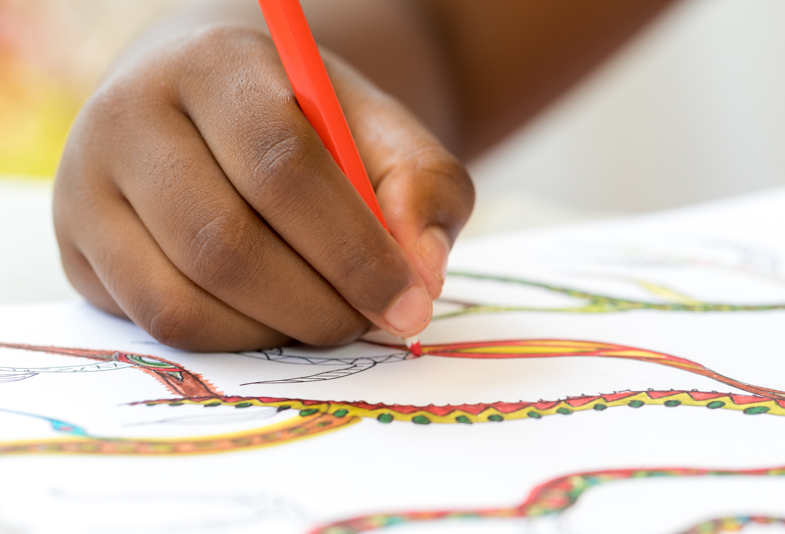
Quick Draw: What does a friend look like?
Notes:
Instructor Notes:
Begin with a Quick Draw Activity and ask students to independently brainstorm: What does a friend look like?
Pass out a copy of Handout 5: I am a friend to each student and give the class 2-3 minutes to draw what comes to mind when they picture a friend!

Slide 17
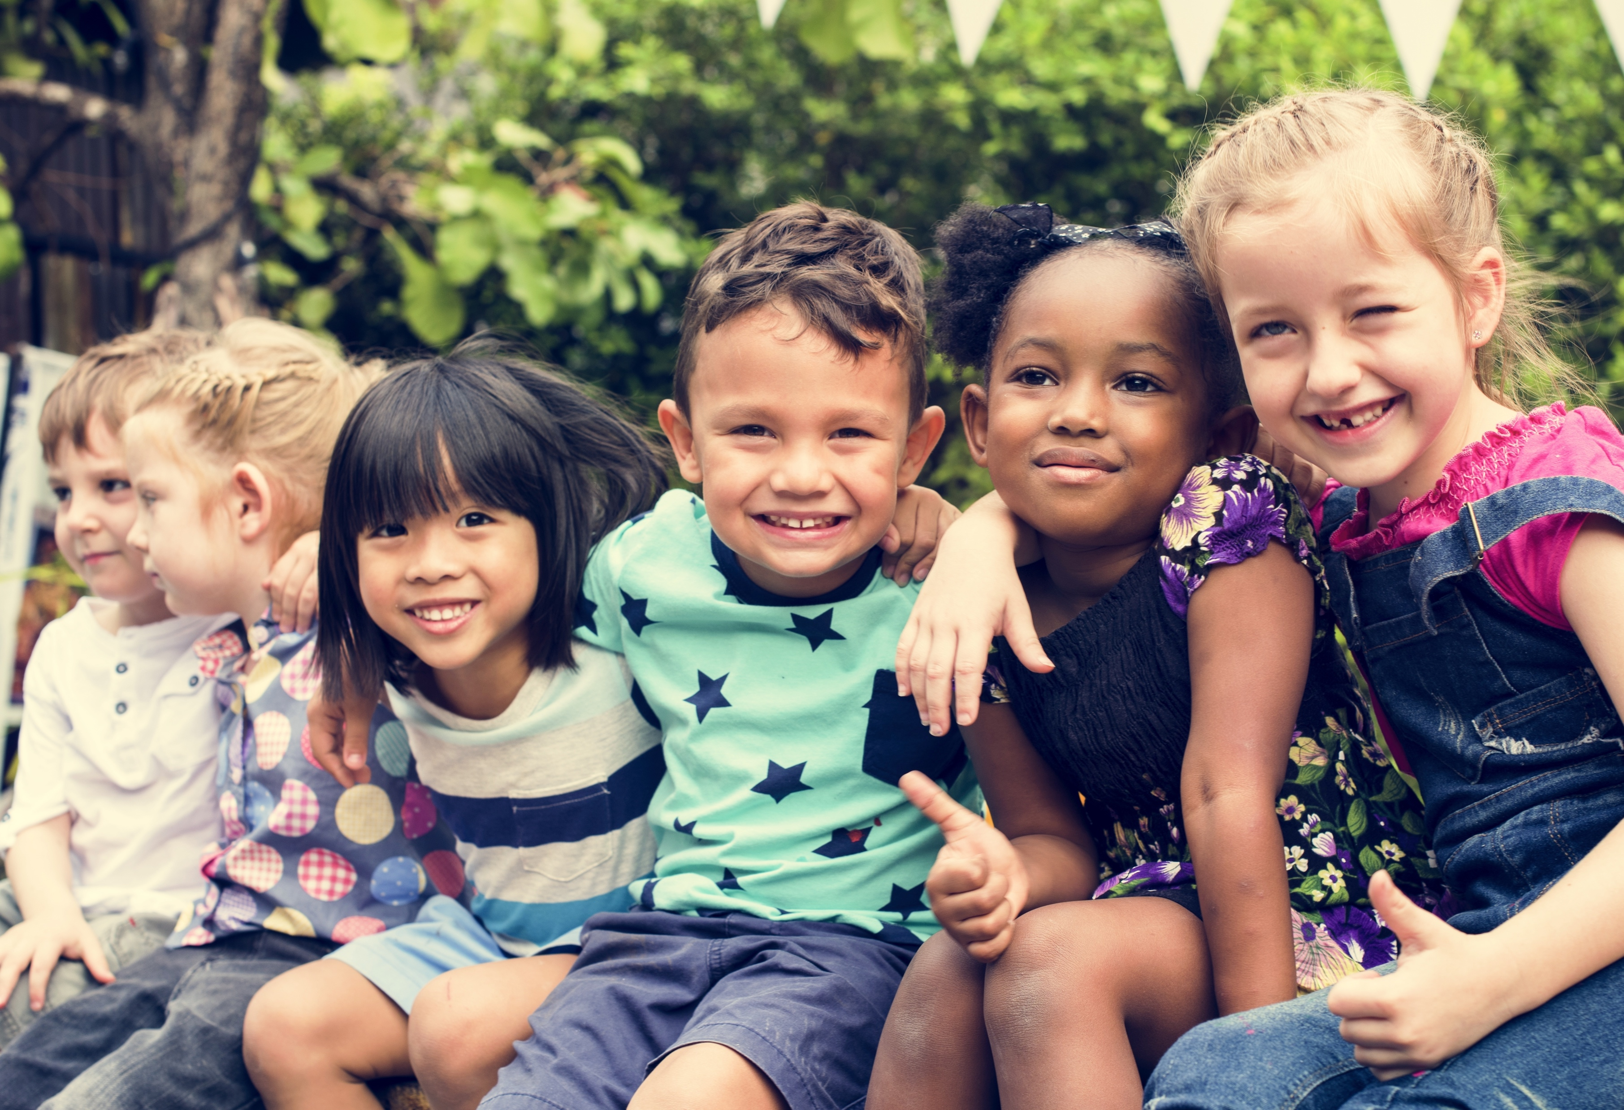
?
Quick Draw: What does a friend look like
Quick Draw: What does a friend look like act like?
Notes:
Instructor Notes:
Assemble students on the floor in circle or semi-circle with their friend drawings in hand and join the students by sitting at their level.
Ask each student to turn their drawing outward so the rest of the class can see.
Give students a moment to look around the circle and observe everyone’s drawing. As they do, encourage them to think about the similarities and differences between them.
Ask students: Does a friend have to look like this?
Lead the class to understanding that a friend could look like anyone…which is why they all drew different pictures! It’s not the outside qualities that make someone a friend; it’s the way they act that matters!
Click twice and then ask: When someone is a friend to you, how do they act? If students are stuck, begin with “act kindly” and challenge more students to share from there.

Slide 18
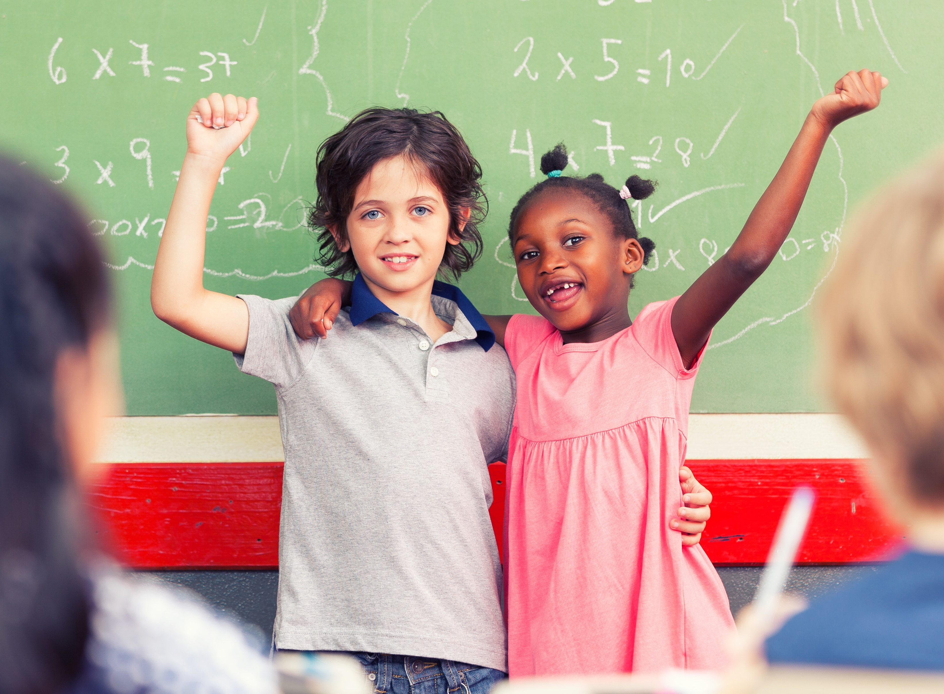
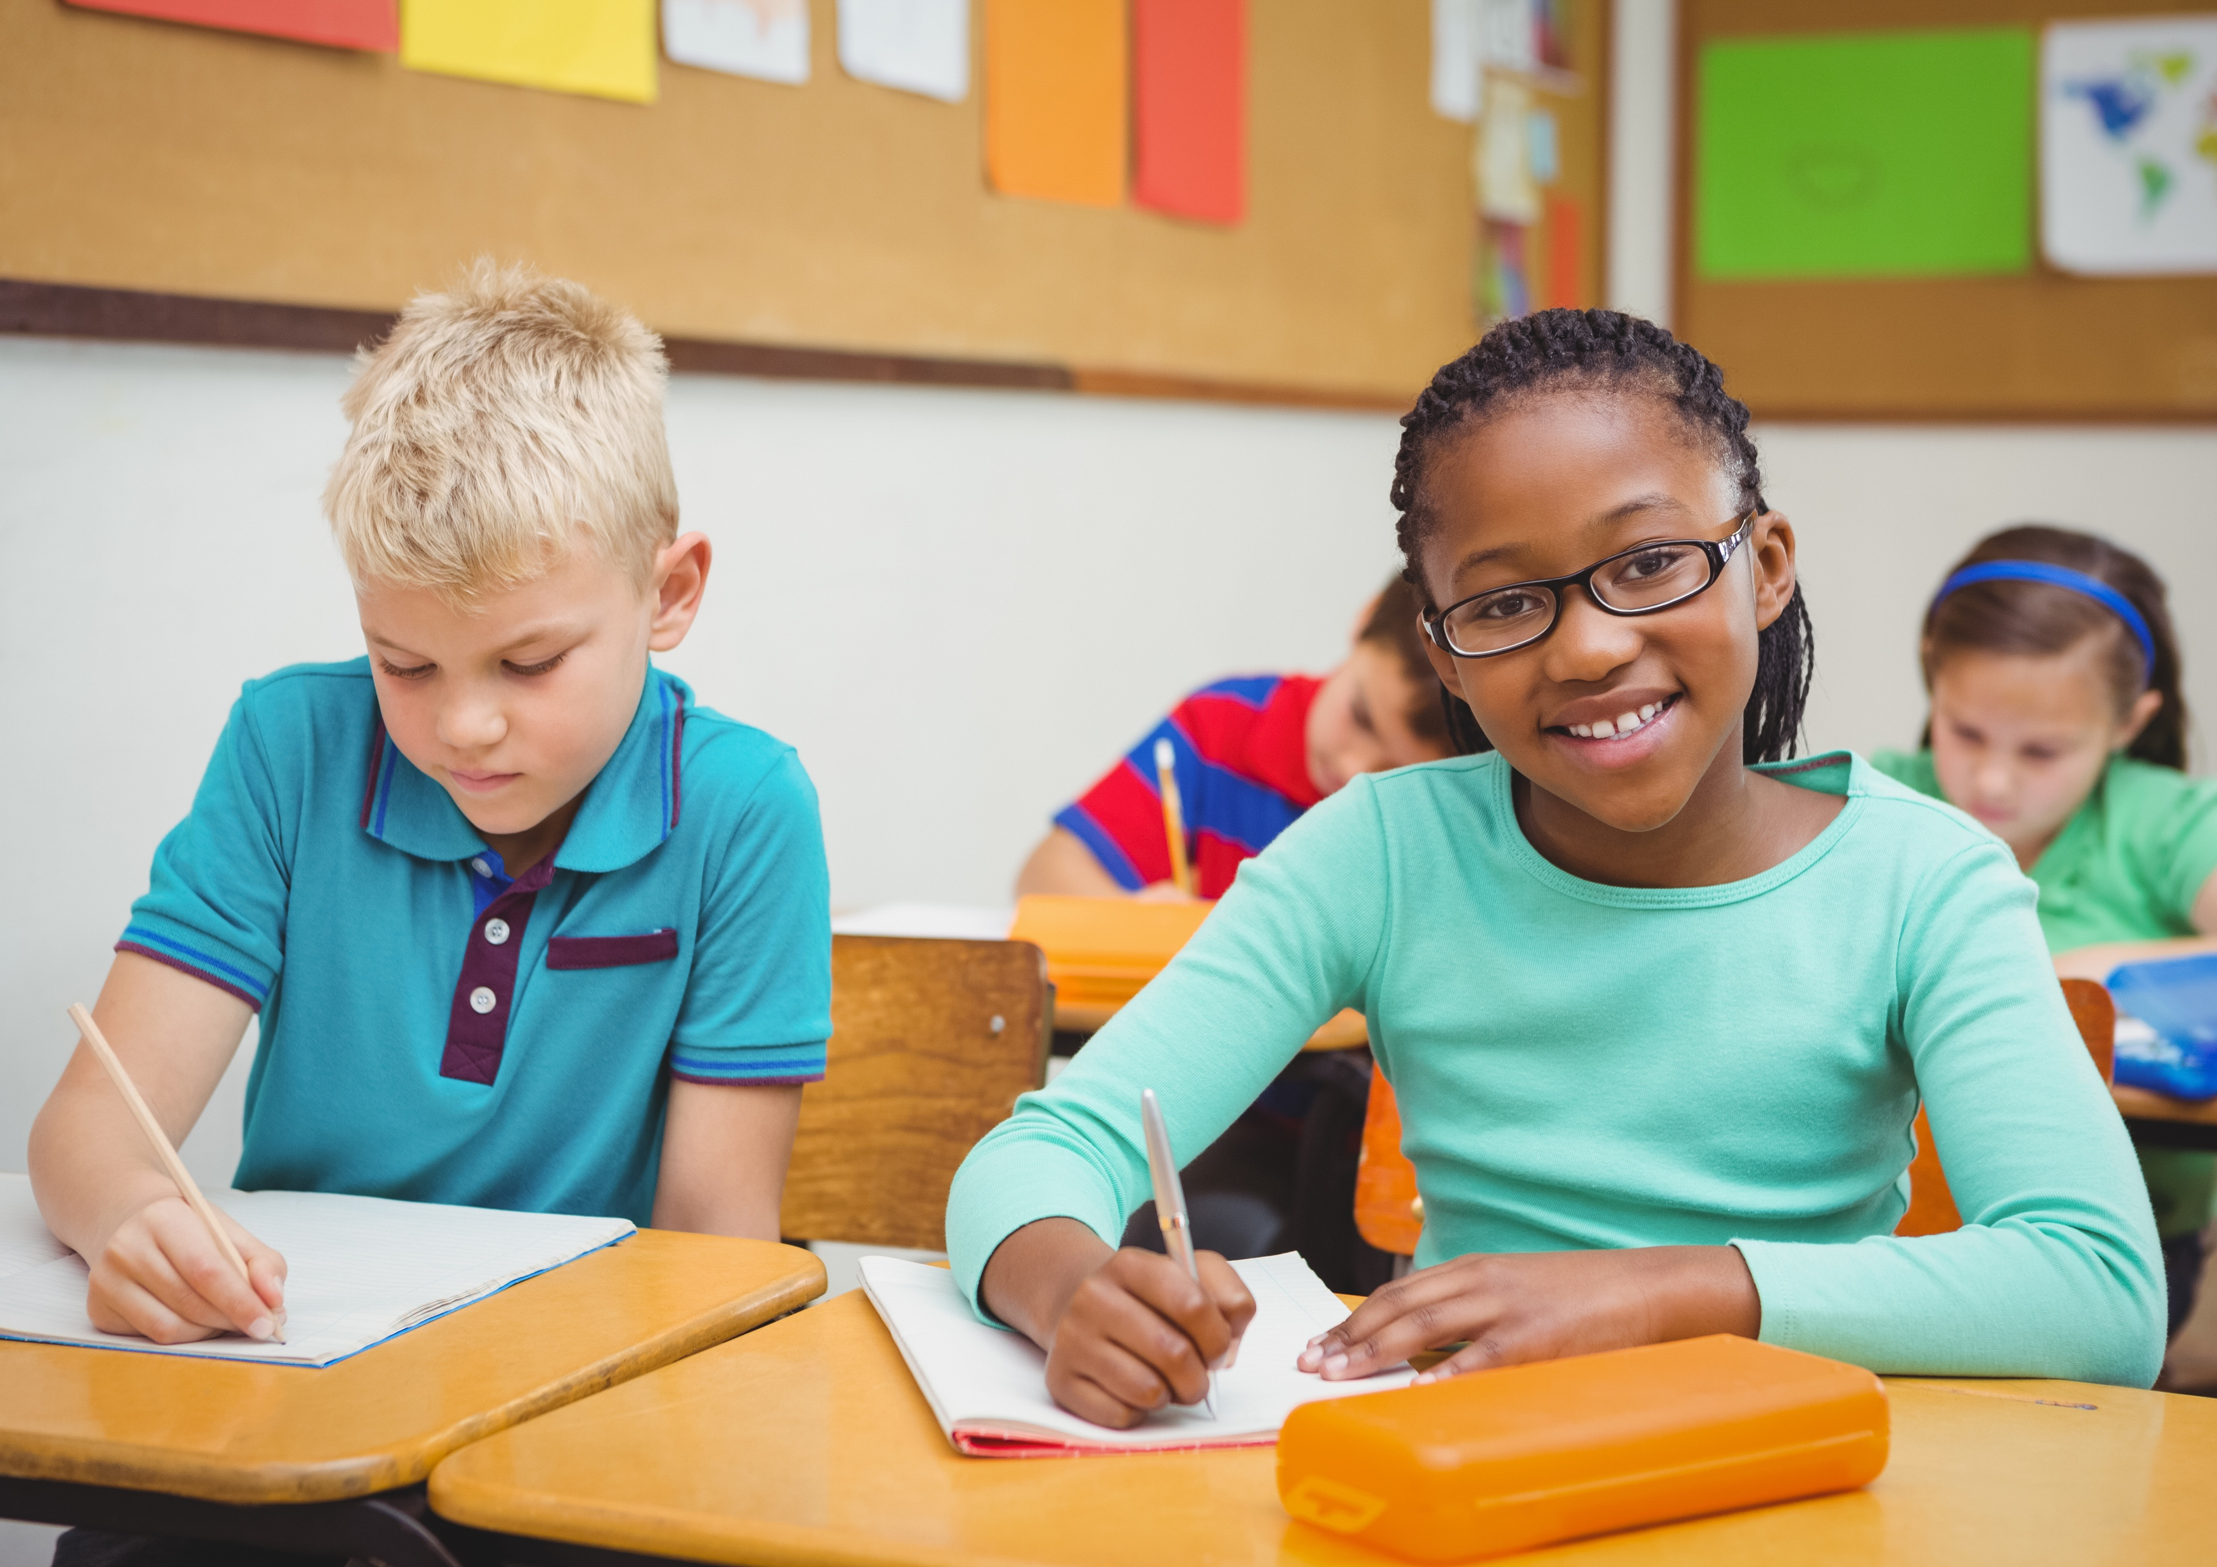
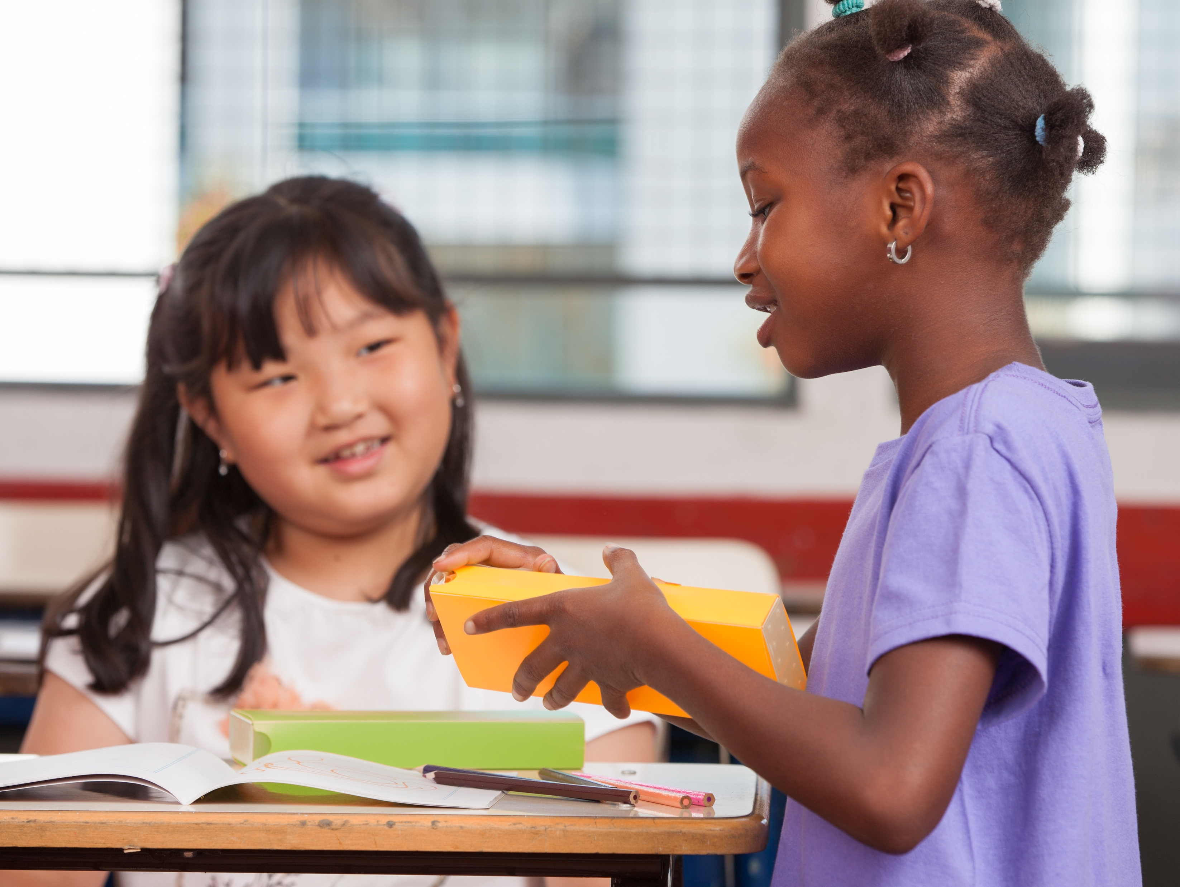
I am a friend. I support and trust.
Working together is a must.
Notes:
Instructor Notes:
Click to project the next verse of the Wings Words to Live By and read it aloud.
Explain that in order to have good relationships with other people, you need to treat others with respect. This means that you act like a friend, you support and help others, you trust others, and you work together.
Ask students to raise their hands if they agree that it’s important to treat others this way.
Then ask them to raise their hands if they think it can be hard to always treat others this way.
Share that, thankfully, you have a few tips to make this a little easier!

Slide 19
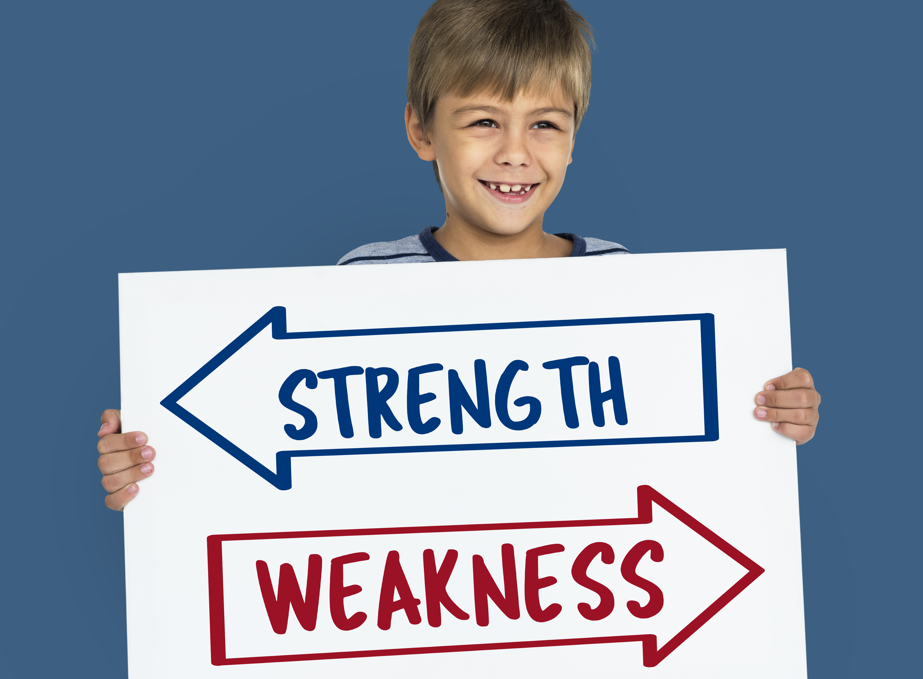
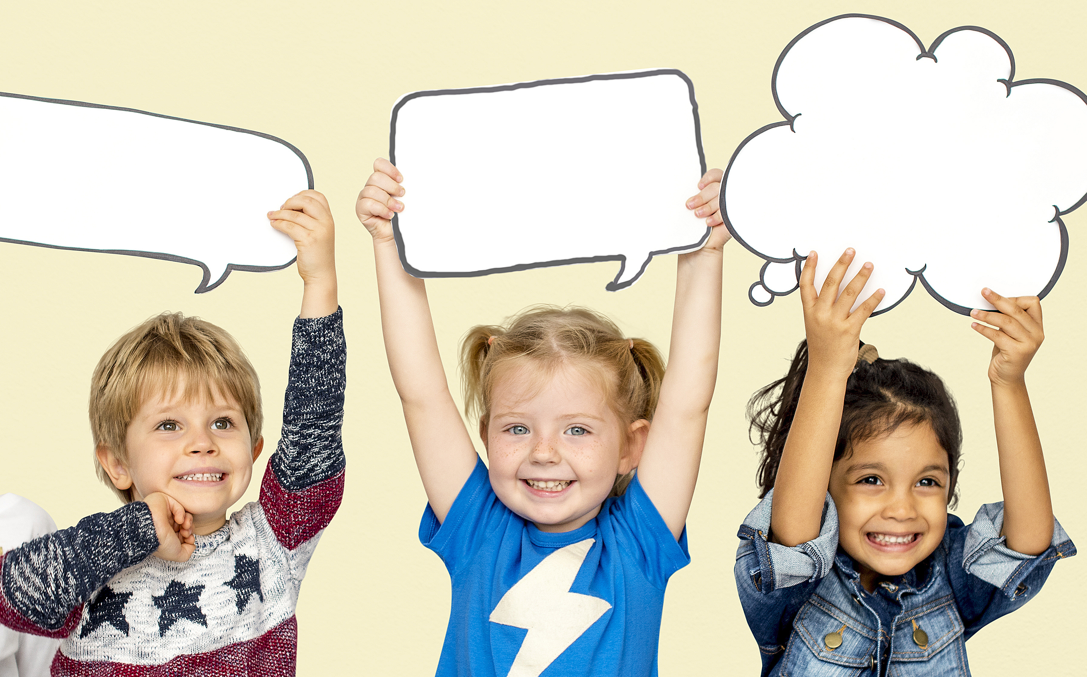
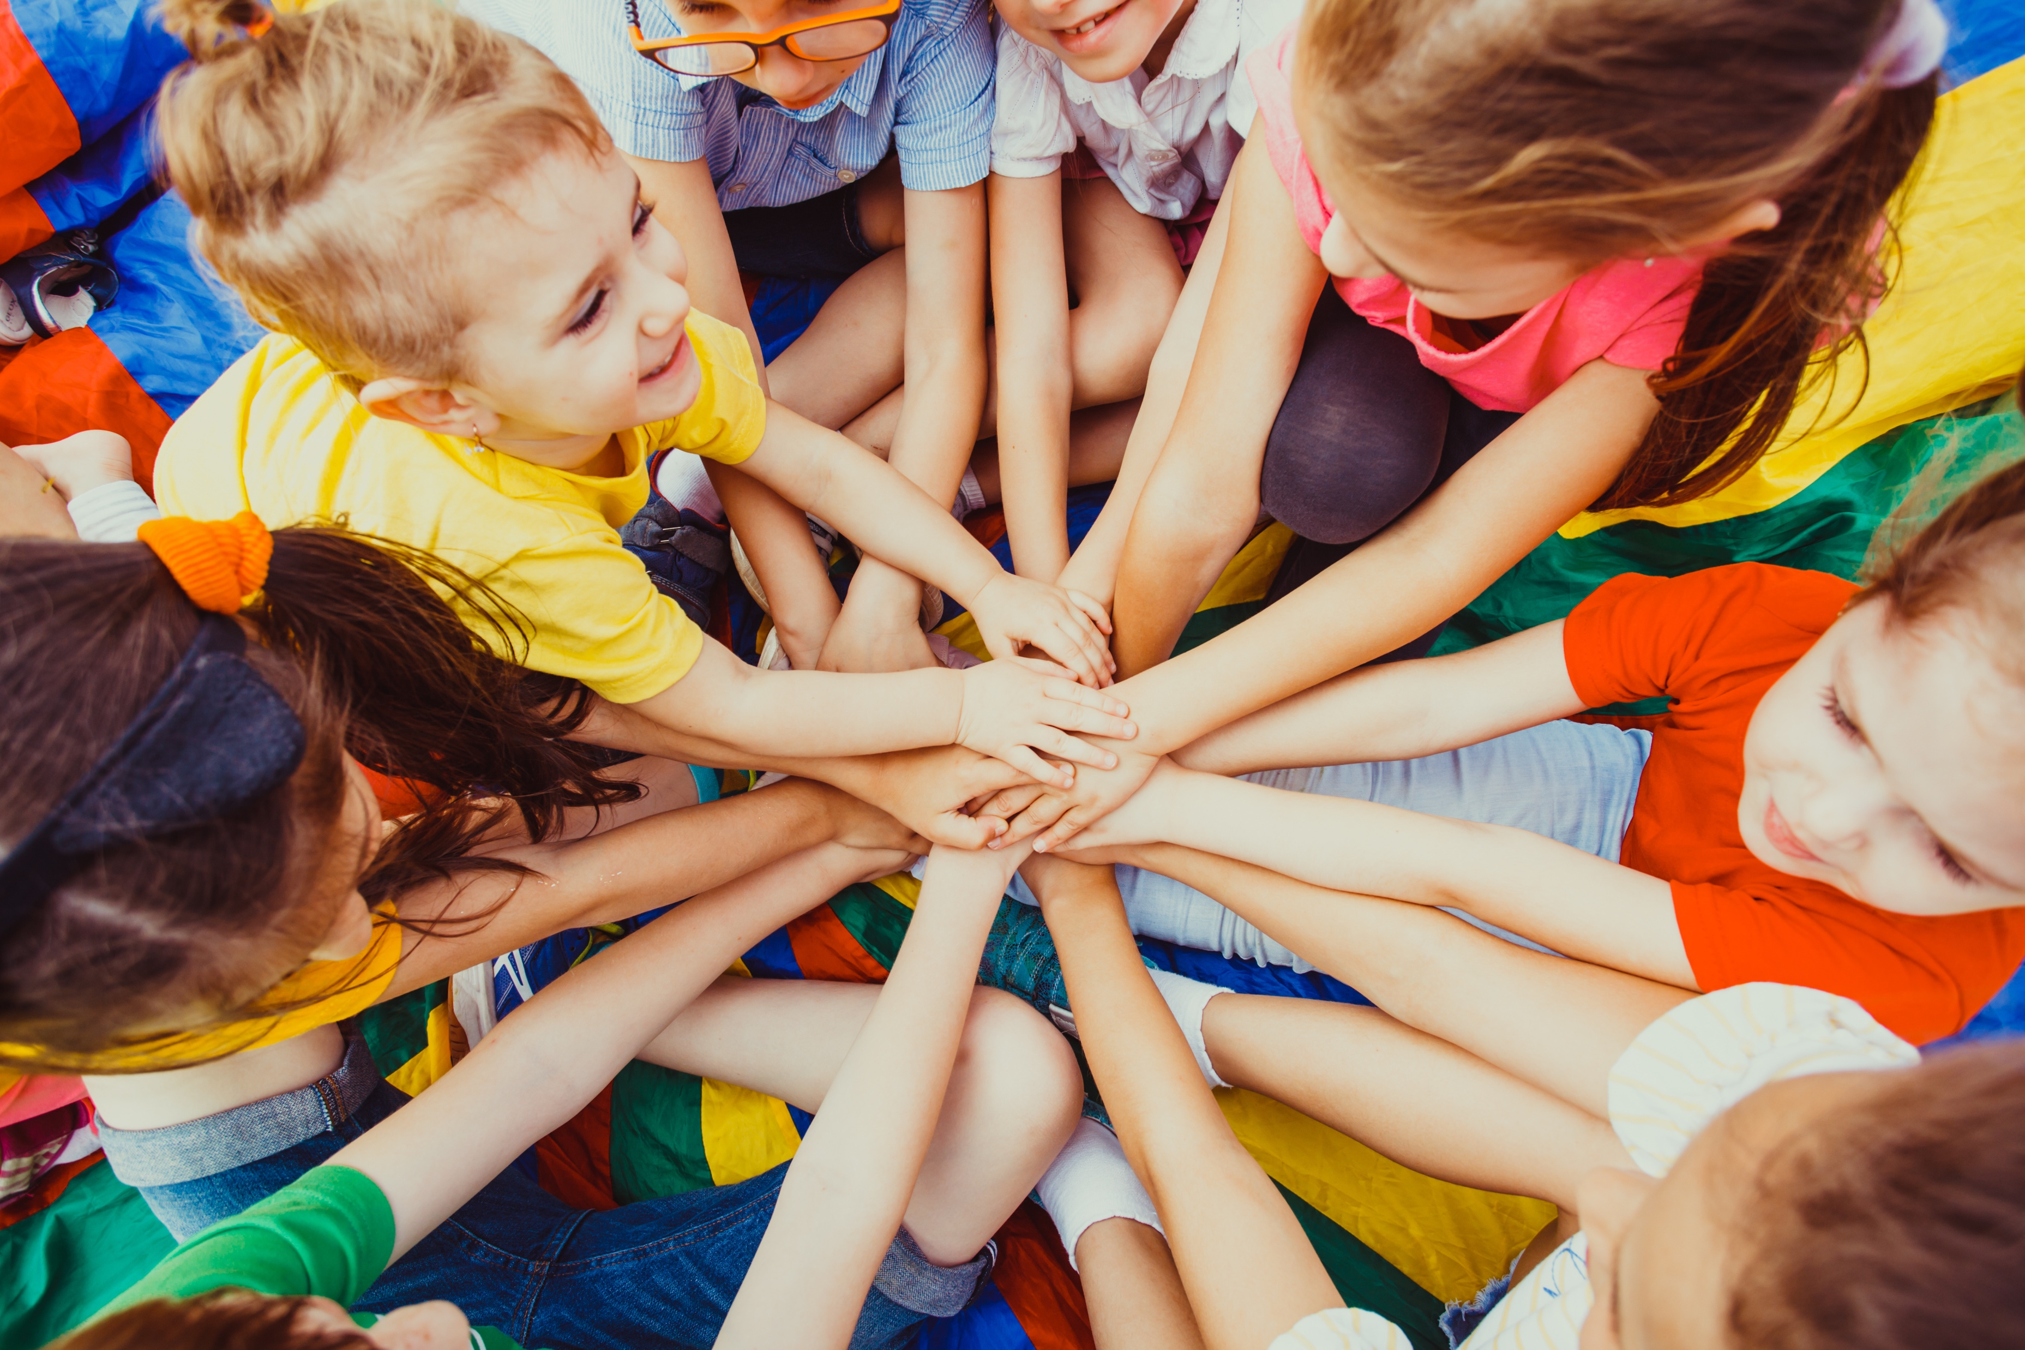
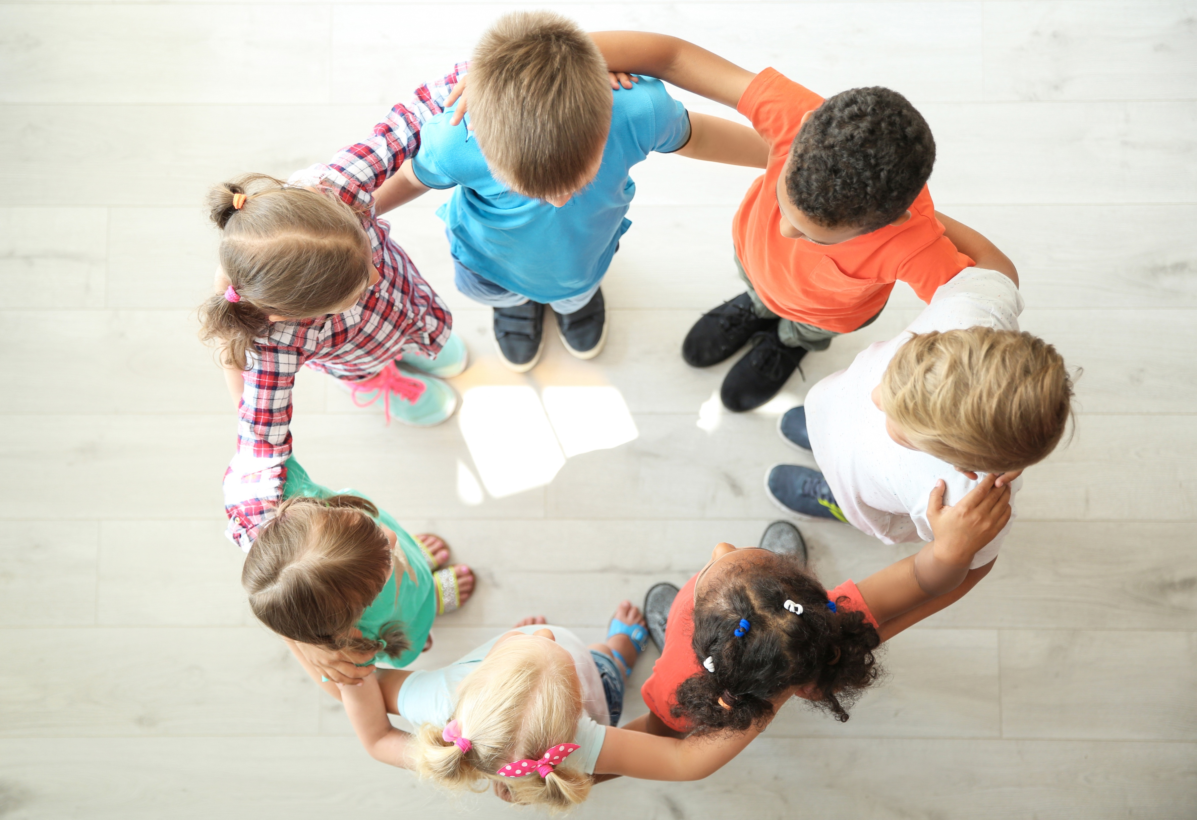
T
ell our strengths and weaknesses.
ct as one…win and lose together!
ake sure everyone is included.
E
xpress (say) words kindly.
A
M
Notes:
Instructor Notes:
Point to the word “TEAM.” Explain that like “OK” and “SHOES”, the word “TEAM” can be used to help you work together and be part of a team!
Ask students to pretend they are on a basketball team.
Click once and explain that T stands for “Tell our strengths and weaknesses.”
Ask: Why would it be important to say what we’re good at and bad at if we’re on a basketball team?
Click again and explain that E stands for “Express (or say) words kindly.”
Encourage students to think-pair-share*: Why would you want to express words kindly and speak nicely to your basketball teammates?
*In a think-pair-share, students think about the question independently, discuss their answers with a partner, and then share their thoughts with the larger class.
Click once more and say that A stands for “Act as one…win together and lose together.” Explain that this means we don’t blame people for mistakes! This also means that whatever happens as a result of the team working together is the responsibility of everyone and not just one person. If they scored it was because of the team’s effort and not just the person who made the shot.
Ask: If someone missed a basket and we lost the game, why shouldn’t we be upset with this person? Why should we act as one?
Click one final time and say that M stands for “Make sure everyone is included.”
Encourage students to think-pair-share: How do you feel if you’re left out? Why is it important for everyone to be included?

Slide 20


TEAM work time!
Notes:
Instructor Notes:
Explain that students are now going to be challenged to do some TEAM work because you don’t have to be on a sports team to work together as a team!
Tell the class that you will divide them into groups of four. In each group, two students will receive a drawing, and two students will get a blank piece of paper. These two pairs will sit back-to-back.
The goal is for the pair with the blank paper to work together to draw a picture using the description provided by the pair with the image. In order for this to be successful, everyone must work as a TEAM!
The two students describing the image support each other and the two students drawing the image support each other. Everyone works together to achieve the goal!
Click once and display an example. Pretend that you haven’t seen the image and ask the class to give you directions so you can draw the image without seeing it. Make sure they do not tell you what it is. They should focus instead on the lines, colors, and shapes of the image.
After you take a few directions from the class and create a sketch based on their instructions, explain that this is what each team will do.
To make it even harder, you will set a timer to see what each group can accomplish in six minutes! Click once to display the timer.
Help position each group of four so pairs of two are sitting back-to-back throughout the classroom.
Then give Handout 6: TEAM Work to one pair in each group and a blank piece of paper to the second pair in each group. One pair of students act as “describers” while the other pair acts as “drawers.”
Once each group is ready, say, “Ready, Set, GO TEAM!” and click the timer to begin. Students conduct the describing/drawing activity modeled by the teacher.

Slide 21
TEAM work
Kind and caring I will be.
I listen to you. You listen to me.
What went well when you were working as a TEAM?
Focus
What was hard about working
as a TEAM?
Figure it Out
Follow Through
Notes:
Instructor Notes:
Once six minutes have passed, bring the class back together into a circle or semicircle and invite each group to display their artwork in front of them.
Click once and ask: What went well when you were working as a TEAM?
Then click again and ask: What was hard about working as a TEAM?
Explain that communicating, which includes listening, is not always easy!
Click twice to display and read the final stanza of the Wings Words to Live By.
Explain it is easier to be kind and caring when you listen, because you are taking time to understand the other person.
Click once more and tell students that the next time they work with others, they can be better listeners if they:
Focus: Look at the person who is talking and don’t interrupt.
As you say this, put your hands over your eyes to make a visor.
Figure it out: Ask questions if you don’t understand.
As you say this, raise your hand in the air.
Follow through: Show that you understand!
As you say this, nod your head.
Read through the three Fs one more time and ask the students to join you in the gestures.
Explain that when you focus on what someone is saying, figure it out when you don’t understand, and follow through to show when you do understand, it is easier to listen to and understand others!

Slide 22
TEAM work time: Create Art!
Remember to…
Focus
Figure it Out
Follow Through
Notes:
Instructor Notes:
Tell the class that they are going to spend the rest of the session focusing, figuring it out and following through as a TEAM!
*Tip: Each time you say the three Fs, continue to perform the accompanying gestures.)
Explain that the groups of four who were working together before will now work together again. But this time, they will be creating their own artwork that represents every person on their team. Further explain:
How they represent each person is up to them. They could draw portraits, create symbols, make cartoons…The sky is the limit!
The most important part is that they learn from each other, treat each other kindly, and work together as a TEAM.
Tell the class that before they begin, they should talk about a plan: In other words, what will their artwork look like?
Explain that you will be looking for students who are focusing, figuring it out, and following through as they decide what their artwork will look like! Once everyone agrees with the plan, they can begin creating their art on their poster board.
Deduct about five minutes from the time remaining in the session and tell students they will have about this much time to create their work of art.
*Tip: Depending on timing, students may also create a draft of their artwork this session and finish at a later point.
Once students understand the instructions, give each group a poster board and encourage them to get to work.
As students are working, rotate among the groups and provide suggestions for how to work even better as a team.
Provide a 5-minute warning when there are 10 minutes left in class.

Slide 23
Positive
Feedback
When you did _____________,
I felt___________!
Notes:
Instructor Notes:
When there are 5 minutes left in class, bring students back to their semi-circle or circle and conclude with a round of positive feedback.
Explain to students that when you tell others that you like something they did and then you add how it made you feel, it’s called giving positive feedback! Positive feedback is a great way to let others know how they make you feel when they are good to you.
Click once and give the example: Watching everyone work as a team on their artwork made me feel very proud today.
Encourage students to think about the work they just completed with their team and ask if anyone has positive feedback about a team member or team members that they would like to share. Choose a few volunteers and guide students in positively sharing what their teammate(s) did and how it made them feel.
*Tip: Try to only call on a handful of volunteers, so that those who don’t receive positive feedback don’t feel left out!
Wrap up by summarizing that when we receive and give positive feedback, we learn how to become better friends and better people! Challenge each student to think about a piece of positive feedback that they can give each student in their group and ask them to tell this person before the end of the school day!

Slide 24
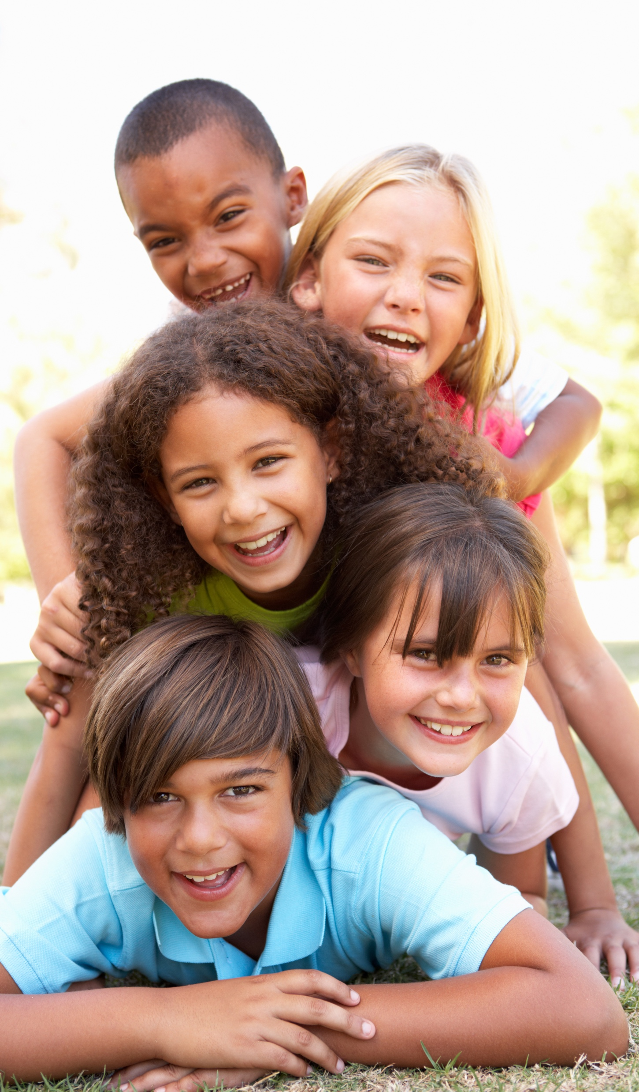
I understand others are unique.
I want to learn more about everyone I meet.
I want to step into their shoes
and see what they are going through.
I am a friend. I support and trust.
Working together is a must.
Kind and caring I will be.
I listen to you. You listen to me.
Notes:
Instructor Notes:
Tell students that you are going to go back to a couple of the surprises that you discussed at the beginning of this session.
Click to re-display a picture of the first surprise, and say: Surprise! Your little brother or sister breaks your new toy.
Click to redisplay one more surprise picture, and say: Surprise! Your mom was supposed to take you to the movies but she has to work.
Instruct partners to discuss the same Control Check question: If you stopped and did a Control Check, how could you react to this surprise in a calm and kind way?

